Slide 1




Ceph Storage
~10 years of Open Source SDS at RAL
Tom Byrne – SCD Storage Architect
14th January 2026
Notes:
The abstract pattern can be removed or repositioned if required. Be careful to ‘Send to Back’ so that it does not obscure any important information.

Slide 2
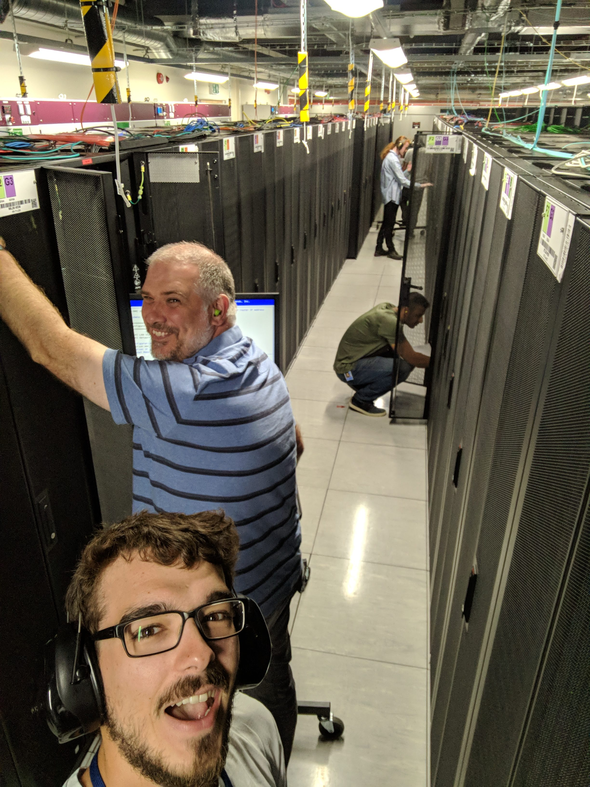
2018: what we had then
Self-service block storage access for the STFC Cloud
Standalone S3 object storage service
  No self-service user access
No filesystem service for STFC Cloud
  Leading in-part to some creative solutions from the community - “Ad-hoc filesystems for dynamic science workloads” (https://indi.to/p2CyW)

Slide 3
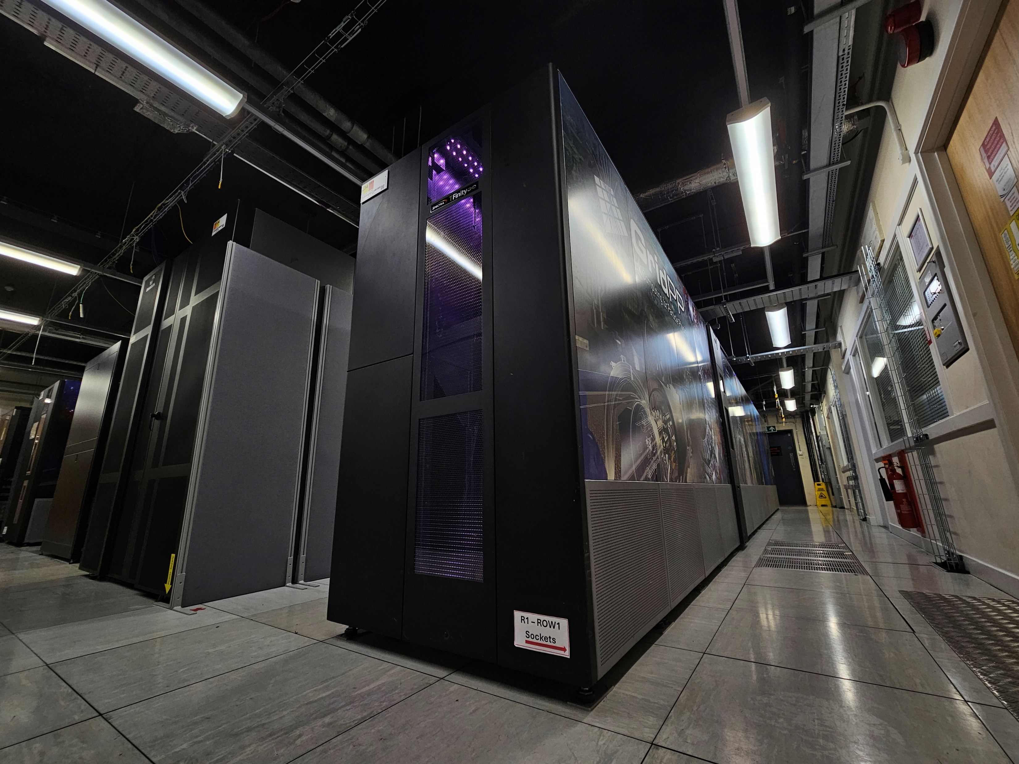
2026: what we have now
Self-service block storage access for the STFC cloud
  Moved to NVMe (2020)
S3 object storage service with OpenStack Integration (2022)
  Self-service user access and cross project data sharing for cloud users
  Quota by default for all new cloud users
  >10 million GETs a day
Two Ceph filesystem services
  Bulk storage for organised experimental workspaces (2019)
  Self-service fast shares for scratch storage (2021)
Archival tape storage for some users (2024)
  (Not Ceph based, CTA+EOS stack)

Slide 4

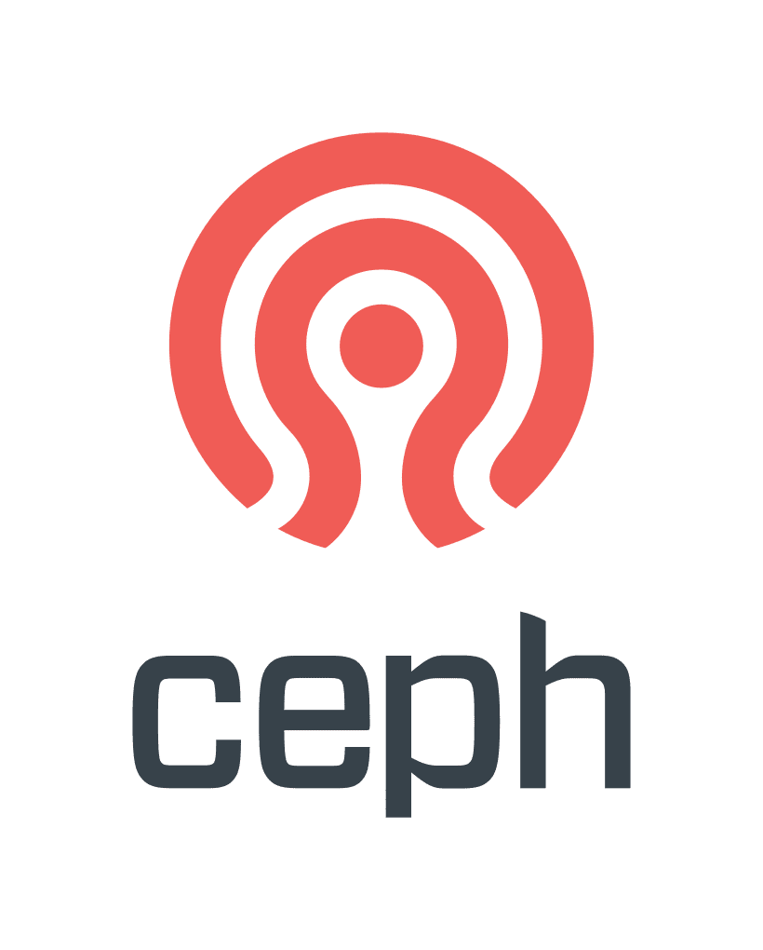
20XX: the glorious future
Ceph continues to be a reliable underlying storage technology with a strong, diverse community
Our Ceph storage offerings cover most of our user's disk use-cases, with increasing uptake of object storage
But reducing friction for users is key, and much can be achieved with new (to us) Ceph features:
  Ceph IAM account support for S3 - better self-service support for more complex object storage models and usage
  Ceph Multisite - additional copies spanning availability zones for critical data
  S3 cloud transition options - potential routes to tape for smaller data volumes

