Slide 1

Research Computing Services @ University of Cambridge
IRIS Collaboration Meeting January 2026

Slide 2








Cambridge RCS - overview
Formed 20 years ago pioneering the use of large scale HPC clusters as leadership class HPC systems, back in 2006 the fastest HPC system in the UK at #20 in top500 (Darwin)
Today RCS is significant UKRI and DSIT national AI & HPC centre excellence
Multiple national / International HPC / AI activities - AIRR, EPSRC Tier2, DiRAC, IRIS, UKAEA, SKA-SRC
Serving a cross domain HPC user community of ~4000 users
Providing ~48% of UK Top500 performance over last 7 years
Successful Industry partnership model, over £80M industry investment over last 4 years,
Strong in-house technology team - system design, implementation and operations

Slide 3
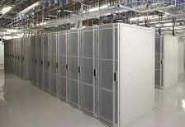
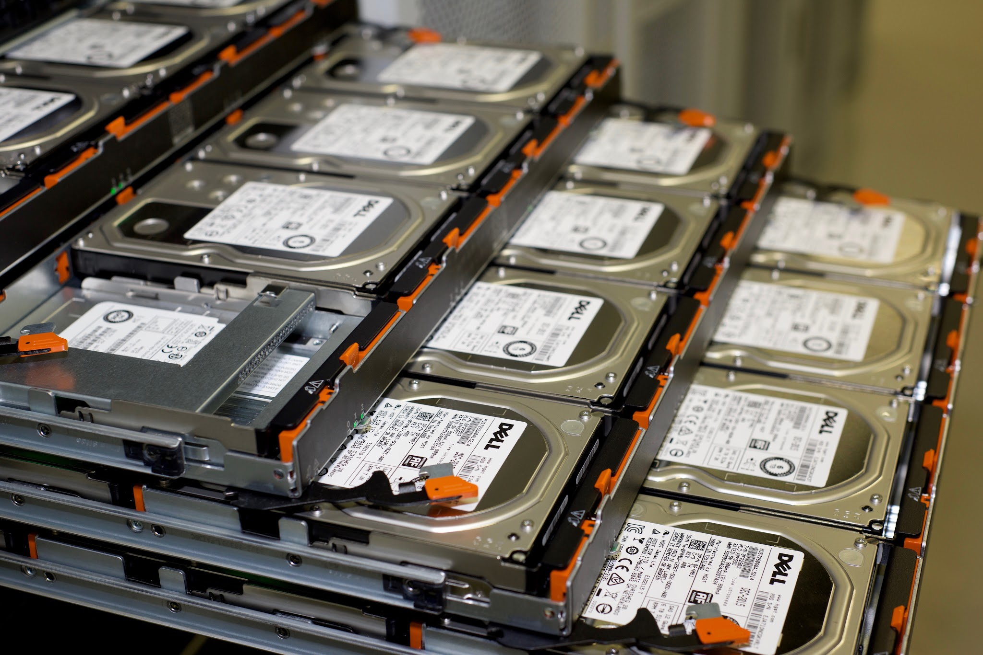


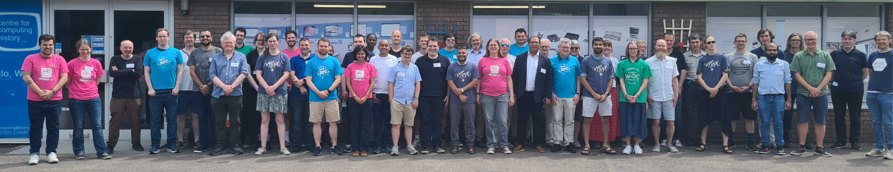
Cambridge RCS - infrastructure & people
£100M of HPC / AI equipment in operation (<5years old)
60 staff across Platforms, DevOpps, RSE, outreach business development
1.8 MW Leading UKRI water cooled AI HPC Data center 100 Racks - £30M University investment in UK national service provision infrastructure
33 PFlops heterogeneous HPC/AI system
3000 Dell servers X86/GPU Intel & NVIDIA
70 PB storage (disk/NVMe/tape)
ISO27001 compliant secure computing for commercial & medical users
Private cloud – system stack using OpenStack in collaboration with StackHPC leading UK SME

Slide 4




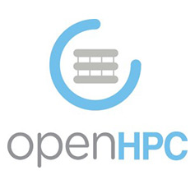


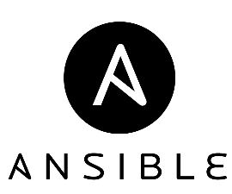



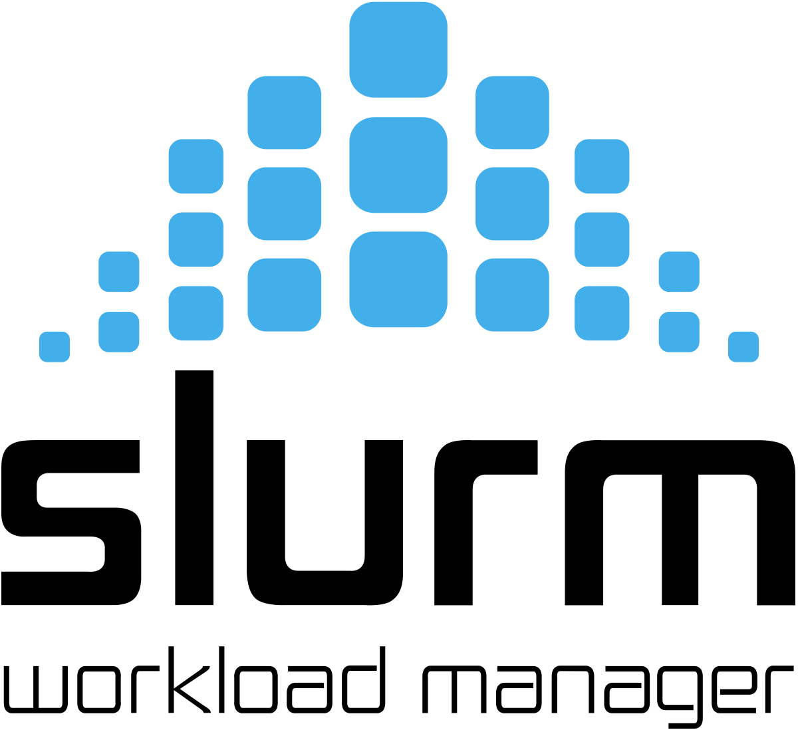

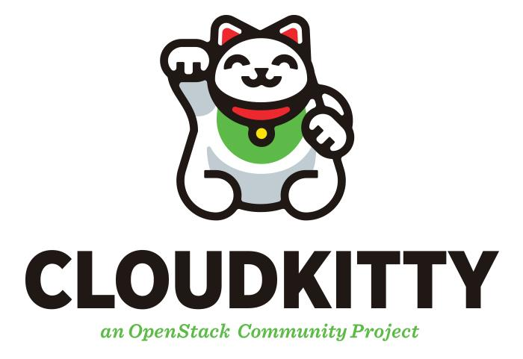
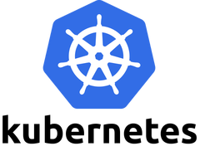
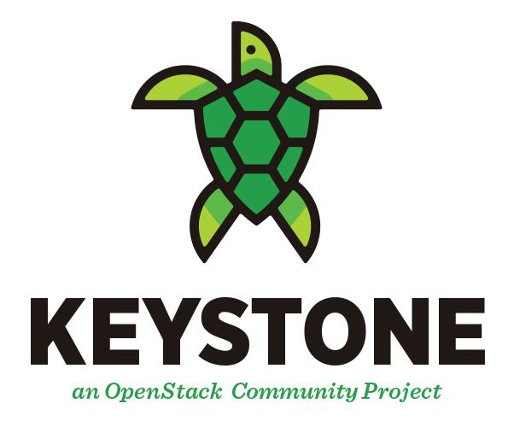

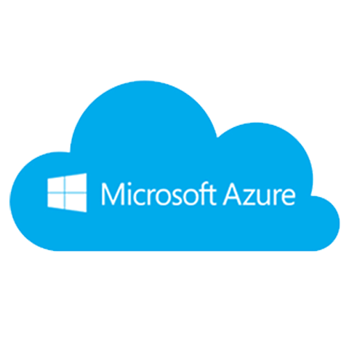





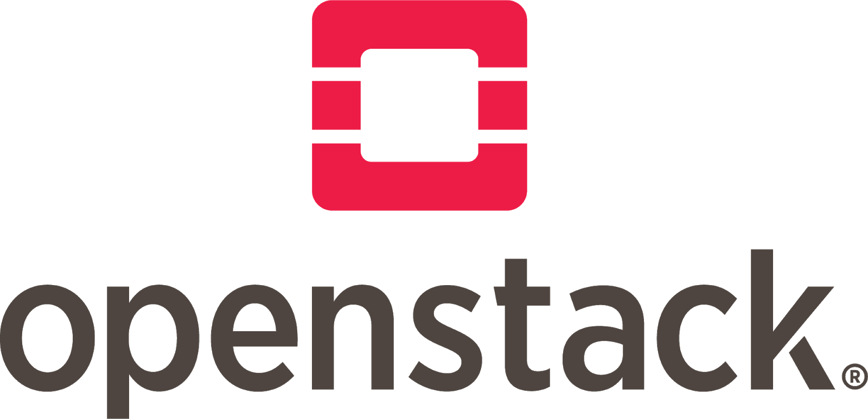

Scientific OpenStack - Arcus On premise science cloud
Deliver HPC & AI via cloud APIs
Under strong active development in partnership with StackHPC with funding from UKRI, SKA, Industry & AIRR
Creating UK “Community Cloud Middleware Stack” UKRI project
Revolutionises flexibility and end user functionality of HPC systems
Controlling all Cambridge infrastructure
Gaining traction within large HPC centres in UK and Europe
Science Workflows

Slide 5

Supporting IRIS @ Cambridge
10 years of supporting IRIS as a service provider
Initially provided HPC resource on CSD3 and managed Data Analytics Hadoop cluster for the Gaia project.
in 2018 started transition to Openstack cloud native infrastructure - Arcus Cloud
To date Arcus has moved through 12 OpenStack major releases
Currently IRIS Infrastructure at Cambridge consists of
170 servers (IceLake and Sapphire Rapids)
18 PB of Ceph Storage
1.5 PB of Lustre Storage
Supporting IRIS has been major driver of innovation and progress in delivering cloud native infrastructure for scientific workflows.
Currently supporting following projects:
CASU, Euclid, Gaia Science Data Platform, Gaia Core, LSST/Vera Rubin, PLATO, SKA-UKSRC, Jetscape

Slide 6
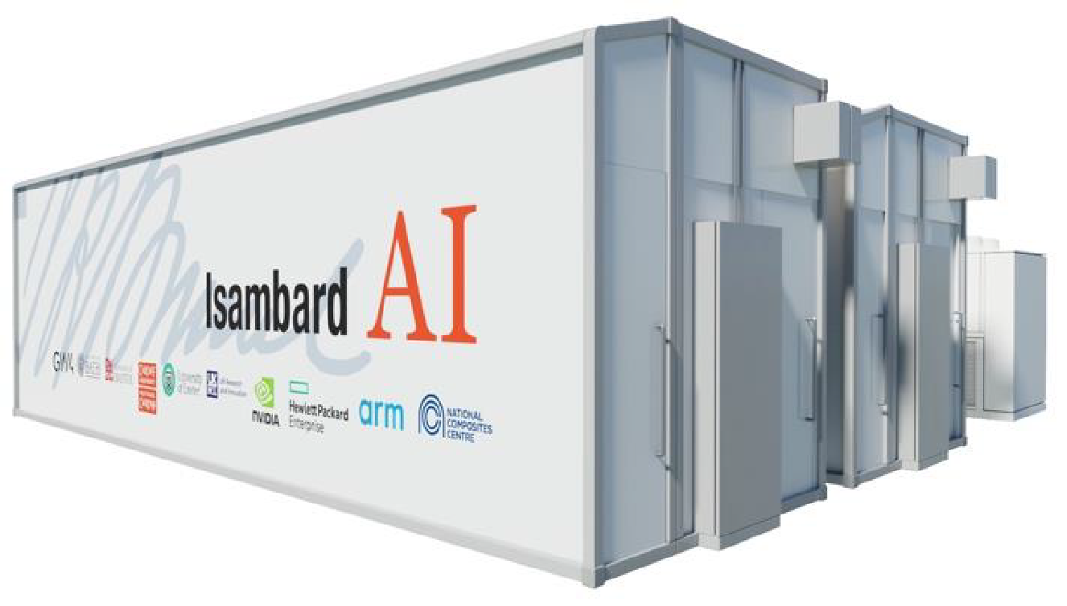
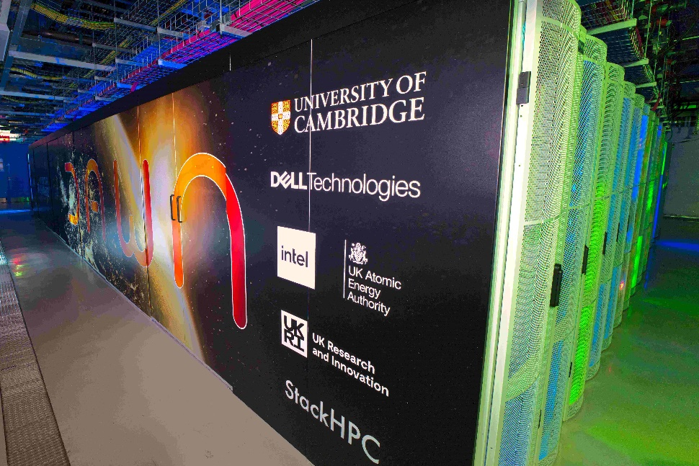

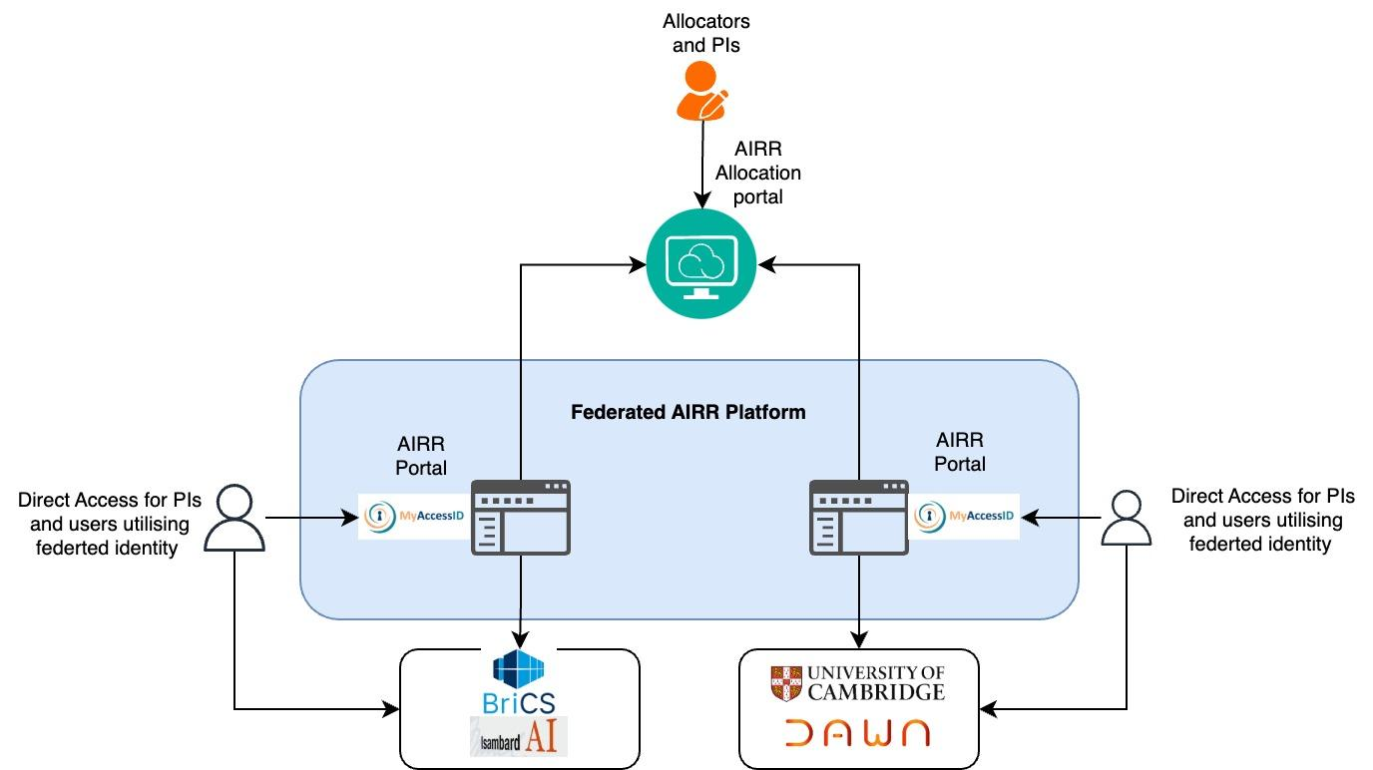
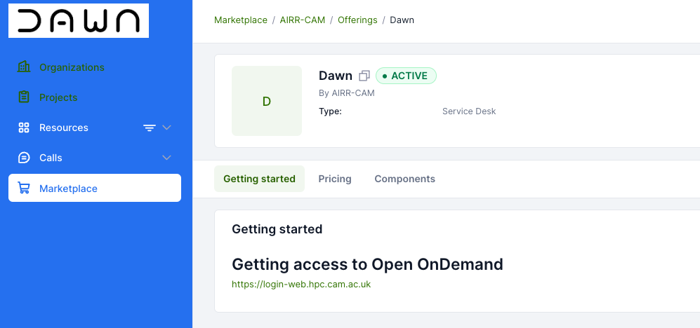
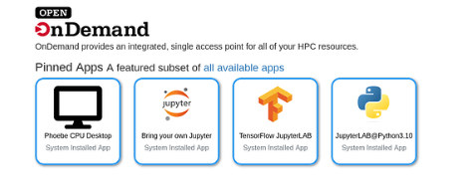
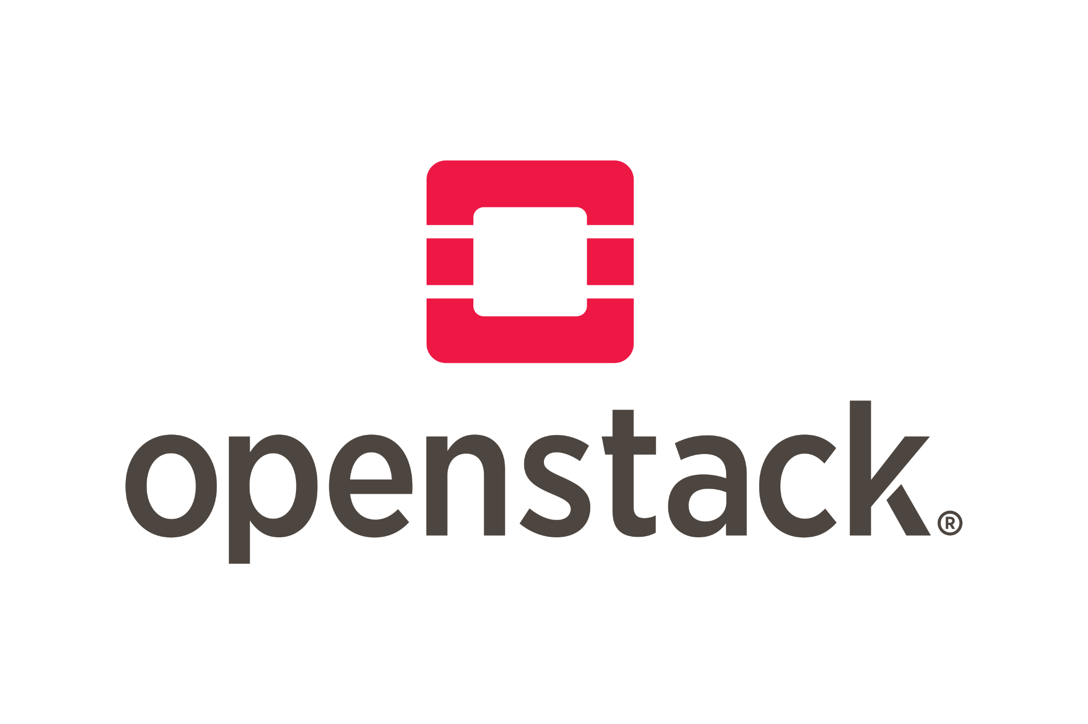
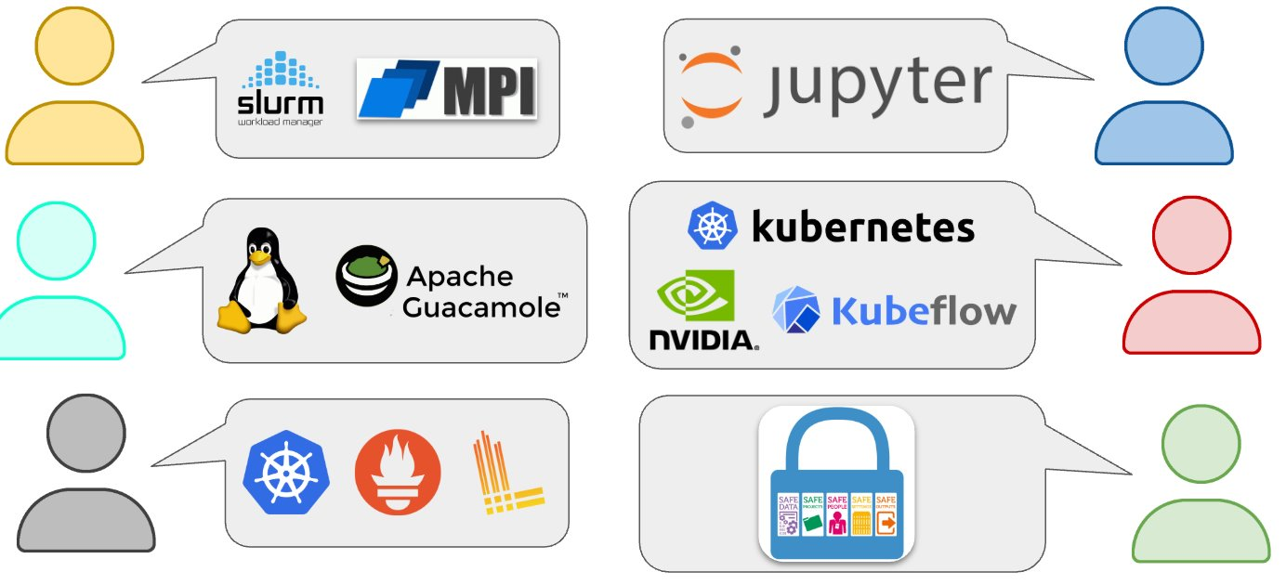

Innovation @ Cambridge
Development of AI Research Resource (AIRR) Service in collaboration with Bristol Centre for Supercomputing
Dawn AI system - 1024 Intel GPUs
AIRR Federation - federated access with my MyAccessID
AIRR Portal - Self service portal for project allocations and resource management
Azimuth self service portal - continuing work with StackHPC on enabling further functionalities and AI support
OpenOnDemand portal - working on enhancing our HPC user environment to enable native AI workloads.
Trusted Research Environments (TRE) - enhancing security and enabling researchers to work on highly sensitive data.
NFCS Network Plus projects
AI containers
MyAccessID
Federated K8s Storage for TREs

