Slide 1
Imperial Cloud
Dan Whitehouse
IRIS Collaboration Meeting January 2026

Slide 2
History
Predates formation of IRIS but IRIS is now arguably most important user.
Many different generations of Nova compute nodes.
Originally deployed on an EL distro using RedHat RDO OpenStack packages.
Now running on Debian and using the https://osbpo.debian.net/ repos.
We deployed the system using our standard git hosted config and puppet.
3.5k physical cores in the “main” part of the cloud which includes IRIS
180TB SSD for volumes / file shares (usable)

Slide 3
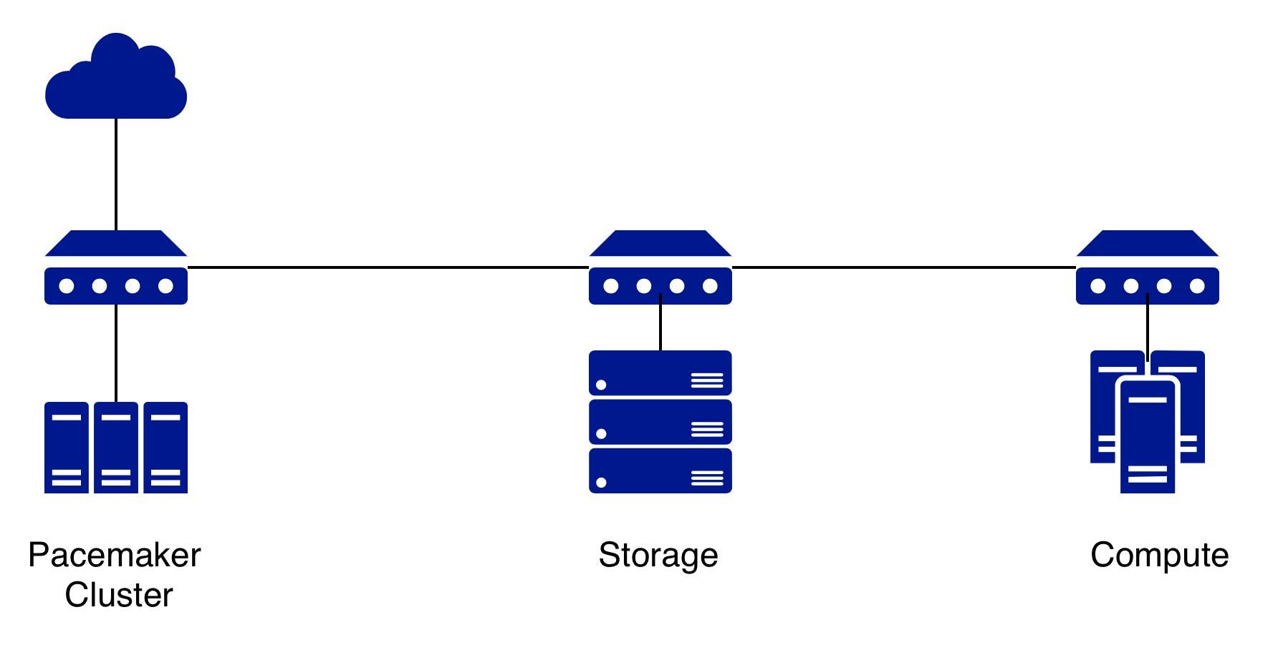
Physical Infrastructure
We use a 3 node pacemaker cluster to host the various controller vms.
PCIE passthrough for Neutron (network controller).
We have a 7 node ssd backed ceph cluster for volumes.
Some more HDD backed storage (replicated and erasure encoded pools) is on the way courtesy of IRIS.

Slide 4
Evolution of the Cloud
Supporting diverse users helps grow our resources and skills
Backfill - python OpenStack bindings
DIRAC - Cloud plugin
DAAAS - (Data Analysis) Experience with GPUs / Octavia
Plato - Additional HDD backed storage.
Euclid - Fast SSD backed storage / Manila
Future projects can also make use of these resources and skills.
Benefits of membership, helping support new science, learning about and working with new technology.

