Slide 1
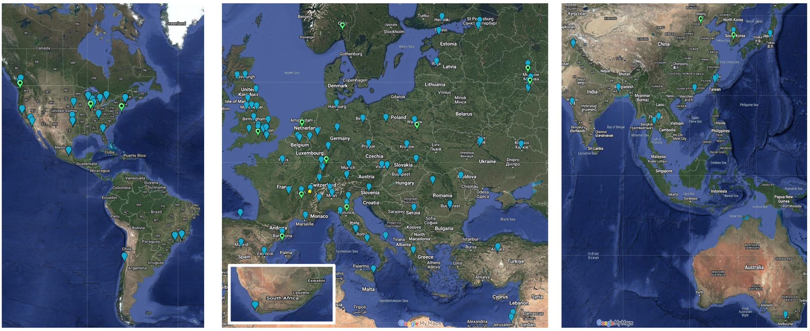
What is GridPP?
(see Pete’s slides earlier in the day)
GridPP is a leading partner in the Worldwide LHC computing Grid (WLCG):
  WLCG is 40+ countries, 164 sites, bound together by 64 MoUs.
  Tier-0 @ CERN; ~12 Tier-1; 150+ Tier-2 sites.
  Global networking up to ~500 Gbit/s.
  1+ Million cores and several Exabytes of data.
  GridPP is 13.5% of the Tier-1/Tier-2 infrastructure of WLCG
  Worldwide context brings constraints and responsibilities: Long established international, standards, agreements, authorisation and security requirements.

Slide 2
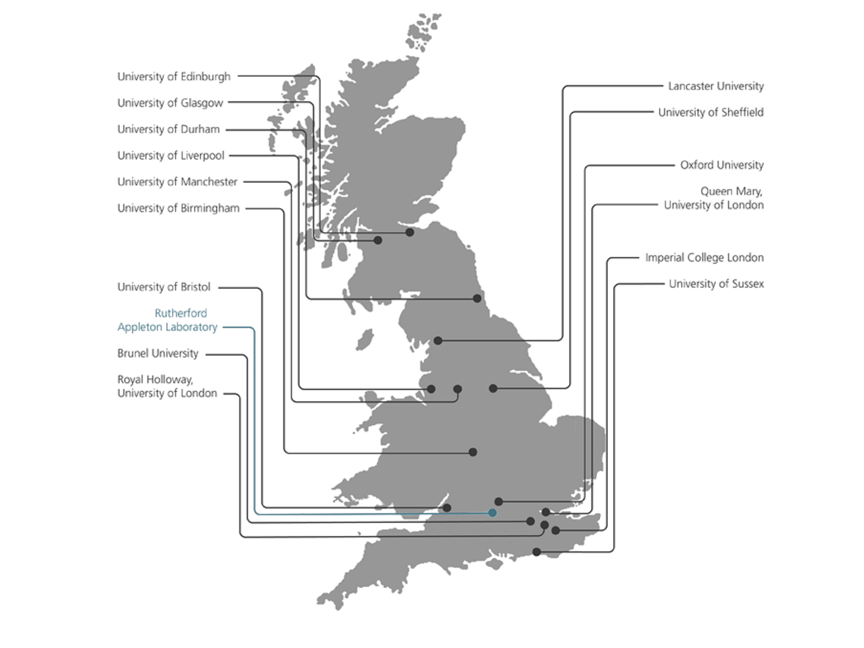
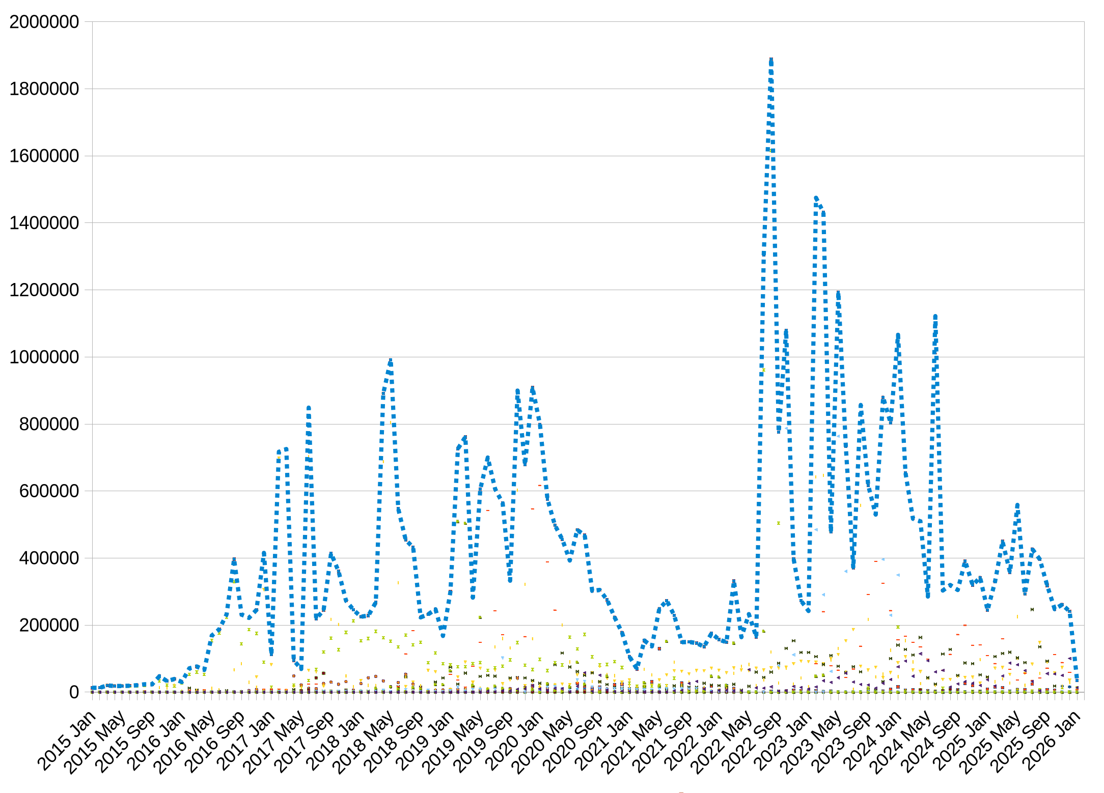
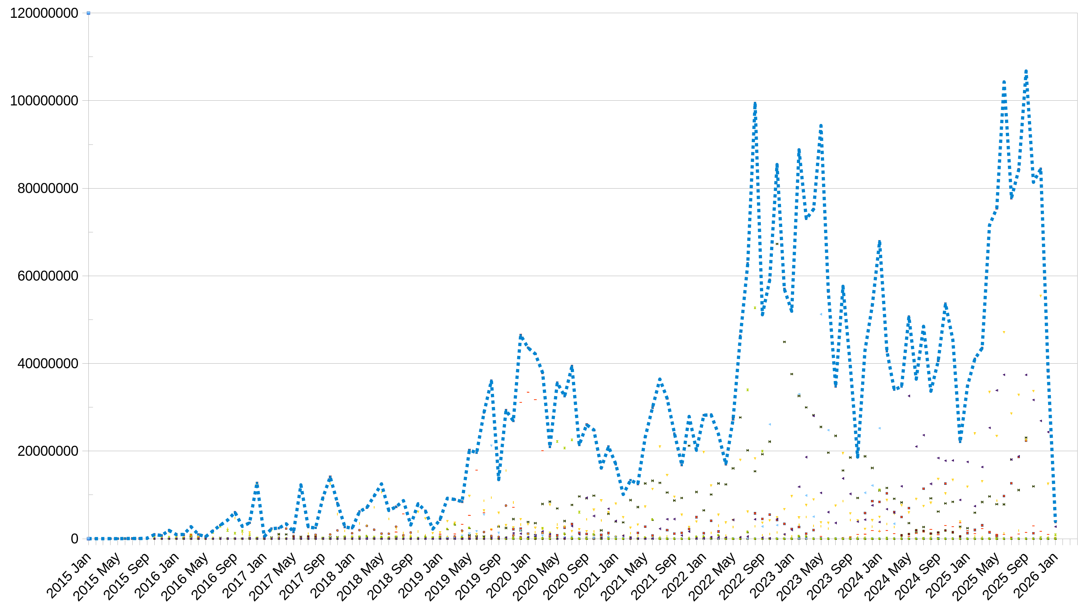
GridPP
STFC funded project that provides UK’s share of compute to CERN (WLCG) – see Pete’s slides!
  Currently 7th (and a bit) round of 4 year projects (“GridPP7”, started 2024)
Hosted at:
  RAL (Tier 1) – Tape, Disk and Compute
  UK Universities (Tier 2s) – Disk and Compute
“Founding” IRIS member
IRIS job numbers per month for the last decade on GridPP resources.
IRIS CPU resource (normalised to HS23) per month on GridPP resources

Slide 3
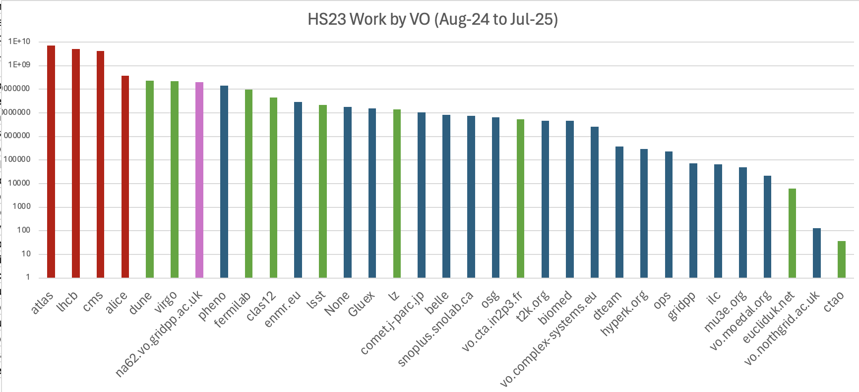
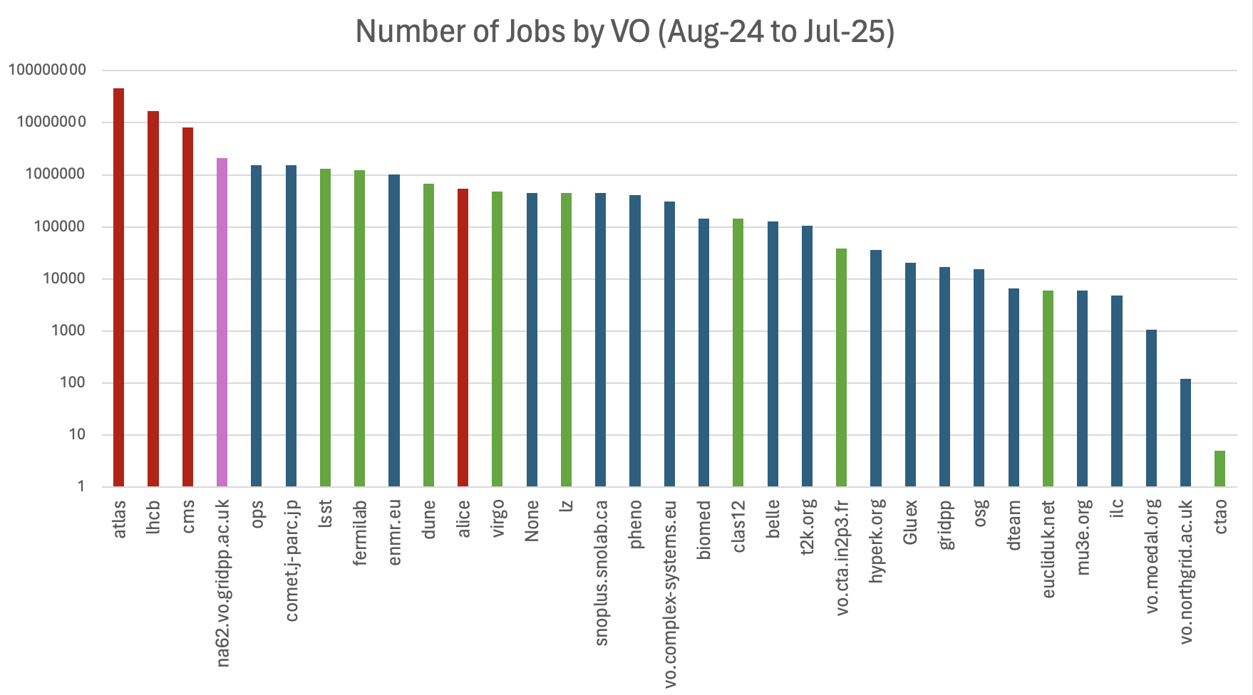
IRIS resource allocations\ -
help us efficiently handle hardware acquisition (especially at Tier-2s)
  additional funding sources on different timescales help smooth hardware profiles
help efficiently “fill” slots – IRIS jobs schedule on different patterns to WLCG workloads, and with different IO/memory/CPU profiles
help us to support GridPP as a valuable resource for STFC!

