Slide 1



Somerville Cloud
Cloud for science Archives
The Somerville Cloud provides STFC science projects with resources that cater to database and archive use cases. Funding is from LSST:UK and IRIS, while the administrative effort is provided by the University of Edinburgh (through the ACF and WFAU).
Infrastructure Details:
OpenStack Cloud, using the Scientific OpenStack standard: https://www.hpc.cam.ac.uk/scientific-openstack
Cloud resources are tailored to meet the specific needs of science data archive projects
    Ceph storage cluster with multiple pools configured to meet project specific metrics, with both HDD and SSD backed resource. Serving volumes, CephFS, and S3 access methods. Current raw capacity of ~13PB.
    Hypervisors with significant NVMe SSDs (HVs with 4 x 3.2TB, 6 x 6.4TB, and 14 x 6.4TB) served via PCI passthrough, intended for use by distributed database technologies such as Apache Cassandra (https://cassandra.apache.org/_/index.html) and Qserv (https://qserv.lsst.io/index.html)
    High speed interconnect at both LAN and WAN level (100Gbps from cloud to JANET backbone interconnect)
Administration assistance contracted through StackHPC (https://www.stackhpc.com/)

Slide 2
Tenant Projects
Vera Rubin/Lsst
Other Projects
Lasair ZTF
    Transient event alert service (i.e. notify astronomer when a supernova is detected).
    Deployed via Kubernetes (Magnum), utilizes Apache Cassandra
    More info: https://lasair-ztf.lsst.ac.uk/
Vera Rubin/LSST Archive Database
    Database containing the Vera Rubin data releases
    Projected to reach >30PB by end of operations
    Qserv RDBMS (sharded relational database) - https://qserv.lsst.io/index.html
Rubin Science Platform (RSP)
    User interface and data analysis tools for bringing processing to the data
    Deployed via Kubernetes (Magnum), uses Jupyter notebooks
    More info: https://data.lsst.cloud/
TiDES
    4MOST Time Domain Extragalactic Survey
    Spectroscopic follow-up of extragalactic transients discovered by Vera Rubin
    More info: https://arxiv.org/abs/2501.16311
WFAU Archives
    Database and image archive of the WFCAM and VISTA surveys
    ~.8PB of MS SQL Databases, ~1.8PB of image data
    More info: http://vsa.roe.ac.uk/
Gaia Data Mining Platform
    Science platform for large-scale exploitation of the publicly released Gaia data products
    Deployed via Kubernetes, utilizes Apache Spark, Jupyter Notebooks
    ~.25PB of sharded RDBMS, ~.5PB compressed archive data
    More info: https://www.gaia.ac.uk/data-releases/mining-platform/the-uk-gaia-data-mining-platform/

Slide 3
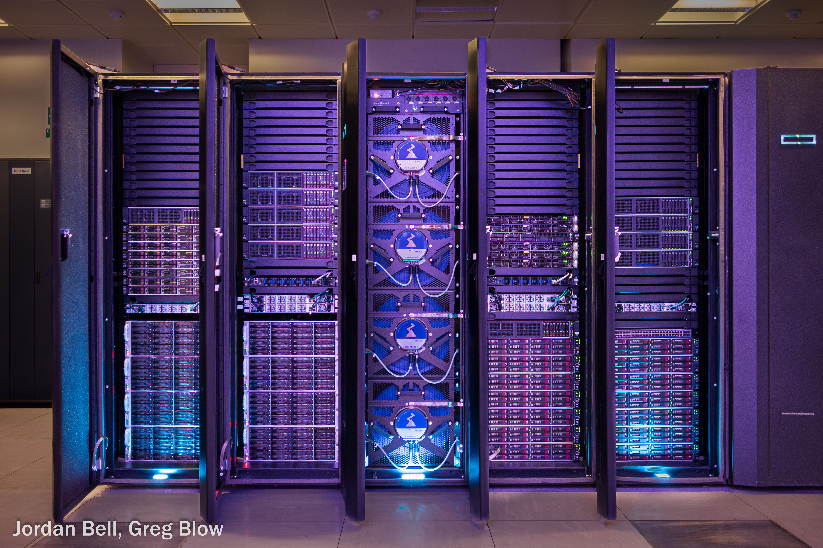
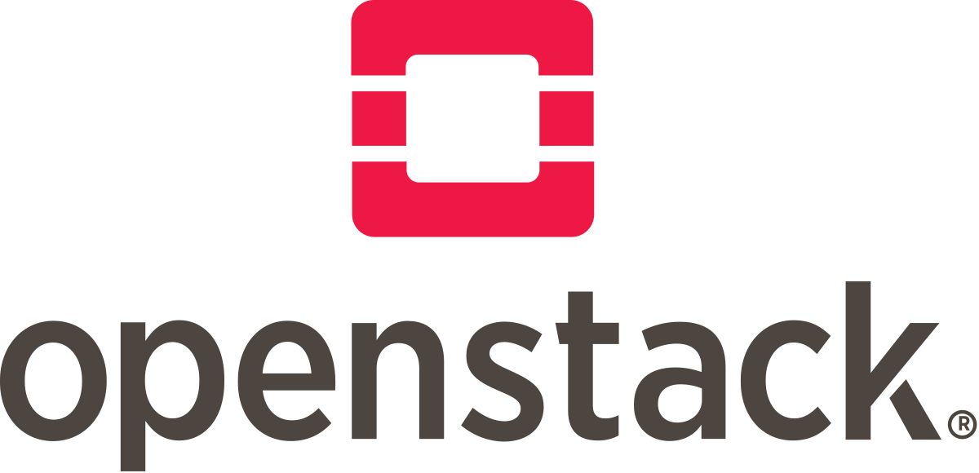




Cloud Resources
Existing Resources
3 x OpenStack Controllers
15 HVs (HPE), each with 64 cores and 1TB RAM
    7 HVs with 11TB NVMe SSD as single local RAID, LVM partitioning
    8 HVs with 4 x 3.8TB NVMe SSD local, Cinder volume partitioning
Ceph Cluster
    13PB HDD backed pools, mix of triple replica and 8/2EC
    150TB SSD backed pools
    22 nodes, most with 22TB HDDs
100 Gbps HA LAN
    All nodes connected on bonded interfaces, HA setup
    100 Gbps connection to JANET Network backbone
Qserv Project Deployment
    16 HVs each with 14 x 6.4TB NVMe SSD
Gaia DMP Deployment
    8 HVs each with 6 x 6.4TB NVMe SSD, 1TB RAM
2026 Expansion
    2 x 400Gbps Mellanox SN4700 switches
    5 x HVs with 64 core, 1TB RAM, 4 x 3.2TB NVMe

Slide 4
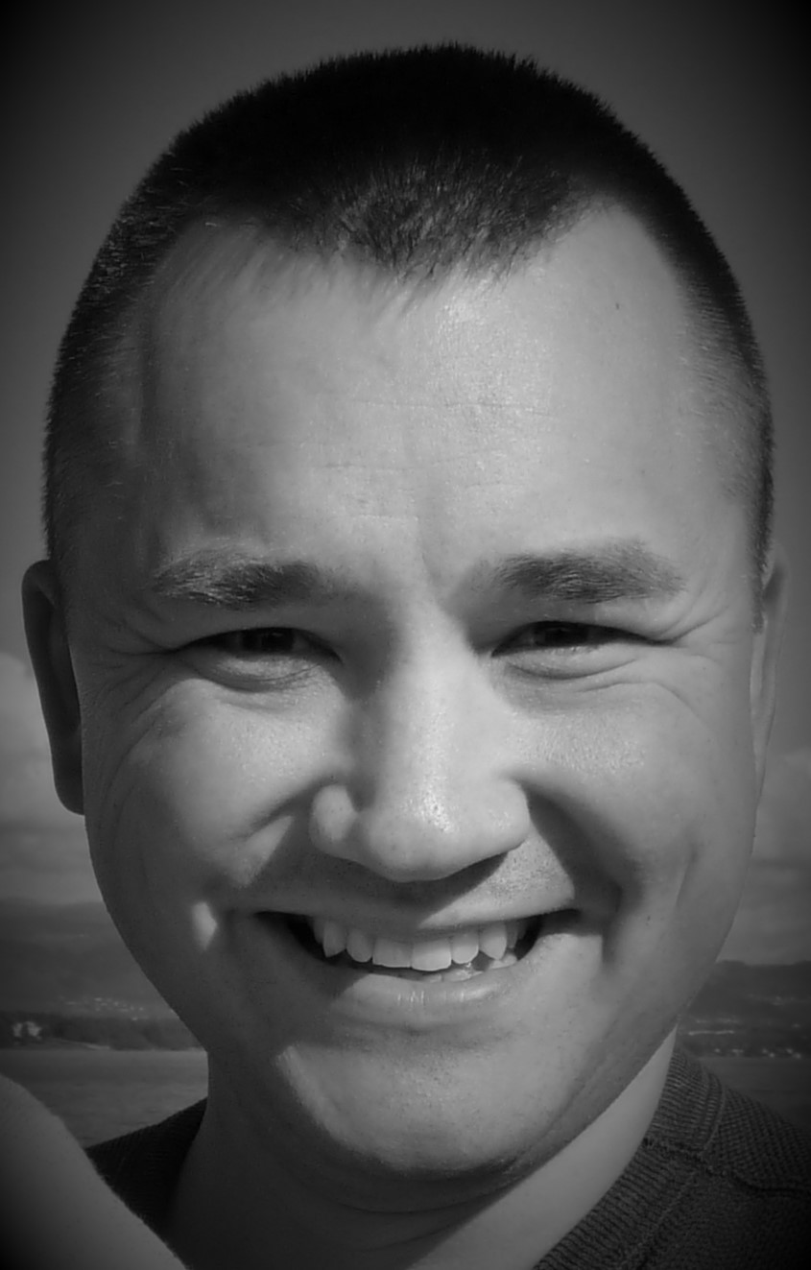
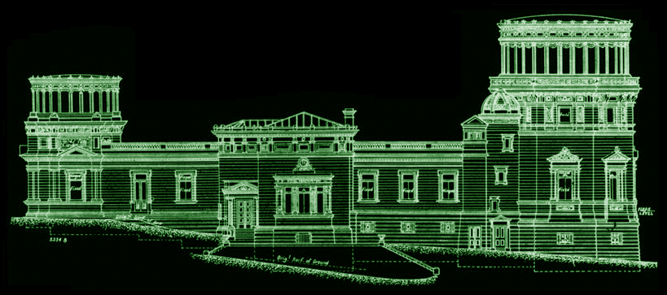
Mark Holliman
msh@roe.ac.uk
Head of IT Services
Wide Field Astronomy Unit
Institute for Astronomy
University of Edinburgh

