Slide 1



Somerville Cloud
Cloud for science Archives
The Somerville Cloud provides STFC science projects with cloud resources that cater to database and archive use cases. Funding is from LSST:UK and IRIS, while the administrative effort is provided by the University of Edinburgh (through the ACF and WFAU). It was started in 2018 as a testbed for LSST:UK use cases and then officially entered operation in 2021 to serve the needs of multiple astronomy archives.
Infrastructure Details:
OpenStack Cloud, using the Scientific OpenStack standard: https://www.hpc.cam.ac.uk/scientific-openstack
Cloud resources are tailored to meet the specific needs of science data archive projects
Ceph storage cluster with multiple pools configured to meet project specific metrics, with both HDD and SSD backed resource. Serving volumes, CephFS, and S3 access methods. Current raw capacity of ~13PB.
Hypervisors with significant NVMe SSDs (HVs with 4 x 3.2TB, 6 x 6.4TB, and 14 x 6.4TB) served via PCI passthrough, intended for use by distributed database technologies such as Apache Cassandra (https://cassandra.apache.org/_/index.html) and Qserv (https://qserv.lsst.io/index.html)
High speed interconnect at both LAN and WAN level (100Gbps from cloud to JANET backbone interconnect)
Administration assistance contracted through StackHPC (https://www.stackhpc.com/)

Slide 2
Tenant Projects
Vera Rubin/Lsst
Other Projects
Lasair ZTF
Transient event alert service (i.e. notify astronomer when a supernova is detected).
Deployed via Kubernetes (Magnum), utilizes Apache Cassandra
More info: https://lasair-ztf.lsst.ac.uk/
Vera Rubin/LSST Archive Database
Database containing the Vera Rubin data releases
Projected to reach >30PB by end of operations
Qserv RDBMS (sharded relational database) - https://qserv.lsst.io/index.html
Rubin Science Platform (RSP)
User interface and data analysis tools for bringing processing to the data
Deployed via Kubernetes (Magnum), uses Jupyter notebooks
More info: https://data.lsst.cloud/
TiDES
4MOST Time Domain Extragalactic Survey
Spectroscopic follow-up of extragalactic transients discovered by Vera Rubin
More info: https://arxiv.org/abs/2501.16311
WFAU Archives
Database and image archive of the WFCAM and VISTA surveys
~.8PB of MS SQL Databases, ~1.8PB of image data
More info: http://vsa.roe.ac.uk/
Gaia Data Mining Platform
Science platform for large-scale exploitation of the publicly released Gaia data products
Deployed via Kubernetes, utilizes Apache Spark, Jupyter Notebooks
~.25PB of sharded RDBMS, ~.5PB compressed archive data
More info: https://www.gaia.ac.uk/data-releases/mining-platform/the-uk-gaia-data-mining-platform/

Slide 3
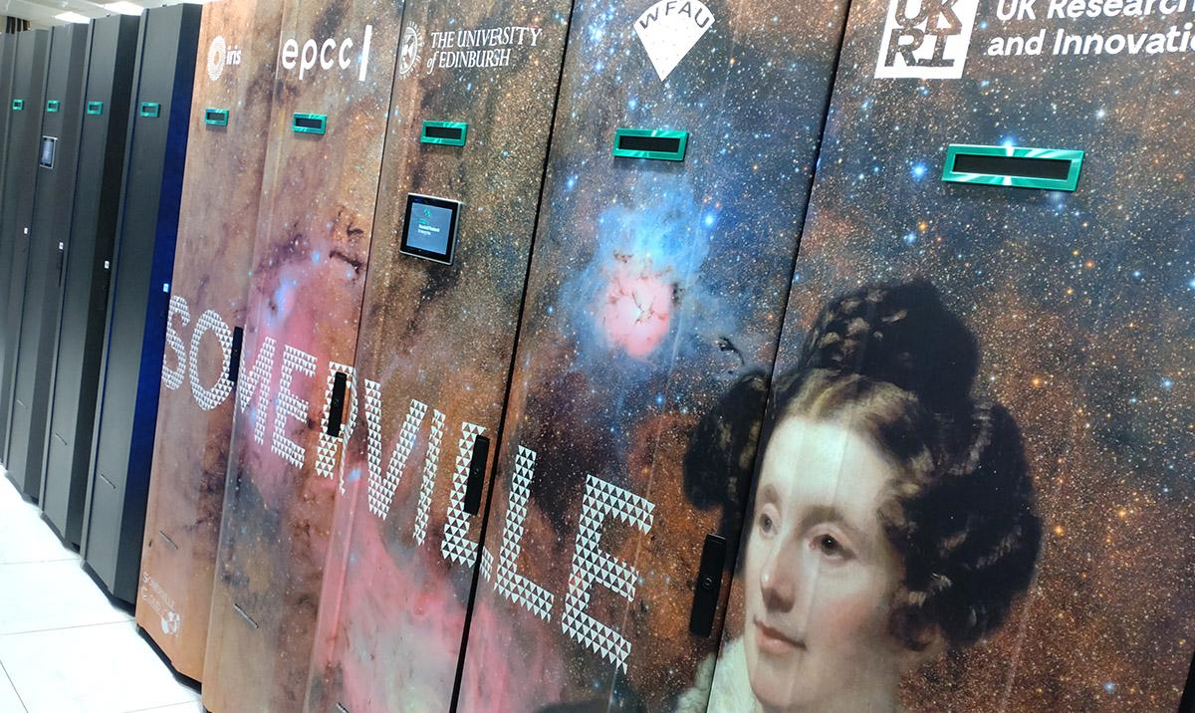
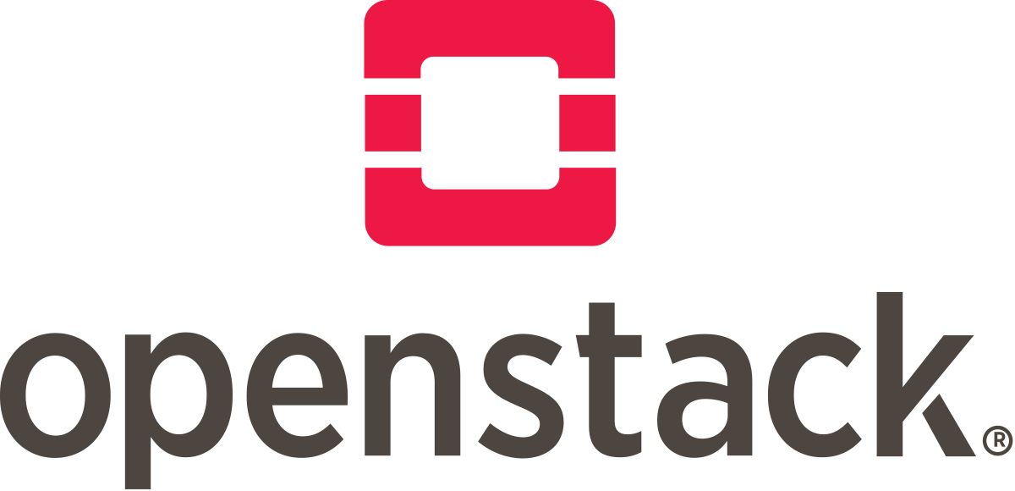




Cloud Resources
Existing Resources
3 x OpenStack Controllers
15 HVs (HPE), each with 64 cores and 1TB RAM
7 HVs with 11TB NVMe SSD as single local RAID, LVM partitioning
8 HVs with 4 x 3.8TB NVMe SSD local, Cinder volume partitioning
Ceph Cluster
13PB HDD backed pools, mix of triple replica and 8/2EC
150TB SSD backed pools
22 nodes, most with 22TB HDDs
100 Gbps HA LAN
All nodes connected on bonded interfaces, HA setup
100 Gbps connection to JANET Network backbone
Qserv Project Deployment
16 HVs each with 14 x 6.4TB NVMe SSD
Gaia DMP Deployment
8 HVs each with 6 x 6.4TB NVMe SSD, 1TB RAM
2026 Expansion
2 x 400Gbps Mellanox SN4700 switches
5 x HVs with 64 core, 1TB RAM, 4 x 3.2TB NVMe
2027 and beyond
Substantial growth will occur to meet Vera Rubin project needs, along with other IRIS supported projects like Gaia DMP
Ceph storage will reach 10’s of PB by 2028, Qserv and Gaia will more than double their current footprint, and other projects will also continue to grow

Slide 4
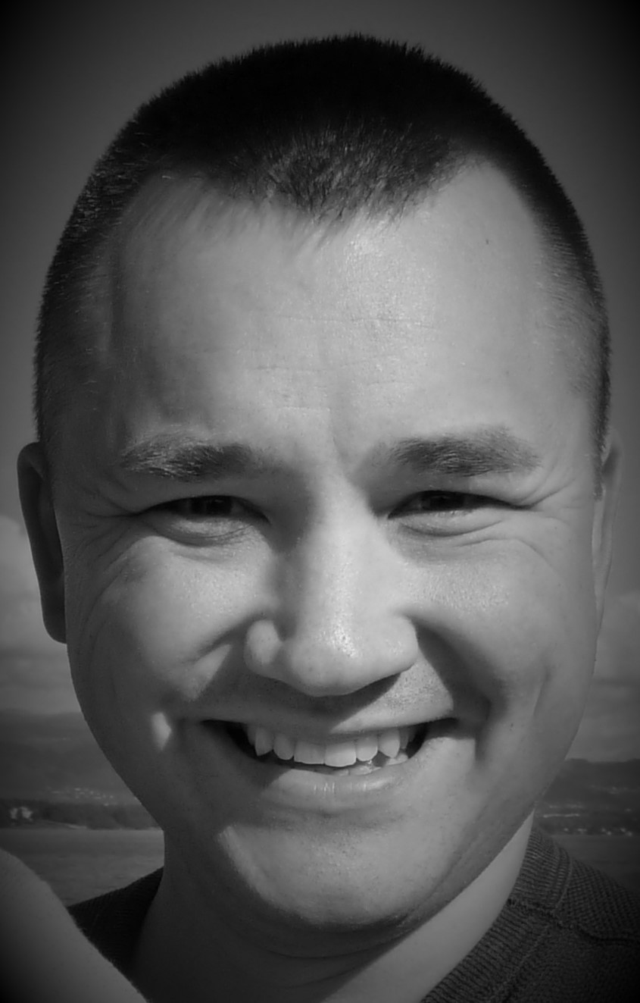
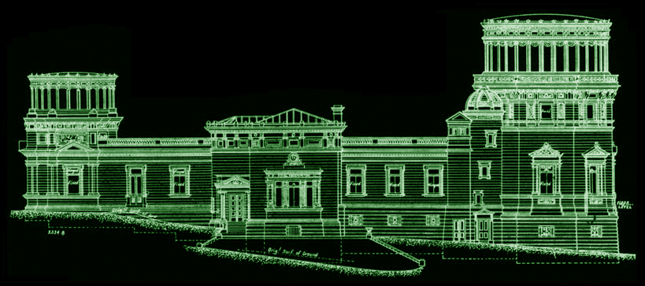
Mark Holliman msh@roe.ac.uk Head of IT Services Wide Field Astronomy Unit Institute for Astronomy University of Edinburgh

