Slide 1
Machine learning for Catalysts Discovery: Application in CO₂ conversion
Devis Di Tommaso
Department of Chemistry
School of Physical and Chemical Sciences
Queen Mary University of London

Slide 2
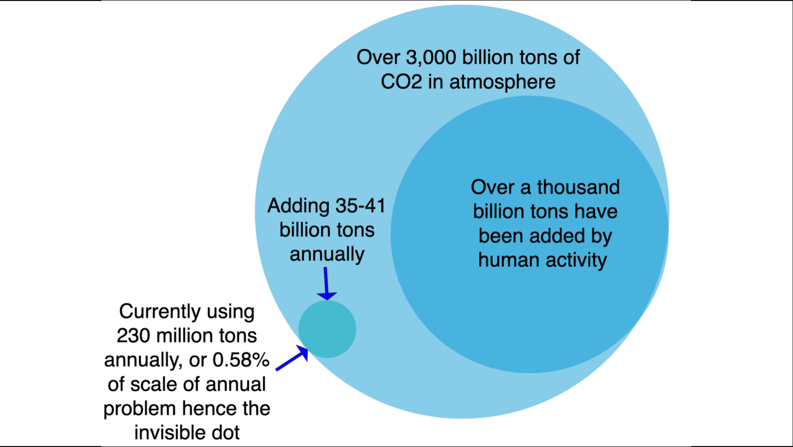
CO₂ utilization
Michael Barnard, Surrey Sustainable Engineering, 2024

Slide 3
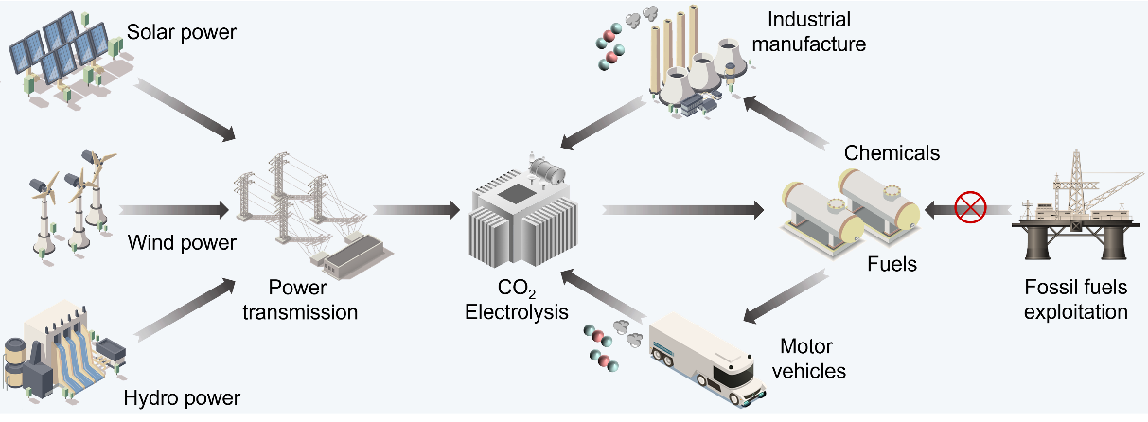
CO₂ electrolysis and the sustainable carbon cycle
“Advanced Catalyst Design and Reactor Configuration Upgrade in Electrochemical CO₂ Conversion”, Adv. Mater. 2023, 35, 2303052

Slide 4
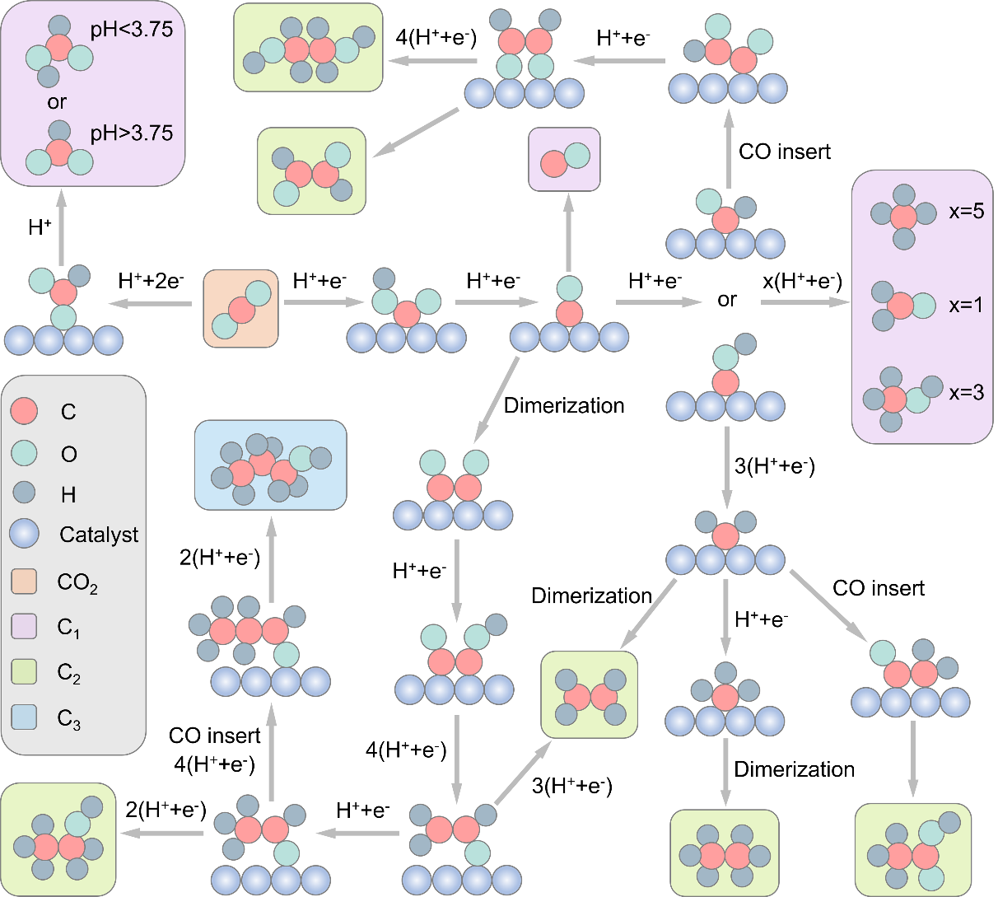
Electrocatalytic CO₂ reduction
Pathways to C₁ and C₂ products
PCET
CO₂
*COOH
*CO
PCET =
proton-coupled electron transfer
“Advanced Catalyst Design and Reactor Configuration Upgrade in Electrochemical CO₂ Conversion”, Adv. Mater. 2023, 35, 2303052

Slide 5
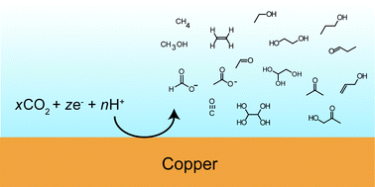
Electrocatalytic CO₂ reduction
> 30 hydrocarbons, oxygenates
MAIN LIMITATION: Poor selectivity

Slide 6
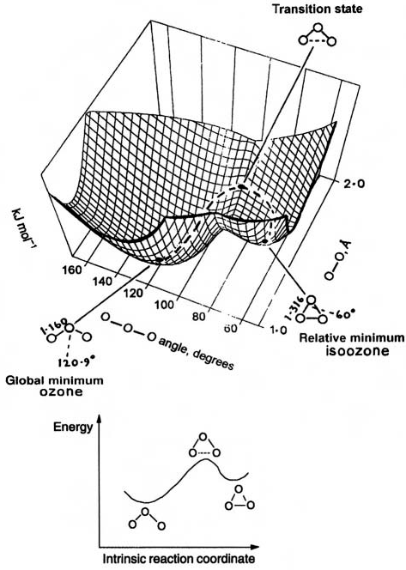
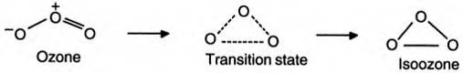

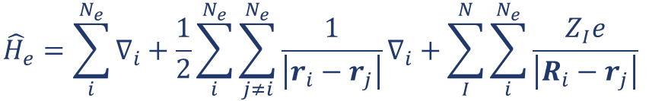

Quantum chemistry calculations of chemical reactions
$E=E\left(\left\{R_{I}\right\}\right)$, I = 1, N
Quantum mechanical
molecular energy
$$E\left(\left\{R_{I}\right\}\right)=\left\langle Ψ_{0}\left|{\hat{H}}_{e}\right|Ψ_{0}\right\rangle$$
$${\hat{H}}_{e}=\sum_{i}^{N_{e}}{∇_{i}+\frac{1}{2}\sum_{i}^{N_{e}}{{\sum_{j≠i}^{N_{e}}{\frac{1}{\left|r_{i}−r_{j}\right|}}∇}_{i}}+\sum_{I}^{N}{\sum_{i}^{N_{e}}{\frac{Z_{I}e}{\left|R_{i}−r_{j}\right|}}}}$$
kinetic
term
e-e
correlation
e-N
correlation

Slide 7
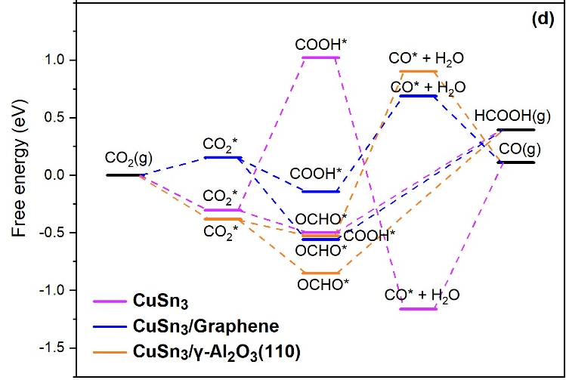
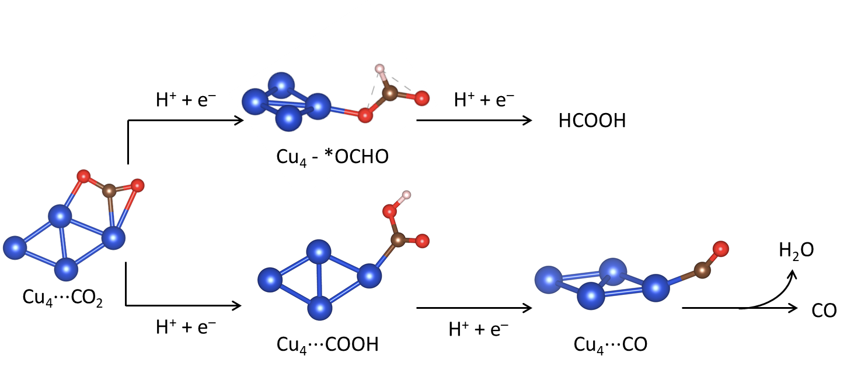
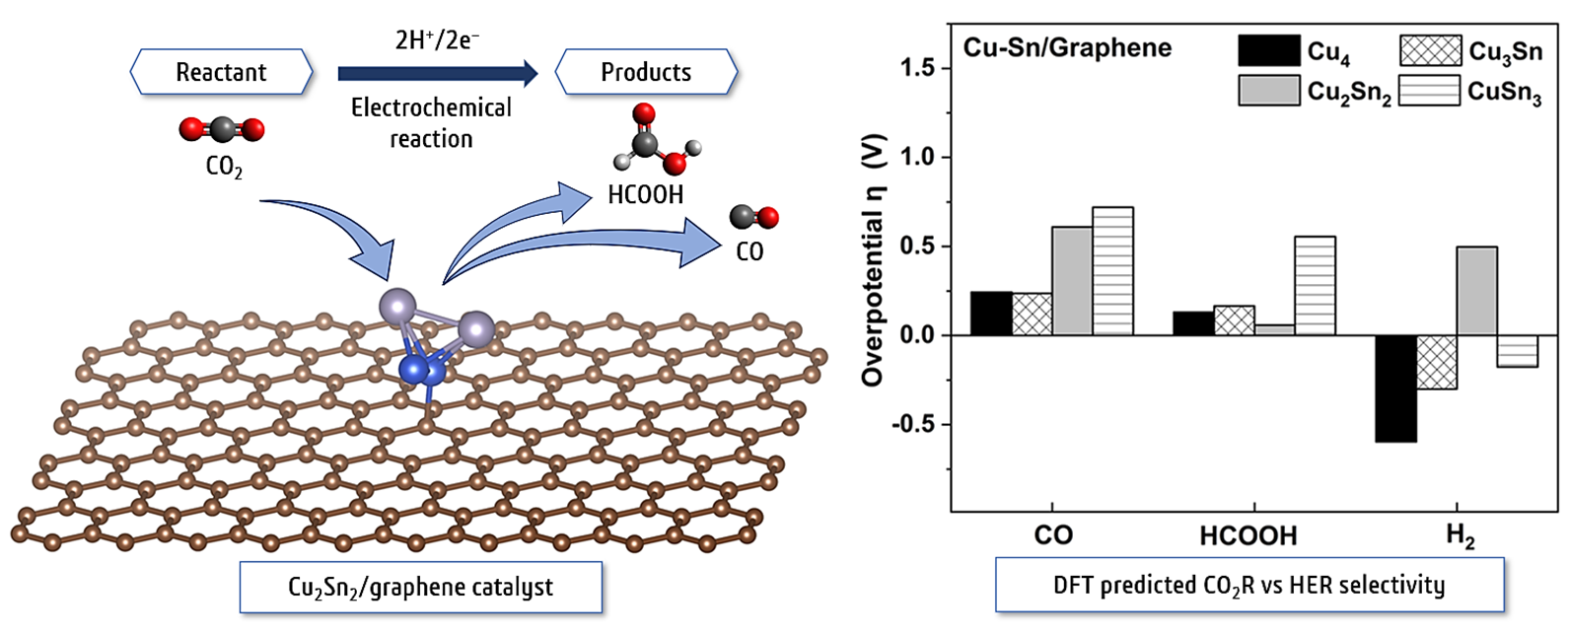
Quantum chemistry calculations of CO₂ conversion
“Adsorption, activation, and conversion of CO₂ on Cu–Sn nanoclusters”, Phys. Chem. Chem. Phys. 2023, 25, 13429

Slide 8
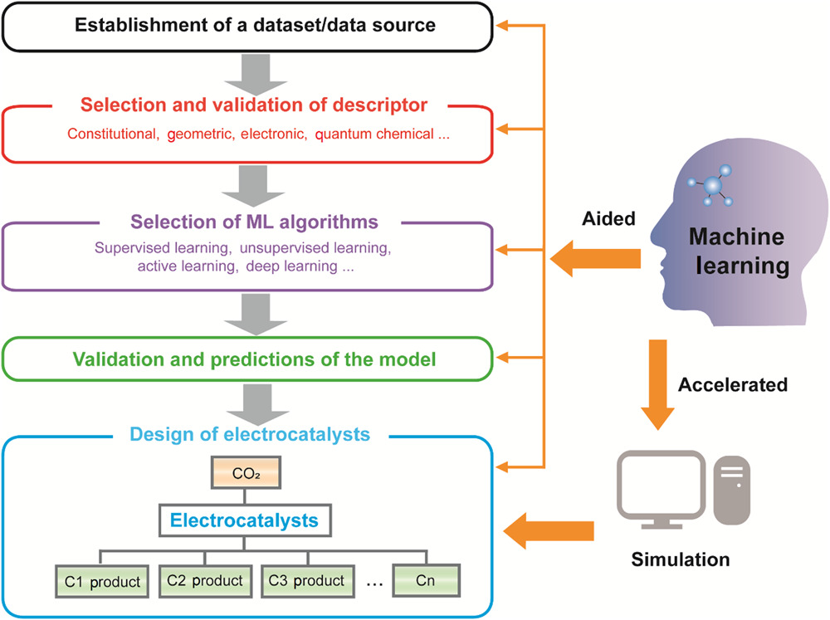
Machine Learning in Catalysis
ML aided prediction of catalytic properties
2
Generation and analysis of data though through ML or training of ML methods
1
ML accelerated calculations to reach larger simulation cell size and time scales
ML potentials to achieve QC accuracy at a fraction of the cost

Slide 9

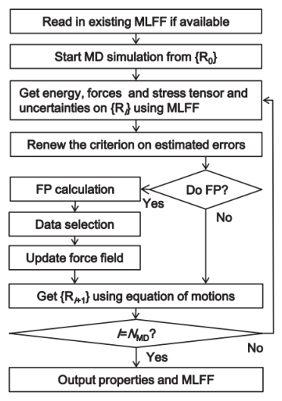

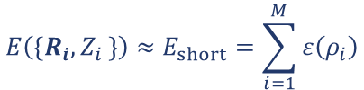
Machine learning potentials
$$E\left(\left\{R_{i}{,Z}_{i}\right\}\right)≈E_{short}=\sum_{i=1}^{M}{ε\left(ρ_{i}\right)}$$
Potential energy
“short-range energy”
Atomic energy ($ε$) function of the local environment $ρ$
Active-learning scheme: unbiased and systematic selection of relevant training structures during ab initio MD → dynamically generated dataset
Jinnouchi et al., Phys. Rev. B 2019, 100, 0141 (implemented in VASP 6.3.0)

Slide 10
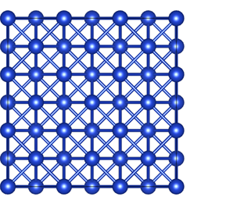
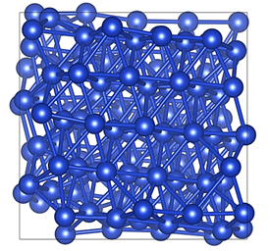

Generation of amorphous models using MLFFs
Melt and quench using MLFF
Crystalline Cu (3$×$3$×$3)
Amorphous
MLPs trained and applied to model amorphous Cu-based alloys
Few hours with MLFF compared to weeks if done with DFT
Screening CO₂ activation on amorphous CuNi
“Impact of amorphous structure on CO₂ electrocatalysis with Cu”, Electrochimica Acta 2024, 507, 145188

Slide 11
Machine Learning in Catalysis
ML aided prediction of catalytic properties
2
Generation and analysis of data though through ML or training of ML methods
1
ML accelerated calculations to reach larger simulation cell size and time scales
ML potentials to achieve QC accuracy at a fraction of the cost

Slide 12
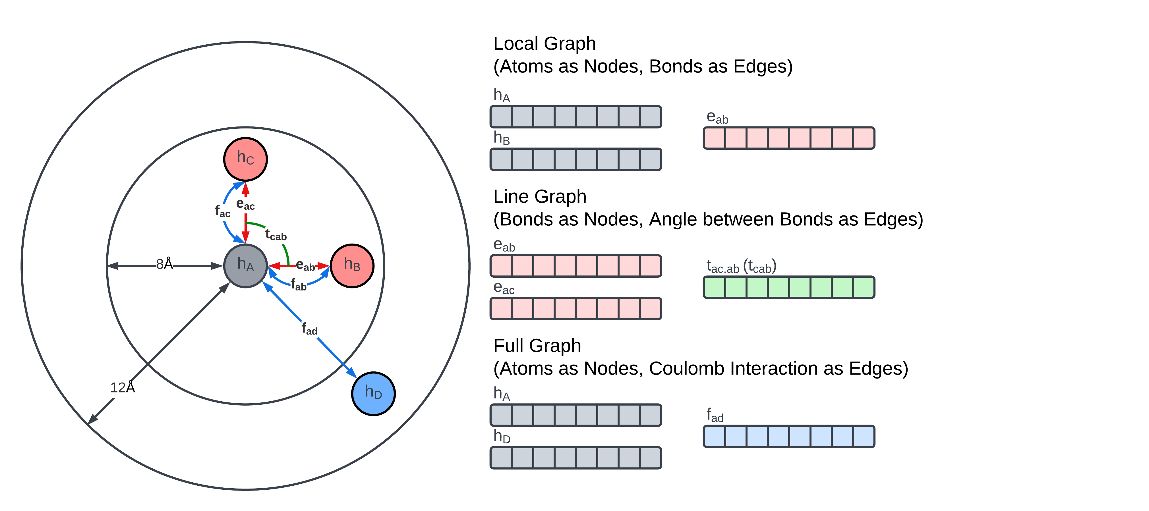
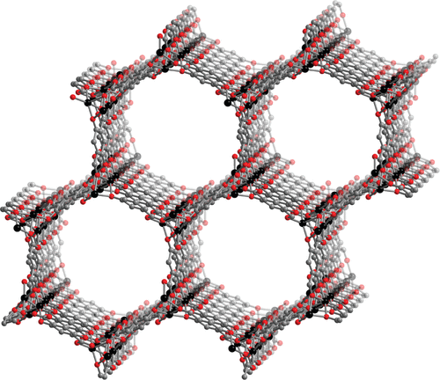
Molecular Graph Transformer
MGT applied to the discovery of MOFs photocatalysts for CO₂ reduction
MGT enhances material property prediction by integrating local and long-range interactions through advanced graph neural network architectures
“Molecular graph transformer: stepping beyond ALIGNN into long-range interactions”, Digital Discovery 2023, 3, 1048-1057

Slide 13
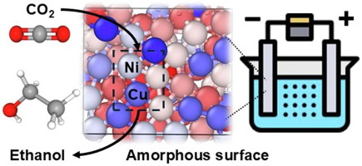
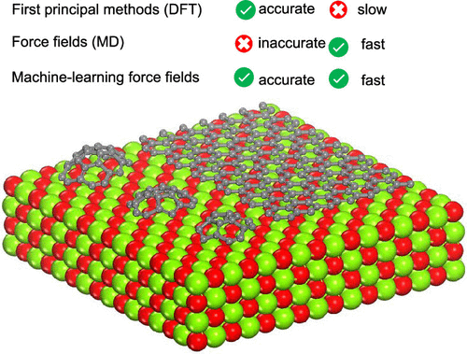
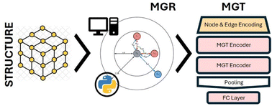



Key publications
CO₂ electrochemical reduction using amorphous catalysts: density functional theory and machine learning simulations, J. Energy Chem. 2025
Unveiling Carbon Cluster Coating in Graphene CVD on MgO: Combining Machine Learning Force field and DFT Modeling, ACS Appl. Mater. Interfaces 2024
Molecular graph transformer: stepping beyond ALIGNN into long-range interactions, Digital Discovery 2024

