Slide 1

The
Cybersecurity
Landscape of
2025

Slide 2

Cybersecurity & CIA
1 The Fundamentals
2 The Core - CIA Triad
Confidentiality
Integrity
Authorization
3 Types of Attack
4 Types of Defense
5 Real-world Examples
6 The Landscape
7 What Can You Do?
5 Nov 2025 M. Souvalioti

Slide 3

1
The Fundamentals
5 Nov 2025 M. Souvalioti

Slide 4
1
The Fundamentals
What is Cybersecurity?
The practice of protecting systems, networks, information and data from being accessed, altered, accumulated or destroyed by unauthorized entities.
→ It’s about digital containment and protection practices
What are we protecting?
Personal information (Identity, credentials, bank accounts etc)
Business data (clients’ information, financial data, intellectual property etc)
Critical services (power grids, hospitals, public services etc)
Your personal data have more value than you think!
5 Nov 2025 M. Souvalioti

Slide 5
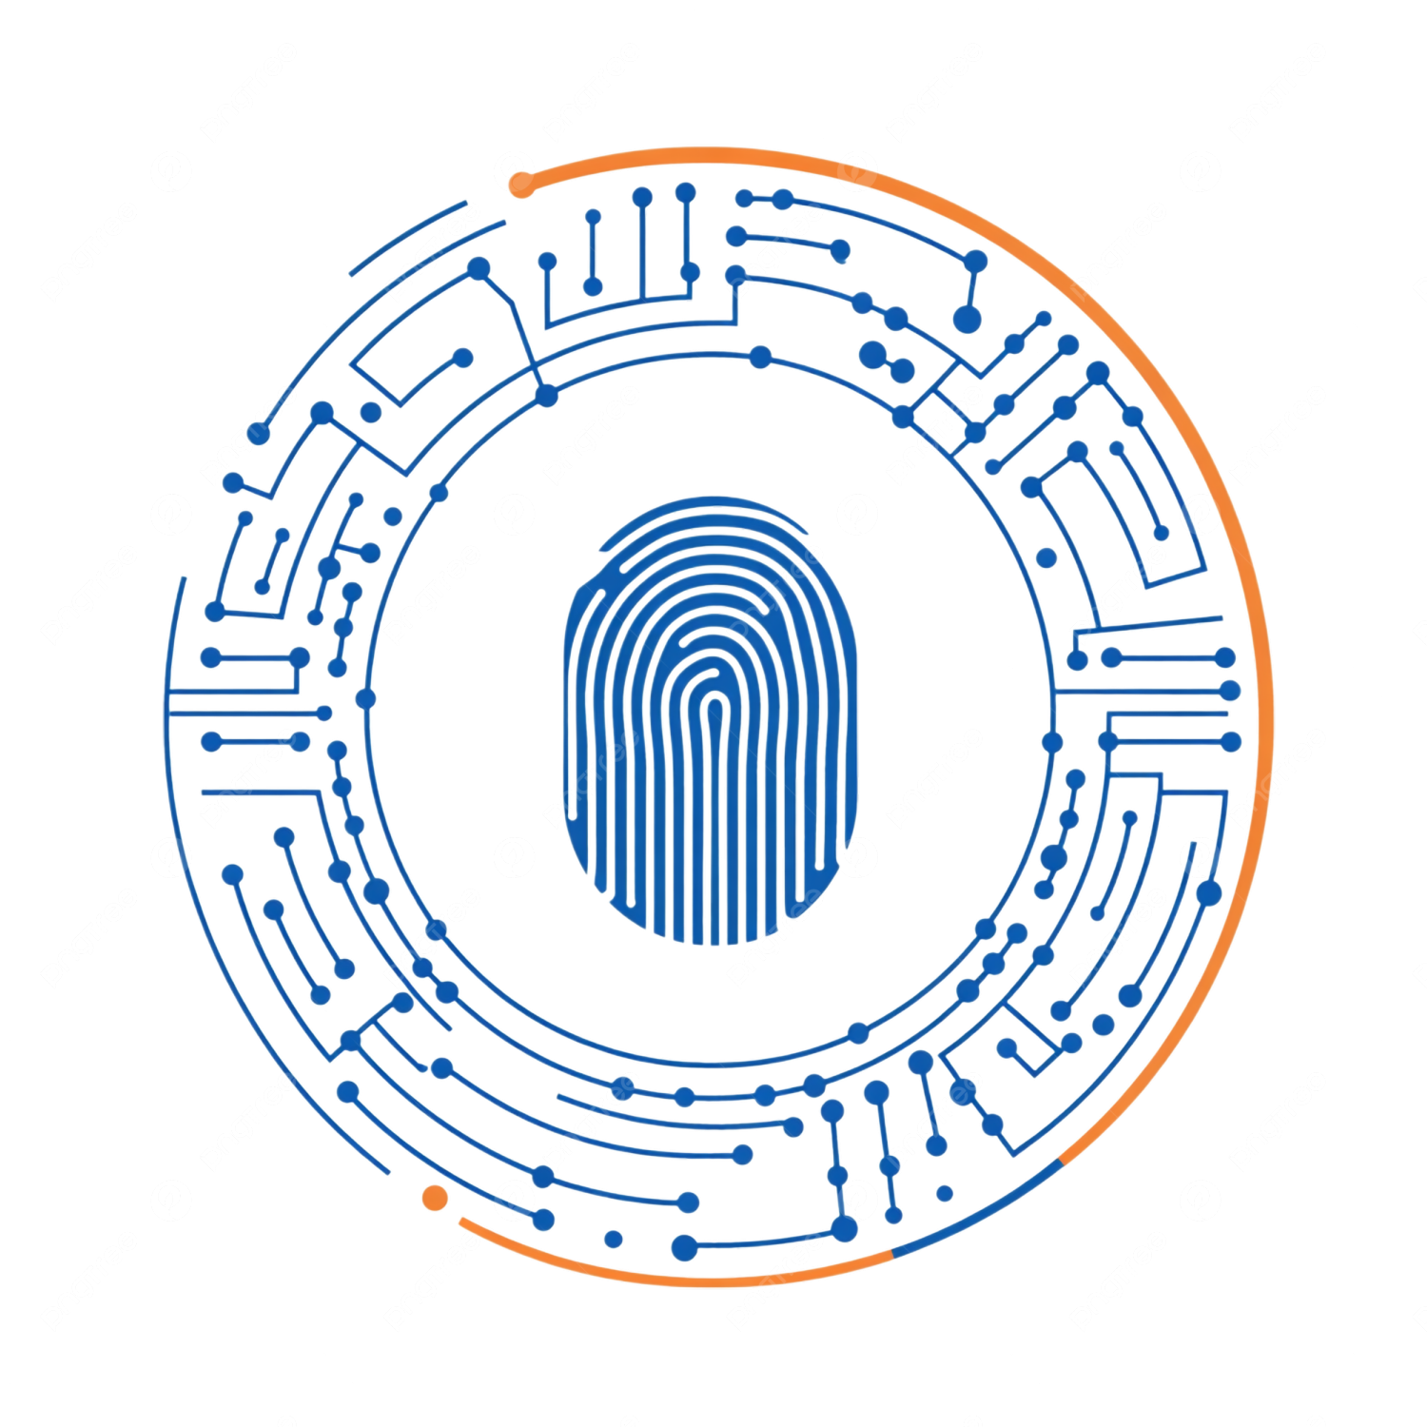
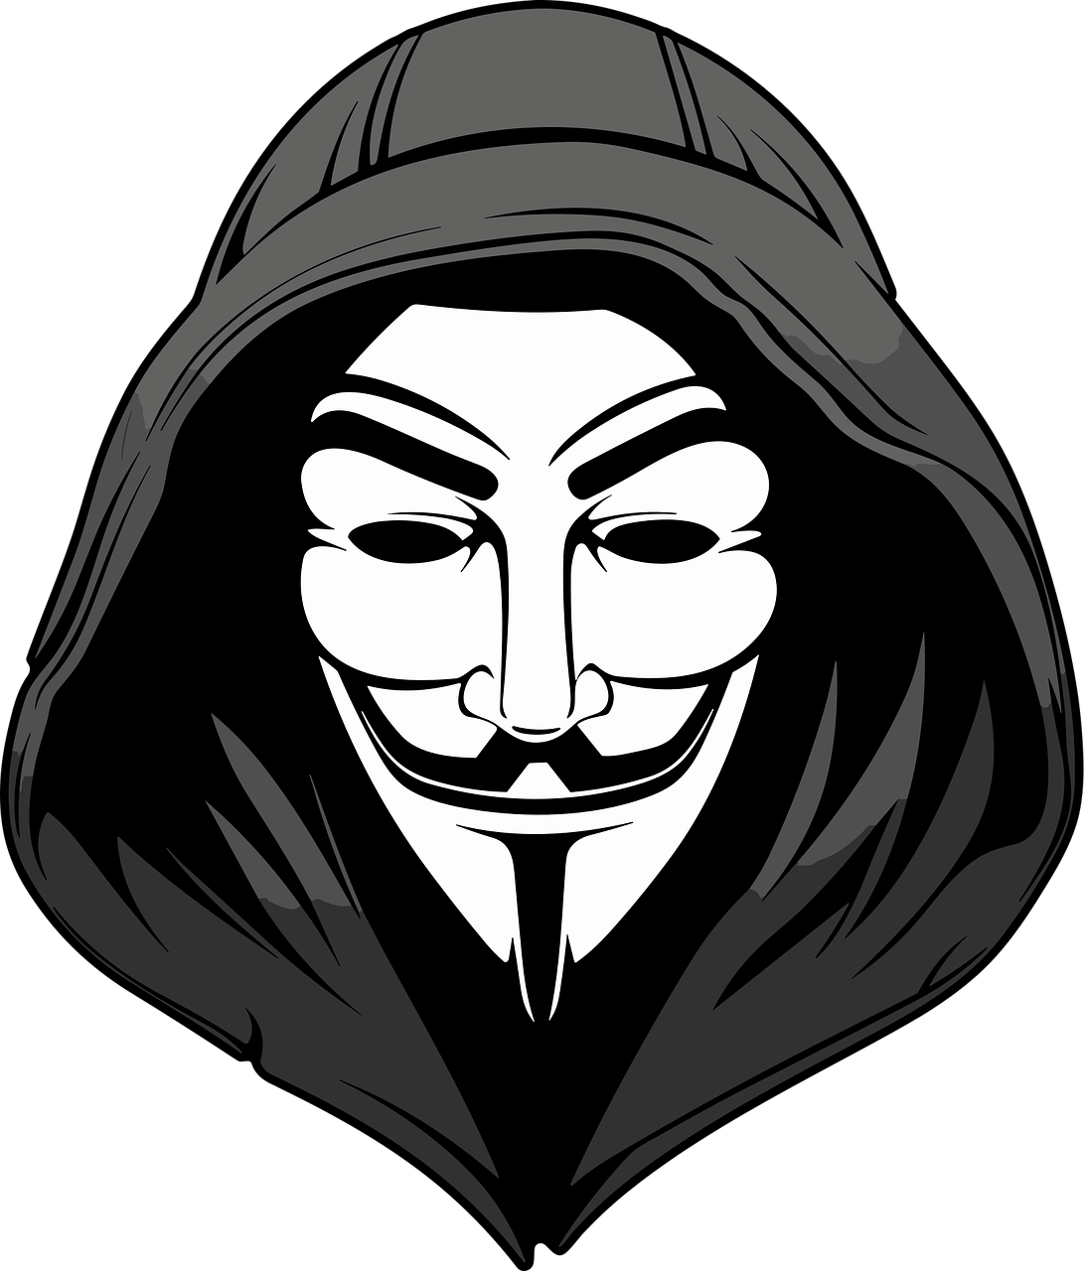
1
The Fundamentals
ATTACKERS
Individuals (either for gain or entertainment)
Hacktivists
Disgruntled employees
Organized groups
Industrial competitors
Foreign intelligence services
Motives?
Money
Disruption
Data theft
Espionage
Geopolitics
TARGETS
Individuals
Public sectors
Machines (from dedicated clusters of servers to IoT sensors measuring the temperature)
Big companies
Everyone and everything really...
Personal data are valuable!
Hackers usually target the weakest link which often is people
5 Nov 2025 M. Souvalioti

Slide 6
1
The Fundamentals
layered approach / multiple layers of defense
Physical
Perimeter
Network Monitoring
Access Controls
Device Protection
Data Protection
User Awareness
Ever evolving
New technologies birth new threats.
The threats are getting smarter (excessive usage of AI).
More attack surfaces with each new smart device being brought to the public.
Old defenses stop working.
Unmaintained software or hardware are easy targets.
Cybersecurity is a continuous 6-step process of preparing, Detecting, analysing, containing, eradicating, and recovering
5 Nov 2025 M. Souvalioti

Slide 7
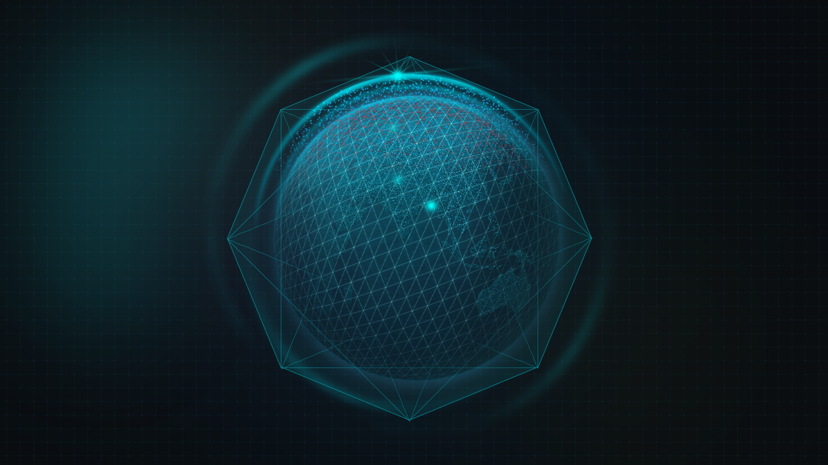

PREPARE
the
6-step process
RECOVER
DETECT
Continuous and neverending
prepare
detect
analyze
contain
eradicate
recover
and repeat
ERADICATE
ANALYZE
CONTAIN
5 Nov 2025 M. Souvalioti

Slide 8
2
The CIA Triad
5 Nov 2025 M. Souvalioti

Slide 9
2
The CIA Triad
C - Confidentiality
Keep data private - Only authorized people should have access to them
I - integrity
Keep data accurate - Information stays unchanged and is not tampered, unless done so by an authorized source
A - availability
Keep data available - Systems and data are accessible when needed, without disruption
5 Nov 2025 M. Souvalioti

Slide 10
2
The CIA Triad expansion
C - Confidentiality
I - integrity
A - availability
As cybersecurity has evolved in the years, so has our understanding of what needs to be protected, so in the CIA triad the following were added:
A - authentication
Are you really who you say you are?
A - authorization
And if you are who you say you are, are you authorized to access those data?
5 Nov 2025 M. Souvalioti

Slide 11
3
Types of Attack
5 Nov 2025 M. Souvalioti

Slide 12
3
Types of Attack
ATTACK TYPE | IMPACT
 | C | I | A | A | A
Phishing | n |  |  | n
Man-in-the-Middle (MitM) | n |  |  | n
SQL Injection | n | n
Ransomware |  | n | n
Denial-of-Service (DoS) |  |  | n
Brute Force |  |  |  | n
Privilege Escalation |  |  |  | n | n
Insider threat |  | n |  |  | n
Cross-Site Scripting (XSS) | n | n
Replay Attacks |  |  |  | n
Session Hijacking | n |  |  | n | n
Data Exfiltration | n
Malware/Trojans | n | n | n | n | n
Misconfiguration Exploits |  |  | n |  | n
Zero-Day Exploits | n | n | n | n | n
So, why is CIAAA important?
Defines clearly what needs to be protected
Offers a structured way of assessing, designing, and placing security controls.
Enables effective risk assessment.
Each C-I-A-A-A element helps evaluate threats and prioritize mitigations.
Security controls like firewalls, encryption, MFA, RBAC, ACLs, backups are designed to protect one or more C-I-A-A-A elements.
Helps guide policy creation, compliance standards and technical implementation.
Helps understand multi-dimensional impacts
CIAAA is not just a checklist. It’s the foundation of security thinking
5 Nov 2025 M. Souvalioti

Slide 13
4
Types of Defense
5 Nov 2025 M. Souvalioti

Slide 14
4
Types of Defense
Because attackers don’t target just one thing, CIAAA also helps in:
Understanding multidimensional impacts
Create layered defenses
Continuously refine and create new defenses based on new vulnerabilities or adversary techniques (MITRE ATT&CK aligned)
MITRE ATT&CK - Adversarial tactics, techniques and common knowledge
Is a gloablly accessible knowledge base of how real-world attackers behave.
Mapped in a structural way, it stands for a playbook of adversary behaviours, categorized by:
what they are trying to achieve (tactics), and
how they do it (techniques and sub-techniques)
5 Nov 2025 M. Souvalioti

Slide 15
4
Types of Defense
Attack type | Defenses
Phishing | MFA, User Awareness
Man-in-the-Middle | TLS everywhere (HTTPS, VPN), Certificate Pinning, Secure DNS
SQL Injection | Parameterized queries, Input Validation, Web Application Firewall (WAF)
Ransomware | Regular offline backups, Endpoint Protection, Endpoing Detection and Recovery (EDR )
Denial-of-Service (DoS) | Rate limiting, Traffic Shaping, Cloud DDoS Mitigation
Brute Force | Account Lockout Policies, CAPTCHA, MFA
Privilege Escalation | Least Privilege Access (RBAC), Patching known exploits quickly
Insider threat | User Behaviour Analytics, Separation of Duties, Access Reviews
Cross-Site Scripting (XSS) | I/O Encoding (HTML escaping), Content Security Policy
Replay Attacks | Timestamps in Tokens, Short-Lived Session Tokens
Session Hijacking | Secure Cookies (i.e. HttpOnly, SameSite etc), TLS, Session Expiry
Data Exfiltration | Data Loss Prevention (DLP), Outbound Traffic Monitoring, Security Information and Event Management Alerts (SIEM)
Malware/Trojans | EDR with Heuristic Detection Algorithms, Application Whitelisting, Antivirus
Misconfiguration Exploits | Baseline hardening, Automated Config Audits, Cloud Security Posture Management (CSPM) Tools
Zero-Day Exploits | Behaviour-Based Detection, EDR, Threat Intelligence, Patch Fast Once Known
5 Nov 2025 M. Souvalioti

Slide 16
5
Real world examples
5 Nov 2025 M. Souvalioti

Slide 17
5
Real world examples
2025
NPM Supply Chain
Attack
2025
Panama MEF
2025
Iberian Peninsula blackout
2025
UK MoD laptop breach
2025
s1ngularity
&
GhostAction
Breach and theft of over 1.5 TB of sensitive data
Worm delivering
data stealing
malware / NPM has over 2.6 billion weekly downloads
Unattended laptop with sensitive relocation information of Afghan individuals
2025
US Cyber Attack on Venezuelan Regime
Spain and Portugal completely cut-off
AI-powered malware hit 2,180 GitHub accounts & exfiltration of 3,325 secrets respectively
CIA-backed cyber op against Maduro’s regime, disrupting infrastructure and communications
2024
Crowdstrike
Vendor-Originated Update Failure
5 Nov 2025 M. Souvalioti

Slide 18
6
The Landscape of 2025
5 Nov 2025 M. Souvalioti

Slide 19
`
6
The Landscape of 2025
5 Nov 2025 M. Souvalioti

Slide 20
`
6
The Landscape of 2025
Key Takeaways
Phishing remains a primary initial intrusion vector
ClickFix-style
Phishing-as-a-Service
QR phishing - quishing
Dependencies and third-party service providers get increasingly targeted
Exploitations of the supply chain
Continuous targeting of mobile devices (esp. Android) and exploitation of outdated devices
Spyware for surveillance purposes increasingly documented
5 Nov 2025 M. Souvalioti

Slide 21
7
What Can You Do?
5 Nov 2025 M. Souvalioti

Slide 22
7
Prevention is the best defense!
PREPARE - detect - analyze
Use STRONG & LONG passwords (at least 26 characters)
MFA wherever possible
CAUTIOUS with links and attachments!
NEVER TRUST emails asking for your personal credentials or information!
UPDATE devices and applications
BACKUP important files
ONLY INSTALL TRUSTED software
REPORT anything suspicious
5 Nov 2025 M. Souvalioti

Slide 23
7
If you’ve been compromized?
ACT FAST! - contain / eradicate / recover
DISCONNECT your device from the network
DO NOT SHUT DOWN THE MACHINE!
REPORT the incident
CHANGE PASSWORDS
SCAN system for malware
RESTORE from a clean backup
WATCH for follow-up fraud
5 Nov 2025 M. Souvalioti

Slide 24
THANK YOU
msouval@iit.demokritos.gr

