Slide 1



7 July 2026
Federated Edge-HPC Architectures for AI workflows in Privacy-sensitive and Real-time Domains

Slide 2
Project and approach
The mission: UK Edge–HPC federation; a dual-stack capability that preserves each site's autonomy while enabling real-time, privacy-sensitive AI workflows. The UK analogue of the EuroHPC AI Factories and the EU EURO-3C Telco-Edge-Cloud federation.
1 Mission need
Why federate
Edge & HPC
2 Evidence
Expert discussions, workshops, TRL-4 testbed
3 Requirements
9 prioritised recommendations
4 Architecture
Dual-stack target system
5 Roadmap
Five-year sequenced delivery
Team
Lead: Dr Theodoros Spyridopoulos (Cardiff University)
Co-lead: Dr Tomasz Szydło (Newcastle University)
Cardiff: Prof Omer Rana · Dr Yasar Majib · Othmane Belarbi
Newcastle: Prof Rajiv Ranjan · Dr Varun Ojha · Dr Yinhao Li · Dr Dev Jha · Amrit Kumar

Slide 3
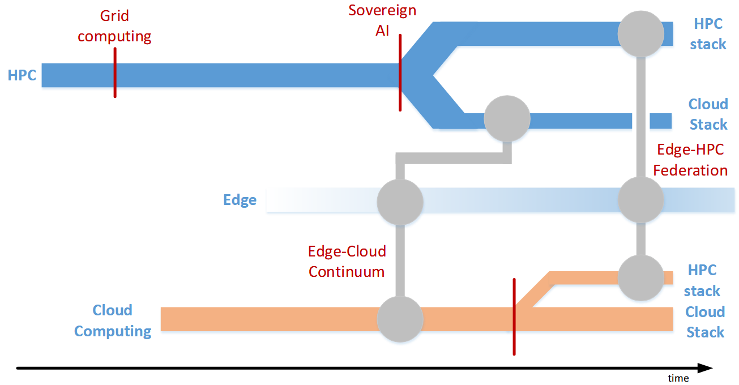
Why federate Edge and HPC?
MOTIVATION
Modern AI is moving to the edge. Continuous, event-driven, latency- and privacy-sensitive workflows in healthcare, transport and advanced manufacturing, deployed close to where data is generated.
THE WALL
UK national HPC and AI Research Resources are batch-scheduled, firewalled and human-mediated — optimised for simulation science, not real-time services.
The barrier is structural. Four gaps make federation hard today:
1
2
3
4
Execution model
HPC enforces batch scheduling and wall-time limits; edge AI needs continuous, event-driven services.
Data path
National compute nodes block inbound connections, so real-time telemetry cannot reach HPC without a workaround.
Identity & trust
Access is built around named human users — not the service accounts, devices, workloads and data federation requires.
Coordination
Workflows are chained by hand; there is no federated engine to place tasks and move data across sites.

Slide 4
Evidence base
Discussions
Workshops
Testbed (TRL-4)
Governance & skills
Requirement elicitation
3 workshops across 2 events
Feasibility evidence
Review of policy + training
5 semi-structured exploratory expert discussions, 60–90 min. Participants: a national AIRR; a national HPC service; an HPC vendor; EU Cloud-HPC projects; scientific workflow-system developers.
EPSRC, Online
Newcastle x2 — Systems + Applications (2–3 Dec 2025); 21 attendees, 6 presenters
Cardiff — Architectures, Orchestration & Cybersecurity (3 Jun 2026, 6 invited talks); 35 attendees, 6 presenters.
EPSRC, Hybrid
Jetson Orin + YOLOv8 (Newcastle Urban Observatory) → Cambridge Dawn/CSD3 (Slurm + Apptainer, SUMO-MESO).
NCSC CAF, NIS, GDPR, IEC 62443
Raspberry Pi ECG Sim (PTB-XL) → Cambridge Dawn/CSD3 (Slurm + OpenCARP).
Research Council relevance: EPSRC (computing, AI, digital research infrastructure, national HPC)
Notes:
A small, deliberately qualitative, requirements-engineering base. We targeted a very specific audience — Edge and HPC providers/engineers — so numbers are modest.

Slide 5
What the testbeds showed — Transport and Healthcare
EDGE
RELAY
HPC
Transport
NVIDIA Jetson Orin; YOLOv8 vehicle detection on Newcastle Urban Observatory feeds
SFTP staging + cron polling outbound ≈ every 2 h (inbound to HPC is blocked)
Cambridge Dawn
Slurm + Apptainer; SUMO-MESO Monte-Carlo over ~1,201 road edges
Healthcare
Raspberry Pi simulates ECG using the PTB-XL Dataset
Async staging + MQTT Subscriber on HPC
Cambridge Dawn
Slurm + OpenCARP
✓ What worked across both
Containerised HPC execution was feasible
HPC Listener (Compute Node)
Dual-stack Edge → HPC pattern demonstrated at TRL-4
✗ What did not — and why
Real-time inbound streaming & machine-triggered submission — blocked by wall-time limitation and no service accounts
Relay "imposed“ a ≈ 2-hour latency floor — unacceptable for real-time
Python AI I/O (many small reads/writes) stresses Lustre/GPFS → needs an object-storage tier
Takeaway: feasibility is proven, but moving from proof-of-concept to a minimum viable product needs the Kubernetes service plane (FEDGE-1), real-time ingress + object storage (FEDGE-5) and a federated workflow layer (FEDGE-3).
Notes:
Two domain testbeds used the same edge → relay → HPC pattern; both demonstrated feasibility and exposed the same structural blockers.

Slide 6
Recommendations at a glance
ID | Recommendation | MoSCoW | Layer | Years
FEDGE-1 | Native Kubernetes orchestration for edge-to-HPC services | Must | Execution & Orchestration | 1-2
FEDGE-2 | Container-first execution environments across the federation | Should | Execution & Orchestration | 1
FEDGE-3 | Federated workflow orchestration across edge and HPC | Should | Execution & Orchestration | 2-4
FEDGE-4 | Secure, governed event-to-HPC job submission | Must | Execution & Orchestration | 1-3
FEDGE-5 | Real-time data ingress APIs and object-storage integration | Must | Data plane | 1-3
FEDGE-6 | Federated identity bridging for SME / commercial users | Could | Identity & Trust | 3-5
FEDGE-7 | Trust beyond user identity | Should | Identity & Trust | 2-4
FEDGE-8 | National Edge–HPC skills and DevOps-culture transition | Should | People & Process | 1-3
FEDGE-9 | Industry/ Community co-investment | Should | Strategic / Partnerships | 2-5
Notes:
https://www.gov.uk/government/publications/uk-compute-roadmap/uk-compute-roadmap

Slide 7
The 3 Must-Haves
FEDGE-1
Native Kubernetes orchestration
FEDGE-4
Secure, governed event-to-HPC submission
FEDGE-5
Real-time data ingress + object storage
MUST HAVE
MUST HAVE
MUST HAVE
Why essential
Continuous, event-driven services cannot run under batch wall-time limits at all — so healthcare, robotics and real-time-monitoring workloads are structurally excluded from federated HPC without it.
Why essential
This is the central problem of event-driven federation: without a governed path, an external edge event cannot reach the scheduler except through ad-hoc workarounds — the real-time use cases stay blocked.
Why essential
Real-time data cannot reach HPC through today's inbound-blocked paths. This sits on the critical path and is what makes the service plane (FEDGE-1) actually usable.
Evidence: the batch-vs-service mismatch (Slurm vs Kubernetes) was the central barrier across our discussions with HPC providers and engineers. Feasible today: Slinky / SLUNK and non-production K8s pilots.
Evidence: facilities offer no machine-triggered submission; our testbed worked around it with an SFTP+cron relay (≈2 h floor). Two governed routes proposed.
Evidence: the only workable testbed path was a polling relay (≈2 h); manual SCP/rsync was a bottleneck; Python AI I/O stresses parallel filesystems.
Timescale Year 1–2
Timescale Year 1–3
Timescale Year 1–3
Notes:
In FEDGE 2, we proposed the development of a slurmrestd /REST API with VPN-restricted endpoints and service account tokens; The path 2 (doable now but still hits the time wall) relies on a DAWN-side consumer that connects outward to a trusted broker and submits jobs locally

Slide 8
Should- and Could-Have enablers
FEDGE-2
SHOULD
FEDGE-3
SHOULD
FEDGE-7
SHOULD
Container-first execution
Federated workflow orchestration
Trust beyond user identity
Standardise unprivileged Apptainer/Podman so edge-built workloads run unchanged on HPC. In the testbed, portability was possible. Foundational enabler.
A cross-site workflow layer (Parsl, Globus Compute, Argo, Nextflow) extended for federated execution. Production engines are largely absent from academic HPC. Pilot LLM-Driven "Agentic" Orchestration for the Computing Continuum.
Node/workload attestation, signed container & model artefacts, data-residency enforcement. Federation authenticates people, not devices or data.
Timescale Year 1
Timescale Year 2–4
Timescale Year 2–4
FEDGE-8
SHOULD
FEDGE-6
COULD
Skills & DevOps culture
SME / commercial identity bridging
A national programme to build cloud-native operating capability in HPC teams. Without people to run the new stack, the technical recommendations stall.
Extend MyAccessID so commercial users authenticate without 12-hour credential renewal. Could-Have: a manual workaround exists, but it limits commercial participation.
Timescale Year 1–3
Timescale Year 3–5

Slide 9
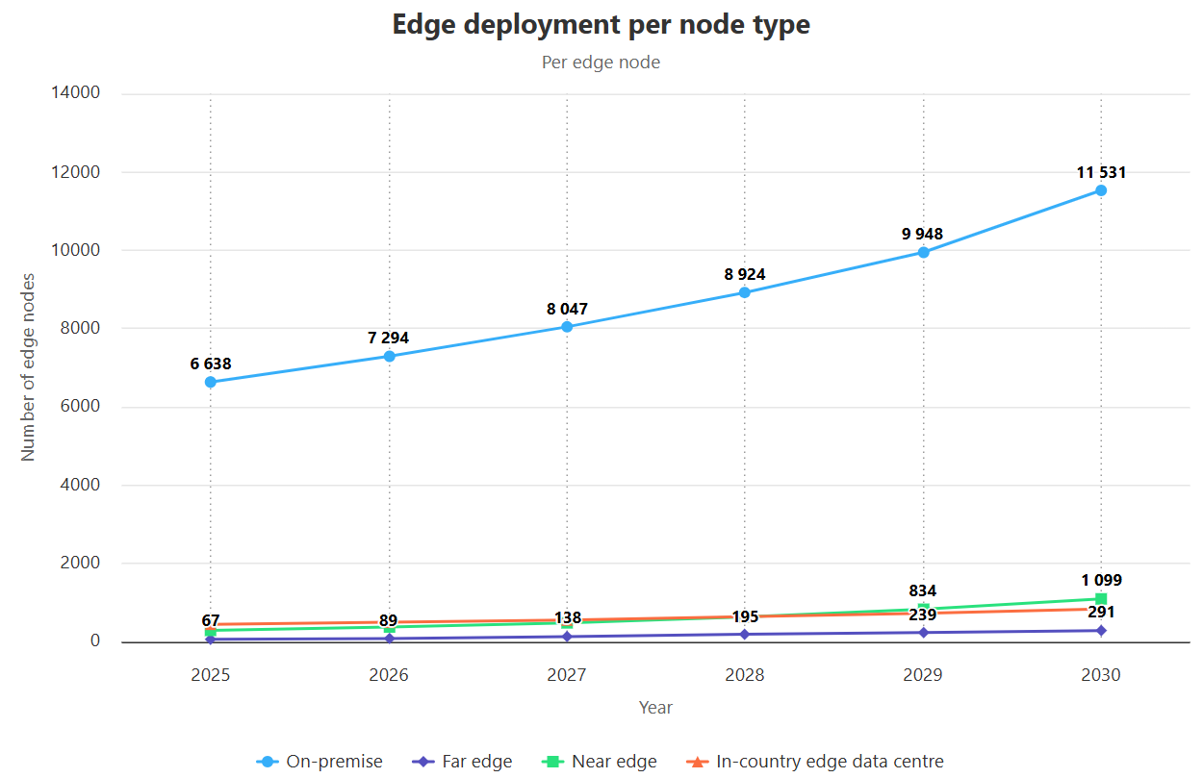
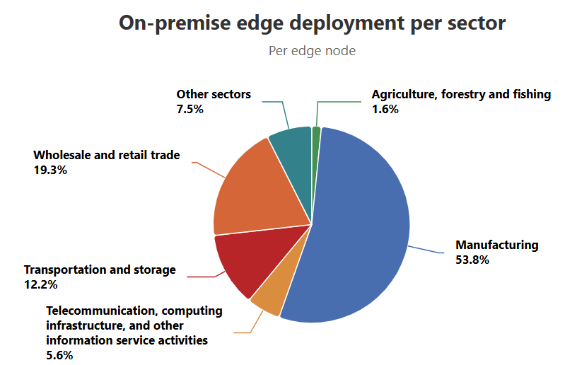
Public–private Telco-Edge-Cloud co-investment
€75M
Horizon Europe funding
87
consortium partners
MWC 2026
announced March 2026
The Edge Observatory - Publications | Shaping Europe’s digital future
EURO -3C: Europe's first large-scale federated Telco-Edge-Cloud infrastructure for digital sovereignty. Two UK partners, BT and Real Wireless Limited.
Establish public–private partnerships with UK AI-cloud and telecoms providers, using initiatives such as BT–Nscale as a starting point, to co-build a sovereign UK federated Telco-Edge-Cloud capability; AI-Continuum CIC could be built on the idea of Community Interest Companies as e.g. LowRISC CIC, CommonAI CIC.
FEDGE-9
Industry co-investment​
SHOULD
Timescale Year 2-5
Notes:
Europe is investing in Telco–Edge–Cloud federation; the UK should use FEDGE-9 to create a comparable public–private federation path.
EUROpean 3C Networks for Secure Telco-Cloud-Edge | EURO-3C | Project | Fact Sheet | HORIZON | CORDIS | European Commission
The Edge Observatory - Publications | Shaping Europe’s digital future

Slide 10
Target architecture: dual-stack, five layers
Dual-stack: a traditional HPC stack (Slurm / batch) and a cloud-native stack (Kubernetes) share GPUs and storage, while a relay layer decouples edge events from HPC scheduling.
Execution & Orchestration
Continuous services, cross-site workflows and governed event-to-HPC submission
FEDGE-1, 2, 3, 4
Data plane
Real-time ingress, object storage, relay for inbound-blocked sites
FEDGE-5
Identity & Trust
Federated identity for users, SMEs, devices, workloads and data
FEDGE-6, 7
People & Process
Skills, DevOps culture and governance alignment
FEDGE-8
Strategic / Partnerships
Public–private Telco-Edge-Cloud co-investment (EURO-3C model)
FEDGE-9
Notes:
The recommendations map onto a target architecture. A dual-stack core (Slurm plus Kubernetes sharing hardware), a relay that decouples edge events, and five functional layers: execution and orchestration, data plane, identity and trust, people and process, and a strategic partnership layer. Each layer is delivered by specific FEDGE recommendations.

Slide 11
Estimated cost
Five-year roadmap
≈ 3 M£
Years 1–5 (FEDGE-1 - 8)
Recommendation | Year 1 | Year 2 | Year 3 | Year 4 | Year 5
FEDGE 1 - Native Kubernetes orchestration | Pilot | Production
FEDGE 2 - Container-first execution | Build | Scale
FEDGE 3 - Federated workflow orchestration |  | Pilot | Build | Production
FEDGE 4 - Secure event-to-HPC submission | Pilot | Build | Production
FEDGE 5 - Real-time ingress + object storage | Design | Build | Production
FEDGE 6 - SME/commercial identity |  |  | Design | Pilot | Scale
FEDGE 7 - Trust beyond identity |  | Design | Pilot | Production
FEDGE 8 - Skills & DevOps culture | Train | Train | Embed
FEDGE 9 - Public–private partnership |  | Engage | Co-build | Co-build | Scale
Must Have
Should Have
Could Have
Milestones: Y1 container-first + K8s pilot; Y2 production Slurm–K8s (on one facility) + governed submission API; Y3 real-time ingress + object tier; Y4 federated workflow & trust in production; Y5 SME & partnership federation
Dependencies: FEDGE-2 enables FEDGE-1 (containers precede orchestration) · FEDGE-5 runs in parallel with FEDGE-1 · FEDGE-3 & FEDGE-4 build on FEDGE-1/2/5 · FEDGE-6 follows once the service plane exists.
Notes:
FEDGE-1 Native Kubernetes orchestration (Must) — Pilot (Y1): K8s running alongside Slurm on one facility (Slinky/SLUNK), one continuous service demonstrated. Production (Y2): supported service plane on ≥1 national facility with onboarding docs and an SLA.
FEDGE-2 Container-first execution (Should) — Build (Y1): approved unprivileged Apptainer/Podman policy plus published, security-scanned base images. Scale (Y2+): maintained, patched image registry.
FEDGE-3 Federated workflow orchestration (Should) — Pilot (Y2): one cross-site workflow (Parsl/Globus Compute). Build (Y3): multi-site execution + data movement + agentic-orchestration prototype. Production (Y4): supported workflow engine with a workflow catalogue.
FEDGE-4 Secure event-to-HPC submission (Must) — Pilot (Y1): governed API-gateway/event-broker triggering a job. Build (Y2): hardened, audited, policy-enforced submission path. Production (Y3): operational event-to-scheduler ingress with full audit logging.
FEDGE-5 Real-time ingress + object storage (Must) — Design (Y1): ingress + S3-compatible object-tier architecture. Build (Y2): deployed object store + streaming ingress. Production (Y3): production real-time data path (removes the ~2h relay floor).
FEDGE-6 SME/commercial identity (Could) — Design (Y3): federated identity model for SMEs/service accounts. Pilot (Y4): onboard pilot SMEs. Scale (Y5): self-service onboarding at scale.
FEDGE-7 Trust beyond identity (Should) — Design (Y2): attestation, artefact-signing and data-residency policy. Pilot (Y3): node/workload attestation + signed model artefacts on the testbed. Production (Y4): enforced in production.
FEDGE-8 Skills & DevOps culture (Should) — Train (Y1): design skills/DevOps programme and curriculum. Train (Y2): deliver training and establish practices. Embed (Y3): embed SRE/on-call, monitoring and incident response.
FEDGE-9 Public–private partnership (Should) — Engage (Y2): scope partnership, agree MoUs (Nscale/BT/telcos). Co-Build (Y3): co-build a joint Telco-Edge-Cloud pilot. Co-Build (Y4): operational federated capability. Scale (Y5): sovereign UK capability + AI-Continuum CIC.
Not all recommendations need be adopted — but the three Must-Haves are the structural minimum for real-time Edge–HPC federation.

