Slide 1
IRIS Capacity Planning Metrics
That old Chestnut

Slide 2
The Issue
IRIS Resource Scrutiny Advisory Panel (RSAP) needs to match resource requests (CPU, Disk and Tape capacity) to resource availability
  >>> Activities >>> “How much stuff do you need?”
  >>> Providers >>> “how much stuff do you have?”
Allocates Stuff according to availability
Need to ensure we give right amount of stuff to each activity – not to much – not too little – but just right
PROBLEM: How do we measure stuff?
This year is first year in a process – philosophical we won’t get it all right this time

Slide 3
Disk and Tape
Fairly easy
Available Storage Capacity
  Number of bytes a user can store (before for example they receive a device/file system full error)
  Measured in units of 10 (ie 1TB=10**12 bytes)
Resilience and system headroom etc is the sites’ problem (ie don’t report RAID overhead as spare capacity)
Usage headroom is the activities’ problem (ie if they don’t like always being 99% full they need to budget some spare space).

Slide 4
CPU
Ideally would like to request/report the amount of work than can be done.
  Impossible to do this in a general way – a well known problem
IRIS is a heterogeneous infrastructure. Different applications perform differently on:
  different hardware architectures
  different compiler version
  Different O/S + library versions
CPU time versus Wall time
Hyperthreading off or on …..
  When I say core I mean “physical core” but turning on hyperthreading may increase throughput but not by a factor 2 usually (which “logical cores” implies.
Risk of several factors of 2 mismatch between resources needed and resources provided if we get this wrong.

Slide 5
# Cores
Which particular core? Eg:
  Skylake cores?
  Skylake gold cores
  Skylake gold 6130 cores
Typically IRIS sites have shiny new core
  Maybe IRIS should use a standard 6130 core as the measure of capacity for now.
Typically applications may have benchmarked on older hardware
  Need to convert old cores to new cores somehow
  Can try and help applications

Slide 6
“Accounting Units”
Seems simple in principle if code is FP dominated. Try calculating TeraDPflop Hours per quarter (kAU). Application can benchmark anywhere and calculate based on:
  Number of floating point units
  Clock speed
Attractive, however very problematic (full stop) particularly so for Skylake

Slide 7
Calculating kAU (on Skylake)
Don’t try this at home!
How many DPFP per cycle?
  Depends on # of AVX-512 units
    1 in skylake silver
    2 in gold
  AVX-512 clocked down wrt main processor
    Variable clock speed – depends on load
Can the code exploit the AVX units – is it compiled against the architecture …..
Hard to see how meaningful result can be obtained

Slide 8
HEPSPEC06
Particle physics specific benchmark
  Measured as a throughput (ie run as many instances as you intend to run in practice)
Rather old – can look up results if a site has benchmarked.
Not a good choice for a non-PP community

Slide 9
SPECrate 2017 FP
A throughput measure (run many instances)
A recent benchmark (has all IRIS CPUs)
  Will need to convert from older cores which have no measured benchmark
For current IRIS hardware Specrate per physical core relatively constant.
Could use: Total SpecFPRate 2017 “months/quarters/years”
Or maybe better – use SpecFPRate17 (HEPSPEC would have similar effect) to normalise capacity/requirement to standard IRIS 6130 cores

Slide 10
Requirement: one agreed unit for compute capacity
A practical translation layer lets IRIS compare demand with supply before allocation decisions are made.
Activities describe demand
workload to run
known cores or walltime
application benchmark evidence
Sites report supply
physical cores available
CPU model and benchmark
capacity over the allocation period
Agreed
compute-capacity
unit
Normalises requests and reported capacity into the same language
RSAP can allocate the “right amount of stuff” — not too much, not too little.
Comparable
Benchmarkable
Flexible
across IRIS sites
with transparent assumptions
when real allocations misfit

Slide 11
Challenge: one number hides performance assumptions
Useful throughput still depends on hardware, workload, software and benchmark choices.
Hardware mix
cores, AVX units,
clock and hyperthreading
Benchmark choice
HEPSPEC, SPECrate
or app benchmarks
One compute unit
standing in for
useful throughput
avoid factor-of-two mismatches
Workload behaviour
vectorisation, memory,
I/O and scaling
Legacy conversion
old cores and
missing measurements
Software stack
compiler, OS
and libraries
Design stance: choose a practical unit, publish assumptions, encourage benchmarking on IRIS hardware, and handle exceptions flexibly.

Slide 12
Conclusion
Need a metric (for CPU) that improves likelihood that we allocate right amount of stuff.
Converting from one metric to another metric is technically challenging.
  Probably best done by technical expert
  Or better by benchmarking on IRIS hardware
Not a perfectly solvable problem.
  Have to recognise its inaccurate and error prone.
  Do the best we can – be flexible and respond to allocation problems

Slide 13
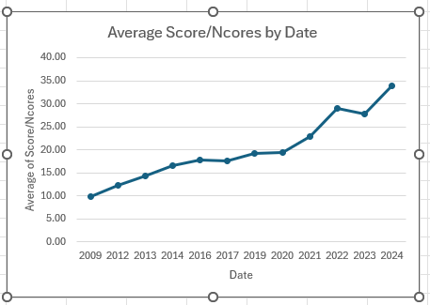
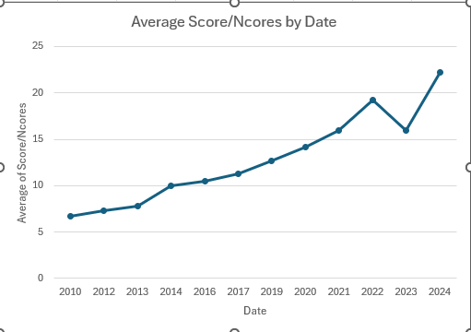
HEPSCORE Performance Scaling
Performance per Core
AMD EPYC 9845 CPU = 32.5 Hyperthreading On
Hyperthreading On
Hyperthreading Off
6130 CPU
6130 CPU

