Slide 1
Funding and strategic landscape: Transformation, DRI funding of compute and resource allocation
Jon Hays
IRIS Collaboration Meeting
20th October 2026

Slide 2
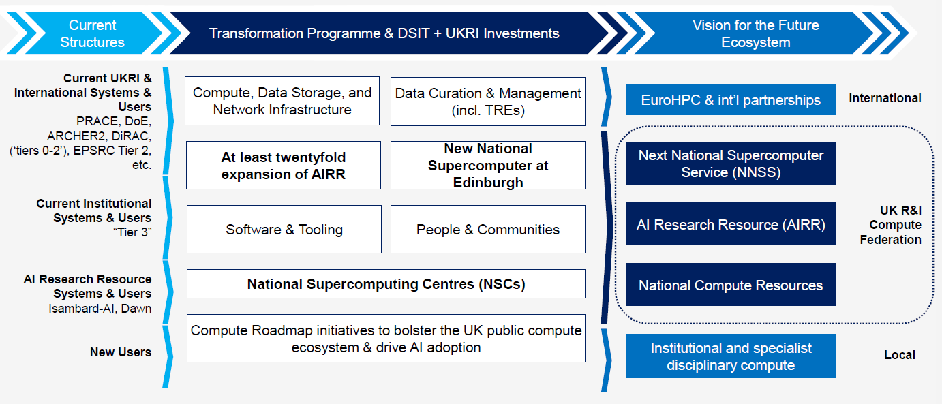
UKRI and DBIST: Vision

Slide 3
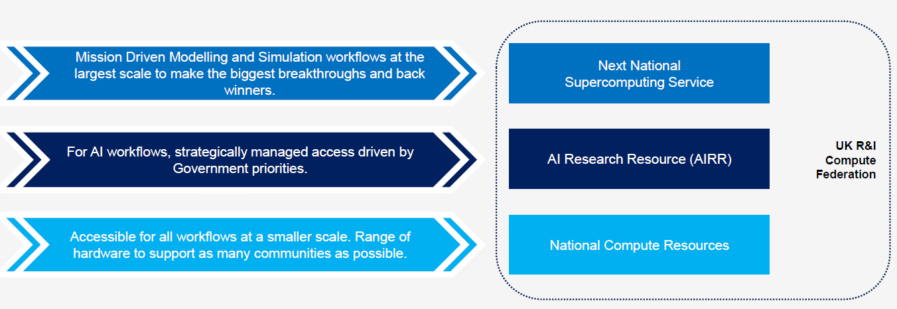
UKRI and DBIST: Service provision

Slide 4
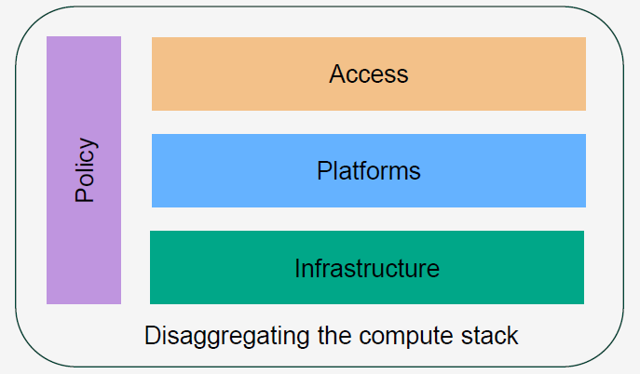
Delaminating the stack

Slide 5
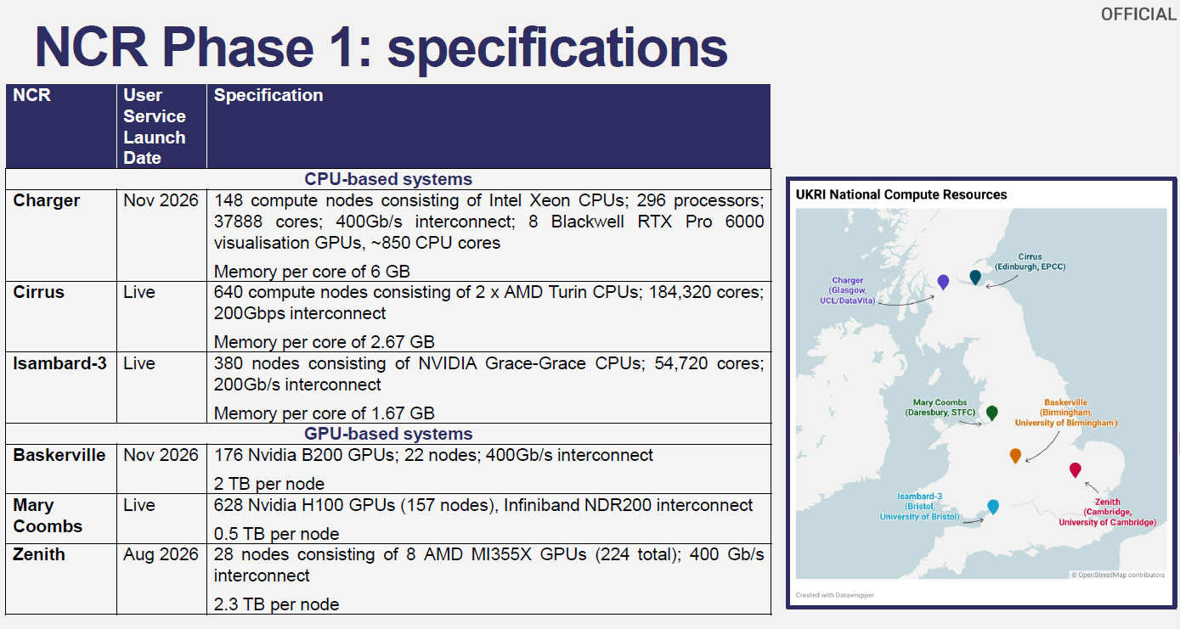
National Compute Resources
No mention of storage or services

Slide 6
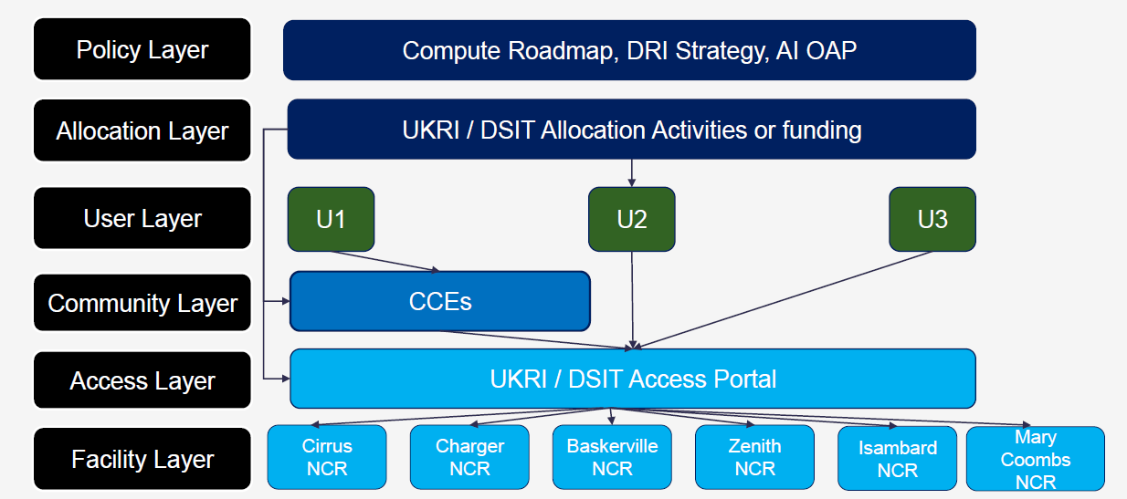
Access…
3 access modes
U1: Community based access
U2: Grant based access
U3: Call based access

Slide 7
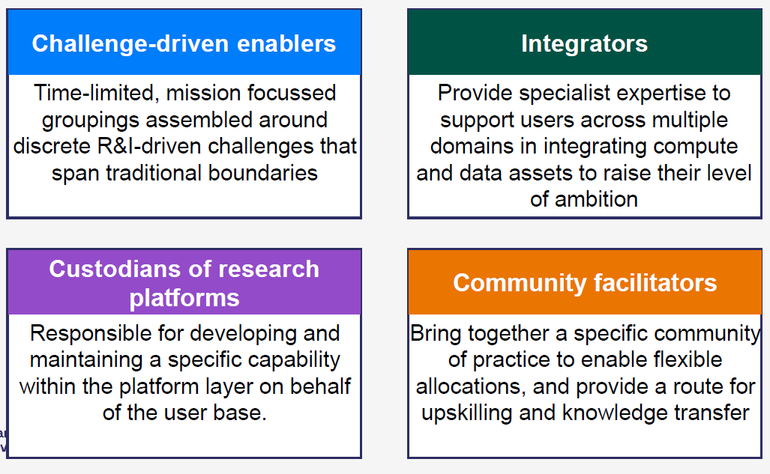
Commnity Centres of Excellence
From the August UKRI/DSIT Webinar

Slide 8
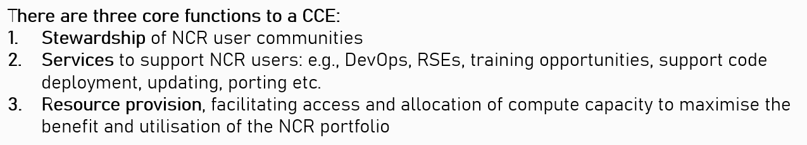
More recently
Updated at the recent HPC-AI Council Annual Meeting and through communications from the DRI team
Observation: oriented viewpoint - very much focused on extracting value for NCRs rather than supporting R&I outputs.

Slide 9
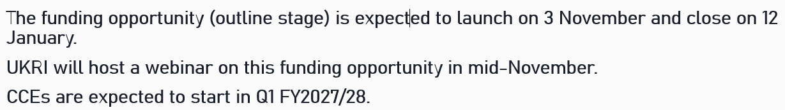
More recently
Updated at the recent HPC-AI Council Annual Meeting and through communications from the DRI team
Observation: oriented viewpoint - very much focused on extracting value for NCRs rather than supporting R&I outputs.

Slide 10
Where does IRIS sit?
Some thinking on this… prior to announcement of CCE etc
IRIS-IAM
IRIS-ACT
IRIS-ALL
IRIS-HLP
IRIS-FED
IRIS-DB
IRIS-PA
IRIS-TWG
IRIS-RSAP
IRIS-GOV
IRIS-BAT
IRIS-VRE
IRIS-GRD
IRIS-CON
IRIS-PLT
IRIS-CLD
IRIS-HTC
IRIS-HPC
IRIS-DAT
IRIS-HDW

Slide 11
Where does IRIS sit?
IRIS-IAM
IRIS-ACT
IRIS-ALL
IRIS-HLP
NFCS-FED
IRIS-FED
IRIS-DB
IRIS-PA
IRIS-TWG
IRIS-RSAP
STFC-IRIS
IRIS-GOV
IRIS-BAT
IRIS-VRE
IRIS-GRD
IRIS-CON
IRIS-PLT
IRIS-CLD
IRIS-HTC
IRIS-HPC
DRI-NCR
IRIS-DAT
IRIS-HDW

Slide 12
Where does IRIS sit?
Federating services, community centre of excellence, hardware and related services?
IRIS-IAM
IRIS-ACT
IRIS-ALL
IRIS-HLP
IRIS-FED
IRIS-DB
IRIS-PA
IRIS-TWG
IRIS-RSAP
IRIS-GOV
IRIS-BAT
IRIS-VRE
IRIS-GRD
IRIS-CON
IRIS-CCE
IRIS-CLD
IRIS-HTC
IRIS-HPC
IRIS-DAT
IRIS-NCR
How might IRIS make use of other NCR services?

Slide 13
IRIS as CCE
Community engagement across over 30 activities
Community based allocation
Community based support
Hardware provision (not CCE function)
Requirements gathering – should be CCE function but isn’t listed at the moment
Given we don’t currently have access to NCRs how can we be a CCE?
  Bit chicken-and-egg at the moment.
  Existing NCR hardware not ideal for IRIS use

Slide 14
DRI funding
IRIS has received in excess of £1m / year from DRI as an existing infrastructure
New funding approach:
  Target Activities:
    Pilot projects or activities with limited user base
    Discipline specific in nature or unproven user base
    Experimental
    Typically based on brief from council level
  Shared Activities
    Where collective action is needed
    Enabling across multiple domains
    Best achieve through collective action
    Typically based on brief from DRI level
Should be able to come up with examples for this – lots of development work to be done
This is more challenging – requires direction to-from DRI

Slide 15
Conclusion
Lots of change
Shape yet to fully form
Opportunities to benefit but risks as well

