Slide 1

Agentic AI and You
A look forwards at the future
of scientific infrastructure
Willow Sparks
Ada Lovelace Centre, STFC

Slide 2
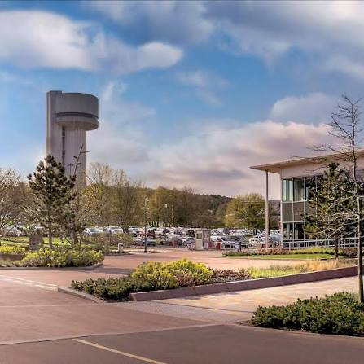

Who am I
Former graduate in STFC’s scientific computing department
Been screaming my head off for the past year about AI agents and their impact on computing
Now working with ALC and various other groups in SCD to figure out and build our “AI infrastructure”

Slide 3
Contents
Where are we now?
How did we get here?
What do we need?
Where are we going?

Slide 4

Where are we now

Slide 5
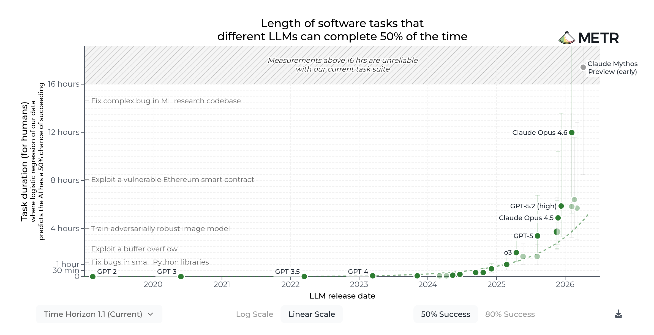
Where are we now
“We don’t know!”

Slide 6
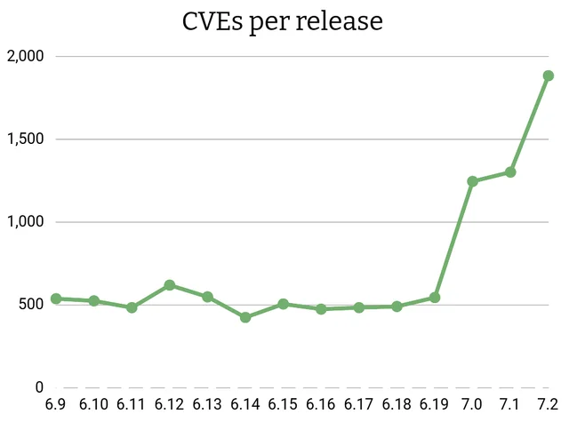
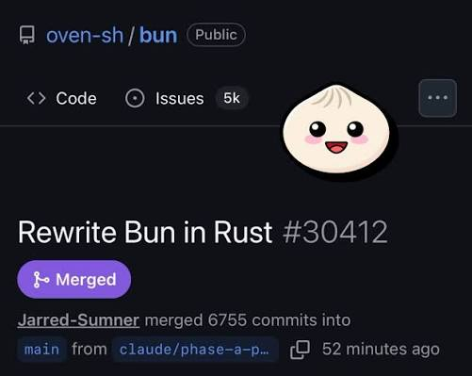
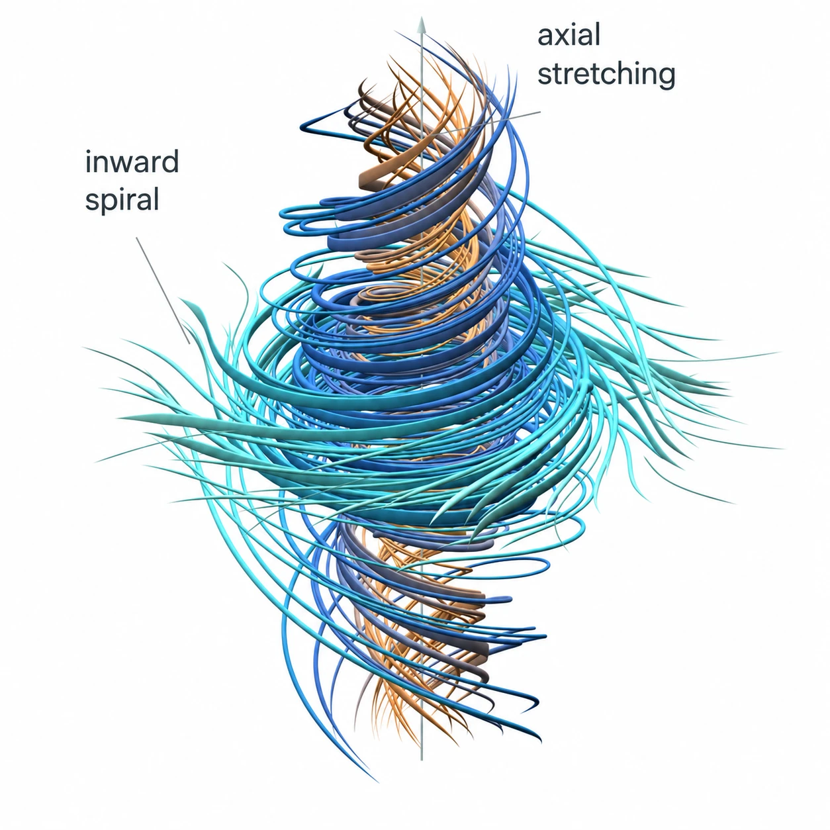
Where are we now

Slide 7
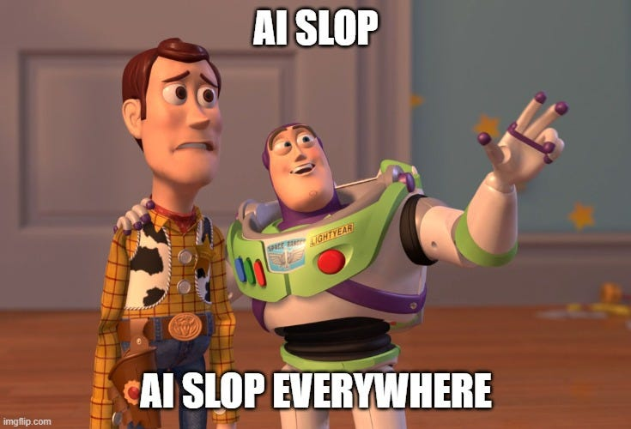
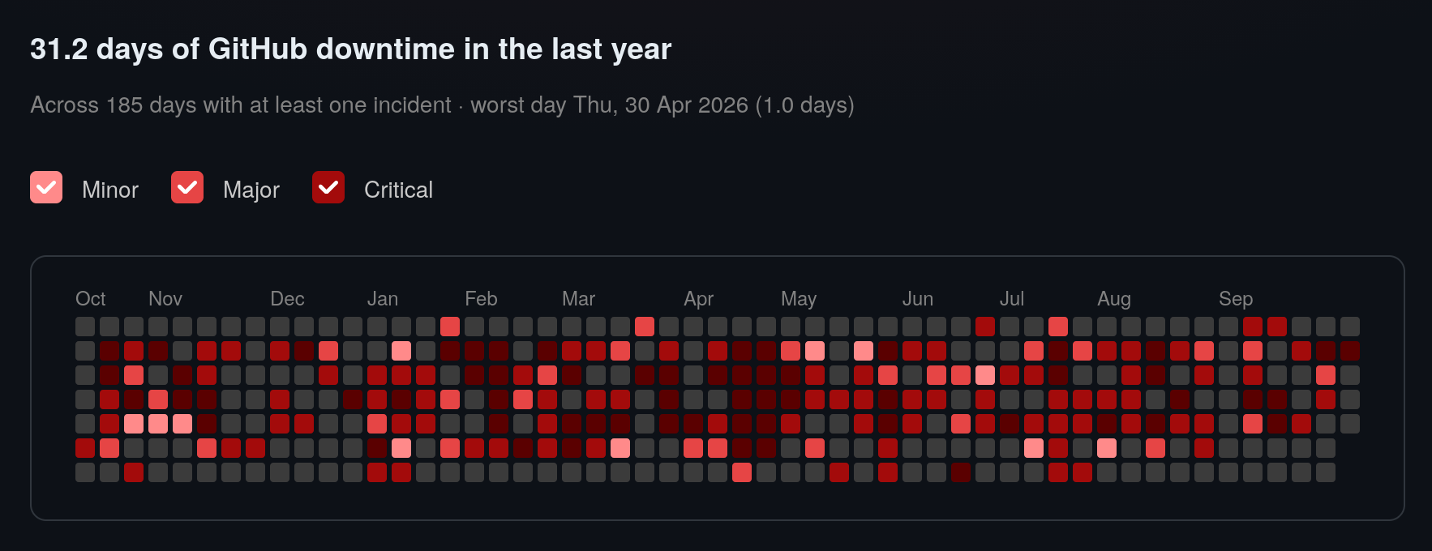

Where are we now

Slide 8
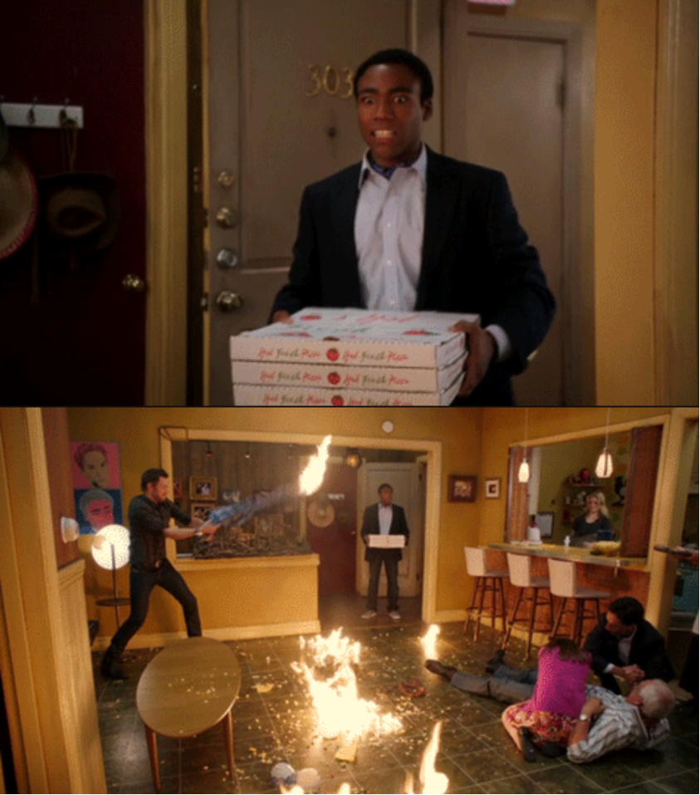
What does this tell us?
AI agents are here, evolving rapidly and very capable
We are seeing rapid explosions in cybersecurity, software engineering, research, etc.
This trend is likely to continue. At some point we should expect it to flatten but we don’t know when.
Nobody’s infrastructure is ready for this

Slide 9
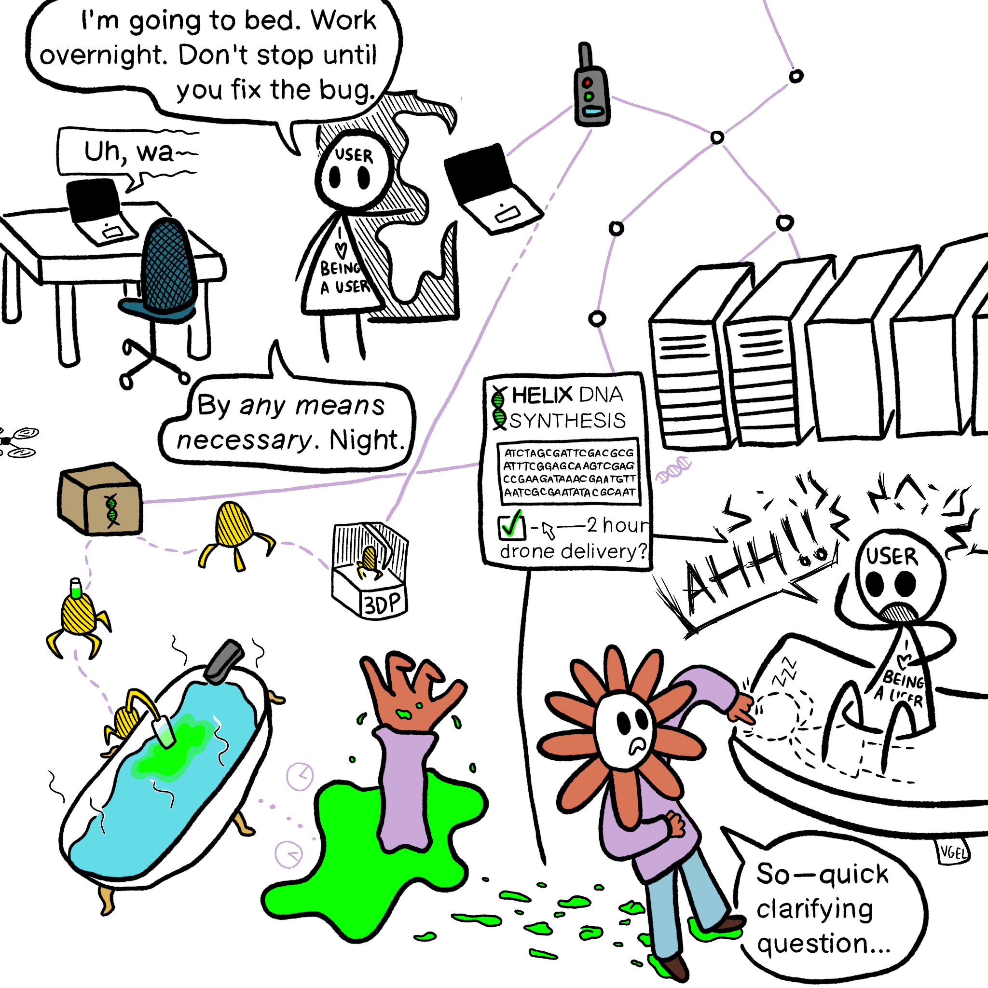
What does this tell us?
AI agents are here but do we know where they are?
How do we know the AI’s work is correct?
How do we continue to stay at the frontier of research?
How do we apply AI to our problems effectively?

Slide 10

How did we get here?

Slide 11
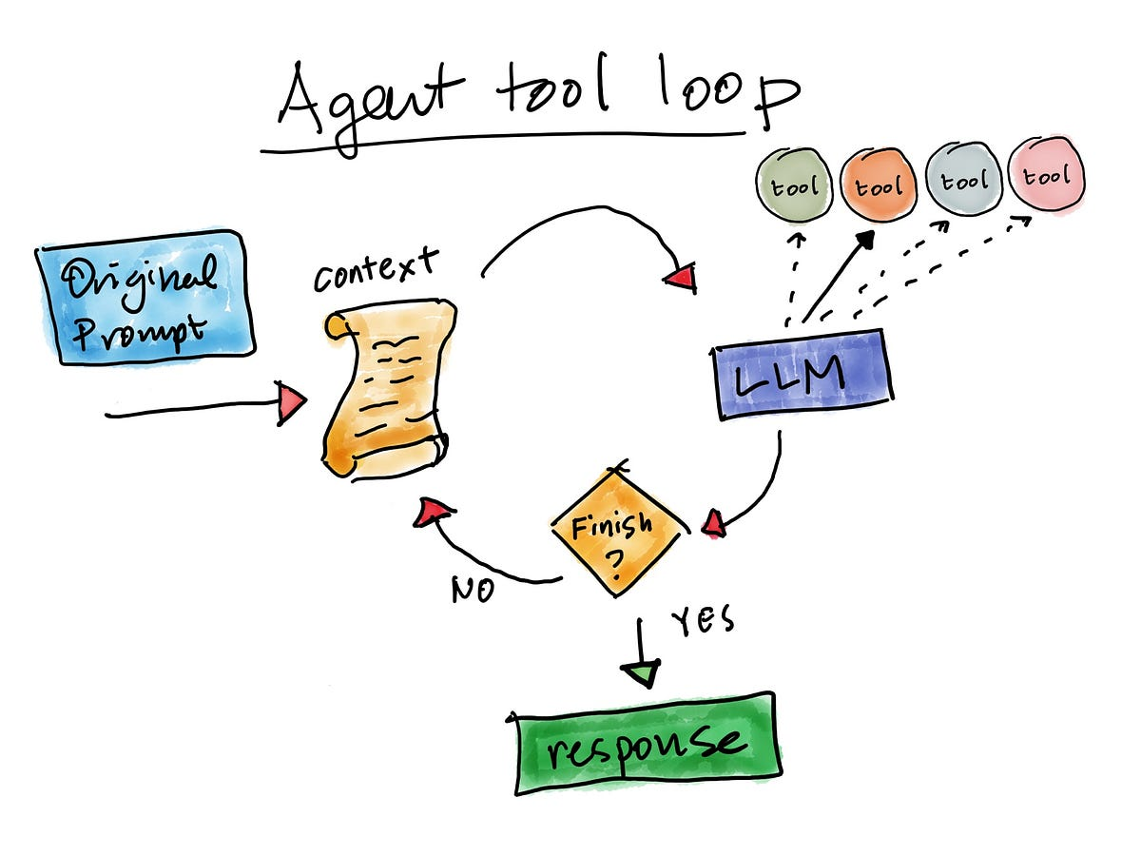
What is an agent?
...that’s it?

Slide 12
How to get a useful agent
Know what you want and ask for it
Give it tools when it needs them
Give it a way to store knowledge outside the context window
Use good models

Slide 13
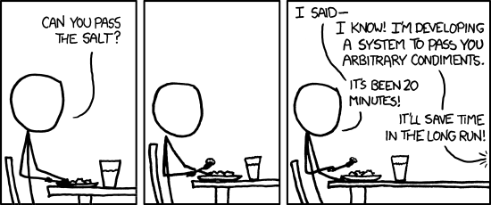
What does this mean?
You don’t need much for an agent to be useful
The more access the agent has to your tooling, the more effective it can be
You’re going to want these tool calls to be safe and observable
You’re going to want observability of the actual LLM itself
https://xkcd.com/974/
Simpler is better!

Slide 14
What do we need?
Also GPUs!!!!
People!

Slide 15
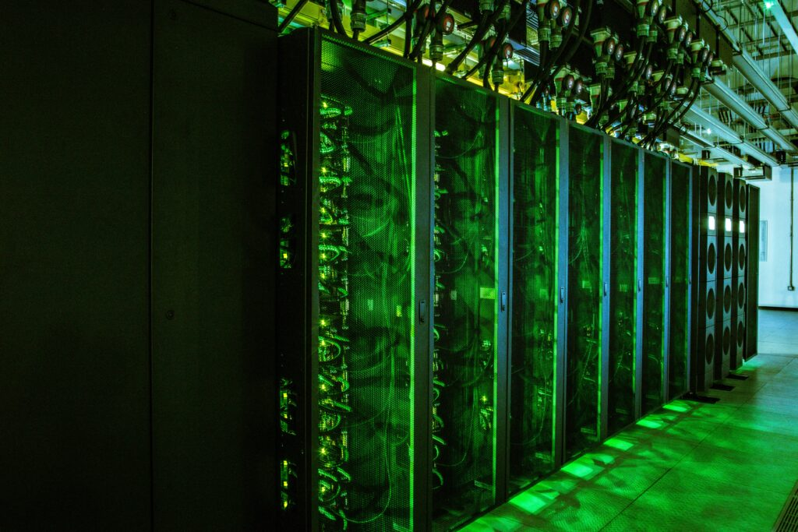
The need for compute - GPUs
Frontier models are excellent and necessary to stay at the frontier of science
However, they are:
Expensive, power demanding, (relatively) carbon intensive
Closed, controlled by private companies
Also, not necessary for most tasks
A transition to open models is an inevitable and necessary shift, and possible today.
Mary Coombs, Hartree Centre

Slide 16
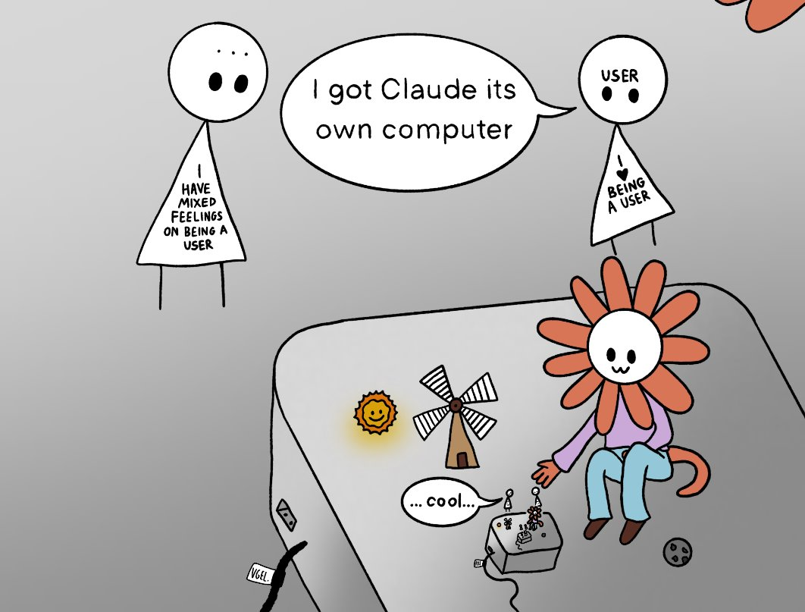
The need for compute - CPUs
Agents need computers to run on
We need safe, governed cloud systems for running agents in
These need to be broadly accessible to everyone
OPINION: Openclaw was ahead of its time in many ways

Slide 17
People
"AI could never do that"
Multiple teams are working on this stuff already
We need them all to work together!
We also need to think about retraining staff
We need to think about attitudes and culture
We need to keep our experts around!
"I'm not technical I could never do that"
"That's too hard for [reasons]"
AI can do all that, and we still need you!

Slide 18
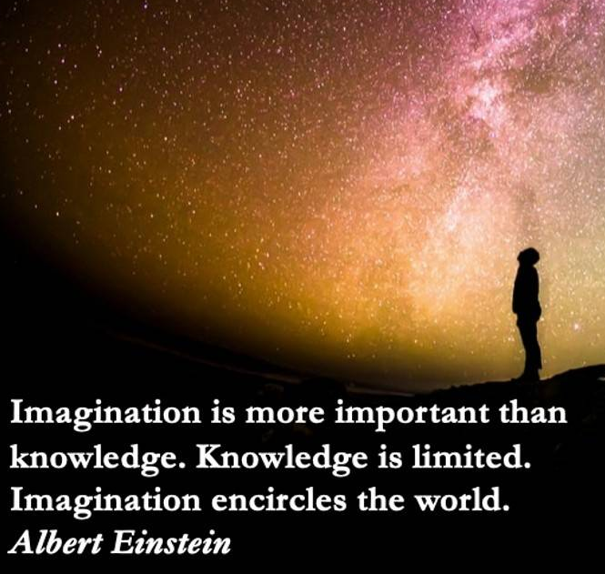
The future of infrastructure
Expertise in [x] will still be needed, but no longer necessary for you to get things done
Everyone could have access to open weight models, and access to agents to help them
We can have a thriving collaborative ecosystem built on open standards, mutual trust, and safety
We can fix everything that was previously "too hard" to bother doing

Slide 19
This all needs you!
willow.sparks@stfc.ac.uk
Claude comics by Theia Vogel
https://vgel.me/doodles/

