Slide 1

Ada
What Science Needs - And What It Can’t Get Today.
Jeremy Spencer – 20/10/2026

Slide 2

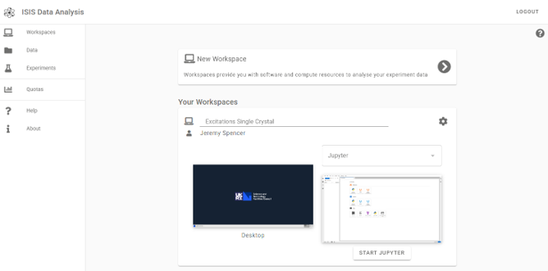
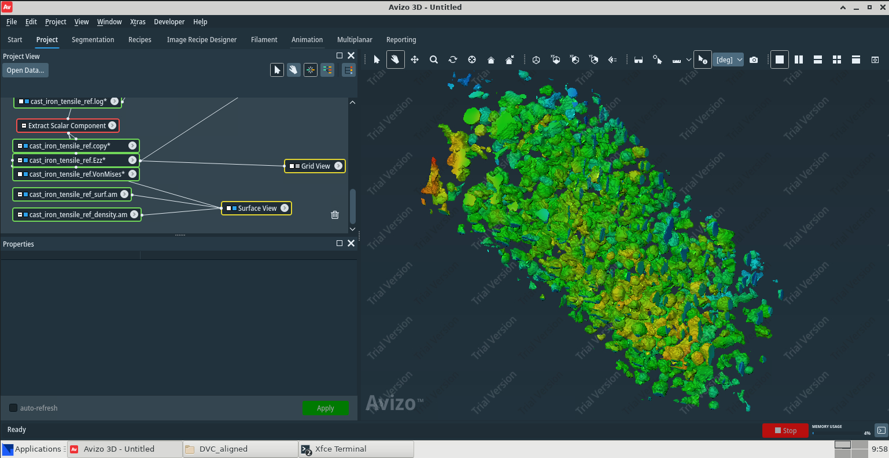


Ada
DAaaS Group (Data Analysis as a Service)
  Provides Ada
    https://ada.stfc.ac.uk/
  Part of Platforms & Services in STFC Scientific Computing
  Funded by the Ada Lovelace Centre
Ada
  Interactive remote desktop sessions and notebooks for data analysis
  Brings together data, software and compute resources for a variety of scientific workflows
  Primary focus on STFC Facilities
  Training interface enables interactive sessions, removes setup time on the day
  Developer interface eases research software testing, deployment and debugging in Ada Workspaces
Notes:
DAaaS Group:
The DAaaS group develops and runs Ada (called IDAaaS when used by ISIS).
For more information about Platforms & Services in STFC Scientific Computing, see Tom Dack’s talk in the session five introduction.
The Ada Lovelace Centre funds the staff effort to develop and support Ada for STFC Facilities
Ada – Simple access to:
Interactive workflows
Remote desktop
Web based software (Jupyter, etc)
VMs preconfigured with required software and data access
We’ve taken over a hundred software applications and taken care of the deployment, so that software can be accessed by any of our users by simply selecting it from a menu.
We enable facility data to be copied into our system with appropriate permissions

Slide 3
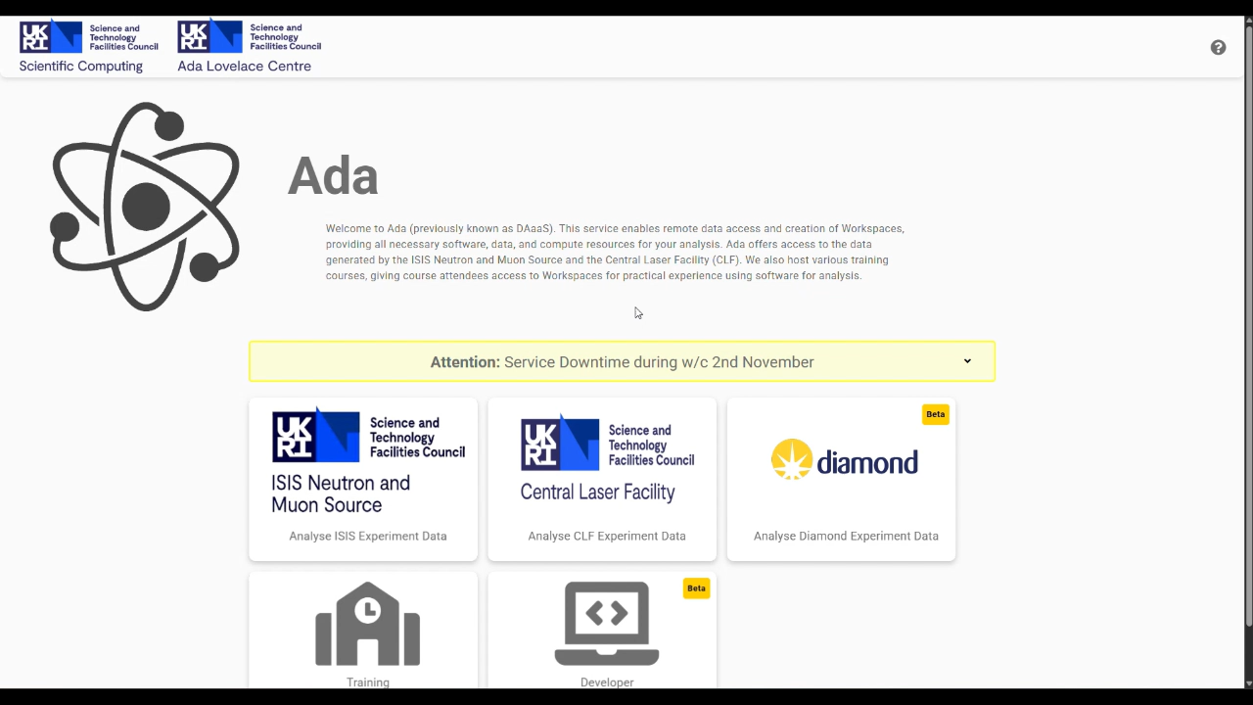

Slide 4

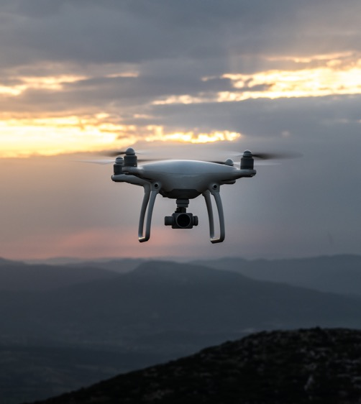

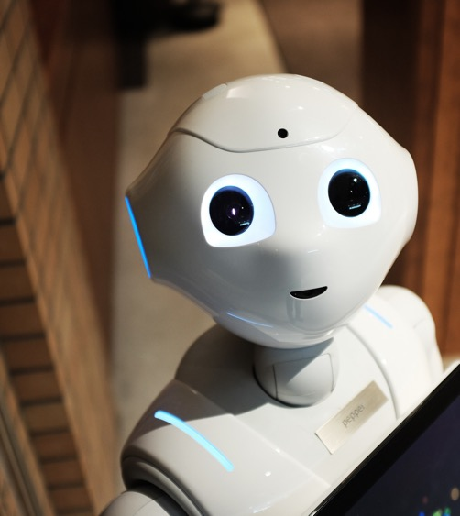
What Science Needs
Experiments
    Pre-experiment
    During experiments
    Post-experiment
Training (people)
    Teach others how to use workflows
    Test and demonstrate new applications
AI Workflows
    Increasing demand here
    Training models, utilising those models
Notes:
Science needs compute resources to run experiments.
To prepare for experiments.
Simulations of the samples, but also the beamlines, designing new instruments.
Analyse data during experiments to guide the experimenter.
Where are the interesting features?
Do parameters need changing in subsequent runs?
Analyse data following the experiment. Further investigations, writing up papers, etc.
To teach others how to use these same techniques.
To test and demonstrate new techniques or applications.
AI Workflows - increasing demand for training models and utilising those models
Training AI models
Utilising trained models

Slide 5
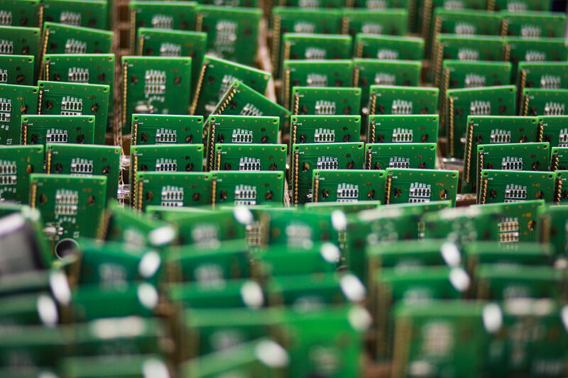
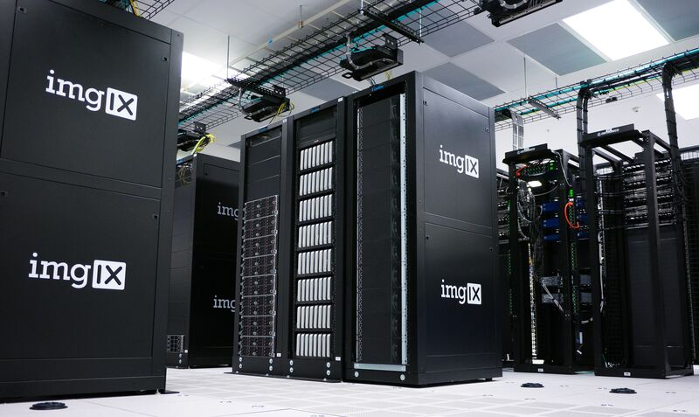


What it can’t get today
Cost of compute rising
    Resource requests only partially filled
    CPU & RAM (large RAM requirements)
    Visualisation GPUs
    Compute GPUs
Guaranteed burst capacity
    Training courses cause spikes in usage
Cloud-level fail-over
    Time-sensitive work (expensive beamtimes)
Notes:
Computing hardware is getting more expensive in general, with RAM and GPUs rising in price dramatically.
So IRIS resources are limited, some of our requests for STFC’s facilities are half fulfilled.
In the case of visualisation GPUs, ISIS has been left without any supplied from IRIS despite demonstrating use over the last 7 years.
Demand for Compute GPUs is high with increasing pressure for AI workflows needing them for training and using models.
The short term training courses we run cause a spike in resource usage, for example last week we required 30 more visualisation GPUs than this week.
Not being able to guarantee these resources will be available on the day makes it difficult to plan such events and opens the organisers to the risk of not being able to run the course.
With limitations on hardware resources, there is very little capacity for fail-over systems to use in the even of downtimes.
In some cases this is very costly.
If you’ve applied to run an experiment at an STFC facility you’ll have waited months or even years for your chance.
If you can’t check your data in good time then the quality of the data you collect will be reduced and you will have missed your opportunity.
This impedes research and changes the course of people’s careers.
We’ve been looking at deploying systems on commercial clouds for certain resources, burst capacity and fail-over in the absence of on prem solutions.
Also oversubscribing resources for out of experiment analysis to squash less time sensitive work into the same hardware.
Ultimately, we may need to remove access to these resources for those not currently performing experiments and dropping some of the support for pre and post experiment analysis.

Slide 6

Thanks
Questions?

