Slide 1
IRIS at a Crossroads
Jon Hays
IRIS Collaboration Meeting
20th October 2026

Slide 2
Funding
Funding is a point of crisis at the moment
  Though IRIS allocation of funding has increased, increases in hardware pricing, and legacy of underfunding mean this is far from sufficient to even maintain existing services
Need to look for more diversity in funding
  UKRI targeted funding?
  Project attached funding?
  Other sources for development work?
  CCE funding?
Need both limited duration funding for development and long term stable (and demand driven) funding for infrastructure

Slide 3
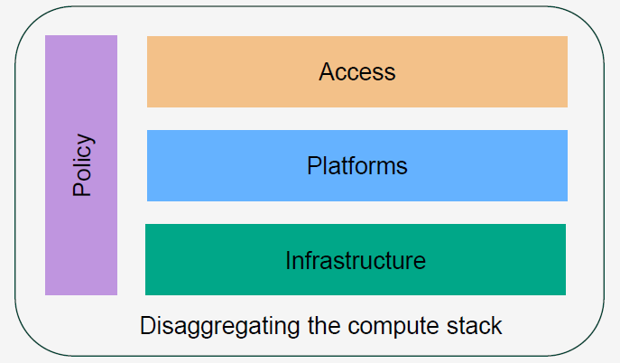
Delaminating the stack
Does aligning with this offer opportunities?

Slide 4
What would it look like?
IRIS-IAM
IRIS-ACT
IRIS-ALL
IRIS-HLP
IRIS-FED
IRIS-DB
IRIS-PA
IRIS-TWG
IRIS-RSAP
IRIS-GOV
IRIS-BAT
IRIS-VRE
IRIS-GRD
IRIS-CON
IRIS-PLT
IRIS-CLD
IRIS-HTC
IRIS-HPC
IRIS-DAT
IRIS-HDW

Slide 5
IRIS Governance and Operations Model
Two elements:
  Current governance model is becoming insufficient for our needs
  Current operating model is becoming insufficient for our needs

Slide 6
IRIS Governance
Driven by three key elements:
Changes within STFC
Introduction of CAP, transformation etc
Changes within DRI
Emergence of DRI operating models – NCR, CCE etc
Changes in IRIS
Growing number of science activities – scaling challenges
Strategic questions:
Should IRIS grow further? Other groups?
How should governance improve to support change?

Slide 7
IRIS Governance
Key issues:
  Current structure doesn’t quite reflect the real nature of the project as programme within National Labs.
  Doesn’t map onto how programmes run with PPAN at all
  Reporting upwards still undetermined
  -> Is this the right way to run things?
  Single DB is simple and functional
    Is it representative enough?
    Management of apparent conflicts of interest? (eg providers sitting on the DB that approves their funding)
    Is the remit appropriate?

Slide 8
IRIS Governance
Key issues:
  Missing technical review of provider solutions and associated matters
  How to manage shortfalls in capacity? Currently try to balance across activities – only SB can tension science – is there a responsive way to do this?
  Managing timelines of funding, allocation, procurement, etc.

Slide 9
IRIS Operating Model
Provision of services:
  Federating services:
    Accounting, IAM, helpdesk, federated data, workflow management etc
    How do we move to more integrated approach with a key set of well-defined services?
  Hardware and related services:
    Improving job portability
    Improving reporting
    Benchmarking
    Technical coordination
    Provider funding? Meet challenges of rising prices and varied costing situation across providers – need to stretch the assets but how to do this in a fair way?

Slide 10

IRIS and Federation
NFCS has submitted its report
  Clear that IRIS has lots of experience with federation both directly as well as through its partners
IRIS as an exemplar of community led federation?
Opportunity to broaden IRIS operations?
Additional funding?
EOSC – current work on-going to understand pathway and potential for an EOSC UK Node.
  Clear that IRIS and its partners have much of the framework for this in place
  IRIS as a use-case

Slide 11

Where next?
Clearer catalogue of federating services
Stronger technical coordination and review
Governance appropriate to scale of IRIS
Mixed model for funding
Alignment with CCE, NCR, NFCS, and EOSC
Broadening of support to additional communities

