Slide 1
Gaia IRIS Resource Request
Two separate aspects:
Gaia Core Processing Feasibility Assessment
UK commitment to pan-European Data Processing and Analysis Consortium treating Gaia telemetry
PBs of persistent storage from 2023 onwards
Gaia Archive Science Platform Development and Deployment
End-user service for publicly released data products
10s to 100s TB persistent storage from 2020
Both require big data hosting as well as cluster HPC (for further details please see the Gaia RRD)

Slide 2
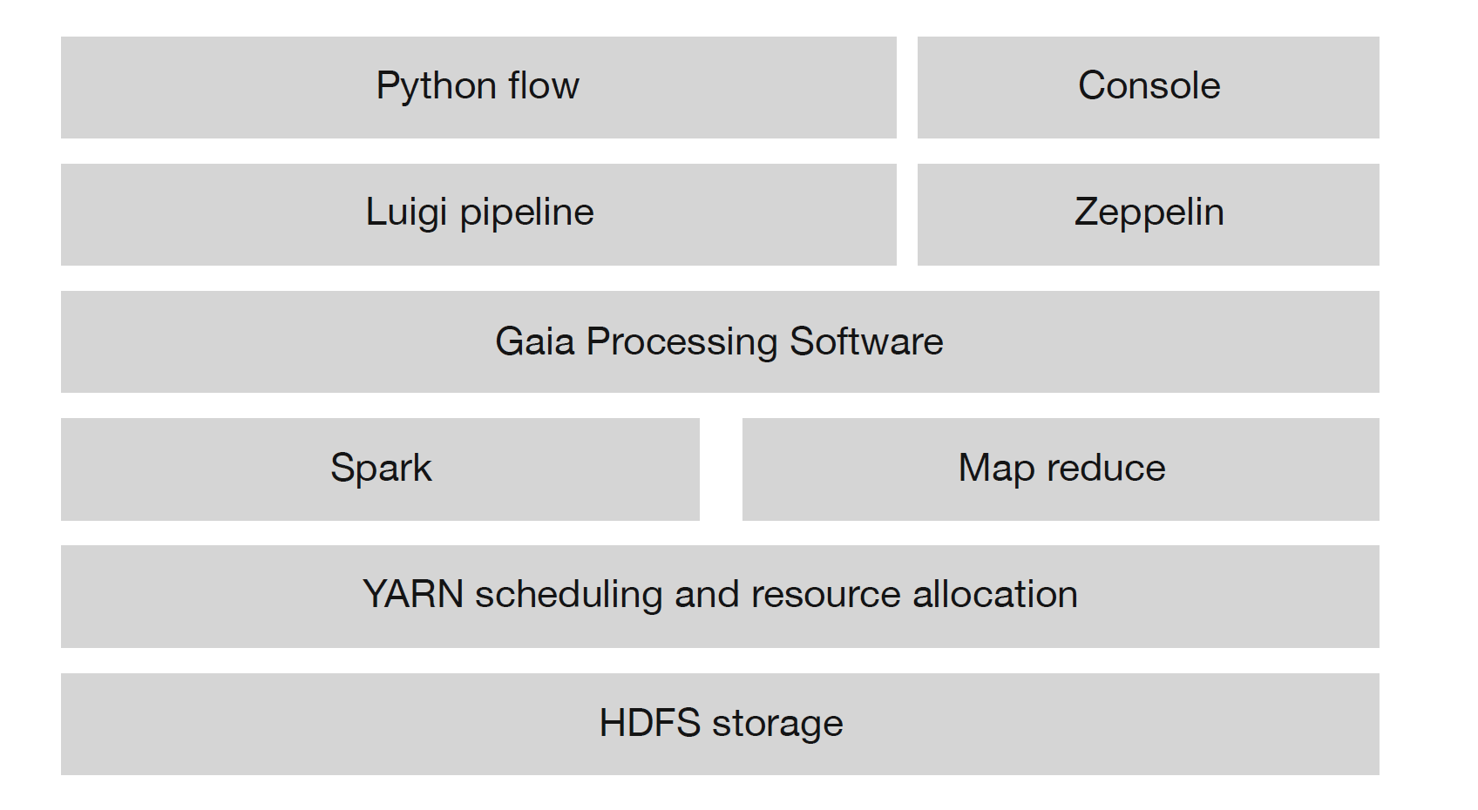
Core processing computing model

Slide 3
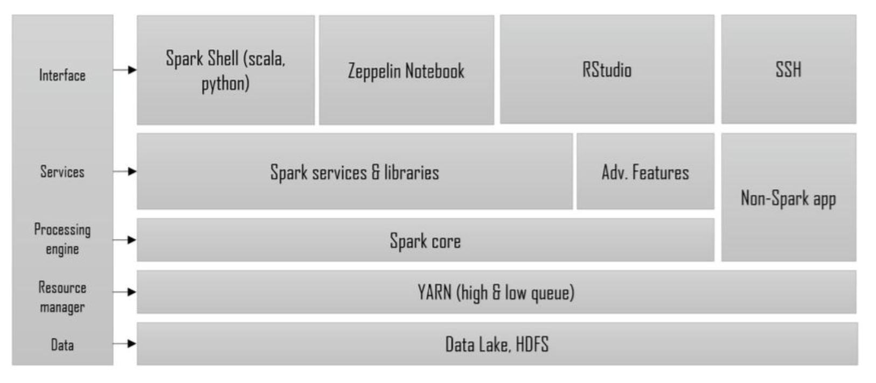
Science Platform computing model

