Slide 1
LSST:UK Plans for IRIS in 2019, and beyond
LSST:UK Consortium begins Phase B of preparations in April 2019
  Gearing up for telescope Commissioning in 2020—2022
Four projects, in 2019, require IRIS-scale infrastructure to progress
  Jupyter Notebook Service for analysis of feed from LSST precursor
  Contribution to DESC Data Challenges 2 and 3
  LSST:UK DEV experiment, optimising sky-subtraction for LSB sources
  LSST:UK DEV experiment, LSST and near-IR data fusion

Slide 2
Jupyter Notebook Service for Lasair
LSST:UK receiving feed from ZTF
  Precursor for LSST Transients
Nightly alert stream ingested, filtered and cross-matched, to identify interesting new phenomena
User interface via web forms/ Jupiter Notebook service

Slide 3
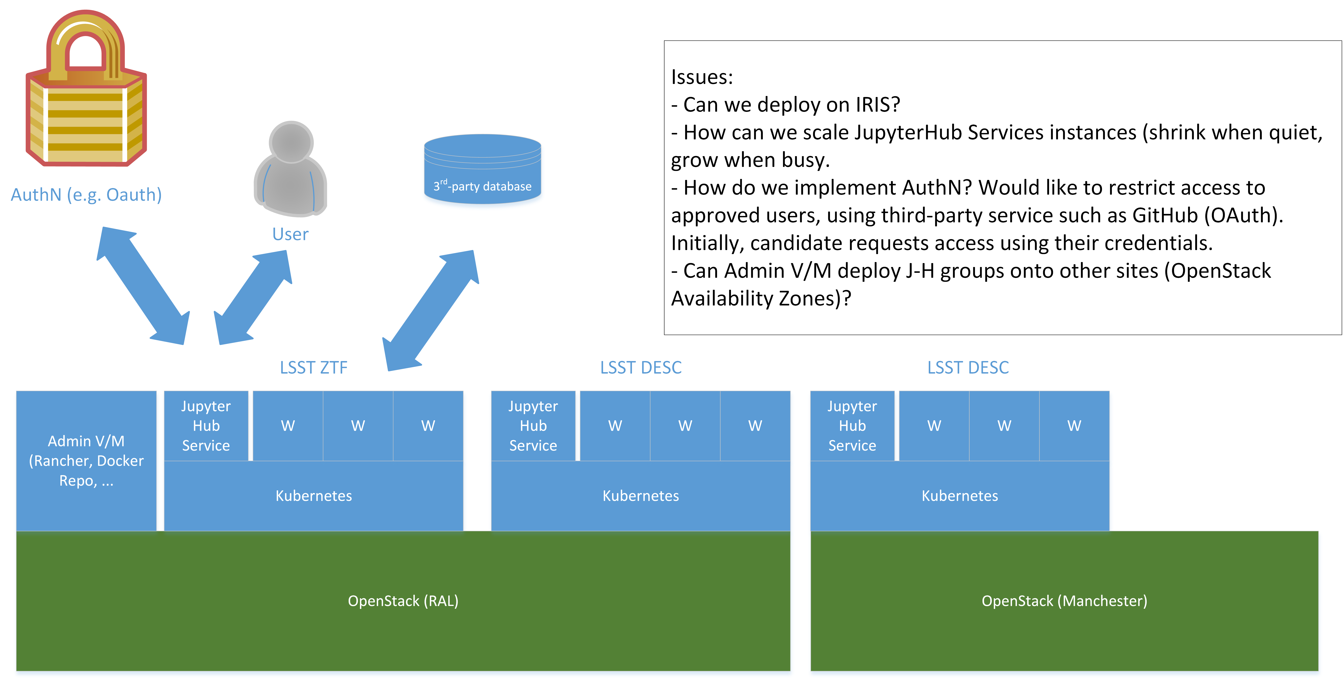
Jupyter Notebook Service for Lasair
Technology Preview running on test-bed system at ROE
In 2019H1, move to IRIS hosting and open up to wider user base
OpenStack/ Kubernetes for auto-configured/ scalable service instances
Open questions
  AuthN / AuthZ
  Working storage for users

Slide 4
DESC Data Challenges
Dark Energy Science Collaboration (DESC) conducting ambitious, end-to-end simulation of how LSST will see the Universe
  Scaling up over series of Data Challenges
Telescope simulator (ImSim) generates images survey
  Based on observing schedule
  And sky map seeded with synthetic, interesting sources
Image generation estimated to require 70M core hours for DC2
  DC3 requirements to be finalised, though will be at least as expensive
High-throughput workflow of O(10⁵) independent jobs
  Modest input (shared instance catalogue)
  Complete set of output images (FITS) occupies ~300TB

Slide 5
DESC Data Challenges
Simulations undertaken in US national labs (NERSC Cori and ANL Theta) and in UK (IRIS)
  Early progress to orchestrate campaigns using Parsl
Open question about most appropriate IRIS interface
  Either: build on previous DC2 runs using GridPP, but with DiRAC client
  Or: follow Euclid approach, using SLURM-as-a-service
Output images transferred to IN2P3 (France) for processing
  To clean images and generate astronomy catalogues
LSST:UK wishes to copy astronomy catalogues (from IN2P3) to IRIS High-performance Database Service in Edinburgh

Slide 6
Optimising sky-subtraction for LSB sources
LSST provide unprecedented view of low-surface-brightness (LSB) sources, ‘invisible’ in previous surveys
UK leadership/ significant interest in LSB for galaxy-evolution studies
Default LSST pipelines likely to corrupt LSB sources
  LSST:UK must refine alternative processing to avoid this
Work undertaken on mock data (from pre-cursor surveys)
  Building up to validation during LSST Commissioning phase
Series of HTC-like experiments to calibrate process
  Each experiment is O(10⁴) core hours, w/ modest parallelism (10s cores)
Candidate for SLURM-as-a-service interface?

Slide 7
LSST and near-IR data fusion
Adapt LSST pipeline workflow to support dual-photometry pipeline
  Joint processing of LSST sources w/ those from infra-red surveys (Euclid)
Develop workflow and software, ready to generate multi-wavelength optical-infrared astronomy catalogues in LSST era
Series of HTC-like experiments to calibrate process
  Each experiment is O(10⁴) core hours, w/ modest parallelism (multi-core)
Candidate for SLURM-as-a-service interface?
Output catalogues and image sets (300TB) will have scientific value, so will be hosted (on IRIS storage?) for downstream analysis

