Slide 1

Diamond and IRIS
andrew.j.richards@diamond.ac.uk
Notes:
The Future depends on what we do in the present (Mahatma Gandhi)
- a brief precis of the function and scope of the group (1-2 slides)
- the broad history of the group, key achievements over the lifetime of Diamond (1-2 slides)
- a short focus on the past 12 months – key achievements and challenges (2 slides)
- a short focus on the next 12 months – key milestones and aspirations (2-3 slides)
- conclusion (1 slide)

Slide 2
What has been achieved?
What is going well?
What is going less well?
What is expected in 2019
What activities do we already have underway that might help?
What more do we need to do?

Slide 3
Bakground: Data Flows
24/6 Operation, ~5000 hours beamtime per year
~9000 visits per year
~30+ Operational Beamlines
~6+ Operational EM
+ data from external sources e.g. EU-XFEL
Producing up to ~60TB per day
  September 2018 – Archived 693TB
Currently 17PB in archive, 6PB last year
Planning for Diamond – II underway (2025)
  Will increase flux and coherence
  = Higher throughput, new detectors, higher data rates.

Slide 4
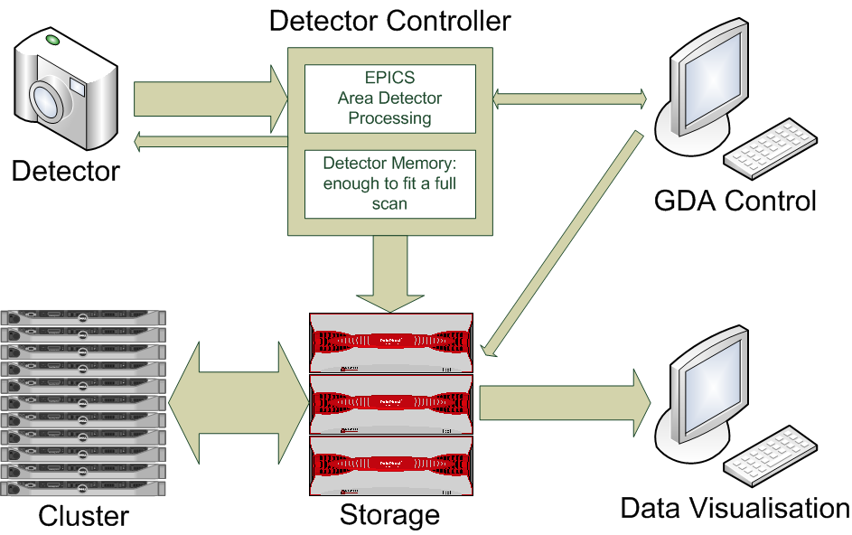
Data Flow

Slide 5
Achieved: Cloud Project Aims
To explore the usage of ‘cloud’ technologies for the processing of scientific, experimental, data at Diamond. Define three use cases for exploratory, proof of concept project.
Use Cases:
UC1 – Cloud Bursting
UC2 – Post processing in the Cloud
UC3 – Archiving data to the Cloud / Cloud based Data Repository* - Open Data Agenda

Slide 6
Ongoing Development
Recruited dedicated Cloud lead person
  Chris Reynolds
Developing Cloud Strategy Working Group
Existing projects using ‘Cloud’
  XChem Workflow
Ongoing trial engagements with IRIS, Google, AWS, Azure

Slide 7
Current Challenges
Work in Progress
Current infrastructure is monolithic.
‘One system’ for data acquisition, analysis and increasingly post-visit analysis, restaging of data.
  Competing requirements for all of Diamond’s activities
Start of separation between online and offline processing

Slide 8
‘Big’ Data Lifecycle challenges
How much do you mean by BIG?
How ‘FAST’ do you need to analyse the data?
What data can be THROWN AWAY?
  (and at what stage?)
How LONG do you need to keep the data?
Open Access ?
And WHERE? Where do you want to transfer the data to/from?
And WHERE do we best do Post-Processing?

Slide 9
2019 Development Plans
Offline / Post Processing – enabling users to process data sets beyond the std. 40 day period ‘easily’
  Need to transfer data from DLS to service (driven by DLS, DLS requirement to move offsite certain types of data processing)
  Defined amount of remote storage requirement
  Defined / will accommodate defined amount of remote compute resource
  Need to install the ‘Diamond Software stack’ – via Docker/singularity preference
Burst computing – ‘top-up’ backend infrastructure for Diamond
  Transparent to end users
  Only works for defined, relatively small (depends on target site) datasets.
  Time – dependant analysis
Hosting analysis services based around Jupyter Hub notebooks – user driven/user customisable
  Need to transfer data from DLS to service (on-demand user driven service?)
  Scalable infrastructure need

Slide 10
Work to do:
Diamond Requirements from IRIS
Address ease of access
AAI: Ability to use Diamond issued credentials OR a users own institute given credentials
  Have requirements that go beyond the UK, supporting ‘other’ users via mechanisms such as Umbrella ID
Standard data transfer mechanisms
  Globus Online end points
  S3

