Slide 1
IRIS Identity Proxy Digital Asset activity
Ian Collier
STFC Scientific Computing Department
IRIS TWG F2F UCL, 23rd January 2019

Slide 2
Purpose
Provide a consistent authentication and authorisation infrastructure for accessing IRIS resources
Standards based
Drawing on AARC project blueprints
Technologies in use across industry (OATH, etc.)
Avoiding perceived problems with user exposure to X509
By providing consistent access across IRIS clouds, grid, HPC & storage we:
improve user experience
facilitate potential workflows moving from one resource to another as appropriate

Slide 3
Drawing on best experience across community
Industry standard token based AAI components
AARC blueprints
Good discussion of current evolution in WLCG here:
https://indico.cern.ch/event/587955/contributions/3012583/attachments/1685421/2709996/CHEP-2018-Beyond-X.509-AC.pdf

Slide 4
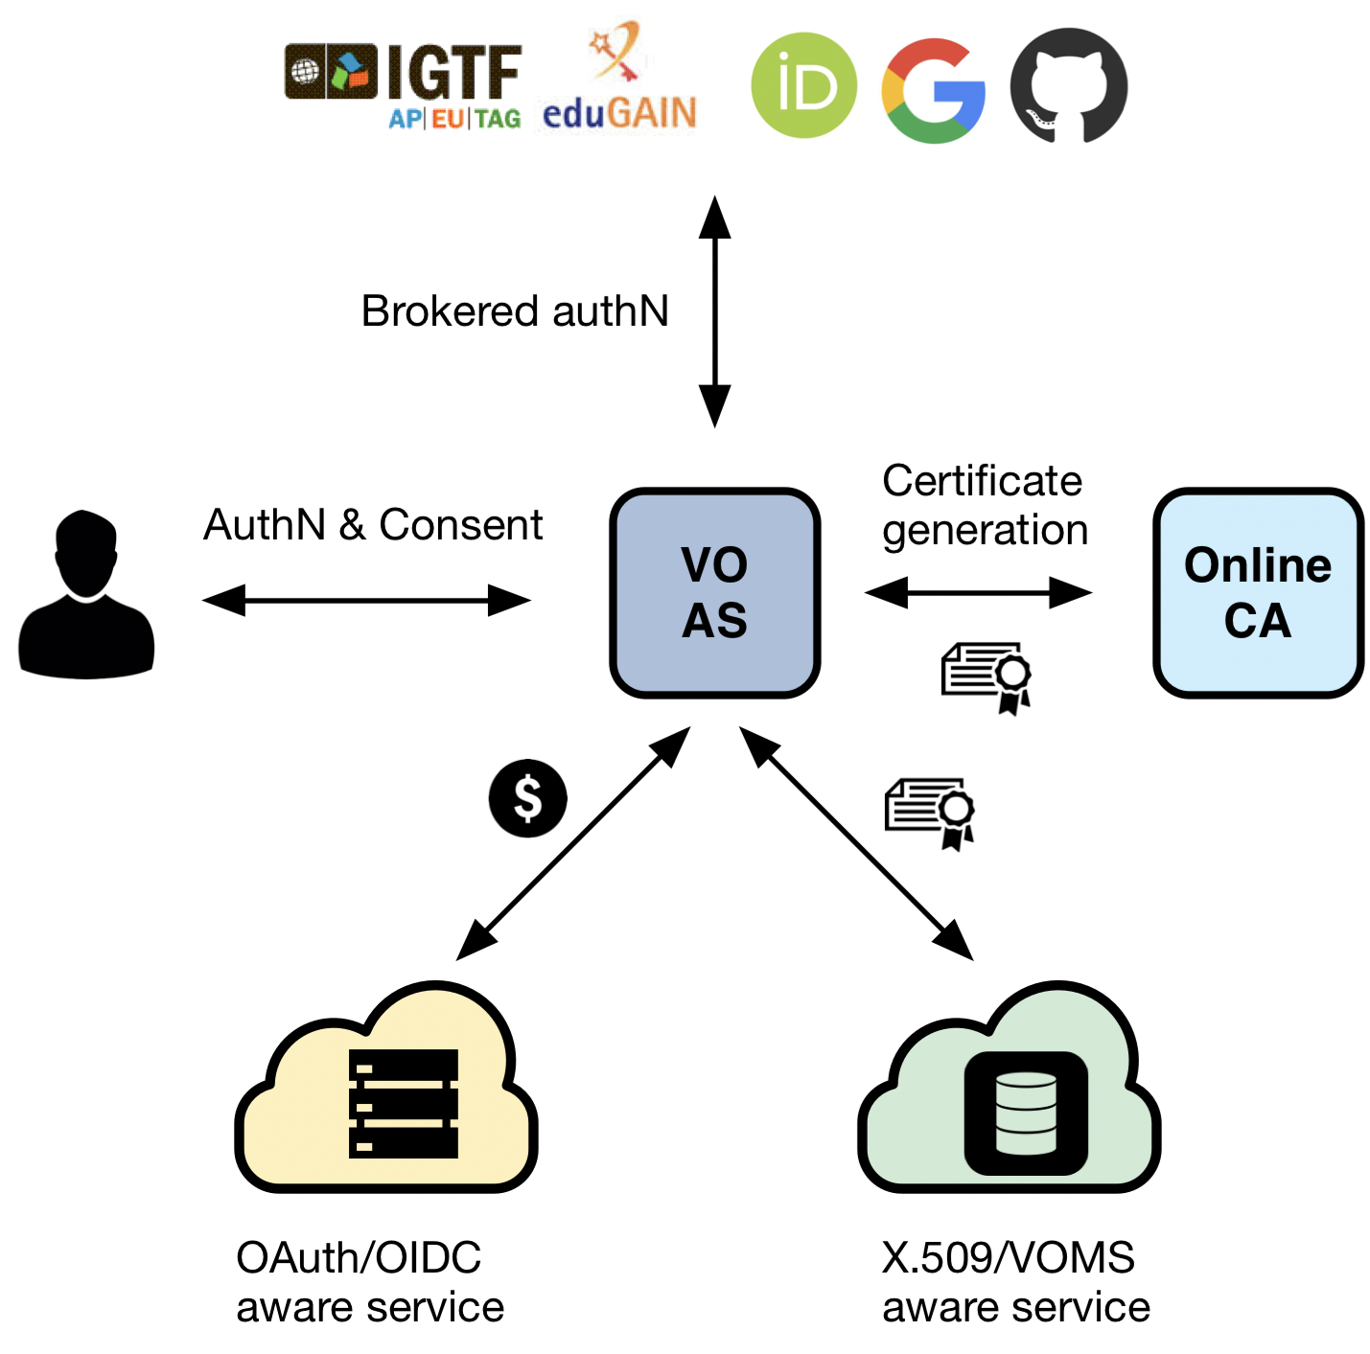
INDIGO IAM - A central VO- scoped service that
supports multiple authentication mechanisms
provides users with a persistent, VO-scoped identifier
exposes identity information, attributes and capabilities to services via JWT tokens and standard OAuth & OpenID Connect protocols
can integrate existing VOMS-aware services
supports Web and non-Web access, delegation and token renewal
Notes:
Maybe too technical for this level - the point about certificates is it's a token translation, translating people's existing identities into a certificate they can download or it can be held in MyProxy and accessed by the infrastructure there. Within EOSC Hub, which will run the RCauth credential conversion CA, I am examining importing the Pathfinder CA as an alternative to TCS (Terena Certificate Service), which would (a) make use of Pathfinder and (b) provide a more user-friendly alternative than the UK e-Science CA.

Slide 5
Building IRIS proxy service using INDIGO IAM
12PM effort
Work begun on 1st January
Building on test deployments of INDIGO IAM at RAL
First phase
Deploying INDIGO IAM 1.0
By 31st March will provide edugain access for external users of SCD Cloud, potentially also to Tier 1 batch farm and ECHO datastore
Group management by SCD staff

Slide 6
IRIS Proxy phase two
Extend to support access to other IRIS resources
Cloud and grid will be straightforward
HPC may require modest development
Integrate INDIGO IAM 2.0
Built around keycloak
Multi-tenancy
Group management can be delegated to communities where appropriate
Possible:
Assent integration
Make use of Pathfinder outcomes
Other TBD based on AAI WG guidance

