Slide 1
IRIS Identity Proxy Digital Asset
Ian Collier, Tom Dack, Jens Jensen
STFC Scientific Computing Department
IRIS F2F, April 2019

Slide 2
Reminder - Purpose
Deploy a token based authentication and authorisation proxy providing consistent secure access to IRIS resources
Standards based
Drawing on AARC project blueprints
Technologies in use across industry (OATH, etc.)
Avoiding perceived problems with user exposure to X509
By providing consistent access across IRIS clouds, grid, HPC & storage we:
improve user experience
facilitate potential workflows moving from one resource to another as appropriate

Slide 3
Building IRIS proxy service using INDIGO IAM
* Slight delay to schedule due to staff injury *
12PM effort
Work begun on 1st January
Building on test deployments of INDIGO IAM at RAL
First phase
Deploying INDIGO IAM 1.0 – in place
By mid-April will provide edugain access for external users of SCD Cloud, and ECHO datastore via Dynafed
Group management by SCD staff

Slide 4
IRIS Proxy phase two
Extend to support access to other IRIS resources
Cloud and grid will be straightforward
HPC may require modest development
Integrate INDIGO IAM 2.0
Built around keycloak
Multi-tenancy
Group management can be delegated to communities where appropriate
Possible:
Assent integration
Make use of Pathfinder outcomes
Other TBD based on AAI WG guidance

Slide 5
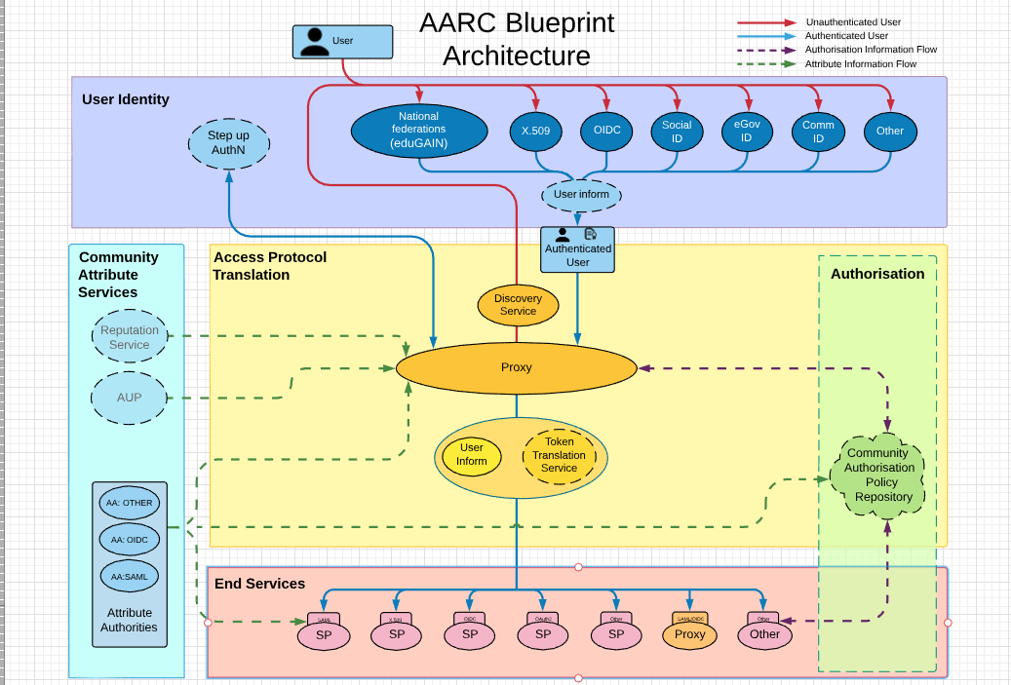
AARChitecture evolutions

Slide 6
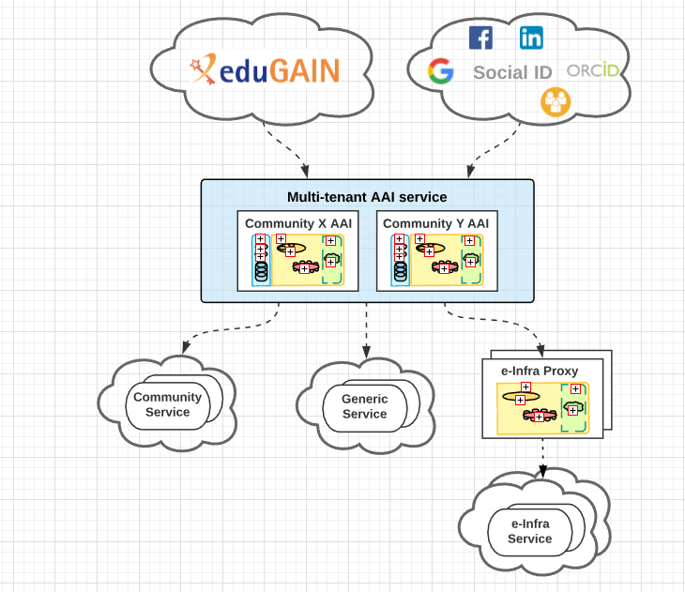
“Community-first” (proxied) AAI
Long Tail Support
2019 Final Update to Blueprint AARChitecture
Managed community access to community
specific services and to generic services
Guidance on using social media IDs
- reputation, step up, peer to peer, “compensatory controls”

Slide 7
Token-based Auz
OAuth2 (usu.opaque tokens)
JWT (incl scitokens)
AUC
Authorisation Server
Authorisation Server
Authorisation Server
PROXY
Validation models require:
Passing token to AS for validation
Or checking AS’s signature
Service

Slide 8
Implementing Best Practices for AA(A)I
Levels of assurance
REFEDS Assurance Framework (RAF)
Step up
Multifactor authentication
Account linking (e.g. ORG + ORCID or ORG+Umbrella)
Support for Community-driven AAI
Community-specific proxies (e.g. CLARIN, ELIXIR)
Support for affiliation through proxy
Proxy cannot re-assert eduPersonScopedAffiliation because resource scope check would fail
“Policy toolkit”

Slide 9
Compliance
IdP (orgs) (and SP orgs ) MUST comply with SIRTFI
Security contacts
Collaborate on resolving security incidents, TLP
Best practices, patching, etc.
Traceability of user
Must have AUP which users see/approve
IAM Proxy MUST comply with SNCTFI

Slide 10
Credential Conversion
X.509 certificates
RCauth will be available for DOGWOOD level
Use Pathfinder or CILogon for higher levels
No need for UK e-Science CA for pers. Certs
OIDC <-> SAML

Slide 11
Command Line
attrs
acct
IdP
IAM
ssh

Slide 12
Command Line
Assent
Need to preserve identity/attrs/perms
IAM login with browser
Then download delegated certificate into GSI proxy location
Or OAuth2 access token (not ssh though)
Upload ssh key to account (à la IaaS cloud)

Slide 13
Risks
All universities have UKAMF IdPs
Only a dozen publish R&S and/or SIRTFI
No one(?) provides RAF (yet?)
Not all have Assent IdPs

Slide 14
Related activities
AARC Pilots
JISC Assent
CLI
OIDCRE – OIDC for research and education
Improve building federations with OIDC
REFEDS
REFEDS Assurance Framework

