Slide 1
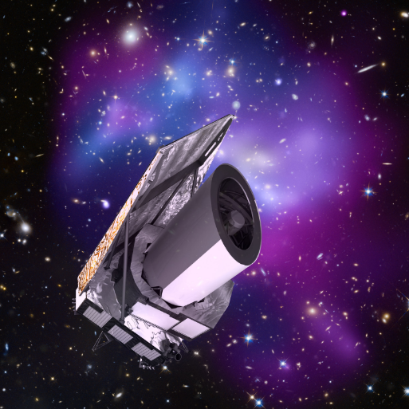
Euclid UK on IRIS
Mark Holliman
SDC-UK Deputy Lead
Wide Field Astronomy Unit
Institute for Astronomy
University of Edinburgh

Slide 2
Euclid Summary
ESA Medium-Class Mission
In the Cosmic Visions Programme
M2 slot (M1 Solar Orbiter, M3 PLATO)
Due for launch December 2021
Largest astronomical consortium in history: 15 countries, ~2000 scientists, ~200 institutes. Mission data processing and hosting will be spread across 9 Science Data Centres in Europe and US (each with different levels of commitment).
Scientific Objectives
To understand the origins of the Universe’s accelerated expansion
Using at least 2 independent complementary probes (5 probes total)
Geometry of the universe:
Weak Lensing (WL) Galaxy Clustering (GC)
Cosmic history of structure formation:
WL, Redshift Space Distortion (RSD), Clusters of Galaxies (CL)
Euclid on IRIS in 2018:
First use of Slurm as a service (Saas) deployment on IRIS resources at Cambridge on the not-quite-decommissioned Darwin cluster with support from Cambridge HPC and Stack HPC teams
Used for Weak Lensing pipeline sensitivity test simulations
~15k cores for 8 weeks from August-October
Generated ~200TB of simulations data on the Lustre shared filesystem during that time (along with ~2TB of data on a smaller Ceph system)
User logins through SSH, jobs run through Slurm DRM head node, workload managed by the Euclid IAL software and pipeline executables distributed through CVMFS (as per mission requirements).
Successful example of Saas, and now we’d like to see the Saas tested/operated on a federated basis

Slide 3
Euclid UK on IRIS in 2019
Three main areas of work:
Shear Lensing Simulations: Large scale galaxy image generation and analysis simulations (similar to the simulations run on IRIS at Cambridge in 2018, though larger in scope).
Mission Data Processing scale out: Proof of concept using IRIS Slurm as a Service (Saas) infrastructure to scale out workloads from the dedicated cluster in Edinburgh to resources at other IRIS providers.
Science Working Group Simulations (led by Tom Kitching): Science Performance Verification (SPV) simulations for setting the science requirements of the mission, and used to assess the impact of uncertainty in the system caused by any particular pipeline function or instrument calibration algorithm.
IRIS 2019 Allocations (all on OpenStack, preferably using Saas)
SCD: 750 cores
DiRAC: 1550 cores
GridPP: 800 cores

Slide 4
Shear Lensing Simulations
Description of work: The success of Euclid to measure Dark Energy to the required accuracy relies on the ability to extract a tiny Weak Gravitational Lensing signal (a 1% distortion of galaxy shapes) to high-precision (an error on the measured distortion of 0.001%) and high accuracy (residual biases in the measured distortion below 0.001%), per galaxy (on average), from a large data-set (1.5 billion galaxy images). Both errors and biases are picked up at every step of the analysis. We are tasked with testing the galaxy model-fitting algorithm the UK has developed to extract this signal and to demonstrate it will work on the Euclid data, ahead of ESA Review and code-freezing for Launch.
Working environment
Nodes/containers running CentOS7
CVMFS access to euclid.in2p3.fr and euclid-dev.in2p3.fr repositories
2GB RAM per core, cores can be virtual
Shared filesystem visible to the head node and workers. Preferably with high sequential IO rates (Ceph, Lustre, etc)
Slurm DRM
Preferably the Euclid job submission service (called the IAL) needs to be running on/near the head node for overall workflow management
Use of IRIS Resources
Saas cluster running at Cambridge on OpenStack (1550 cores)
Ceph Shared FS
Saas cluster running at RAL on OpenStack (750 cores)
Shared filesystem TBD – options include using Ceph ansible to make a converged file system across the workers, or creating a single NFS host with a reasonable amount of block storage to mount on the workers. Tests are in progress.

Slide 5
Mission Data Processing
Description of work: Euclid Mission Data Processing will be performed at 9 Science Data Centres (SDCs) across Europe and the US. Each SDC will process a subsection of the sky using the full Euclid pipeline, and resulting data will be hosted at archive nodes at each SDC throughout the mission. The expected processing workflow will follow these steps:
Telescope data is transferred from satellite to ESAC. Level 1 processing occurs locally (removal of instrumentation effects, insertion of metadata).
Level 1 data is copied to target SDCs (targets are determined by national Mission Level Agreements, and distribution is handled automatically by the archive). Associated external data (DES, LSST, etc) is distributed to the target SDCs (this could occur prior to arrival of Level 1 data).
Level 2 data is generated at each SDC by running the full Euclid pipeline end-to-end on the local data (both mission and external). Results are stored in a local archive node, and registered with the central archive.
Necessary data products are moved to Level 3 SDCs for processing of Level 3 data (LE3 data is expected to require specialized infrastructure in many cases, such as GPUs or large shared memory machines).
Data Release products are declared by the Science Ground Segment Operators and then copied back to the Science Operations Centre (SOC) at ESAC for official release to the community.
Older release data, and or intermediate data products, are moved from disk to tape on a regular schedule. The data movement is handled by the archive nodes, using local storage services.

Slide 6
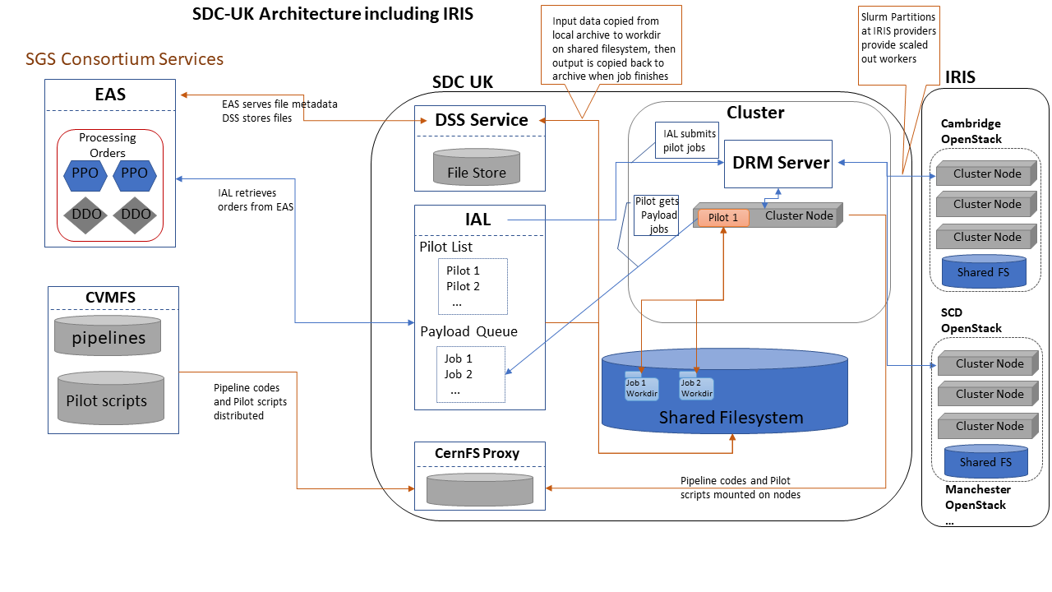
SDC-UK Architecture

Slide 7
Mission Data Processing con’t
Working Environment
Nodes/containers running CentOS7
CVMFS access to euclid.in2p3.fr and euclid-dev.in2p3.fr repositories
8GB RAM per core, cores can be virtual
Shared filesystem visible to the head node and workers. Preferably with high sequential IO rates (Ceph, Lustre, etc)
Torque/SGE/Slurm DRM
Euclid job submission service (called the IAL) needs to be running on/near the head node for overall workflow management
Use of IRIS Resources
The goal is to have a working Saas solution tied into our existing infrastructure by 2020 for the final phase of Euclid end-to-end pipeline tests.
Preliminary tests will occur in 2019, based around a Slurm head node running on the Edinburgh OpenStack instance, with workers running on the Manchester OpenStack instance (and likely others). This setup will require use of VPN type networking to connect the workers to the head node. These tests will include use of a multi-site converged CephFS for shared storage.
Expected resource utilization is only 100 cores for 2019.

Slide 8
Science Working Group
Description of work: The Science Working Groups (SWG) are the name of the entities in Euclid that before launch set the science requirements for the algorithm developers and also the instrument teams, and assess the expected scientific performance of the mission. The UK leads the weak lensing SWG (WLSWG; Kitching), which in 2019 is tasked with Science Performance Verification (SPV) for testing the Euclid weak lensing pipeline. The current version of SPV simulations take a catalogue of galaxies from an n-body simulation and creates a transfer-function like chain of effects whereby the properties of each galaxy are modified by astrophysical, telescope, detector, and measurement process effects. These modified galaxy catalogues are then used to assess the performance of the mission as well as the impact of uncertainty in the system caused by pipeline algorithms or instrument calibration algorithms.
Working Environment:
Nodes/containers running CentOS7
Python2 (with additional scientific libraries)
6GB RAM per core, cores can be virtual
Shared filesystem (for data workflow management)
Use of IRIS Resources
700 Cores on Manchester OpenStack
Shared FS will need to be sorted, with the lead possibility being the use of a converged Ceph system (the same system tested for the Mission Data Processing work). A local NFS node with sufficient block storage could be used as a fallback.
Saas head node will likely run on the Edinburgh OpenStack, connected to workers through VPN

Slide 9
Euclid UK on IRIS 2020…
Shear pipeline sensitivity testing – The UK developed pipeline algorithms need to be tested at scale pre-launch (Dec 2021) to ensure accuracy and performance, and then yearly simulations will need to be run post-launch for generating and refining calibration data.
Pre-launch simulations are estimated to require ~3k core years per year, and 200TB of intermediate (shared) file storage.
Post-launch simulation are estimated to require ~1.5k core years per year, and 100TB of intermediate (shared) file storage.
Mission Data Processing – Euclid UK will have a dedicated cluster for day-to-day data processing over the course of the mission, but it is expected that this will be insufficient at peak periods (i.e. official data releases, data reprocessing). During these periods we need to scale out onto other resource providers, ideally through an Saas system (or something equivalent). It is also likely that we would want to use a shared tape storage system for archiving older Euclid data.
Estimates currently anticipate ~1.5k core years and 100TB of intermediate (shared) file storage from 2022-2024.
Data tape estimates are currently very fuzzy while we await the mission MLA’s to be finalized, but they should be on the order of growing 100TB a year per year from 2020 onwards
Science Working Group – The weak lensing SWG anticipates a similar need for simulations in 2020 as in 2019 (1.5k core years). But then the SWG expects to ramp up significantly on launch year and beyond, running a suite of simulations for verifying mission science requirements and data analysis
2021 - 4k core years, 100TB of intermediate (shared) file storage
2022 – 5k core years 200TB of intermediate (shared) file storage
2023 – 5k core years 200TB of intermediate (shared) file storage

