Slide 1
IRIS Scientific OpenStack
March 2019 Update
John Garbutt, StackHPC @johnthetubaguy

Slide 2
UK-T0 IRIS Aims
“
The proposal is fully consistent with the STFC Computing Strategic Review which calls for STFC areas to work more closely together to find ways of sharing computing infrastructure, with new projects encouraged to make use of existing expertise and infrastructure.
Access to a cloud (OpenStack ) platform, and a containerised platform, as well as more conventional access to ensure all communities can quickly and easily use the infrastructure. Industrial partners will be engaged to develop OpenStack services.
”

Slide 3
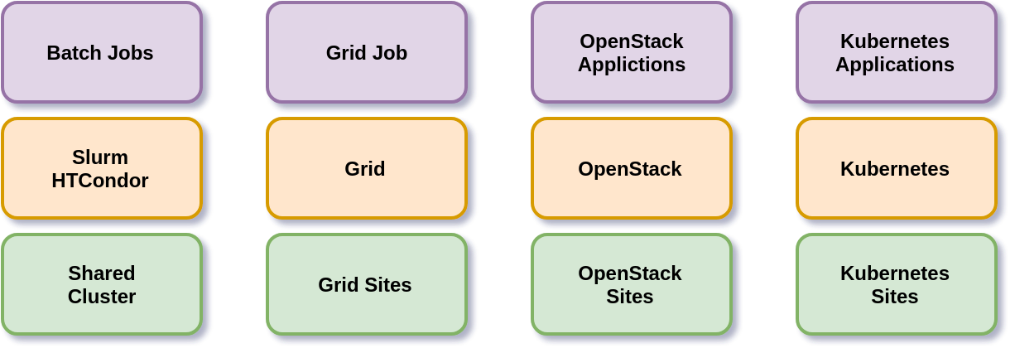
Specialised Sites

Slide 4
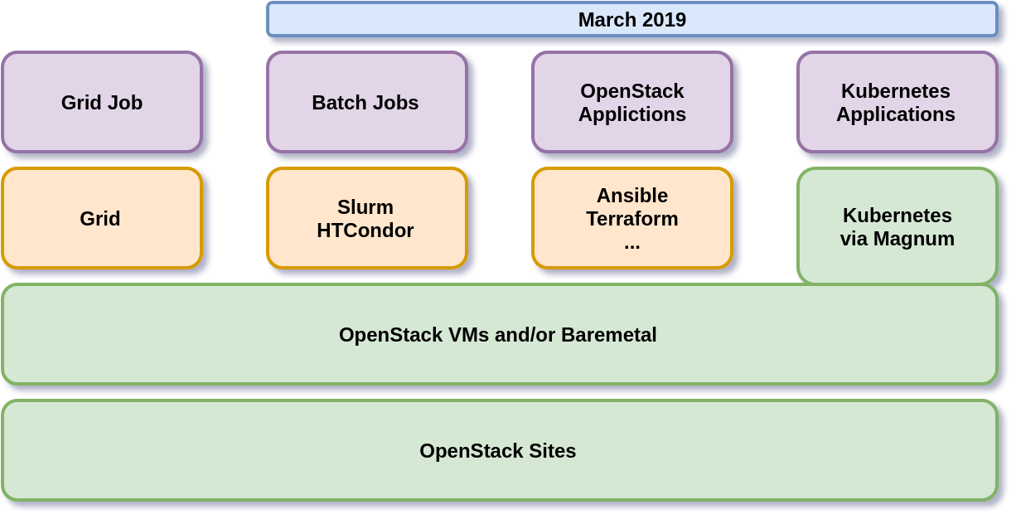
Expanding OpenStack Site Workloads

Slide 5
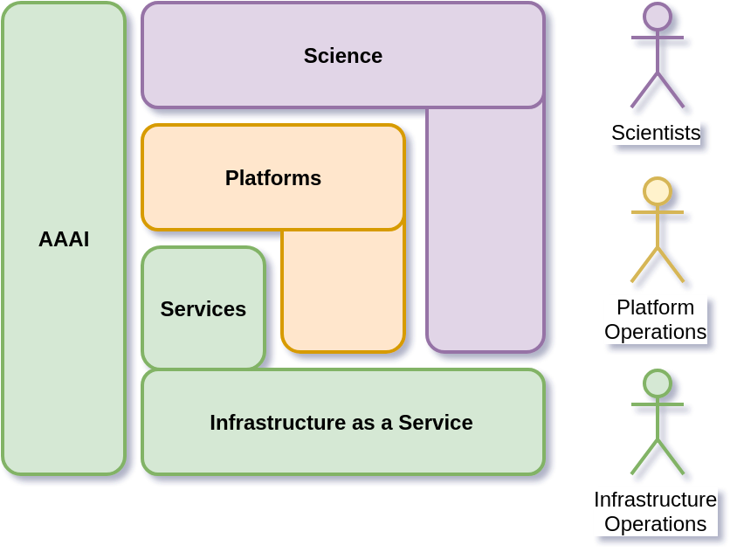
Scientific OpenStack Vision

Slide 6
Part 1: What is in the Digital Asset?

Slide 7
IRIS Scientific OpenStack 2018/19
Kayboe Workshop Materials
Deployed Scientific OpenStack at Cambridge
Draft IRIS Conformance Tests
Delivered v1.0 Scientific OpenStack Digital Asset

Slide 8
Infrastructure Sites
OpenStack deployment passing IRIS tests
1
Site Specific Configuration
2
Scientific OpenStack
Digital Asset
3

Slide 9
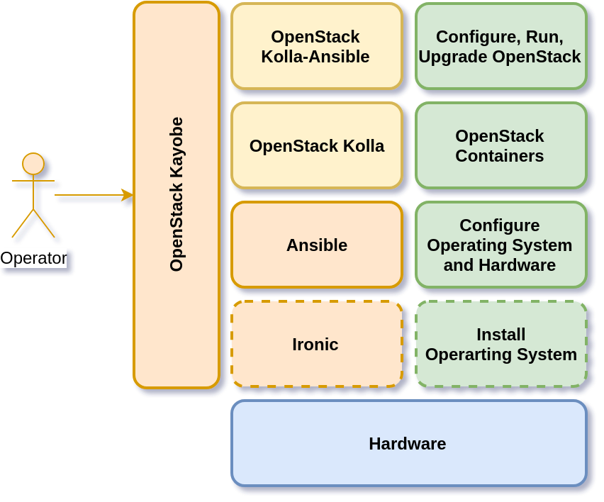
OpenStack Deploy Tooling

Slide 10
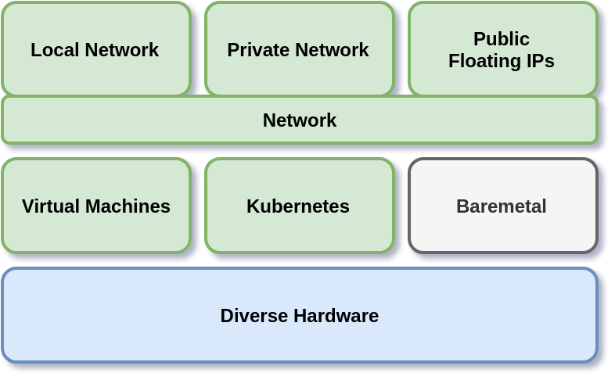
Scientific OpenStack Compute

Slide 11
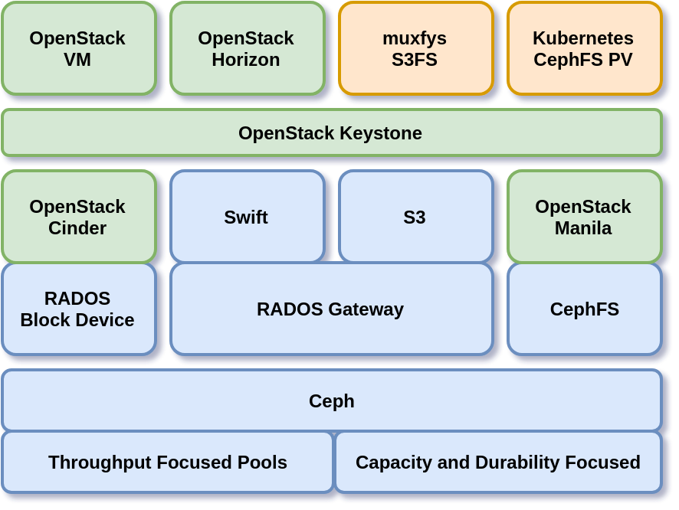
Scientific OpenStack Storage
Notes:
https://github.com/VertebrateResequencing/muxfys

Slide 12
Activities
Shared Approach
OpenStack Rocky, no overcommit Flavors
Public Floating IPs
Shared Provider Network preferred, but support private networks
Local Disk, Optional RBD Volumes and CephFS, Keystone protected Object Store
Kubernetes via Magnum, with Manila CephFS RWM Volumes
Euclid
Slurm as a Service
Site to Site VPN demonstration
Hyperconverged CephFS

Slide 13
Federated Identity

Slide 14
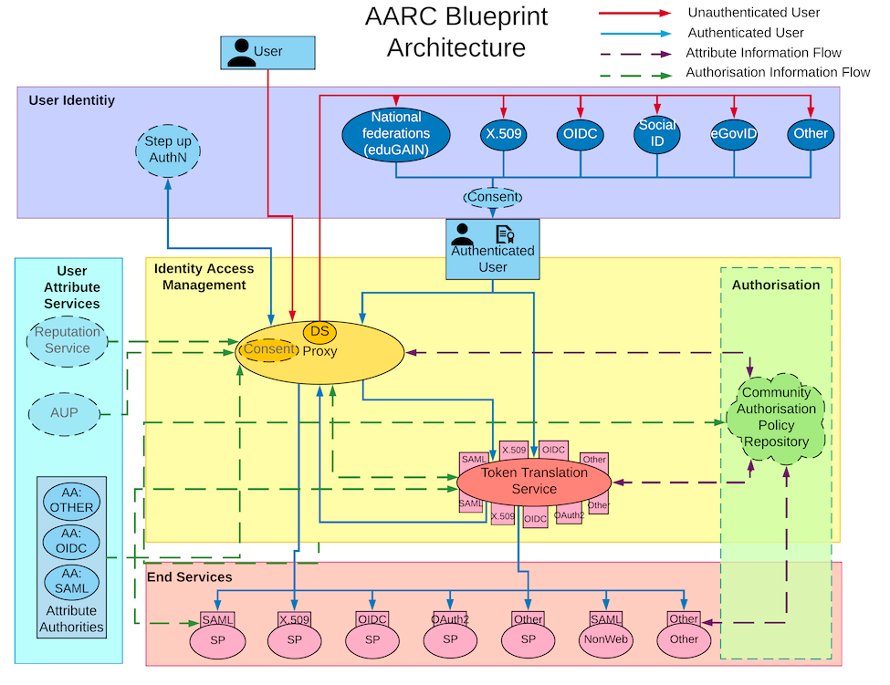
Notes:
Authentication and Authorisation for Research and Collaboration
https://aarc-project.eu/architecture/

Slide 15
Federated Identity Login
Access Horizon
Authenticate
Federation Mapping
Create App Credentials

Slide 16
Authorization of Federated Identity
Access Horizon
Authenticate & Accept AUP
Request Access
Assign Role in OpenStack

Slide 17
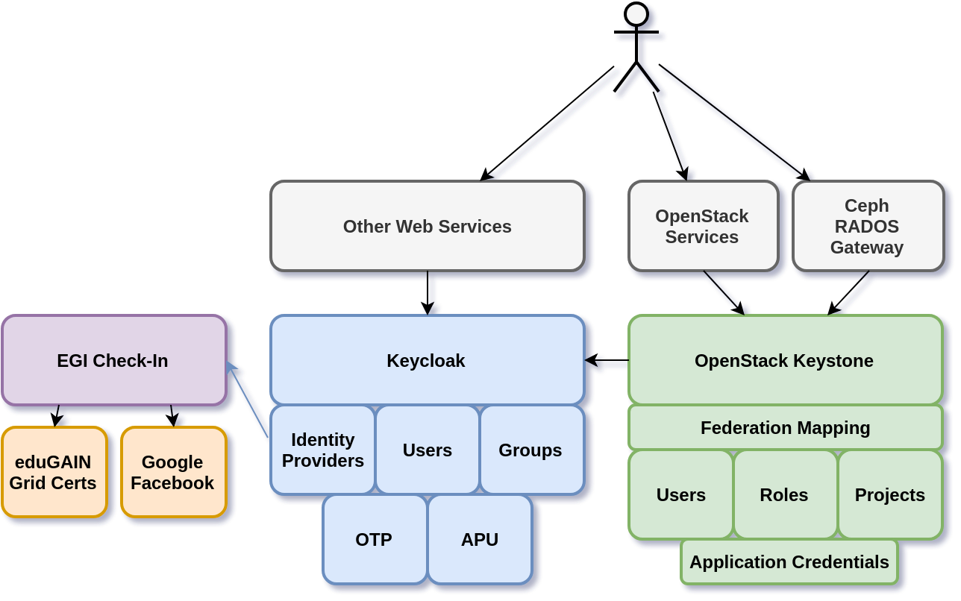
Keystone Federation

Slide 18
Building Blocks of Federated Identity
Keystone OIDC using Keycloak
Keycloak OIDC to EGI Check-in (dev)
Indigo IAM
Federation Mapping
Concrete users and roles
Avoid Groups
Application Credentials
Notes:
https://en.wikipedia.org/wiki/Padlock#/media/File:Early_padlock.jpg

Slide 19
Supporting Infrastructure Operations

Slide 20
Scientific OpenStack Vision

Slide 21
Operations
Day 1 and Day 2 Ansible based framework
Build on Cross Site similarities
Share digital assets: code, dashboards, alerts
Future: RunDeck
Notes:
Digital Asset Capital Funding issues.

Slide 22
OpenStack Deploy Tooling

Slide 23
Day 1 Operations
Kayobe, Kolla-Ansible, Kolla
Install Operating System and Configure Hosts
Deploy and Configure Support Services
Deploy and Configure OpenStack Services
… Upgrading

Slide 24
Day 2 Operations
User, Project and Quota management
Admin APIs: Networks, Flavors, Images, etc
Monitoring
Accounting and Audit

Slide 25
Monitoring
Outputs: Alerts, Tickets and Debug (and Audit)
Current Scope: Control Plane and Data Plane
Today: Prometheus, fluentd, elasticsearch, mtail
Future: OpenStack Monasca

Slide 26
Accounting and Audit
Focus on Traceability
Usage: cASO sends to Fluentd (and APEL)
Quota: limit maximum concurrent usage
Allocation: allowed usage over given duration
Audit:
local logs, aggregated in elasticsearch
Alerts using mtail + prometheus
Notes:
https://github.com/apel/caso

Slide 27
Part 2: Where could we go next?

Slide 28
Improve Resource Sharing
Notes:
Multiple sites

Slide 29
Kubernetes and OpenStack
Collaborate with CERN efforts
Networking: Octavia Load balancers
Storage: Cinder and Manila integration
Autoscale POC: Cluster API and Magnum
Improved platform examples: Pangeo, Jupyter

Slide 30
OpenStack
Assets to support Operations
Stein Upgrade
Database lifecycle management
Assist other sites adopting (parts of) Scientific OpenStack
Performance optimisations (while still live-migrating)
Ironic (RedFish, NGS) for Kubernetes
GPU support (passthrough), integrated with Cryo-EM
Improved Slum-as-a-Service
Preemptable POC

Slide 31
Monitoring
Improve OpenStack Monitoring
Better targeted Alerts
Better metrics from logs
Integrate Rally testing
Data Lifecycle Management
Workload Monitoring
Develop simple standard patterns derived from OpenStack monitoring
Expose sanitised OpenStack Metrics
OpenStack Monasca for long term persistence and trends

Slide 32
Federated Identity
Move to Idigo IAM
User Group to Project Mappings
Get-me-a-box App
SSH bootstrap App

Slide 33
@johnthetubaguy johng@stackhpc.com

