Slide 1


Some QCD-related results from the ATLAS experiment
Hugo Beauchemin
Tufts University
Seminar at Queen Mary University, June 19, 2019
Notes:
Put photo of team.

Slide 2
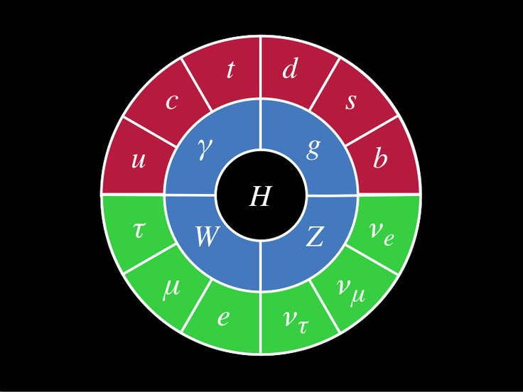
The particle content of the Standard Model has fully been directly and unambiguously observed!
1900
1994
1968
1979
1974
1955
1968
1977
2012
1975
1956
1962
1937
1983
1983
1897
2000
Notes:
Note on meaning of “discovery”: We can argue about these dates, depending on how we define the “observation” and “discovery”. For example, I used here the date of the confirmation of the associate production of strange particles for the s-quark, but I could have chosen the year of the first evidence (1954), or the discovery of quarks (1968). Similarly, I used 1900 as the confirmation of the ψ-radioactivity for the photon, but I could have used 1905 as the year of their particle interpretation, or 1923 for the Compton effect, a direct experimental confirmation that the photon is an elementary particle. What matter is that the existence of these particles is not controversial and is now fully taken for granted, including the Higgs.

Slide 3
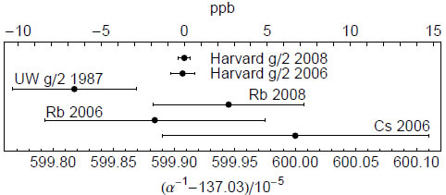
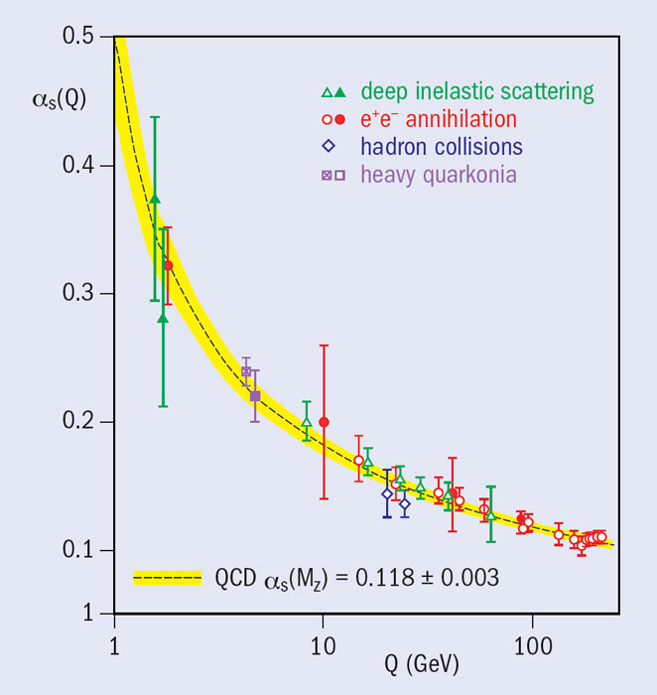
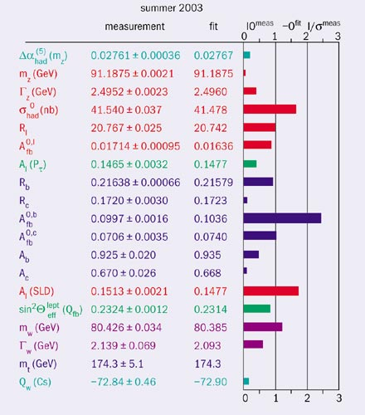
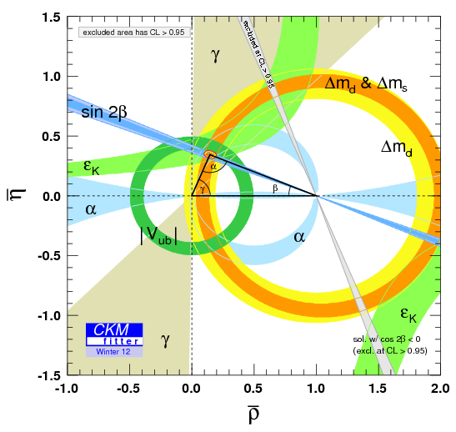
The description of the 3 fundamental interactions of the SM has long been confirmed to a high level of precision
Fine structure
constant
Strong coupling
constant
Weak
interaction
parameters
Unitarity triangle
Notes:
Want to say: It is not so much the particles that matter, they are given, input, but the couplings and the relationships between parameters and they have been tested to very high level of precision, so SM isn’t questions… or is it?

Slide 4
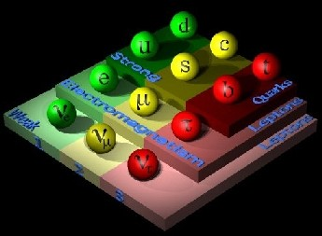
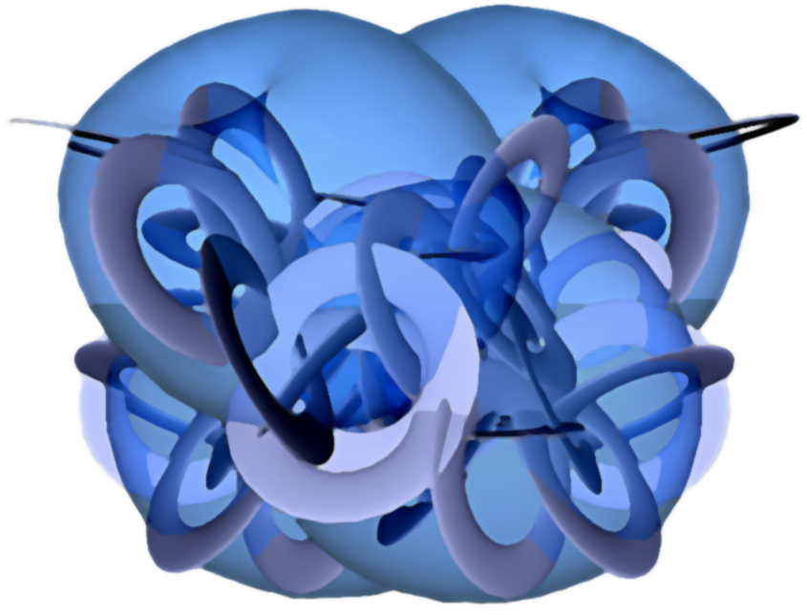
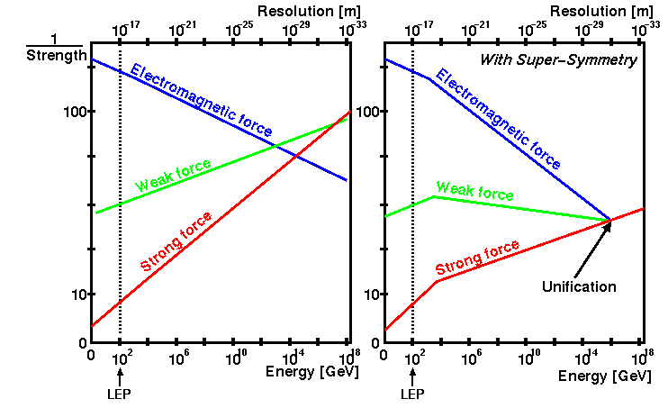
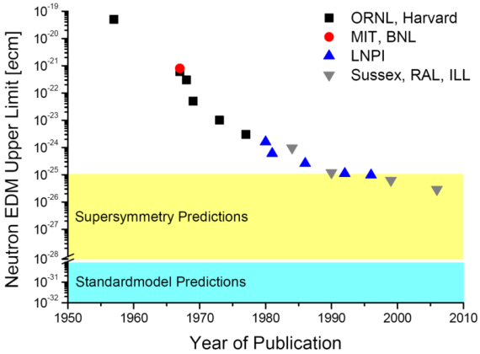
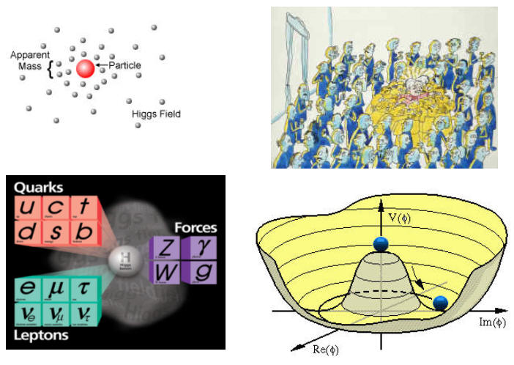
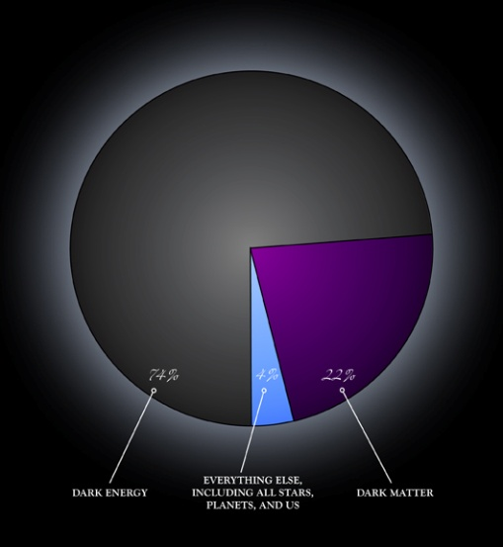

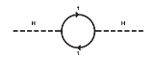
Of course we all believe that the SM is not the end of the story…
Number of families
Space-time Structure
& Gravity
Unification
Strong-CP problem
Fine tuning
Hierarchy Problem
Dark Matter
Dark Energy
ElectroWeak Symmetry Breaking
Notes:
Note on SM problems: And while for many theorists, some of these are not problems but only features of Nature (e.g. proponents of string landscape and multiverse), I don’t thing anybody think that the SM is the end of the story.

Slide 5
…so why dedicating so much effort in performing evermore precise and sophisticated measurements of Standard Model physics, known and well-established for decades???
Notes:
Want to say: Thousands of human hours and millions of CPU hours…
Note about measuring rare processes: SM rare processes such as vector boson scattering/fusion were (almost) never experimentally evidently measured, and used intense analysis efforts. However, in the end, the quest for precision will always last.
Indeed, the reasons why these rare SM processes are being measured is because we:
1) want to show that we can find rare processes where they are expected,
2) want to know all possible background to what we are looking beyond the SM.
In both cases, one day you have evidence, but you won't be content with it, until you reach the precision to claim an observation. But then, you will not be content with that precision, because this process will become a significant bkg to at least some new physics searches.

Slide 6
The Answer :
Need to understand Strong Interaction Phenomena
*Also some interesting electroweak physics can be studied at the LHC, but
not discuss in this talk.
Notes:
Want to say: It is the phenomena that involve the strong interactions that need to be well described/predicted and that are the issue. It is not only a question of lagrangian, but the question of describing with accuracy all the phenomena that are predictable from this lagrangian. This is a key to discover new physics and is the issue to be discussed here.

Slide 7
Plan of the talk
We will see why QCD calculations are needed for any LHC predictions and why they globally make sense.
But we will see that getting accurate precise predictions for LHC phenomena with QCD is challenging.
  Help understanding what is the meaning of the sophisticated set of calculations made available by the theory community;
  To justify the need for the measurements to be presented.
Then, I will present some of the calculations that we have in hand.
I will finally explicitly present measurement results and interpretations in terms of the issues that will be raised.

Slide 8
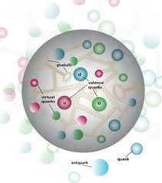
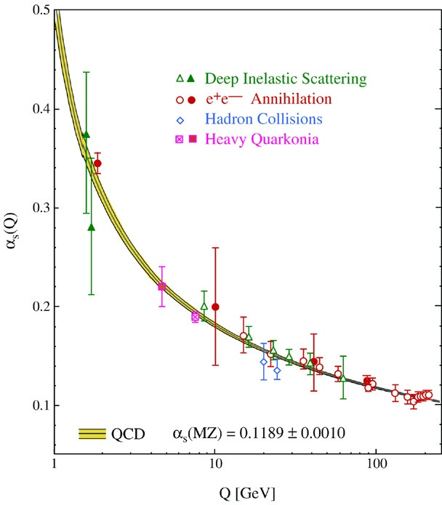
In quantum field theory, transition probabilities between initial and final states of interest are only calculated perturbatively.
Q: Is this a problem for the strong interaction given that
hadrons / nucleons are strongly-coupled bound states ?
  Renormalization group equations tells how physics
systems change when viewed at different scales
  For QCD, α_{s} evolves from being strong at
low energy to be not so strong at high energy
A: For distance scales probed at the LHC, quarks
and gluons can be considered as free particles
and physics processes involving them can be
calculated using perturbation theory.
QCD predictions at very high energy are theoretically under control at the LHC
Notes:
Note on running: Ignorance of very high energy properly encoded in α_{s}, at the expanse of a scale dependence. Experiment can be used to fix a_{s} at scale μ, and theory can be used to evolve it at any other scale.

Slide 9
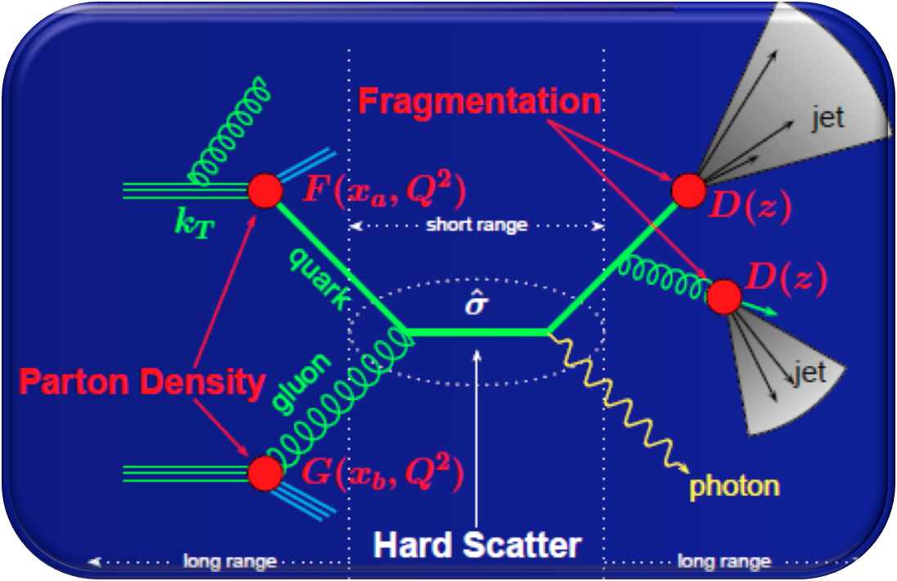
The strong interaction intervenes in various ways and at various scales in every single event at the LHC
  Matrix element of
  interest
  Gluon emission (ISR/FSR)
  Proton structure
  Fragmentation and hadronization
  Underlying event
Long distance
physics
Short distance
physics
Long distance
physics
We can make
robust predictions!
Not so sure…
Notes:
Summary of the idea: the asymptotic freedom allows for perturbative predictions of the hard scatter, but it is not clear that it would be possible in the IR limit. That is what will be discussed in the next slide.
Note on “every event”: Like in French, physics always have some exceptions to the rule. Here, it is that recent observation of photon scattering in heavy ion collision doesn’t depend on QCD (phot + phot -> phot + phot).

Slide 10
The strong interaction intervenes in various ways and at various scales in every single event at the LHC, including BSM if any…
  Matrix element of
  interest
  Gluon emission (ISR/FSR)
  Proton structure
  Fragmentation and hadronization
  Underlying event
Multiple scales are probed in any single events at the LHC!
Momentum transfer in QCD bremsstrahlung can be very small, and PDF, fragmentation and multiple interaction processes occur at large distance scales, where perturbative calculations are impossible
Physics predictions at the LHC seem to be in jeopardy…
Multiple scales are probed in any single events at the LHC!
Notes:
Summery of the problem: How can we make predictions about events when at least some aspects of them are not predictable using perturbative tools?

Slide 11
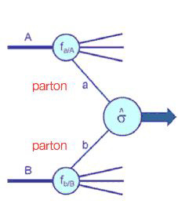
There must be a solution, otherwise we wouldn’t be doing HEP at hadron colliders since so long…
Factorization theorem:
Long distance and short-distance processes are
incoherent: their probability amplitude factorize.
Low energy divergent behavior can be embedded
into the factors describing large-distance physics
Predictions can be obtained from the convolution of short distance
physics and a universal non-perturbative regime obtainable from data
Allows for calculable predictions for many observables
Notes:
Note about factorization: It is not proved for all situations, but only for a some inclusive processes. For many other processes, we have some kind of not very rigorous proof (more like indications). In addition, there are situations in which it breaks down and we have to supplement the predictions with other tactical. For example, adding phase space selections on various observables might lead to some breakdown of this nice factorization. We’ll come back to this when we discuss resummation, but for now, it essentially saves us.
Summary of the point made here: Ok, at first order we are fine: even if there is a regime where QCD becomes non-perturbative, and even if every single events will involve such long distance physics effect, factorization theorem allows us to make robust predictions at the LHC for any processes of interest.
There are nevertheless what I would call second order effects that could be quite annoying, and which requires a sophisticated measurement program at the LHC.

Slide 12
Globally we are fine with using QCD to make robust predictions at hadron colliders, but the devil is in the details…

Slide 13
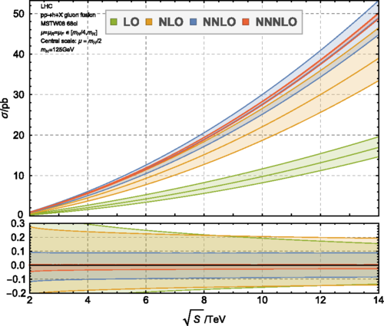
For some processes, higher-order corrections might be very large
  Tree-level processes start to contribute at higher orders
  Event selections can lead to large logs in the predictions
  Factorization (μ_{F}) and Renormalization (μ_{R}) scale uncertainties can get massively reduced at higher-order
Example:
Higgs production (gluon fusion) vs √s. α_{s} is small at m_{H}, yet quantum corrections are large
  NLO / LO correction = 70%
  NNLO / NLO = 30%
NNLO scale uncertainties are comparable to experimental systematic uncertainties
  NNLO: ~10% vs N3LO: ~1%
Notes:
Want to say: With perturbative calculations, we naively think that higher order corrections are proportional to a^{n}, where “a” is the expansion parameter, alpha_s ~0.1 in the case of QCD. We would naively think that NLO corrections are 10%, NNLO 1%, etc. Well… this is naïve!
=> We cannot tell a priori to which order will the predictions start to behave as naively expected.
Note on NNLO vs NLO: the central value of the NNLO predictions is larger than the NLO+Unc prediction
Note on scale Unc.: The scale uncertainty at LO is smaller than at NLO and even NNLO which shows that this way to assign an uncertainty on LO predictions is INADEQUATE.

Slide 14


Another problem
When selections are applied to optimize sensitivity to new physics or when distributions are being measured, higher order predictions in α_{s} are not necessarily the only key to precision
A schematic example: Consider Drell-Yan process when going from LO to NLO
V*
+
Finite prediction
Diverges when E_{g}=0 or θ=0
(Q² is the virtuality of the W)
The exact same divergence occur in
but with opposite sign
Notes:
Can we understand the origin of these uncertainties and large correction effects?
Note: that = -2p.k = EqEg (1-cos(theta))

Slide 15
From this calculation: fixed order calculations are of the form:
The expansion is not anymore in a_{S}, but in α_{S}L²
  If μ² and Q², are very different, as expected if we separate large and short distance scales, the logs will be large and the perturbative expansion and unitarity will be compromised
    Cannot describe simple observables like P_{T} in Drell-Yan…
However, this is just an artifact of using fixed order calculation:
At higher order, processes such as W+1j, W+2j, etc., will follow the
same rule, and the full sum at all orders should behave well:
Notes:
Remember, we saw that we might need to go to NNNLO to control scale uncertainty, and get right predictions (for which higher order would only be a small correction), but it might even not be possible, when scales involved in the problem are so different.

Slide 16
Solution: Resummation
We can shuffle the terms and express the differential cross section as:
LL
NLL
NNLL
This procedure, called resummation, corresponds to an all-order evolution from large to small distance scales restoring the predictive power of pQCD and unitarity, similarly to the running of couplings
QCD contains all ingredients to address
predictability issues at the LHC…
  Equation used to evolve PDF : DGLAP equations
  Analytic Resummation: predictions for specific differential cross sections
  Parton shower: numerical correction to fixed order calculation to yield final states consistent with DGLAP evolution
  Resummation at high-energy/small-x regime: BFKL approach
… up to a certain level of accuracy, which can widely vary with event topologies
Notes:
Note on Resummation: It is not g1 which is LL and g2 which is NLL, but the first term of g1 which is LL, or the 2nd term of g1 + the first of g2 which is NLL, and similarly, you need up to g3 for NNLL, but you also need a term in g1 and in g2.
Also, the exponential saves everything because rather than having a diverging prediction when Q->0, you have something that converge to 0 (that means prob very small to happen). In reality, the suppression is not as strong as converging to 0, That’s because the emission of the soft parton is not uncorrelated between parton, but this is a coherent process. That’s why, for example, it is important to include coherence in parton shower.
-PS provide an all-order approximation of parton radiation in soft and collinear region through iterative splitting and radiation of partons

Slide 17
The above QCD calculations cannot be exact, but involve a certain level of accuracy which (often largely) varies with the phase space probed.
In addition, assumptions, approximations, phenomenological modeling, and experimental inputs impact these predictions.
All this results in many sources of uncertainty related to the modeling of various QCD effects:
  Choice of scale in fixed-order α_{s}
  Parton shower and matching
  Mass of heavy flavor quarks
  npQCD effects such as PDF, fragmentation, underlying event
  Infrared sensitive predictions
  Electroweak corrections
The QCD prediction tools need some “tuning” or adaption
in order to address concerns in broader range of situations
Notes:
Point to stress: Energy range, stats, and experimental precision at the LHC allows to study QCD loop effects

Slide 18
The key to make a discovery is to control systematic uncertainties and errors to maximize the sensitivity to the physics of interest and get convinced of the validity of a discovery.
Theoretical uncertainties affect both the predictions and experimental results.
Need for more precise predictions!
Notes:
Note on the need for precision: The game at the LHC is no more to pick up “low hanging fruits”.

Slide 19

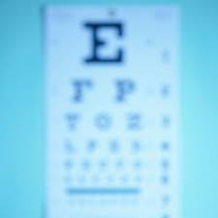

So we need QCD-related precision measurements to improve theory predictions because:
Errors in the SM predictions can mask new physics signals or lead to false discovery
Large uncertainties on SM predictions result in a suppression of the sensitivity of the experiments to new physics
QCD uncertainties on new physics make it hard to understand a newly observed signal
Notes:
Might say: We can loose the north…

Slide 20
While for some predictions the above QCD modeling can be accurate enough for a successful LHC physics program, there are event selections used in BSM searches in which they could be questioned:
  Very high jet multiplicity
  Multiple scales in the same event, such as very different jet p_{T} selections
  Selections based on observables sensitive to soft radiation
  Gluons splitting in heavy-flavor quarks
We can use LHC data to constrain QCD calculations. Measuring observables sensitive various effects pointed above allows to:
  Determine best model/calculations for predictions
  Tune fragmentation and parton shower parameters

Slide 21
Predictions in hand

Slide 22
Various level of predictions (I)
MC generators are the test benches of the various progresses made on the modeling of the different QCD effects over the past years
LO ME +PS
Pythia (6, 8), Herwig
These generators incorporate different modeling
of QCD corrections
Leading Order Matrix Element calculations
Soft and collinear emission corrections
integrated in a parton shower model
Fragmentation and hadronization
Underlying event

Slide 23
Various level of predictions (II)
MC generators are the test bench of the various progresses made on the modeling of the different QCD effects over the past years
Tree-level multiple parton ME +PS
Alpgen, Sherpa 1.4, MadGraph
Again, different modelings of QCD corrections
A merging procedure is needed to avoid the double counting of ME and PS partons
  Alpgen: MLM cone, Sherpa/MadGraph: CKKW-L
Alpgen and MadGraph interfaced to Pythia or Herwig
Sherpa has its own PS (CS dipole) +Had (cluster)
Notes:
Note on merging: Sherpa uses reweighting procedure, Alpgen uses veto to avoid double counting of QCD emission between ME and PS

Slide 24
Various level of predictions (III)
MC generators are the test bench of the various progresses made on the modeling of the different QCD effects over the past years
NLO multi-parton ME
MCFM, BlackHat
Differences in the matrix element calculations
An NLO cross section for N=1,…5 partons
Different calculation techniques
  Feynman graphs: MCFM (up to 2 partons)
  Unitarity: BlackHat (up to 5 partons)
No PS, had, or UE corrections
Need some kind of sum rules for inclusive final states
NNLO:
  Drell-Yan = FEWZ, DYNNLO
  N_{jetti}NNLO: Z+jets, Loopsim: Approximate V+j

Slide 25
Various level of predictions (IV)
MC generators are the test bench of the various progresses made on the modeling of the different QCD effects over the past years
NLO ME for lowest multiplicity +PS
POWHEG, MC@NLO
MadGraph
Different matching procedures
Interfaced to Pythia or Herwig for PS, had and UE
MadGraph goes up to 2-jets at NLO
These generators incorporate different modeling
of QCD corrections
Notes:
Note on Powheg: The matching procedure uses modified Sudakov form factors, same as in ME. Maintain NLO and LL accuracy.

Slide 26
Various level of predictions (V)
MC generators are the test bench of the various progresses made on the modeling of the different QCD effects over the past years
NLO ME for low multiplicity, LO for others + PS
Sherpa 2.x (MEPS@NLO),
MEnloPS:
  NLO inclusive cross section
  Normalization at NLO accuracy
MEPS@NLO:
  NLO for 1 and 2 partons
  LO + PS for higher multiplicity
  State of the art for V+jets
Notes:
Note on Sherpa: Use Comix and OpenLoop.
Note on other matching/merging:
-FxFx: aMC@NLO - MadGraph ME, PS from Pythia/Herwig
-UNLOPS: Not quite sure…
-MinLO: Use V+jets in Powheg, pushes jet cut to PS IR cutoff, apply NNLL Sudakov rejection weight for intrinsic line in Born configuration,
remove double counting and reweith to NNLO fixed order.

Slide 27
Various level of predictions (VI)
MC generators are the test bench of the various progresses made on the modeling of the different QCD effects over the past years
Resummation
Resbos, HEJ
Resum large logs at all orders in α_{s}
  Extend validity of perturbation theory
  Improve normalization and shape
  Analytical functions for Leading Logs, etc
Low energy regime: Resbos (NNLL)
  Logs from IR and collinear parton emission
High Energy Regime: HEJ
  Large invariant mass between jets
  Approximation which captures hard wide-angle emission
  BFKL-inspired
Notes:
Note on Resbos:
-Resums the leading contributions up to NNLL and matches the cross section to fixed order calculations at O(a_{s}²), using pT and y dependent k-factors
-Resbos cannot give information about the hadronic recoil, nor can it yield predictions for non-explicitly calculated variables, but can be used,
for example, to reweight ZPt or WPt for different predictions.

Slide 28
Various QCD effects are often modeled differently by theorists, and are implemented in their generator. Measurements test the accuracy of modeling choices. There are also overlaps.
Generator | Features | Comments
SHERPA 1.4 | ME up to 5 partons, with C-S dipole shower,CKKW matching, cluster frag., 5FS (with m_{b}≠0) | CT10 PDF, NLO norm.
PYTHIA | LO 2->2 ME, PT-order dipole shower, 5FS, Lund string frag., AU2 and A14 tunes | PHOTOS, LO PDF (CT10)
Herwig++ | LO 2->2, angular-order shower, cluster frag., UE-EE tunes | LO PDF (CTEQ6L1)
Sherpa 2.2 | NLO up to 2 partons, LO up to 3 add. Partons, MEPS@NLO merging, | YFS QED resum., features of 1.4.
MadGraph | Pythia 8.2 , NNPDF23NLO | 4-jet tree-level +PS or 2-jet NLO+PS, CKKWL matching/FxFx merging, A14 PS tune
NLOJET++ | NLO 2->3, no npQCD effects, no PS (inf.-red sing. Removed with C-S dipole, ) and no resum. | NNLO PDF with same as in ME, corrections from Pythia 6
JetPhox | Full NLO pp->γ+jet+X (direct + frag.), n_{f}=5, NLO frag from BFG module, no npQCD corr. | NNLO PDF, npQCD corr from Pythia 6, photon iso.
Non exhaustive list of features and options

Slide 29
Generator | Interfaces | Comments
ALPGEN | HERWIG+ JIMMY, PHOTOS, CTEQ6L1, AUET2 tune | mP- ME up to 5 parton, MLM matching
BLACKHAT*+SHERPA | CTEQ6.6M | NLO up to 5-jets (unitarity)
POWHEG | PYTHIA | NLO+PS (1-jet)
MC@NLO | HERWIG | NLO+PS
DYNNLO* |  | NNLO Drell-Yan
LOOPSIM* |  | nNLO W/Z+jets

Slide 30
Measuring observables sensitive to these effects allows to:
  Determine best model/calculations for predictions
  Tune fragmentation and FSR parameters or PDF fit.
It is however important to keep in mind that many of these different QCD effects are intertwined with each others
  Hard to disentangle them in a measurement, to know exactly which effect is mismodeled in a prediction and why.
  Accuracy (validity) of the modeling of each effect can vary with event topology, kinematic observable, and phase space selection

Slide 31
Measuring α_{S} using correlations and decorrelations in multijet events

Slide 32
Issues in measuring α_{s}
Precision on α_{s} impacts all pQCD predictions because ME, PS and PDF all depend on α_{s}
  PDF also depends on RGE
However, a value of α_{s} extracted from dσ/dX measurements depend on ME, PS, and PDF, used at different scales
  α_{s} and the RGE are assumed in the input of the measurement
  Results in larger uncertainties.
Cannot get α_{s} in a fully model independent way, but PS and PDF dependence can be limited by using ratios to extract α_{s}
  e.g. Can use R_{3/2} the ratio of trijet to dijet cross sections

Slide 33

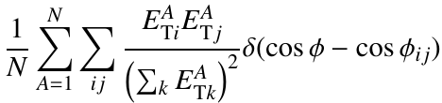
The observables
Eur. Phys. J. 77 (2017) 872
The TEEC observable is defined as the transverse energy-weighted angular distribution of jet pairs in a multijet event
  Have high sensitivity to pQCD effects
  Can be used to get α_{s} at various Q-scale: use Q=H_{T}/2
  It is infrared safe quantity with small 2nd order corrections
  Precisely measured from ratio of energies times angular quantities
The asymmetry between the forward and backward part of TEEC can also be measured (ATEEC).
  Better mitigation of scale uncertainties; scales are not asymmetric in cosφ.
TEEC:
N: events in a cosφ bin,
ij :jet pairs, φ_{ij} is φ_{j}-φ_{i}
ATEEC:
Notes:
Note on the Asymmetry: Because leading order effect is back-to-back, so phi=0 and phi=pi are very different, but also higher order effects on dijet shift them from back-to-back, we have a strong azimuthal asymmetry in the dijet topology, and so measuring this asymmetry is a good trick to increase the sensitivity to pQCD.

Slide 34
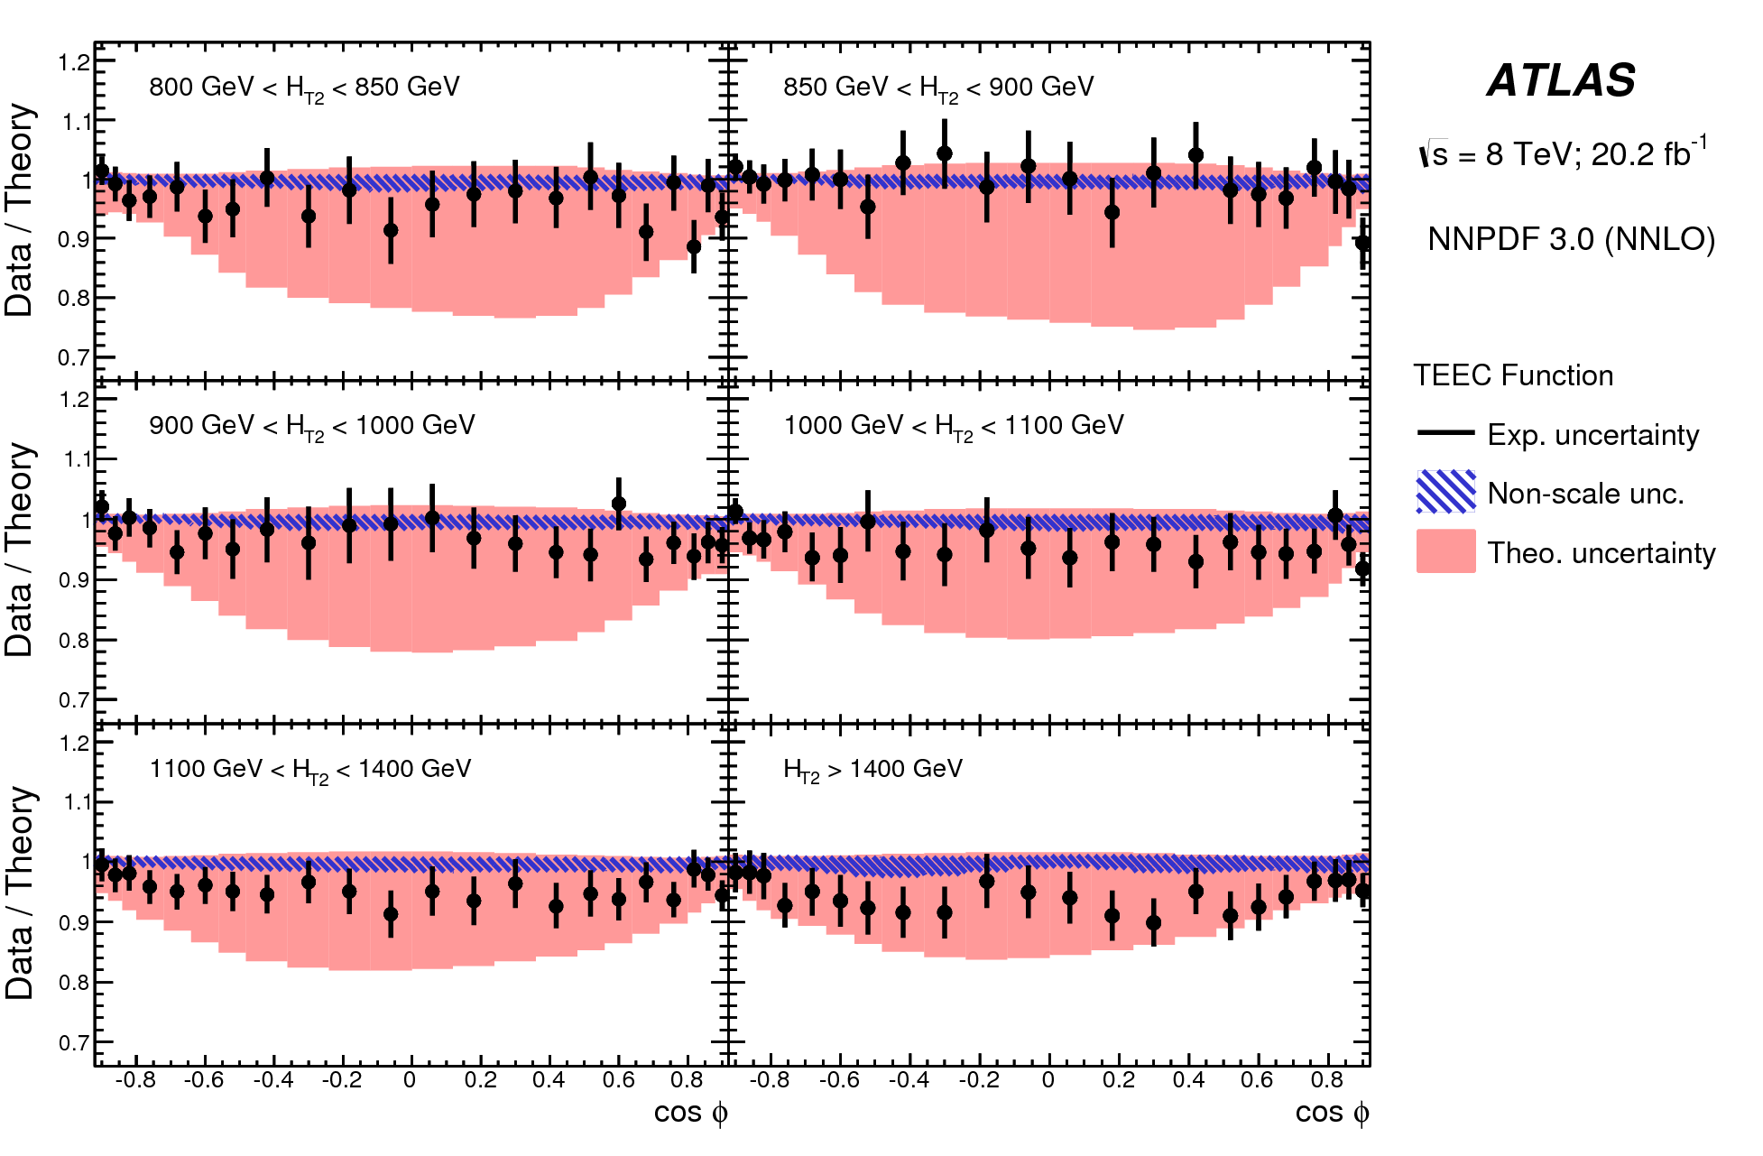
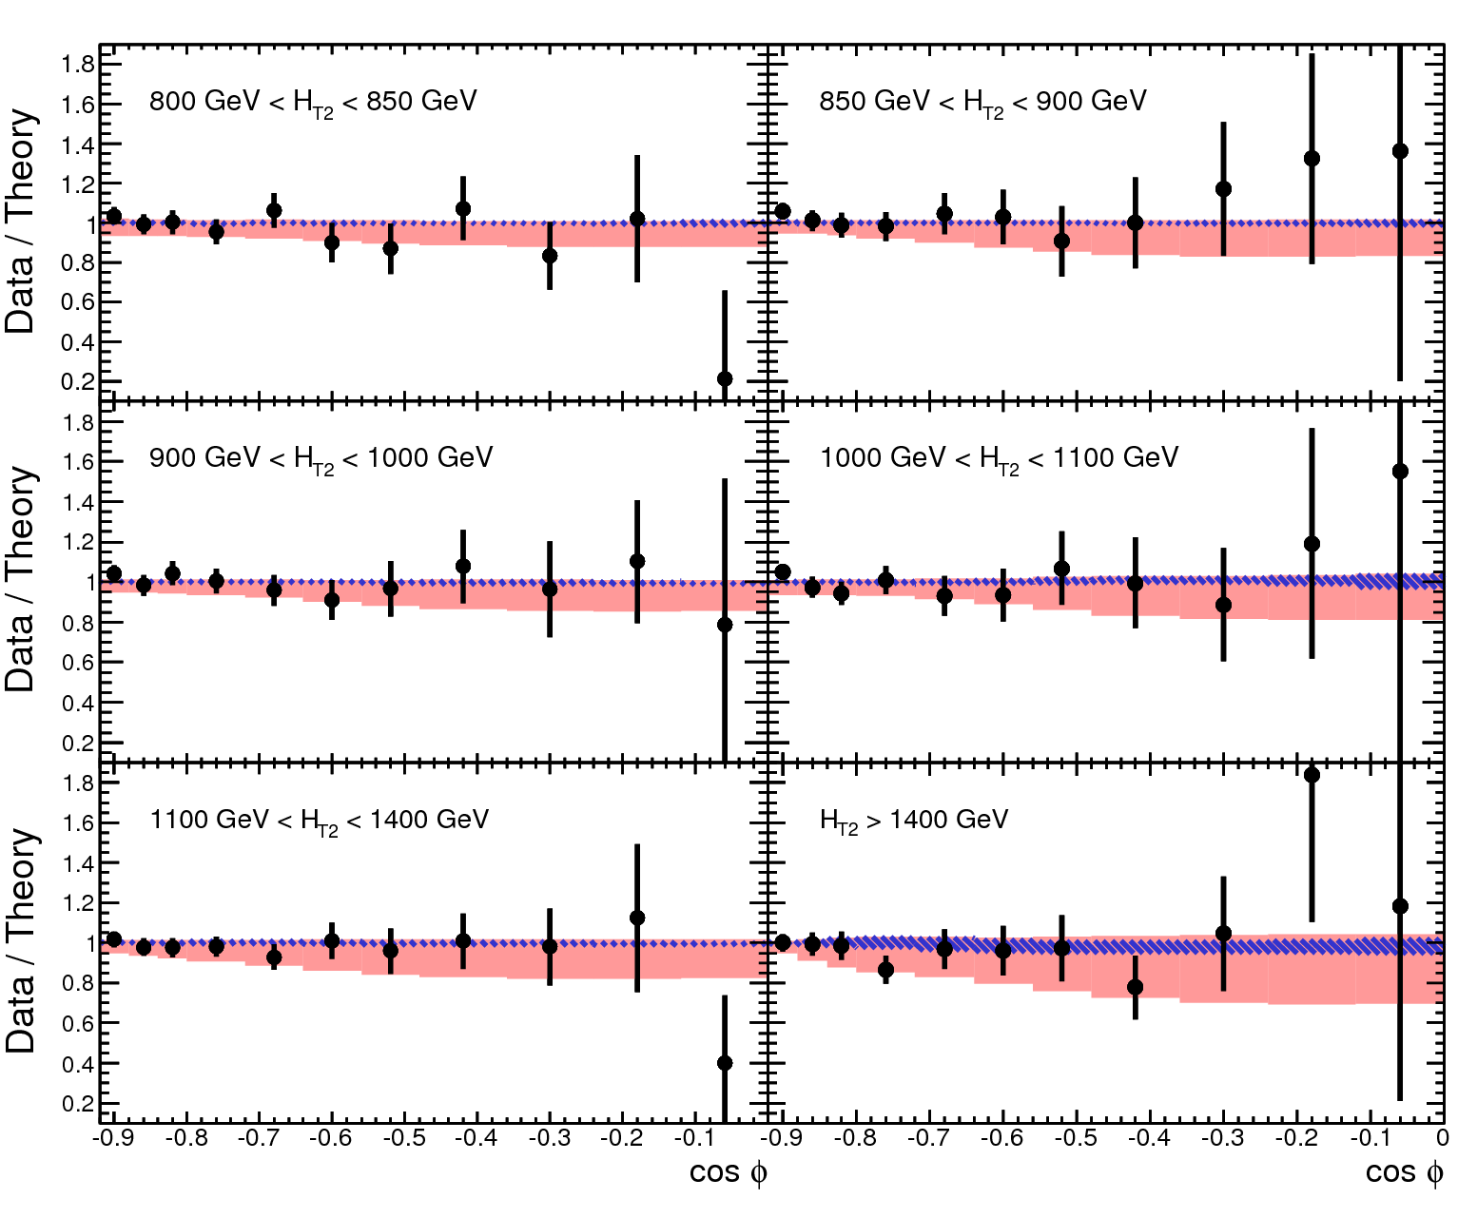
NLOJet++ provides an excellent description of both TEEC and ATEEC for most of the kinematic regions probed
  Little disagrement for TEEC at high H_{T}
Scale uncertainties are much smaller for ATEEC
  Indicate a too large estimate of higher order effects in TEEC
Both measurements can be used to extract α_{s}, with higher expected precision for α_{s}(Q²) from ATEEC
Notes:
Want to say: Most important thing to notice is that the data to prediction agreement is excellent for both observable in essentially all kinematic region (slight tension for TEEC at high HT).
=> The behavior of these observable is well understood by the pQCD predictions in hand, and so these are excellent candidates for alpha_s extraction.
However the most striking features is how much the scale uncertainty is reduced in the asymmetry measurement. Since theory must be assumed for extracting alpha_s, this should yield more precise results.

Slide 35
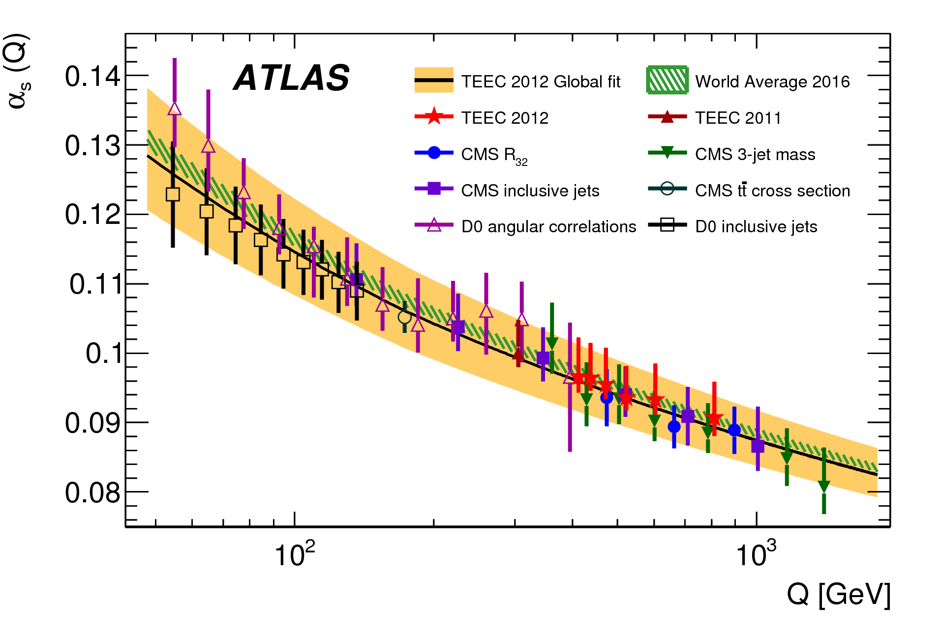
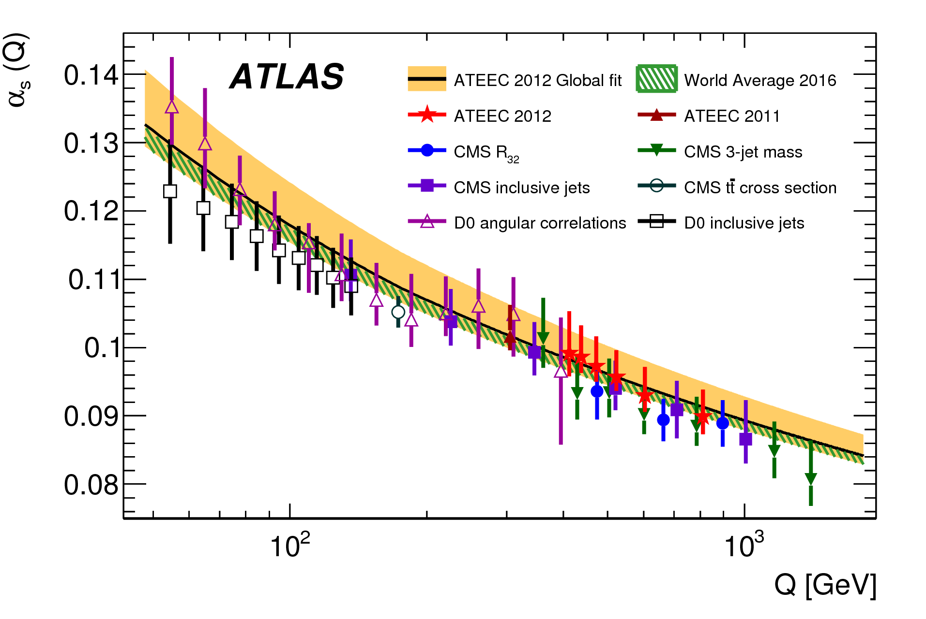
α_{s}(m_{Z}) is obtained from a χ² minimization in each bin of H_{T} with the various sources of systematics as nuisance parameters
  Need to interpolate/extrapolate data with an analytic function
  Assuming RGE, α_{s}(m_{Z}) measured in each H_{T} bin are evolved to Q=H_{T}/2 to get α_{s}(Q)
Results are:
  Consistent with world average
  More precise than other hadron collider results
TEEC
ATEEC
Notes:
Note on the results: That will tend to push the alpha_s value to slightly higher value, meaning, for a given scale, slightly more QCD radiation.
Note on the fit: The fit is done in a 74 dimensions space, 73 for the systematics (accounts for the correlations between them), and one for α_{σ}.
Transition rules are applied to n_{f} when evolving from Q<m_{t} to Q>m_{t}.

Slide 36
Soft Parton Radiation
(QCD Bremsstrahlung)

Slide 37
Vector Boson P_{T}
Eur. Phys. J. C 76, 5 (2016) 1-61
CMS-PAS-SMP-15-011
Test multiple aspects of QCD predictions
  Peak position: Intrinsic-K_{T}
  p_{T} ^{Z} << M_{Z}: logarithmic resummations
  p_{T} ^{Z}~M_{Z}: (N)NLO + PS perturbative QCD
    Important test of parton shower ISR tuning
  PTZ >> MZ: Fixed order + EWK corr.
NNLL soft-gluon Resummation:
(including GNW npQCD corr.)
Good description at low and
average P_{T} , but not when hard
gluon emission dominates
NNLO Fixed order (DYNNLO):
Cannot describe low P_{T}, but still does poorly at average P_{T}
PS can model low p_{T}, but with large variations on PS models
Multileg ME is important, even at LO, at larger p_{T}
Notes:
Want to Say: Measuring ZPt spectrum at the LHC is a fantastic laboratory for studying various QCD effects:
-Test of PS ISR: No color flow between initial and final state complementary to LEP FSR studies
-Same resummation needs for transverse momentum description of Higgs boson
Notes on the predictions:
-Sherpa here is Sherpa 1.4.1, so LO
-RESBOS is an approximate NNLO because it applies corrections to ISR from NNLO Wilson coefficient function. The soft-gluon emission is resummed at NNLL.
It used GNW parametrization at low Pt for non-perturbative effects.
Notes on the results:
-One of the problem of RESBOS at PT~50 GeV is the lack of NNLO QCD correction to the gamma* and the Z-gamma* interference contribution, visible by a larger deviation in this region when 46 < Mll < 66.
-Check which POWHEG parameters was used. One-jets ME or 0-jet ME. => From the reference, it seems they used the 0-jet NLO, so 1-jet LO, which makes sense for Drell-Yan Pt measurement.
SO, it uses 0-jet ME at NLO, so it is really the PS which is tested here, especially when 1/sigma dsigma/dpt is measured.
Other notes:
-Limitation of info that can be extracted: size of the bin limited by resolution effects

Slide 38
Vector Boson φ*
Complementary physics can be obtained by measuring Z φ*
  Finer resolution (bin) at low P_{T}^{Z}
  Smaller systematic
    From 0.1% to 0.6%
    2% to 6% for theory
Depend solely on angle of two leptons
Highly correlated to P_{T}^{Z}/M_{ll}
  0< φ* < 1 ⬄ P_{T}^{Z} < 100 GeV
Soft-gluon resummation (RESBOS) again provides a very good description of data in regimes where hard parton emission is not significant
  Smaller uncertainty
Notes:
-There seems to be better resummation model available for this observable (paper in my list?)
-higher purity -> bin-by-bin unfolding
-Sherpa and Alpgen: best description for f*>0.1 -> need for multiple parton matched to PS for intermediate PTZ (~50-100); fixed order calculation not enough

Slide 39
Vector Boson φ*
Parton shower approach to soft radiation can also provides a good description of low to average φ* values
  But high sensitivity to PS model or tuning
ME hard parton emission better describes large φ* or P_{T} values
Sensitivity to merging or matching of ME to PS
Notes:
-I say merging/matching because CMS Phi* is better described by MadGraph+Pythia, an LO calculator, than POWHEG+Pythia which is NLO, but with the same PS and tune as the Madgraph. For NOW to be worse, the issues must come from matching/merging procedure. It can also be due to the number of parton described at ME which is only one in Powheg and 4 in madgraph.

Slide 40
Need for tuning
JHEP 09 (2014) 145
Huge advantage of PS tuning over more accurate ME predictions for low and average P_{T} region, less critical for high Z P_{T} values
  True for both Z P_{T} and φ*
  Tuning effects larger for LO
  than NLO, but end point
  comparable

Slide 41
Limitations of tuning
Tuning provides a better description of data with similar event topology
  The AZNLO tune has been obtained from the 7 TeV ATLAS Z P_{T} and φ* measurements for 66 GeV < m_{ll} < 116 GeV
  It performs very well in the same phase space for 8 TeV data
A tune will however often be sub-optimal in some other phase space regions.
Tuning cannot be the solution to all QCD emission mis-modeling issues for future predictions
  But it can be a useful tool for reweighting

Slide 42
Steps of k_{T} jet algorithm
Illustration of the kt clustering sequence starting from the original input configuration (three objects p1, p2, p3, and beams B1, B2). At each step, k+1 objects are merged to k
Initial situation
The min(d_{ij},d_{ib}) is between p₂ and p₃:
The two particles are merged and the
new object is the sum of the two 4-vectors
The min(d_{ij},d_{ib}) is between p₁ and B₂:
p₁ is defined as a jet
The min(d_{ij},d_{ib}) is between p₂₃ and B₁:
p₂₃ is defined as a jet

Slide 43
The physics of k_{T}-splittings
Parton radiation is intimately related to jet clustering algorithms:
sequential k_{T}-type jet algorithms produce infrared- and
collinear-safe branching history of partons.
    Each step of the k_{T} algorithm identifies the pair of partons which would most likely proceed from QCD emission or splitting
    Used to determine when a branching occur in CKKW for example
Criteria for combining partons i and j:
Splitting prob. for branching in partons i and j in the soft and collinear limit:
Measuring the k_{T}-splitting scales at different steps of the iteration would allow to test branching modeling at different scales therefore testing resummation, parton shower, ME, etc.

Slide 44
The measurement
Eur. Phys. J. C 73, 5 (2013) 24-32
JHEP 08 (2017) 026
√d_{k}: k_{T}-splitting scales where number of input drops from k+1 to k
  Large k and low √d_{k} values are sensitive to soft emission and non-perturbative effects; low k and high √d_{k} are sensitive to hard radiation
  Can be used for tuning
Low √d₀ is sensitive to PS and npQCD; high √d₀ is not sensitive to soft effects, but favors high-multiplicity LO over low-multiplicity at NLO
Use tracks for more precision
Improvements at high √d₀: Sherpa 2 uses NLO+tree-level+PS.
NNLOPS is NNLO for Drell-Yan only, so ME up to 2 jets.
Ratio of scale is more precise. The √(d₁/d₀) probes NLO to PS matching. The MC@NLO matching is better than the Powheg approach.
Notes:
Want to say: These are Drell-Yan processes, and so the 0-parton final state is the low PtV region, sensitive to soft effects, especially if d0 is small. If d0 is large, it is a case where the emitted radiation was hard.
=> This provides further information from what PTZ and phi* provided.

Slide 45
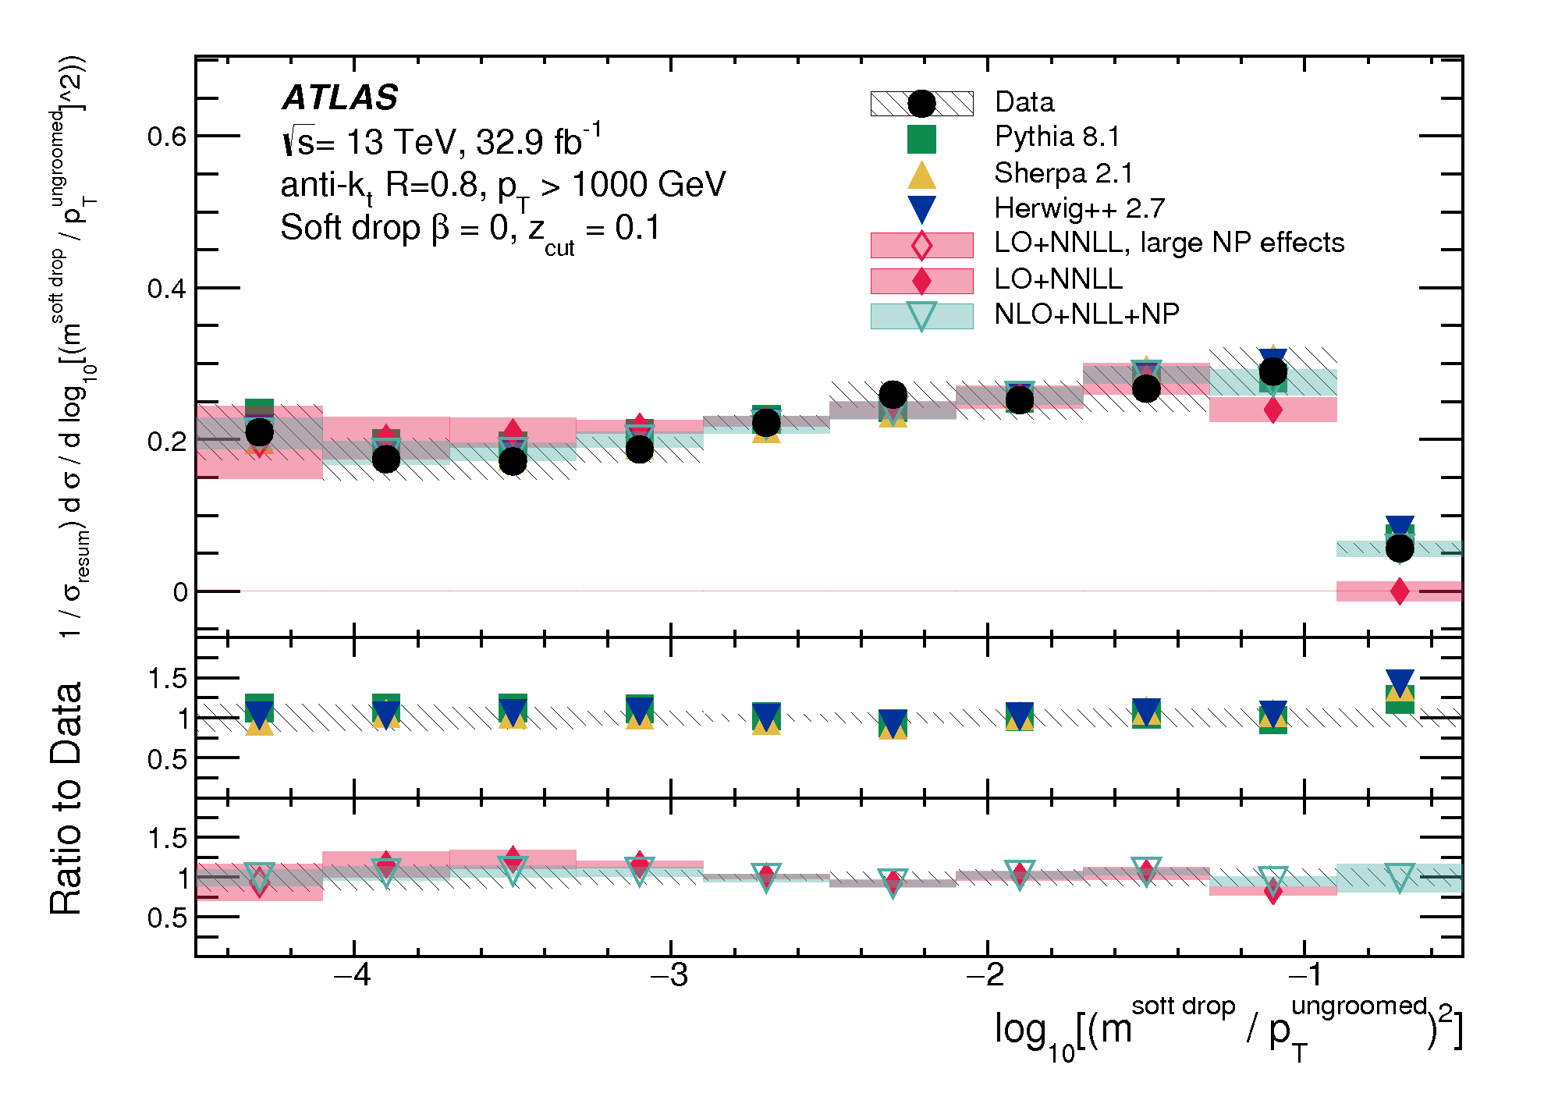
Soft drop groomed jet mass
Phys Rev. Lett. 121 (2018) 092001
Soft drop is a jet grooming procedure that yields NNLL resummed jet observables.
  Discard soft gluon emission when condition not satisfied until a sufficiently hard branching is found
  PS and NNLL resummed predictions are in agreement with data
Sensitive to npQCD effects
Sensitive to HO ME corrections
Soft drop grooming strips soft-radiation from the jet, suppressing the Sudakov peak good test of ME calculations
Notes:
Want to say: You form the logs of two energy-scale quantities (square) that could get large and not under control if these logs are present in the calculation. If they are not, then the prediction can be considered resummed to the level of accuracy probed, and so the predictions with different model of resummation below that level will be the same. That’s what we observe.
-The soft drop grooming eliminates the non-global logs due to the correlation between the in- and out-of-jet scales, which prevents from going beyond the LL accuracy that can already be obtained in parton showers.
-Also, by applying the soft drop algorithm to jets, the soft portions of a jet are removed, resulting in a dramatically reduced Sudakov peak in the jet mass distribution, showing that very soft and collinear radiation have been removed.
-Pythia uses the CUETP8M1 tune, while Herwig uses CUETHS1.
-Frye et al uses SCET to get their NNLL accuracy on multijet process obtained from madgraph at LO
-Marzani et al uses traditional NLL calculations merged to NLOJet++

Slide 46
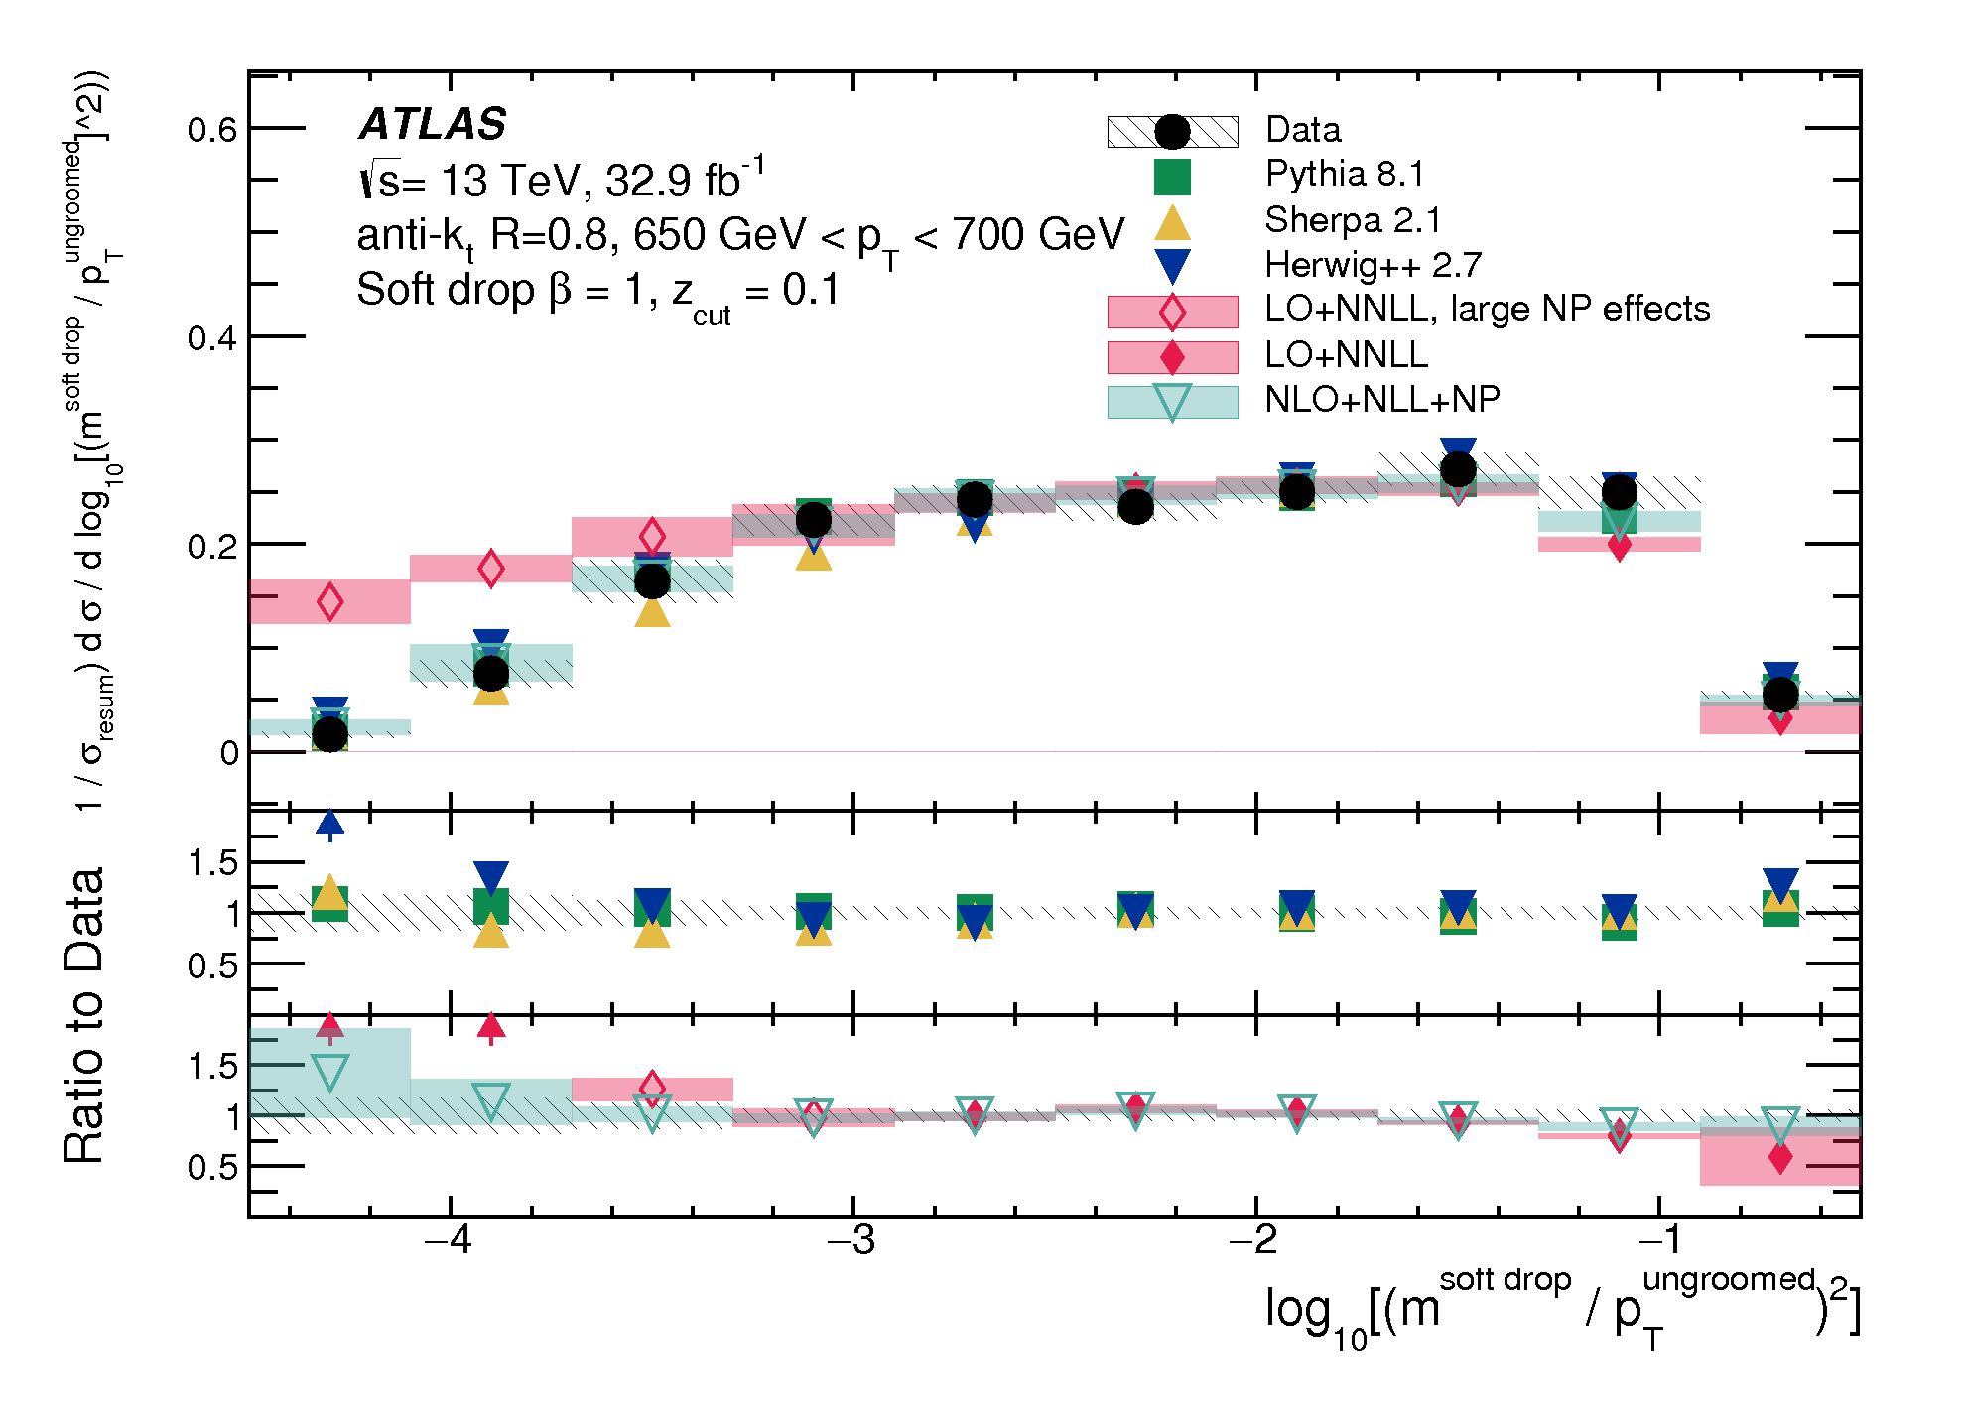
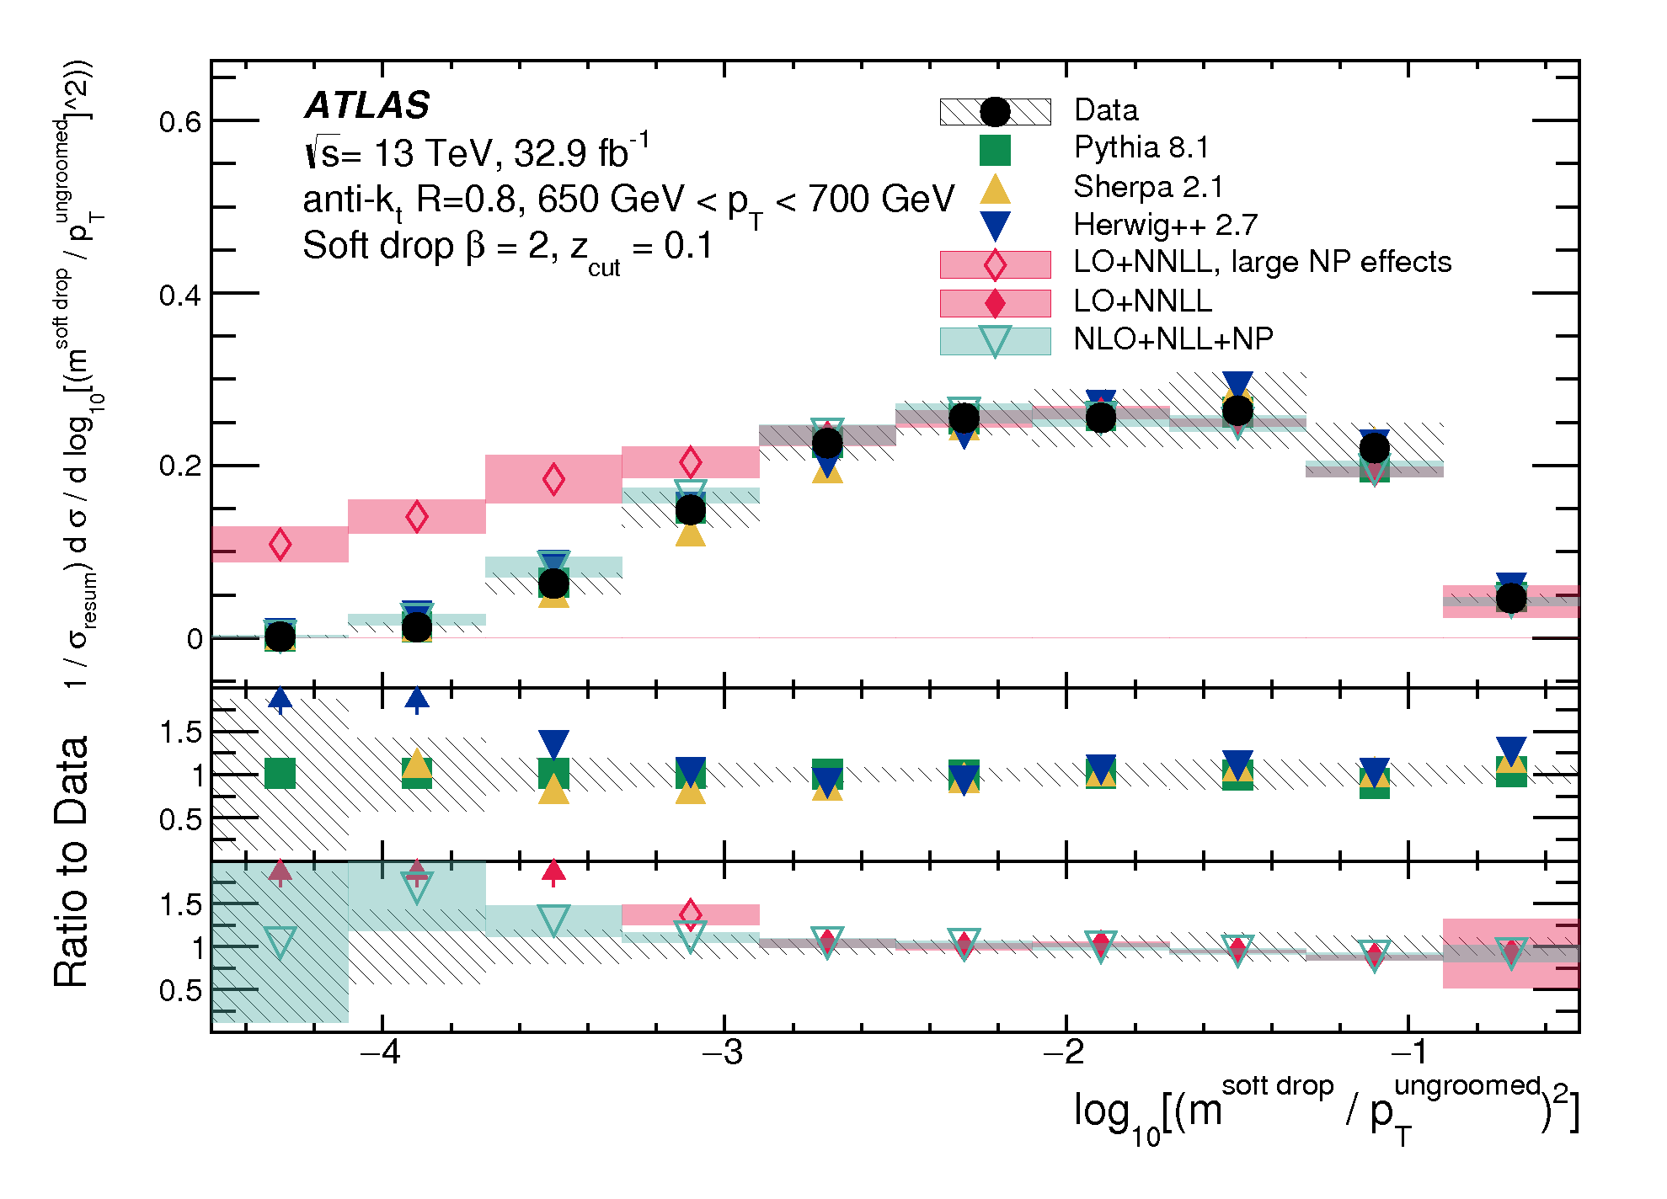
As β increases, the fraction of radiation removed by soft-drop grooming decreases and sensitivity to npQCD effects gets larger.
In resummation region: NLL, NNLL, and PS equally describe well jet substructure. Only extreme cases depend on ME or Frag/Had.
  Parton level predictions for the two leading jets of dijet events are robust, but resummation is important to separate other topologies.
Notes:
Note: This is looking at how the mass is modeled when the jets clearly come from ME partons, and there, indeed, collinear and soft radiation doesn’t matter, provided resummation happens. It would have been nice to compare to a non-resummed prediction. Of course, modeling 3rd and 4th jet topology rely essentially on this extra radiation when it is out of the jet, so in phase space where the radiation is not that soft and not that collinear. So the bottom line is that resummation indeed restore the calculation, but it doesn’t fix all problems.

Slide 47
Hard Parton emissions

Slide 48
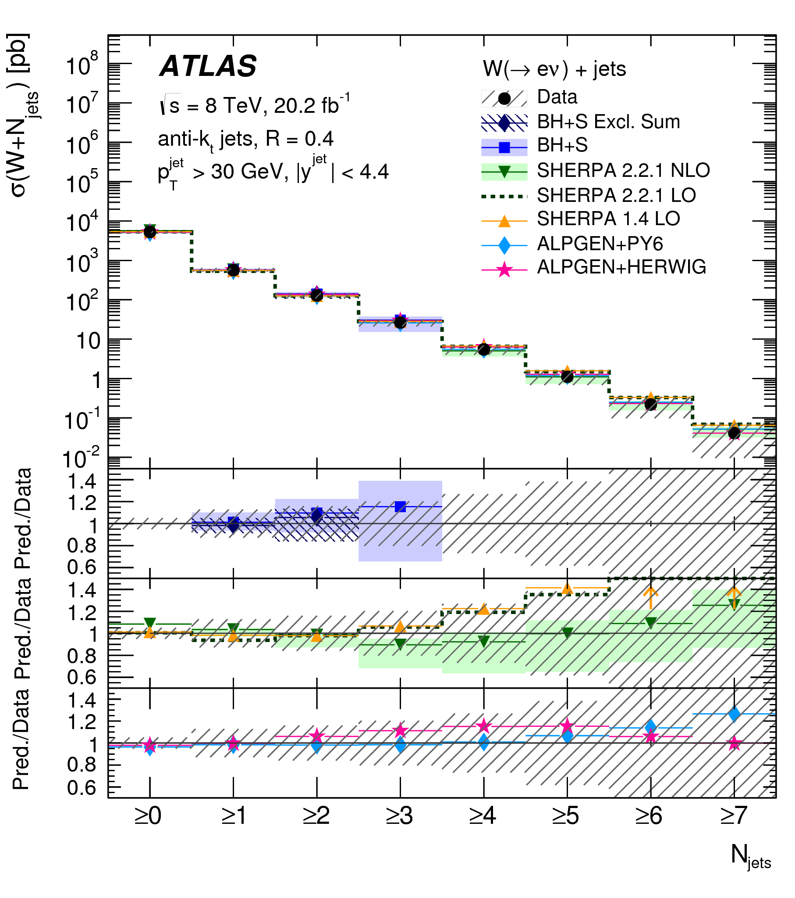
Hard radiation: V+jets
Eur. Phys. J. C77 (2017) 361
Test pQCD in more exclusive final states
  Large phase space for QCD bremsstrahlung: room for hard radiation
  Both ISR and FSR are entangled
  Multiple scales in each event force more sophisticated predictions
  Direct study of SM in regions where new physics is often predicted
JHEP 05 (2018) 077
Multiplicities in good agreement with ME when jets are hard
  PS lacks of large angle hard emission
  More jets at LO ME is better than fewer jets at NLO
  PS and merging matters at high N_{jets}
8 TeV Z+jets
13 TeV Z+jets
Notes:
Want to say: Also notice that mis-modeling effects hits harder in 13 TeV (see Z+jets) than in 8 TeV (see W+jets) because more energy is available to produce more jets.

Slide 49
Lack of PS is detrimental to jet momentum modeling
  Exclusive sum and NNLO not sufficient to restore agreement in H_{T}
  Adding “virtual corrections” does not improve on exclusive sum with no matching procedure
No significant sensitivity to the choice of PS (Alp+Pyt~ Alp+Her)
Alpgen ME+MLM merging cannot describe W+/W-
Is there a big issue with MEPS@NLO matching prescription?
Notes:
Want to start with:
-From previous results, it sounds like if PS was bad, but in fact, it is a good thing, just not accurate enough for some corner of the phase space.
Want to add:
-You might think that if you sum the jet energy, it doesn’t matter if you made this jet splititng or not, you’ll get the right thing if your initial partons are right. Well, this is not the case. First, the sum could be scalar, and the lack of PS is very bad, or it could be vector, and it is still not good. PS does more than just your soft resum.
-The sensitivity to PS really depends on the observable and the kinematic region probed.

Slide 50
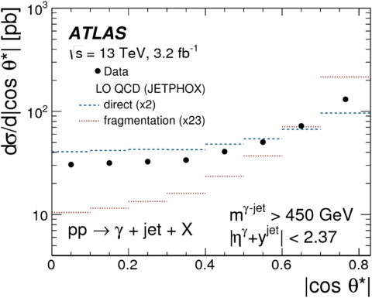
γ+jets: Different contributions
Phys. Lett. B 780 (2018) 578
|cosθ*| indicates, at LO, the relative contribution from hard scatter and softer quark fragmentation effects
  Even if these effects are merged at NLO, it indicates the relative impact of emissions at different scales
  It is sensitive to the spin of the exchange particle
    t-channel quark exchange -> hard scatter
    t-channel gluon exchange ->dijet + frag.
    s-channel: both effects are non-singular
Frixione Isolation on γ:
To regularize collinear divergences in ME, and constraints fragmentation :
Also help suppressing π⁰, η bkg.
Notes:
Note: The variable θ∗ coincides with the scattering polar angle in the centre-of-mass frame for collinear scattering of massless particles

Slide 51
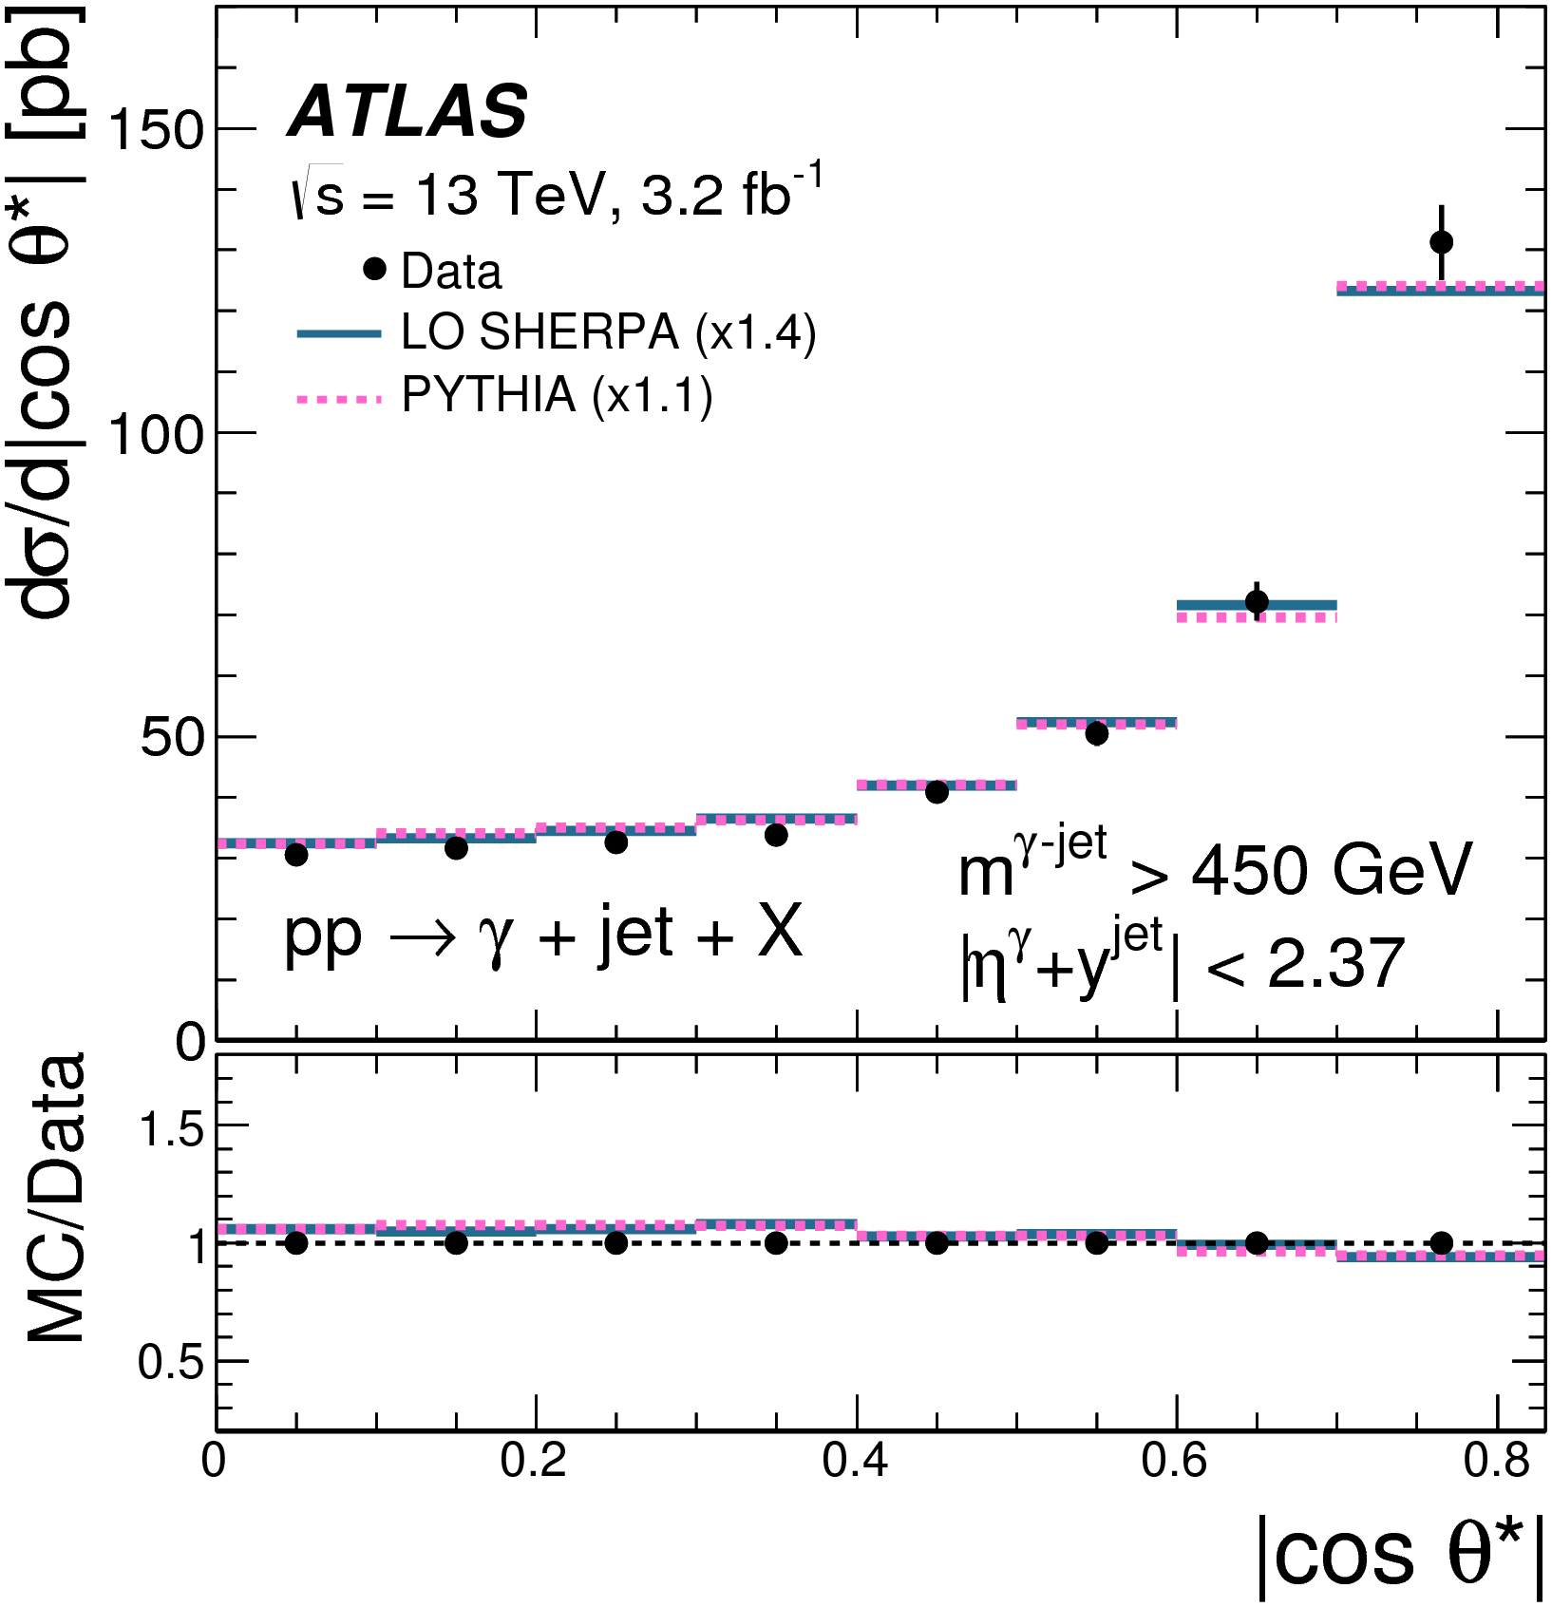
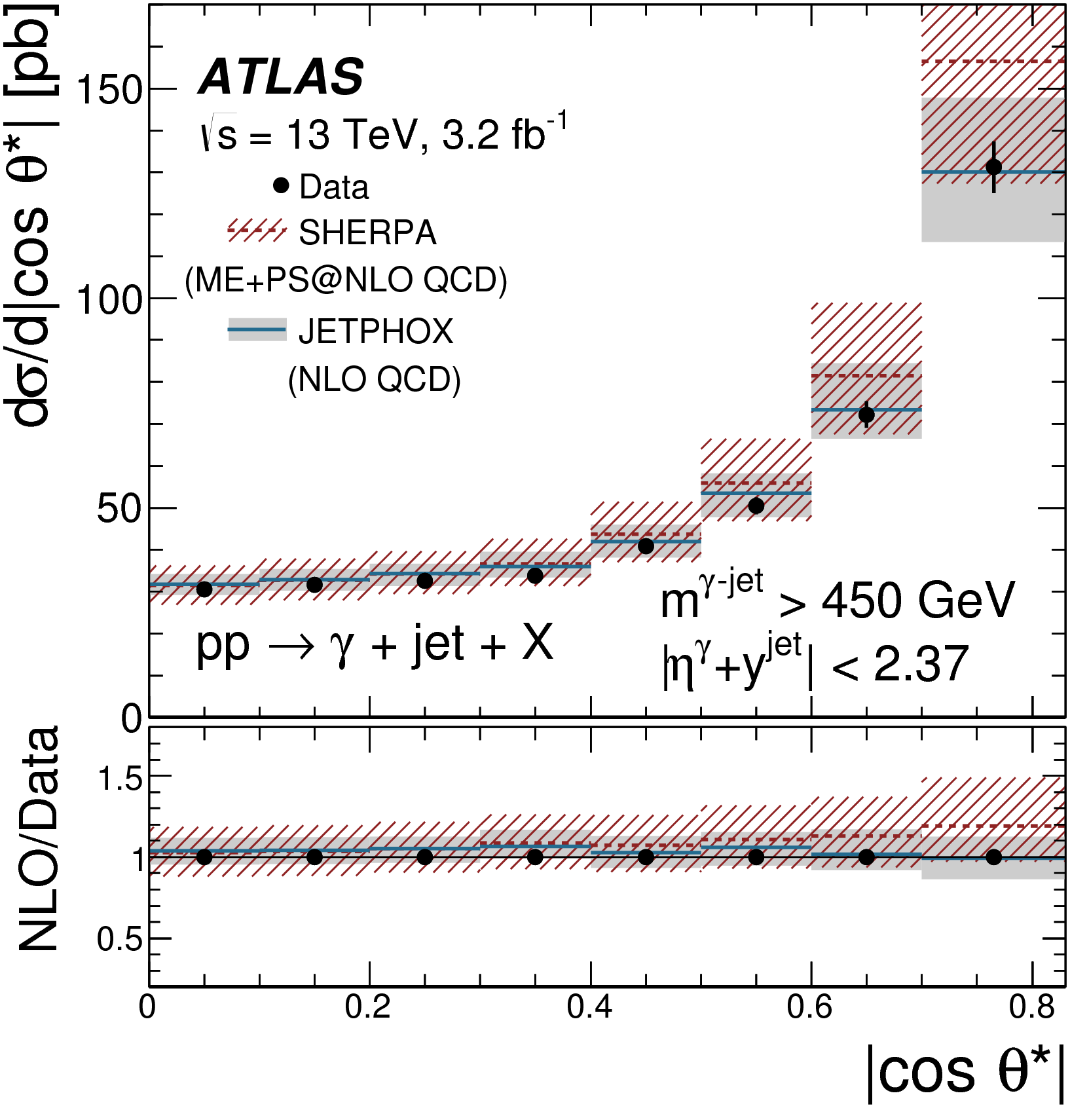
Both LO and NLO describe well the composition of γ+jets in terms of hard scatters and softer QED emission
  Good description of photon bremsstrahlung both from QED FSR and from ME calculation
  LO predictions are normalized to the measured cross section value
  Scale uncertainties only included for NLO (dominant systematic)
LO
NLO

Slide 52
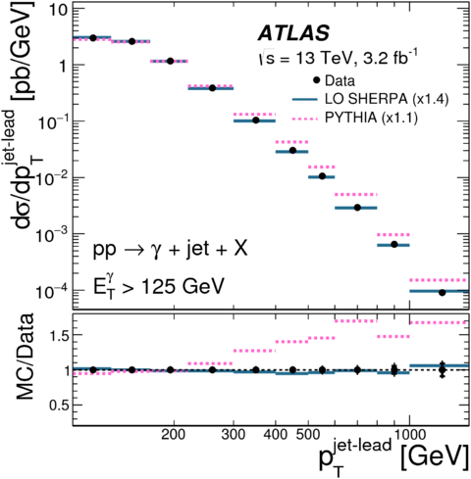
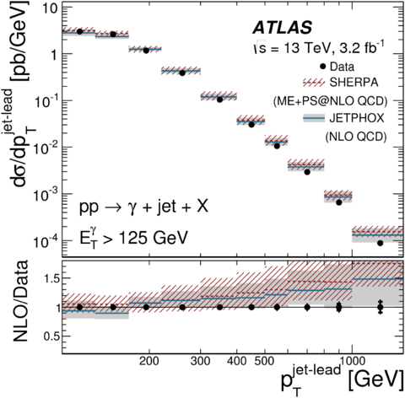
Excellent shape description from LO SHERPA but agreement spoiled at large p_{T}^{jet} when higher order corrections are added.
  Merging issue? Some double counting?
    E_{T}^{γ} is well described at both LO and NLO so it is a QCD issue…
  JETPHOX has no PS correction and agrees a little bit better
    QED fragmentation is at NLO
  Scale uncertanties are large…
Pythia has too large γ-brem from tune for harder jets
LO
NLO
Notes:
Start saying: can we model other relevant observable as well as cos?

Slide 53
Heavy Flavor Jets

Slide 54
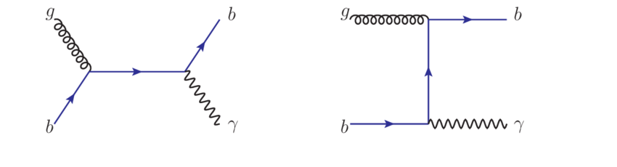
X+b-jets: The Issues
Treatment of massive quarks in ME calculations
  5 flavor scheme: m_{c,b} = 0 in ME, initial b-line in Feynman diagram with probability obtained from PDF
    Large log resummed in DGLAP
    Only small contribution in W+b because of CKM
  4 flavor scheme: m_{b} ≠0 in ME so only 4 flavors in PDF, b-quark obtained from gluon-splitting in ME
    Introduces non-resummed large log(Q²/m_{b}²) when Q is large
Mass of c- and b- quarks in PS spoils “resummation”?

Slide 55
Heavy flavor: Z+b-jets
JHEP 10 (2014) 141
Data favor scheme where the b-quark is taken from PDF (5FNS)
  Shapes seem not too badly modeled regardless of the approach
  LO+PS generators underestimate the cross section
Notes:
-The MadGraph NLO prediction is also obtained using 5FNS PDF. The same applies to Powheg.
-The discrepancies with NLO could be due to singularities in Altarelli-Parisi splitting functions at NLO that are not present a LO.

Slide 56
Heavy flavor: Z+bb
Different impact of flavor scheme when 2 b are in the final state
  Mostly come from gluon splitting in all cases
Gluon splitting seems not to be very well understood in the collinear regime at LO and NLO.

Slide 57
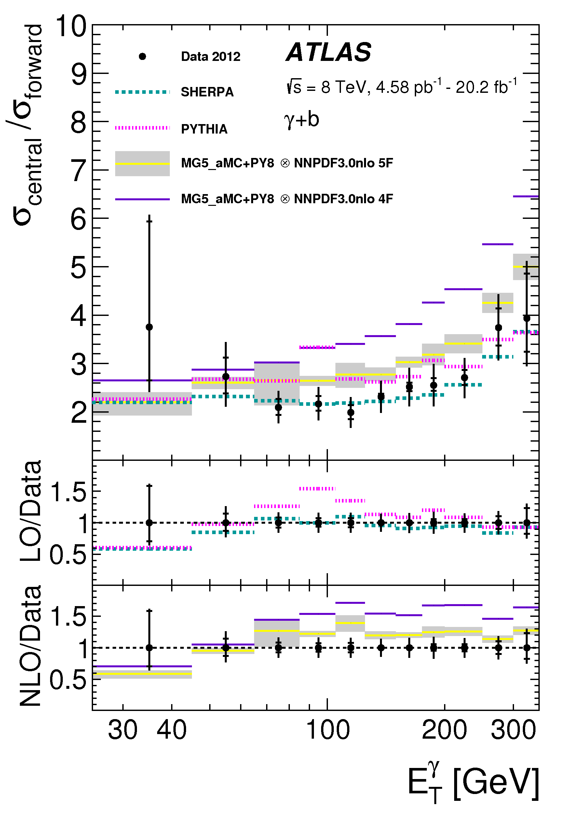
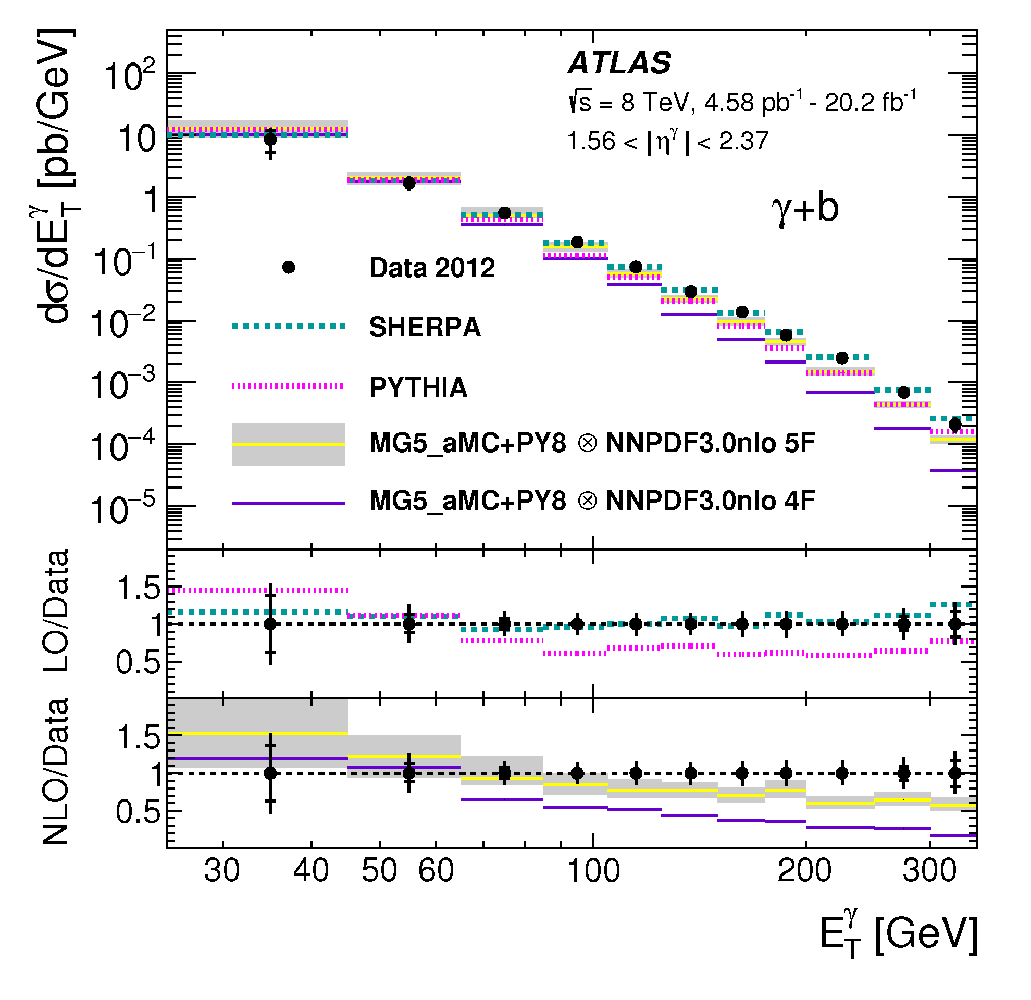
γ+Heavy Flavor
Phys. Lett. B 776 (2018) 295
SHERPA gives a near perfect description of the E_{T}^{γ} at all y^{γ}
  SHERPA is 5-FLS with up to 3 extra partons at tree-level and m_{b}≠0
  Significant tensions with (2->2) LO PYTHIA (5FS m_{b}=0)
NLO+PS don’t describe high E_{T}^{γ}, but 5 FS agrees better than 4 FS
  Fails where log(Q²/m_{b}²) are large
  Gluon-splitting, modeled at LO, dominates over Compton at high E_{T}^{γ} due to steeply falling PDF.
γ+b

Slide 58
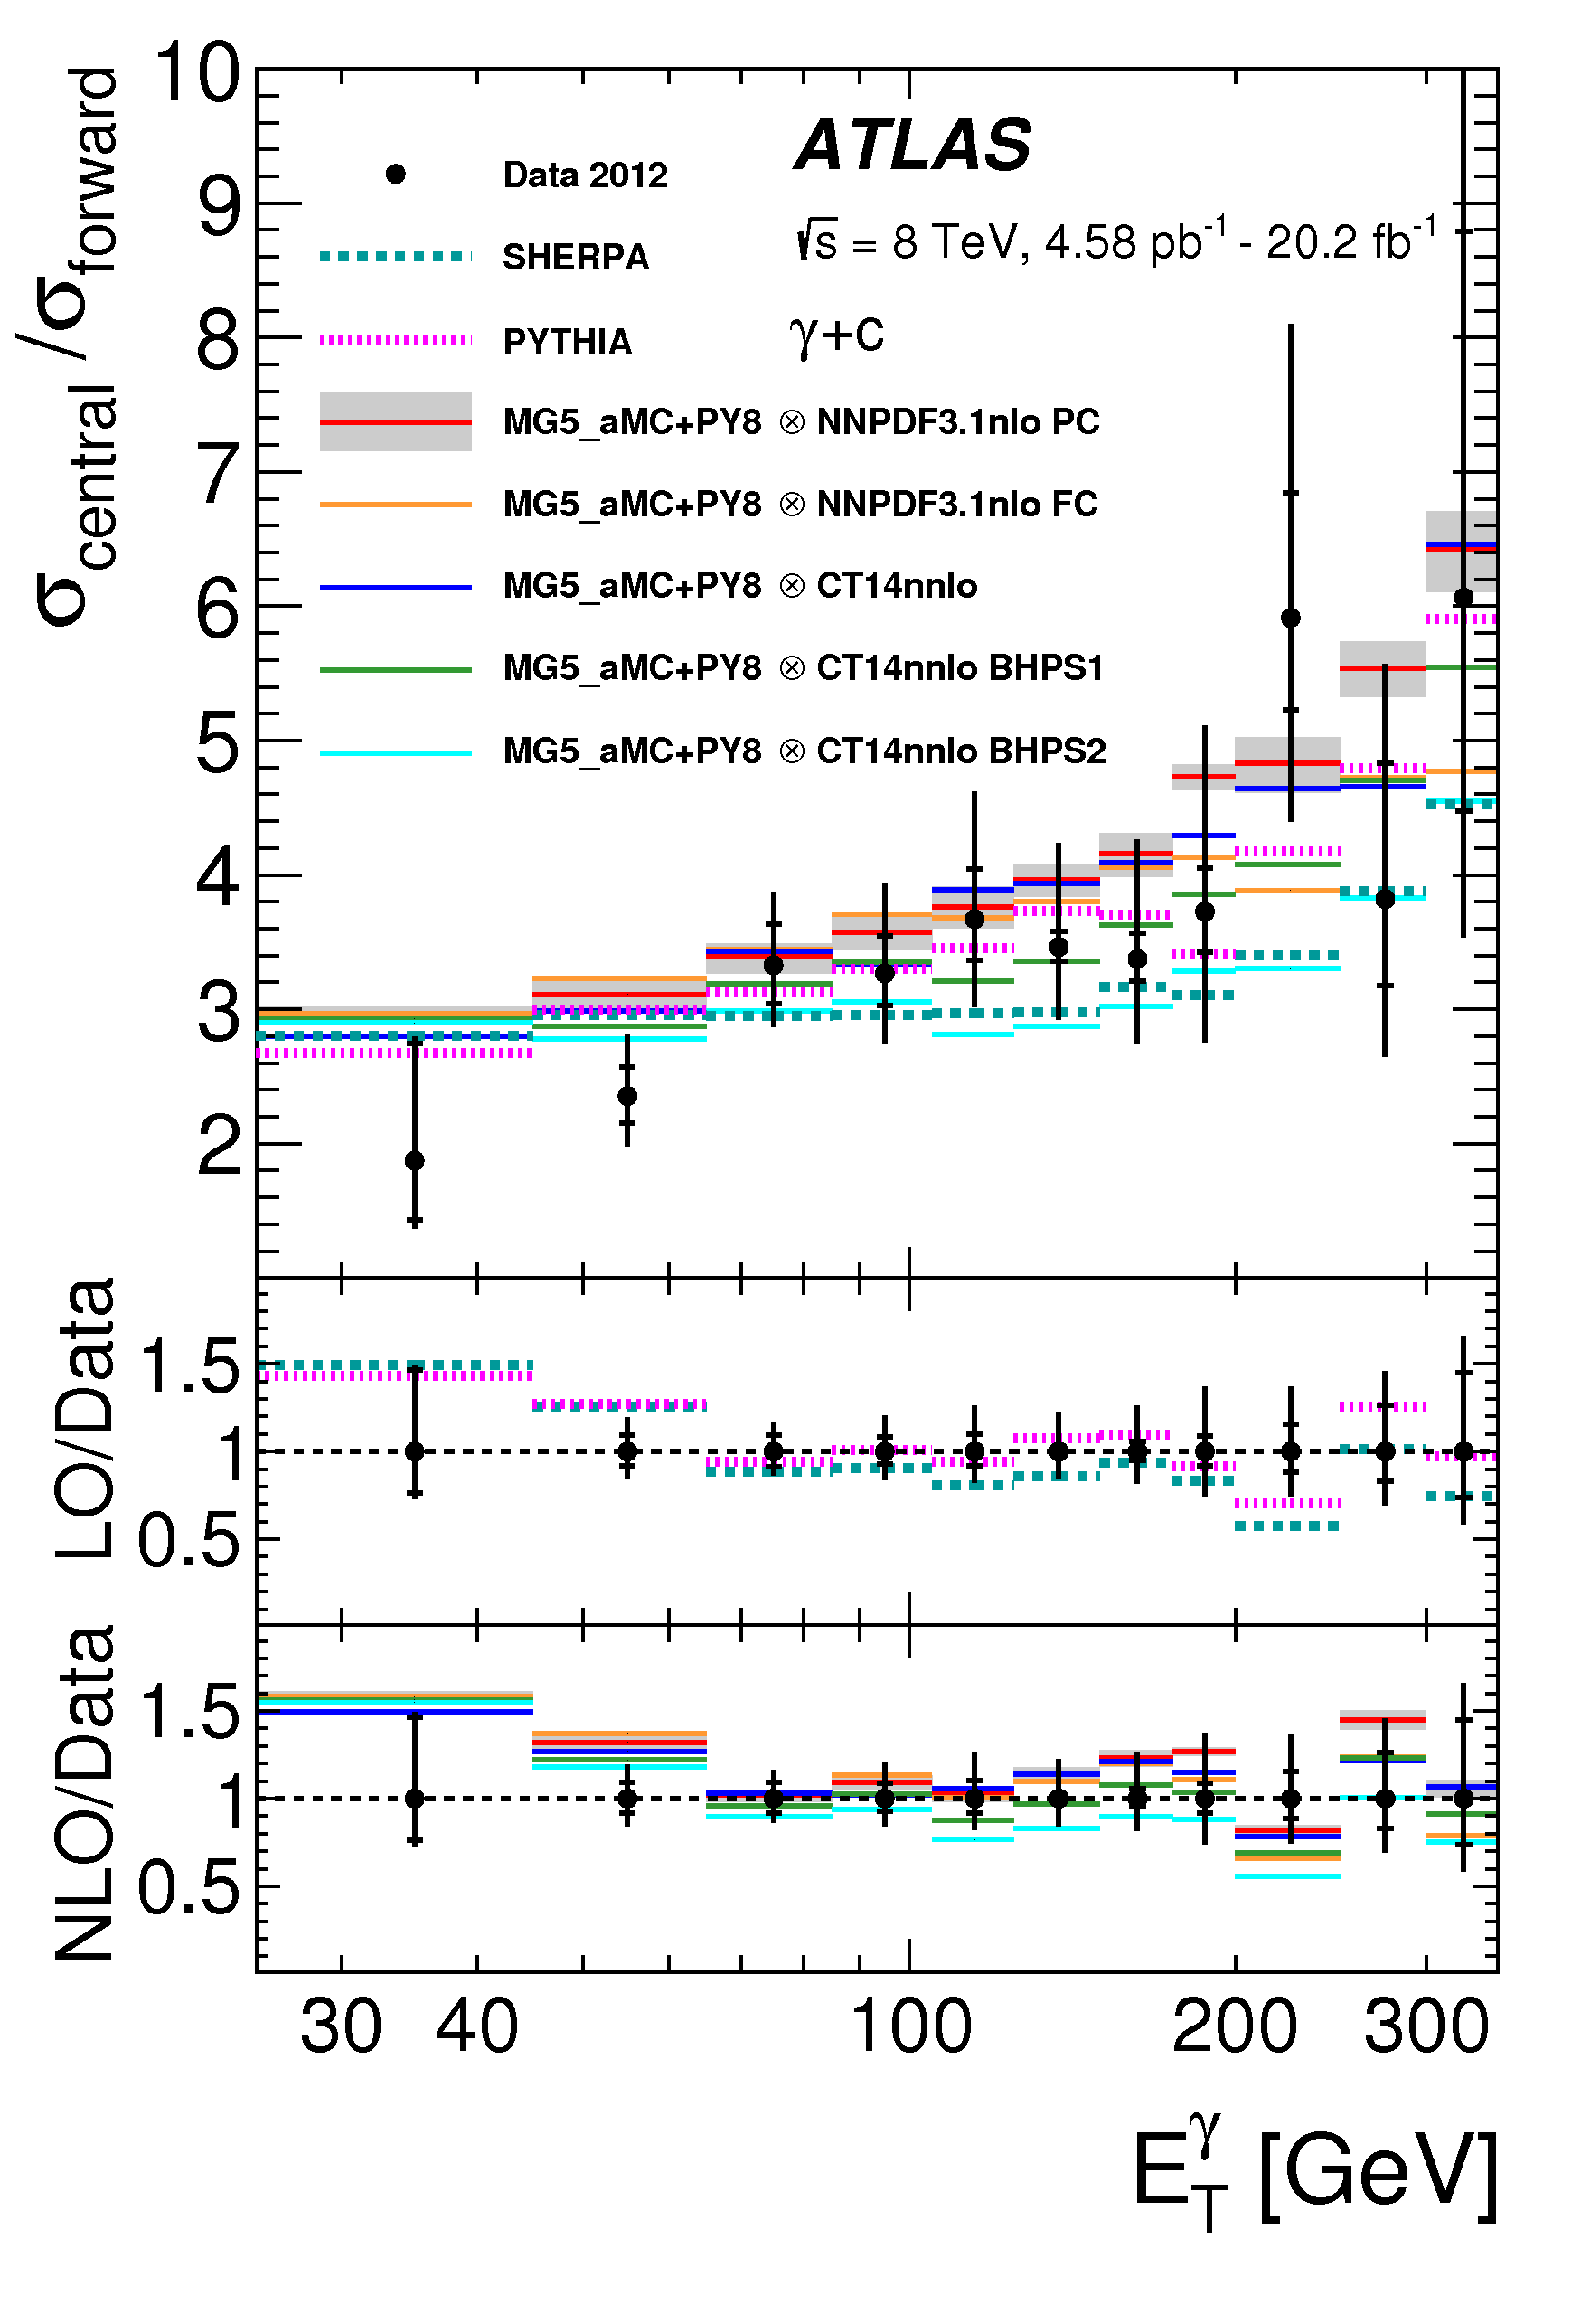
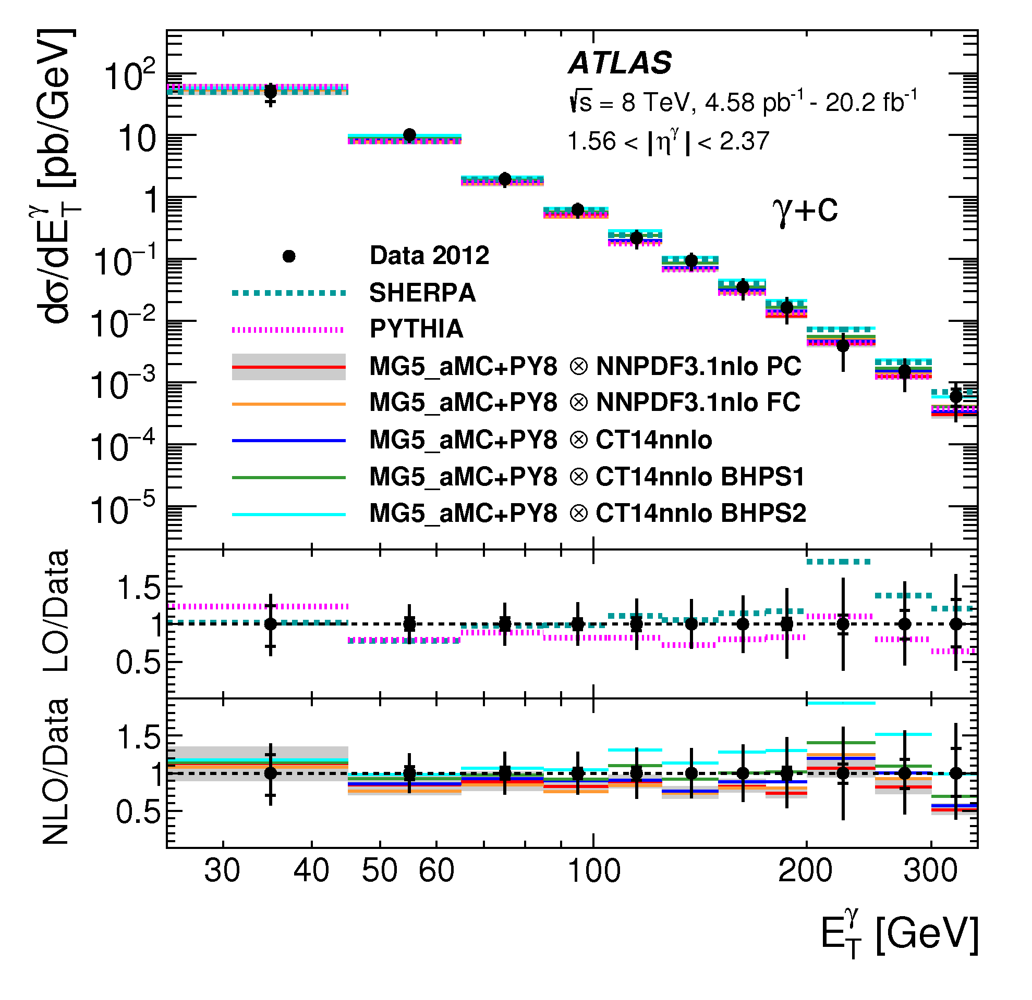
Agreement between data and NLO+PS predictions much better than for γ+b because gluon-splitting process is relatively less important at probed E_{T}^{γ}
  Larger PDF and electric charge
  Gluon-splitting comparable to γ+b for E_{T}^{γ}>~ 700 GeV
Even if not enough precision to infirm intrinsic-charm, tensions with BHPS2 indicate that IC<2.1%
γ+c

Slide 59
Conclusion

Slide 60
Conclusions
QCD effects are pervasive elements of particle physics:
Subject of a variety of challenging experimental measurements… only a small subset has been shown
Each measurement usually delivers an important message to the experimental and theoretical communities
Comparison against state-of-the-art theory predictions
  Tensions with predictions indicate where theoretical improvements are needed
  Improved understanding of the proton, of soft and hard radiation, of gauge structure, and of anomalous couplings
These measurements help reducing uncertainties, which improves search sensitivity to new physics
Mastering QCD is both essential for the future of the LHC program and for the advancement of our knowledge

Slide 61
Back-up slides

Slide 62
More Intro

Slide 63
Below are a few examples of QCD modeling impacting differential cross section and specific event selection predictions
Parton showers model parton evolution through gluon emission and splitting, while resummation is limited to specific predictions:
  Soft and collinear approximations (where QCD radiation is enhanced)
  Leading order kernel functions
  Choice of ordering parameter
Parton distribution function (PDF):
  Uncertainties on measurements used to extract structure functions
  Modeling of structure functions at Q₀
Fragmentation function:
  Gaussian modeling of D(x,s) at small x
  Supplemented by hadronization model

Slide 64
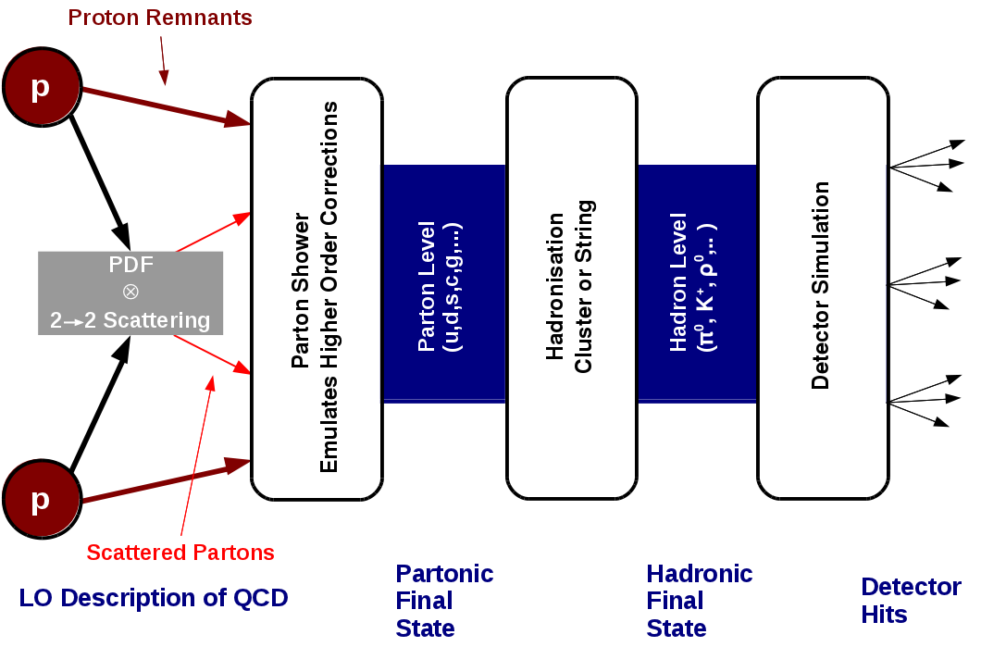
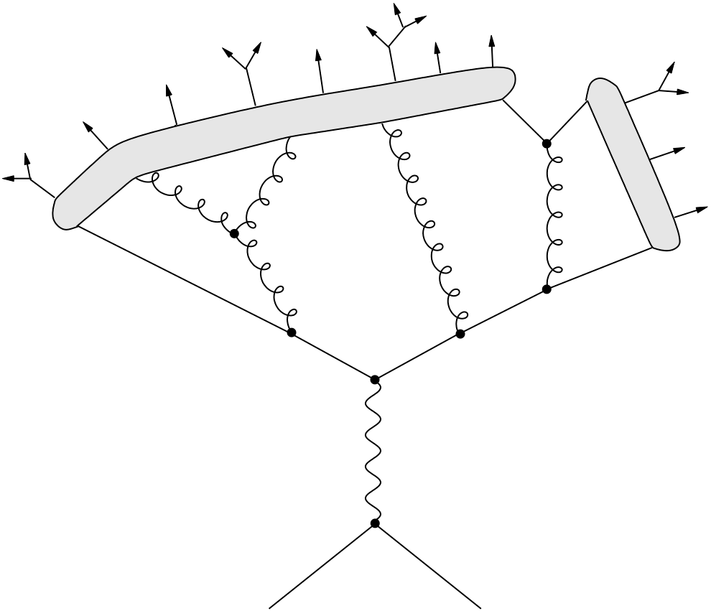
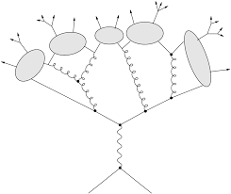
Pythia (8.175) vs Herwig++ (2.63)
Hadronization:
Pythia: Lund string
(linear confinement)
Parton shower
Hadronization
Herwig: Cluster
(preconfinement)
Pythia: p_{T} ordering
(natural for a shower partly based on dipole approach)
Showers ordering:
(nLL resummation)
Herwig: angular ordering
(deal with quantum interference)
Notes:
Notes on QCD features of these calculations:
-Shower ordering: determine evolution of resolved QCD emission
-Linear confinement: color field stretching between quark-anti-quark pair like a string breaking spontaneously in segment of q-qbar pairs.
-Preconfinement: pair of color connected neighbor partons with a universal and Q2-independent asymptotic mass distribution suggesting particles.
Check ref 47 and 48 of jet-charge for the discussion on use of NLO PDF on LO ME.

Slide 65
Pythia (8.175) vs Herwig++ (2.63)
PDF:
Different PDFs can be used in generators, but there is the question of the compatibility between choice of PDF and matrix element
E.g.: LO** PDF
Will not focus on these effects in this presentation, but they might convolute to the effects of interest
Pythia: AU2 & A14 tunes
(Many parameters)
Multiple interactions:
(Each generator is tuned for different PDF on Run-1 ATLAS data)
Herwig: EE3-EE5 tunes
(Fewer parameters)

Slide 66
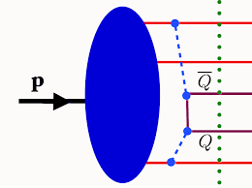
Study the heavy flavor (HF) content of the proton
  Extrinsic component where HF follows from PDF evolution
  Intrinsic component which would consist on a non-pQCD HF contribution to PDF
    Has never been observed before but was hypothesized by Brodsky et al. (1980)
    A model (BHPS) with various level of intrinsic
    charm (IC) contribution (0.6% and 2.1%) is
    available through LHAPDF
Five-quark Fock state |uudQQ> of the proton at the origin of IC .
Adv.High Energy Phys. 2015 (2015) 231547
Notes:
Note:
-Larger effect expected at large Bjorken-x, so intrinsic HF contribution is enhanced when selecting high η^{γ} and E_{T}^{γ}
-Since m_{b} >> m_{c} ~ Λ_{QCD}, b-quark can more accurately be perturbatively included in PDF, so IC is expected to be larger

Slide 67
Strategies

Slide 68
Choose to measure the differential cross section of observables for which theoretical predictions disagree for the SM effects under investigation
Example:
The azimuthal angular decorrelation (≠π) between the two leading jets in inclusive 2-jets events is sensitive to parton emission of various “hardness”
Predictions on Δφ₁₂ widely differ
Eur. Phys. J. C 78 (2018) 566
Perform the measurement to determine which calculations provide a better description of data and which theory improvement is needed
In our Example:
The Herwig parton shower provides a poor description of data especially at large angle, while matching a PS to a ME yields the best agreement

Slide 69
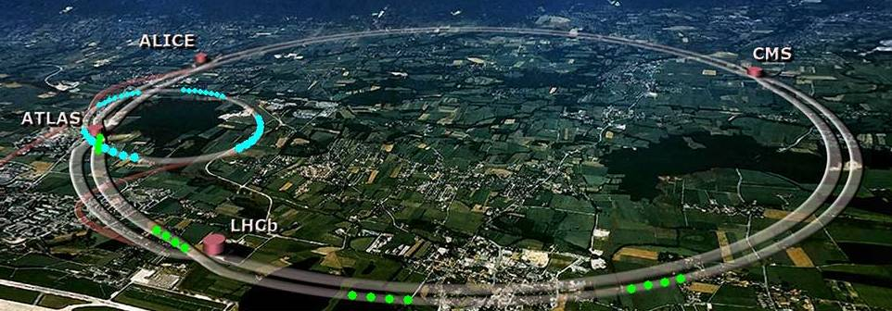
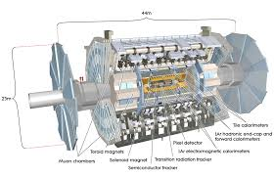
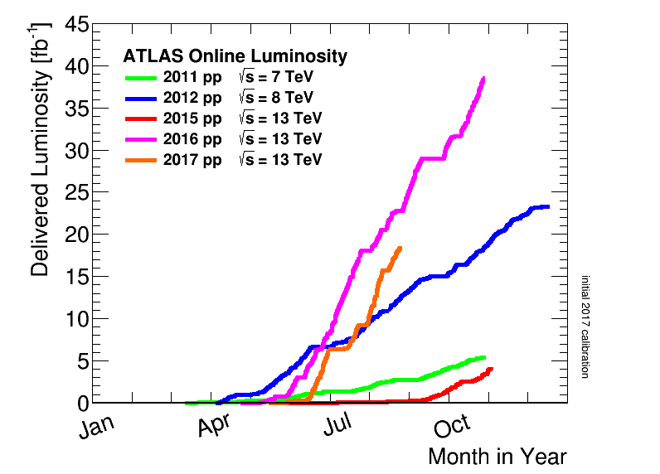
Our tools!
The results to be presented here have been obtained with either the 7 TeV 2011, 8 TeV 2012 or 13 TeV 2015-2016 ATLAS data
  4.6 fb⁻¹ (2011), 20 fb⁻¹ (2012), 3.2 to 36.1 fb⁻¹ (2015-2016)
ATLAS

Slide 70
General measurement approach
For such data to prediction comparison to be meaningful:
  Background must be subtracted
  Detector effects must be unfolded from data
The objective of such SM measurements is precision:
  Measurement designed to minimize experimental errors
  Dependence of measurement results on theory input is minimal
  Well-defined quantities and final states
All systematic uncertainties with correlations must be assigned properly and taken into account in fits or in data-to-MC comparisons

Slide 71

It is impossible to cover all the beautiful SM measurements that have been done by ATLAS in Run-1 and Run-2
It is also impossible to discuss in details the measurements that I choose to present below
This presentation is based on a personal choice among the most recent results, and focuses on the conclusions relevant to the narrative
  Will hopefully give a good taste of the progresses made thanks to our measurements

Slide 72
More Results

Slide 73
QCD effects to be measured
Different LHC measurements to address specific aspects of QCD:
  PDF and softs QCD studies:
    Not covered in this talk
  α_{s} measurements:
    Energy correlation (TEEC/ATEEC), Azimuthal decorrelation
  Resummation in soft regime:
    Z P_{T}, φ*
  Resummation at high P_{T}
    W+jets, rapidity gap and angular decorrelation in dijet events, kT-splitting scales, soft drop mass
  Hard QCD radiation and matching to ME
    V+jets, γ+jets
  Heavy flavor jets
    W+b, Z+b, Z+bb, γ+b, γ+c

Slide 74
Dijet Azimuthal Decorrelations:
Phys. Rev. D 98 (2018) 092004
Difference in the azimuthal angle between the two leading jets in multijet events is sensitive to higher order corrections
  If N_{jets} = 2: Δφ_{dijet} = |φ_{j1}-φ_{j2}| = π – ε (LO predictions)
  If N_{jets} = 3: π > Δφ_{dijet}> 2π/3 (1st radiation corr.)
  For Δφ_{dijet}< 2π/3, N_{jets} ≥ 4 (higher order corr. and PS)
The ratio of 2 of the above measurements can be used as a precise alternative to extract α_{s}
  Can be measured as a function of Q = H_{T}; y*, to test the rapidity dependence of pQCD; and Δφ_{max} to test hardness of radiation

Slide 75
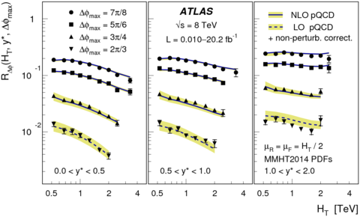
NLO predictions describe very well the data for all H_{T} and y* when the event topology is dominated by 3-jets events
  Very good precision Δ^{meas} and Δ^{theo} < 5%: stringent pQCD test
  Many theory effects cancel in the ratio
The 4-jets dominated region (Δφ_{max}< 2π/3) can only be obtained at LO, but R_{Δφ} is well-describes
Small tension with at larger y*
  Large scale uncertainties
  Impact of non-resummed large logs?
Notes:
Note on the plot: The three first Dphi_max curves force the events selected to be with Njets=>3, with Njets=3 as the dominant contribution, but the last one force it to be Njets>=4. This becomes a LO prediction with NLOJet++ and no PS. Yet, the description is pretty good, except when the rapidity gets higher. Of course, the scale uncertainty is also larger.

Slide 76
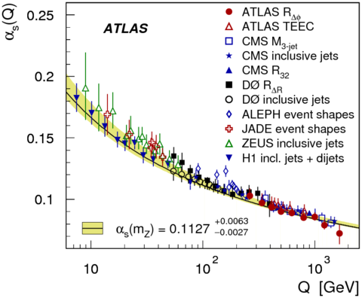
Strategy to extract α_{s}(Q) similar to what was used in (A)TEEC.
  Kinematic regions probed not all independent and optimal: choose (Δφ_{max} = 7π/8, 0 < y*< 0.5) and (Δφ_{max} = 7π/8, 0.5 <y*< 1.0) for all H_{T}
    Best PDF cancellation, smaller scale uncertainty
  Running estimated from Q=H_{T}/2 at the arithmetic center of the bin
Results:
  Extend test of RGE up to Q = 1.6 TeV
  Consistent with world average at Q=M_{Z}
  Small tension in the running (shape)
    Disappear if Q=262.5 GeV is ignored
Notes:
In comparison to the other measurement: The scale uncertainty is comparable to ATEEC, and the experimental uncertainty is a little bit larger, but it doesn’t have a huge impact compared to the scale uncertainty.

Slide 77
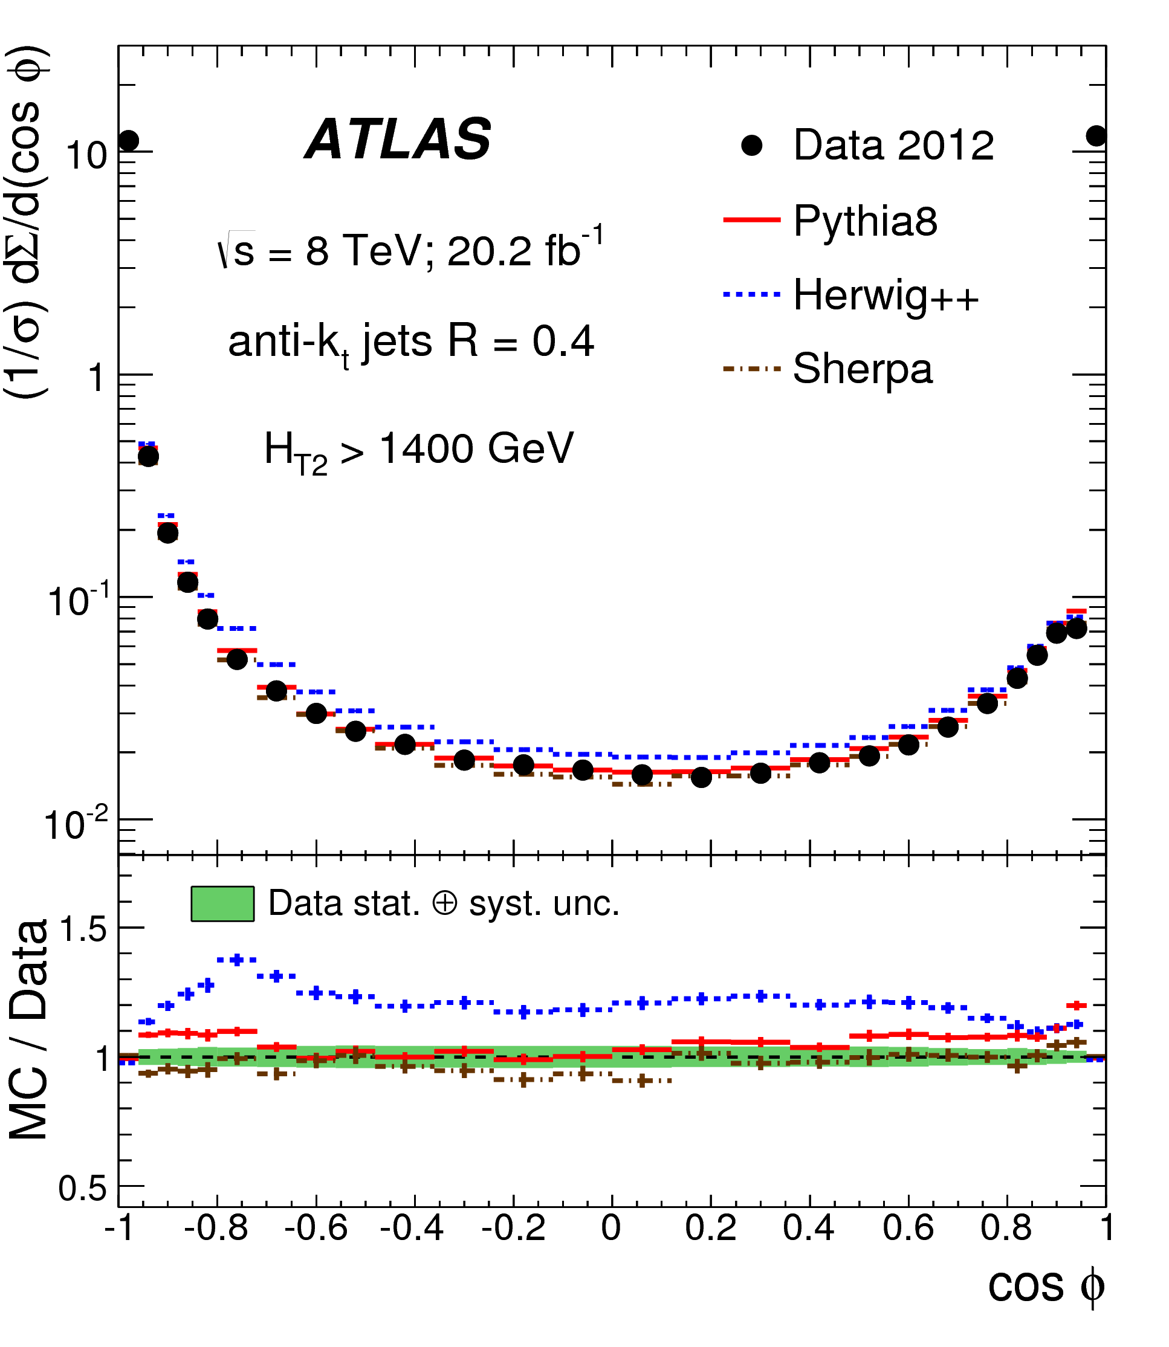
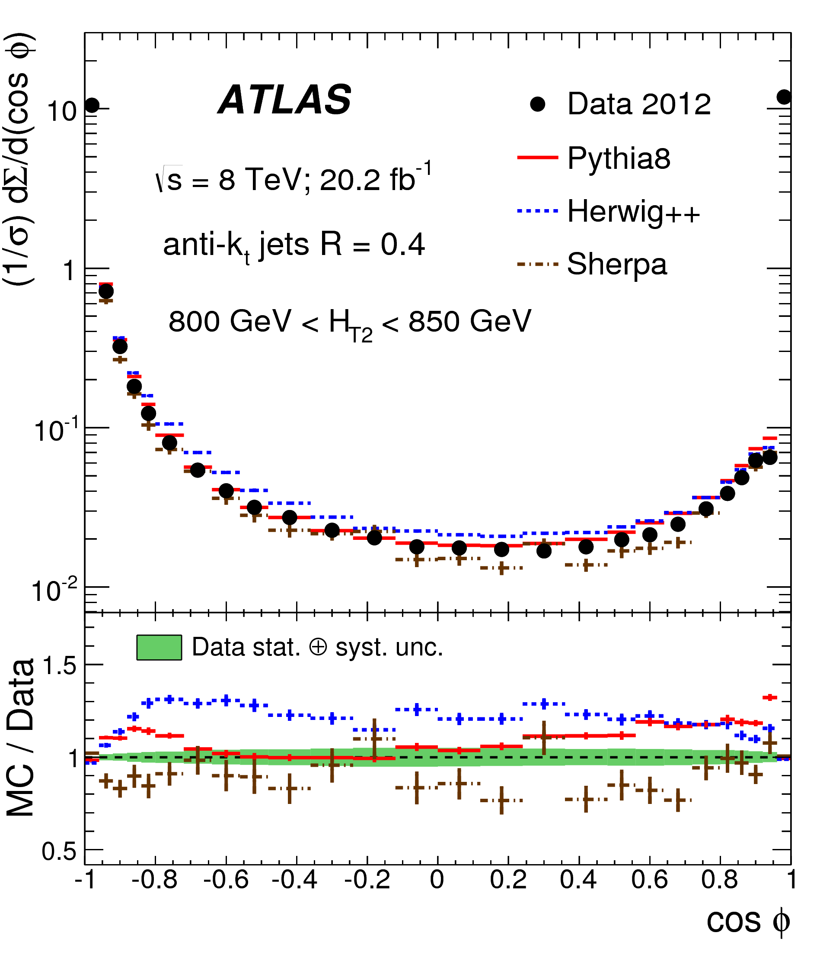
Comparing TEEC measurement results to tree-level predictions
  LO 2->2 ME are sufficient to provide a good description of the data
    Pythia describe the data as well if not better than Sherpa 1.4
  Dipole showers provide a much better model of TEEC than the angular-ordered Herwig++ shower
Notes:
This is the post fit comparison, i.e. that the fitted as and nuisance parameters have been used. LO predictions do also not contain scales uncertainties.
Note: In the a_{s}(m_{Z}) measurement, all nuisance parameters after the fit were consistent with 0, with the exception of the parameters associated with QCD modeling in MC. This is an indication that the TEEC and ATEEC data can be used to further tune the MC generators for multijet processes.

Slide 78
Jet veto in dijet events
EPJ C74 (2014) 3117
Events with large rapidity gap are in phase space region where DGLAP reaches its limit of validity
BFKL resummation in terms of
ln(1/x) is an alternative
  Implemented in HEJ
Expect and observe an exponential suppression in function of ln(P_{T}/Q₀)
Good agreement with Powheg+Pythia and HEJ+Ariadne
  PS has the bigger effect
  Probe BFKL vs DGLAP???

Slide 79
Azimuthal decorrelations in dijet events
Better agreement for HEJ+Ariadne
But:
  PS has a bigger effect than BFKL
  Powheg = Ariadne for rapidity
  None reproduces all data
This kind of observables are important
for VBF and Higgs studies…

Slide 80
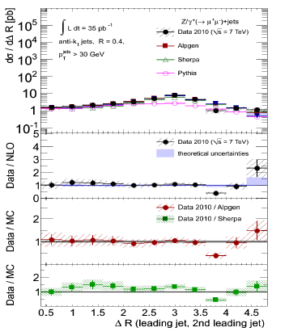
Hard radiation: Z+jets (I)
JHEP 07 (2013) 032
Similar conclusions as in W+jets measurements
  NLO and mP-ME+PS describe data up to 4/5 jets
  PS jets are too soft or at low angle to model hard jets (e.g. N_{jets})
    Not an effect of missing NLO corrections on ME
  LO+match: too large p_{T} spectrum, but NLO+merge is fine => scale effects
Phys. Rev. D85 (2012) 032009
Eur. Phys. J. C77 (2017) 361
Notes:
Zcc and Zbb explicitely included at ME, and a matching is done to avoid double counting with PS.
MadGraph+FxFx is not in good agreement for Njets>3 because they are taken from PS in this case.

Slide 81
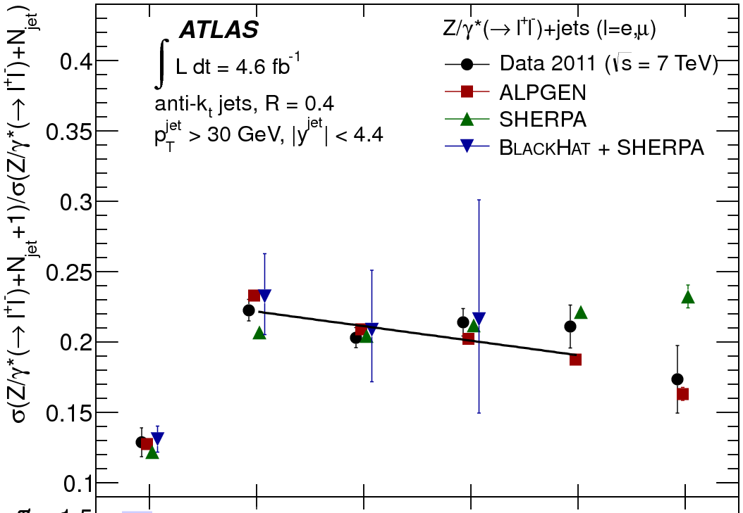

Scaling patterns in Z+jets
Study the probability that an extra hard jet get radiated from a given hard process: R_{(n+1)/n} = P_{n+1}/P_{n}
Two patterns provide limiting cases for most LHC processes
  Staircase scaling R_{(n+1)/n} = e^{-b}: non-abelian QCD effects
    Radiation depend on the hard process due to PDF
  Poisson scaling : gluon radiation off hard quark
    Log enhanced radiation ME due to large hierarchy of scales
Theoretically
Understood!
P_{T}^{jet} > 30 GeV
P_{T}^{jet} > 30 GeV
P_{T}^{lead} > 150 GeV
1/0
2/1
3/2
4/3
5/4
6/5
2/1
3/2
4/3
5/4
6/5
Notes:
Extra notes on Scaling effects: In General, there are no clear pattern for P(n+1)/P(n) except in two extreme cases:
Poisse scaling: very bald statement because it means that n radiation is a n-iteration of the same independent process, i.e that each radiation sees the same hard process…
=> Cannot really be the case because of non-abelian nature, emitted parton CAN emit too, breaking independence of successive emission.
<= However, for the primaries, we do have a Poisson scaling because the QCD evolution proceed from Sudakov form factor that are resummed as exponential that factorizes from the n-parton xsection, making such that the spin, color and interference between dsignma(n+1) and dsigma(n) is lost. These parton emission processes are universal and do not depend on the hard scatter.
SO, by selecting large asymmetries between lead and second jets, we probe phase space regions where secondaries are much less important than primaries, and we can observe a Poisson scaling!
Staircase scaling: triple gluon vertex dominates the cross section such that the the probability of emission is essentially constant.

Slide 82
Systematic uncertainties
Systematic uncertainty at same level as the NLO theory uncertainty for W/Z+jets measurements
  Even below for some observables
    E.g.: leading jet P_{T} in Z+jets
  Dominated by Jet energy scale uncertainty
    More data allow for in-situ calibration studies
  Statistical uncertainty important in a large part of the spectrum probed
W+jets
R_{jets}

Slide 83
Measuring ratios: Rjets
Eur. Phys. J. C (2014) 74:3168
The ratio of W+jets to Z+jets retains sensitivity to parton emission with high precision, but little dependence on other QCD effects
  Sensitive to difference between Wjets and Zjets: not flat ➔ PS
  Good way to test tuning with high precision
    Significant discrepancy at high rapidity between Alpgen and Sherpa
  Mismodeling due to missing n-parton contribution cancels in this ratio

Slide 84


QCD radiation in top events
Top quarks do not fragment before decaying, so can be used to test ISR and decay products FSR (for had top decay)
Use fiducial differential top-anti-top cross sections defined from observable particles in order to study QCD effects
  Large dependence on ISR (t_{h} is similar to t_{l}), especially for ttbar system
JHEP 06 (2015) 100

Slide 85


  Less ISR/FSR dependence and much better agreement to data with PS matched to NLO Matrix Elements
  Comparable sensitivity to PDF
The leading radiation seems to be the key issue with ttbar processes and NLO ME merged to PS yields the best description of this

Slide 86
EWK radiation corrections (I)
At very large momentum, real emission of a W-boson in dijet events is expected to have a large contribution to W+2-jets events
  Contribution scales as O(αln²(p_{T,j}/m_{W}))
  Despite being regulated by the large W-mass, the collinear emission of W-boson from jets is enhanced
    EWK parton showers are being developed
  At low ΔR(W-jet), the cancellation between real and virtual corrections is incomplete due to violation of Bloch-Nordsieck theorem
It is not clear what is the interplay between QCD higher-order corrections to W+1-jet, and EWK real correction emission to dijet
  Some overlap / double counting
  Different virtual corrections…
  Expect QCD to dominate at large ΔR(W-jet) and EWK at low ΔR(W-jet)
Measuring ΔR(muon-jet) would provide an observable capable of testing these ideas

Slide 87
EWK radiation corrections
Phys. Lett. B 765 (2017) 132
At large momentum, dijet real emission of W is expected to have a large contribution to W+2-jets events when W and jets are collinear
  Contribution scales as O(αln²(p_{T,j}/m_{W}))
EWK predictions can be tested with a ΔR(muon-jet) measurement
  Pythia 8.21: Both W+1-jet ME and dijet+EWK PS, all at tree level
  Sherpa incorporates both NLO QCD and EWK corrections
Results:
  Collinear emission enhanced at large p_{T,j}
  Tree-level W+jets doesn’t model normalization, and shape at low ΔR
  EWK PS is not enough
  Important to get QCD right
  Not clear if EWK is well-modeled
500 GeV < p_{T}^{lead-jet} < 600 GeV
650 GeV < p_{T}^{lead-jet}
Notes:
-Despite being regulated by the large W-mass, the collinear emission of W-boson from jets is enhanced because at low ΔR(W-jet) the cancellation between real and virtual corrections is incomplete due to violation of Bloch-Nordsieck theorem
-Sherpa incorporates both NLO QCD and EWK corrections to W+j and W+jj with exclusive sum and off-shell W emission
-It is not clear what is the interplay between QCD higher-order corrections to W+1-jet, and EWK real correction emission to dijet, especially at low dR where EWK corrections are expected to be important.
-Why Not clear is EWK is well-modeled?
Ans: They should have compared sherpa with NLO QCD, but a prediction with EWK correction, and another without, to see if the EWK effects are indeed tested by the prediction. The upper ratio shows so large QCD effects, that it is not clear if we really see EWK corrections, or just a very good description of Sherpa QCD.

Slide 88


Heavy Flavor: W+b-jets
JHEP 06 (2013) 084
Further theoretical uncertainties for heavy flavor jets:
  Heavy flavor content of PDF
  Gluon splitting pushed in the limit of invalidity when m_{q} is large
  Mass effects in ME calculation
4FNS vs 5FNS:
  b-quark from gluon splitting vs DGLAP (PDF)
Tension between predictions and data
  Systematically increasing with P_{T}
  Experimentally very challenging
  ➔ Not yet significant
  ➔ Need more precision t0 conclude…
Notes:
5-flavor schemes calculations are:
a) Simpler
b) Allow for the resummation of possibly large initial state logarithms of the type log 2m2b into the b parton distribution function (PDF)
However:
a) Effects of initial state logs are rarely very large in hadron collisions, impacting only large-x with the possibly large ratios 2m2b’s are always
accompanied by universal phase space suppression factors
b) 4-flavor computations are pertubatively well behaved and more appropriate for exclusive final state
Reason why it is experimentally very challenging:
1) V+HF jets smaller cross section means larger relative background contributions
2) HF jets identified using secondary vertexing, track impact-parameter, etc. Often combined using MVA which comes with a trade-off between efficiency and purity

Slide 89
W mass measurement
Eur. Phys. J. C 78 (2018) 110
First LHC W mass measurement
  Comparable in precision to CDF; better than any other measurements
  Need several ancillary measurements to pin down the systematics
    V pT, PDF, EWK, etc.
  Will be more challenging at higher pile-up
δm_{W}/m_{W} = 0.024%
m_{W} = 80370 ± 7 (stat) ± 11 (exp. syst.) ± 14 (modeling syst.) MeV
Notes:
PDF: 9.2 MeV, QCD: 8.3%, Stat: 6.8% Lept (6.6 mu, 6.4 el)

