Slide 1
John R. Woodward j.wooward@qmul.ac.uk
Head of Operational Research http://or.qmul.ac.uk/
Automatically Building Better Algorithms : taking existing computer programs and automatically improving them

Slide 2
Aim:Take existing code and improve it automatically
Applications
  Airport ground movements.
  Software engineering
  Medicine – heart disease indicator
  I currently teach on programme at BUPT – 3 years
  Previously at University Nottingham Ningbo China – 4 years
  http://gpbib.cs.ucl.ac.uk/gp-html/index.html (40th / 10,000. 2nd largest AI BIB)
  https://scholar.google.co.uk/citations?user=iZIjJ80AAAAJ&hl=en

Slide 3
Supervised Machine Learning
Data set
Learning or training
Machine Learning Algorithm
Data instance
model
Prediction or classification
application or testing

Slide 4



One Man – One/Many Algorithm
Researchers design heuristics by hand and test them on problem instances or arbitrary benchmarks off internet.
Presenting results at conferences and publishing in journals. In this talk/paper we propose a new algorithm…
1. Challenge is defining an algorithmic framework (set) that includes useful algorithms. Black art
2. Let Genetic Programming select the best algorithm for the problem class at hand. Context!!! Let the data speak for itself without imposing our assumptions.
In this talk/paper we propose a 10,000 algorithms…
Heuristic1
Heuristic1
Automatic
Design
Heuristic2
Heuristic2
Heuristic10,000
Heuristic3
Notes:
Ga
Ga’
Ga ‘ version 2.o
Ga ‘ version 2.o hydidized with knobs and whistles.

Slide 5
On-line Bin Packing Problem [9,11]
A sequence of items packed into as few a bins as possible.
Bin size is 150 units, items uniformly distributed between 20-100.
Different to the off-line bin packing problem where the set of items.
The “best fit” heuristic, places the current item in the space it fits best (leaving least slack).
It has the property that this heuristic does not open a new bin unless it is forced to.
Array of bins
Range of
Item size
20-100
150 =
Bin
capacity
Items packed so far
Sequence of pieces to be packed

Slide 6
Genetic Programming applied to on-line bin packing
Not obvious how to link
Genetic Programming to combinatorial problems.
The GP tree is applied to each
bin with the current item and placed in the bin with
The maximum score
C capacity
E emptiness
Fullness is
irrelevant
The space is
important
Terminals supplied to Genetic Programming
Initial representation {C, F, S}
Replaced with {E, S}, E=C-F
F fullness
S size
S size

Slide 7
How the heuristics are applied (skip)
%
C
-
C
+
-15
-3.75
3
4.29
1.88
S
F
70
120
85
70
90
60
45
30
30

Slide 8
The Best Fit Heuristic
Best fit = 1/(E-S). Point out features.
Pieces of size S, which fit well into the space remaining E, score well.
Best fit applied produces a set of points on the surface,
The bin corresponding to the maximum score is picked.
emptiness
Piece size

Slide 9
Our best heuristic.
Similar shape to best fit – but curls up in one corner.
Note that this is rotated, relative to previous slide.

Slide 10
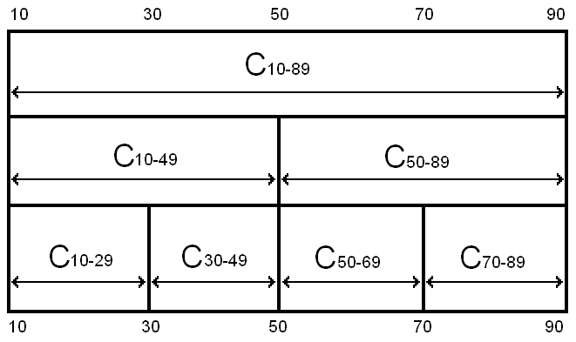
Robustness of Heuristics
= all legal results
= some illegal results
Notes:
Even though the problem is the same, and the hard constraints are the same, the heuristics can fail to stay within the hard constraints if they are asked to pack piece sizes they have not seen before
The safeguards against giving illegal solutions that work in one class will not work in another

Slide 11
Testing Heuristics on problems of much larger size than in training
Table I | H trained100 | H trained 250 | H trained 500
100 | 0.427768358 | 0.298749035 | 0.140986023
1000 | 0.406790534 | 0.010006408 | 0.000350265
10000 | 0.454063071 | 2.58E-07 | 9.65E-12
100000 | 0.271828318 | 1.38E-25 | 2.78E-32
Table shows p-values using the best fit heuristic, for heuristics trained on
different size problems, when applied to different sized problems
1. As number of items trained on increases, the probability decreases (see next slide).
2. As the number of items packed increases, the probability decreases (see next slide).

Slide 12
Compared with Best Fit
Amount
evolved
heuristics
beat
best fit by.
Number of pieces
packed so far.
Averaged over 30 heuristics over 20 problem instances
Performance does not deteriorate
The larger the training problem size, the better the bins are packed.

Slide 13
Compared with Best Fit
Zoom in
of previous
slide
Amount
evolved
heuristics
beat
best fit by.
The heuristic seems to learn the number of pieces in the problem
Analogy with sprinters running a race – accelerate towards end of race.
The “break even point” is approximately half of the size of the training problem size
If there is a gap of size 30 and a piece of size 20, it would be better to wait for a better piece to come along later – about 10 items (similar effect at upper bound?).

Slide 14
Meta and Base Learning [15]
At the base level we are learning about a specific function.
At the meta level we are learning about the probability distribution.
We are just doing “generate and test” on “generate and test”
What is being passed with each blue arrow?
Training/Testing and Validation
Meta level
Function class
Mutation operator designer
function
mutation
Function to optimize
GA
base level
Conventional GA

Slide 15
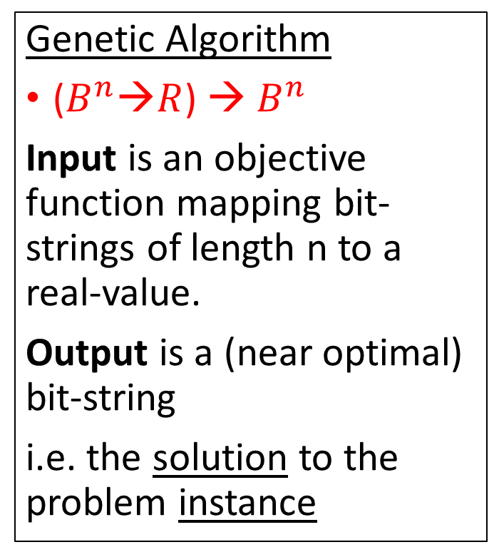
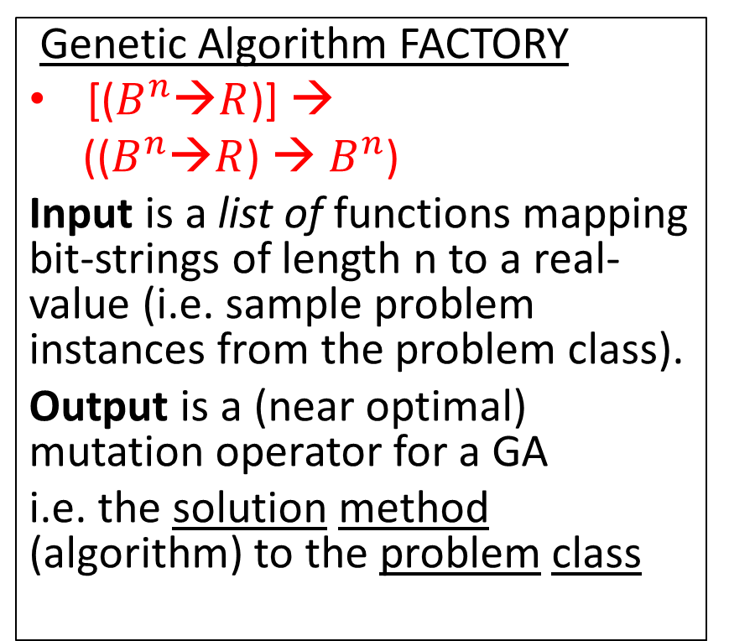
Compare Signatures (Input-Output)
Genetic Algorithm
($B^{n}$→$R$) → $B^{n}$
Input is an objective function mapping bit-strings of length n to a real-value.
Output is a (near optimal) bit-string
i.e. the solution to the problem instance
Genetic Algorithm FACTORY
[($B^{n}$→$R$)] →
(($B^{n}$→$R$) → $B^{n}$)
Input is a list of functions mapping bit-strings of length n to a real-value (i.e. sample problem instances from the problem class).
Output is a (near optimal) mutation operator for a GA
i.e. the solution method (algorithm) to the problem class
We are raising the level of generality at which we operate.
Notes:
Fish the north sea dry…

Slide 16
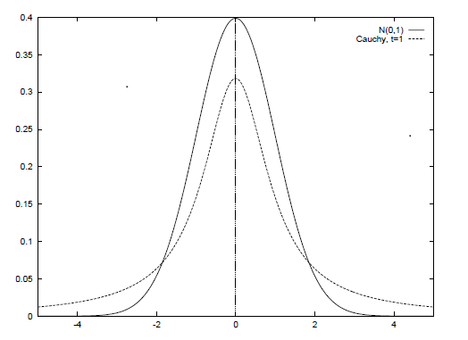
Designing Mutation Operators for Evolutionary Programming [18]
Evolutionary programing optimizes functions by evolving a population of real-valued vectors (genotype).
Variation has been provided (manually) by probability distributions (Gaussian, Cauchy, Levy).
We are automatically generating probability distributions (using genetic programming).
Not from scratch, but from already well known distributions (Gaussian, Cauchy, Levy). We are “genetically improving probability distributions”.
We are evolving mutation operators for a problem class (a probability distributions over functions).
NO CROSSOVER
Genotype is
(1.3,...,4.5,…,8.7)
Before mutation
Genotype is
(1.2,...,4.4,…,8.6)
After mutation

Slide 17
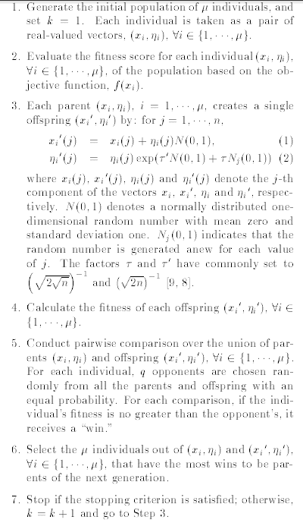
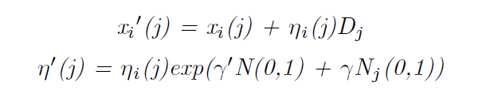
(Fast) Evolutionary Programming
Heart of algorithm is mutation
SO LETS AUTOMATICALLY DESIGN
EP mutates with a Gaussian
FEP mutates with a Cauchy
A generalization is mutate with a distribution D (generated with genetic programming)

Slide 18
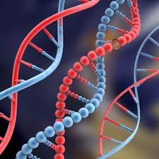


Evolution GA/GP
Feedback loop
Humans
Computers
Generate and test: cars, code, models, proofs, medicine, hypothesis.
Evolution (select, vary, inherit).
Fit for purpose
Generate
Test
Inheritance
Off-spring
have similar
Genotype
(phenotype)
PERFECT
CODE [3]

Slide 19

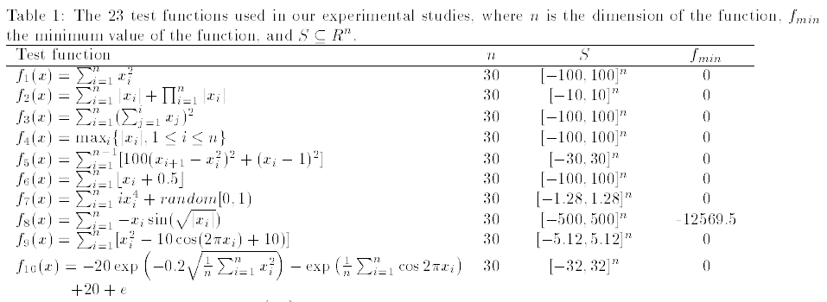
Optimization & Benchmark Functions
A set of 23 benchmark functions is typically used in the literature. Minimization
We use them as problem classes.

Slide 20
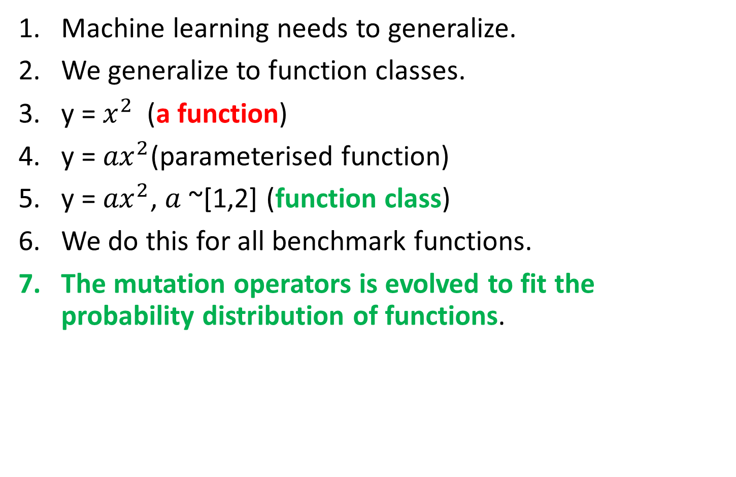
Function Class 1
Machine learning needs to generalize.
We generalize to function classes.
y = $x^{2}$(a function)
y = ${ax}^{2}$(parameterised function)
y = ${ax}^{2}$, $a$ ~[1,2] (function class)
We do this for all benchmark functions.
The mutation operators is evolved to fit the probability distribution of functions.

Slide 21
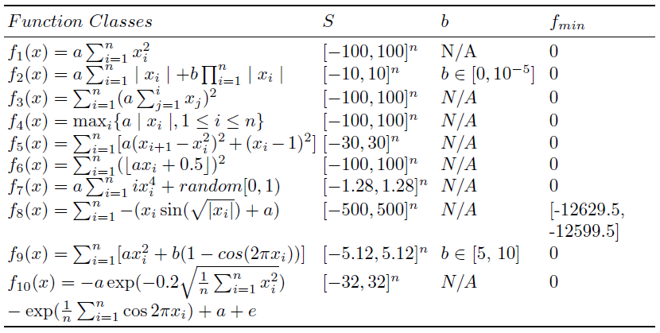
Function Classes 2

Slide 22
Meta and Base Learning
At the base level we are learning about a specific function.
At the meta level we are learning about the problem class.
We are just doing “generate and test” at a higher level
What is being passed with each blue arrow?
Conventional EP
Meta level
Function class
Probability
Distribution
Generator
Function to optimize
EP
base level

Slide 23
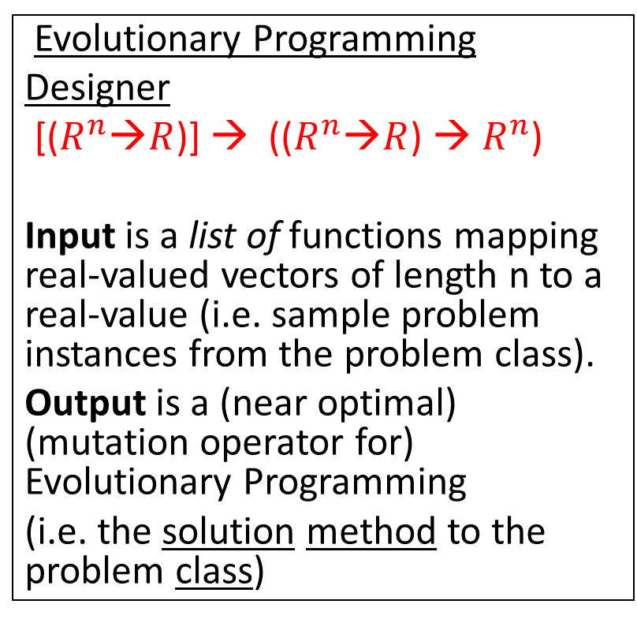
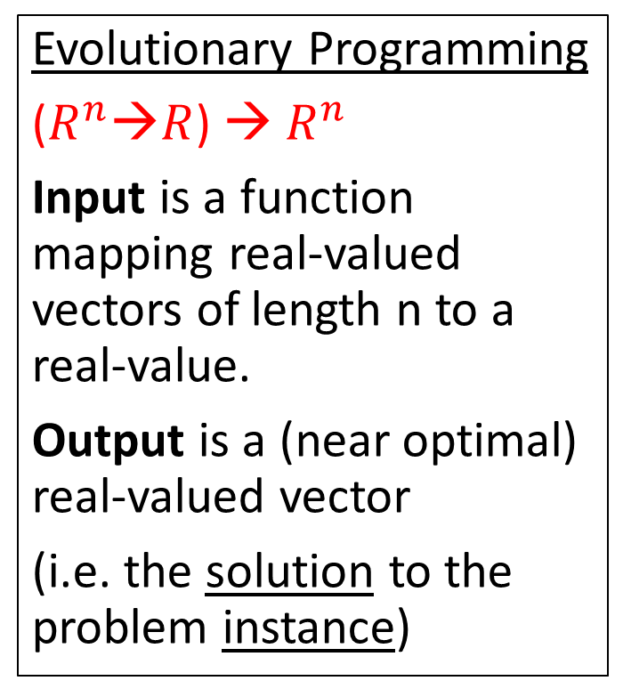
Compare Signatures (Input-Output)
Evolutionary Programming
($R^{n}$→$R$) → $R^{n}$
Input is a function mapping real-valued vectors of length n to a real-value.
Output is a (near optimal) real-valued vector
(i.e. the solution to the problem instance)
Evolutionary Programming
Designer
[($R^{n}$→$R$)] → (($R^{n}$→$R$) → $R^{n}$)
Input is a list of functions mapping real-valued vectors of length n to a real-value (i.e. sample problem instances from the problem class).
Output is a (near optimal) (mutation operator for) Evolutionary Programming
(i.e. the solution method to the problem class)
We are raising the level of generality at which we operate.

Slide 24
Genetic Programming to Generate Probability Distributions
SPACE OF
PROBABILITY
DISTRIBUTIONS
GP Function Set {+, -, *, %}
GP Terminal Set {N(0, random)}
N(0,1) is a normal distribution.
For example a Cauchy distribution is generated by N(0,1)%N(0,1).
Hence the search space of probability distributions contains the two existing probability distributions used in EP but also novel probability distributions.
GAUSSIAN
CAUCHY
NOVEL
PROBABILITY
DISTRIBUTIONS

Slide 25
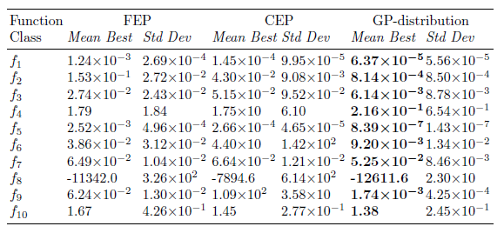
Means and Standard Deviations
These results are good for two reasons.
starting with a manually designed distributions (Gaussian).
evolving distributions for each function class.

Slide 26
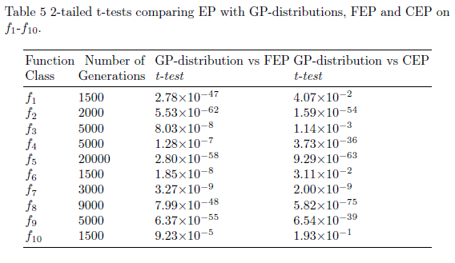
T-tests

Slide 27
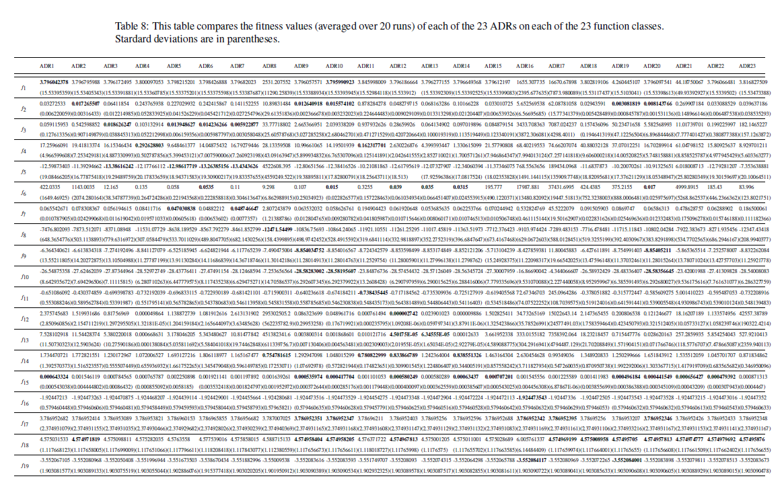
Performance on Other Problem Classes

Slide 28
Performance on Other Problem Classes

Slide 29
Theoretical Motivation 1
Metaheuristic a
Search
space
Objective
Function f
P (a, f)
x1
x1
x1
1.
2.
3.
X1.
X2.
X3.
Y1.
Y2.
Y3.
SOLUTION
PROBLEM
A search space contains the set of all possible solutions.
An objective function determines the quality of solution.
A (Mathematical idealized) metaheuristic determines the sampling order (i.e. enumerates i.e. without replacement). It is a (approximate) permutation. What are we learning?
Performance measure P (a, f) depend only on y1, y2, y3
Aim find a solution with a near-optimal objective value using a Metaheuristic . ANY QUESTIONS BEFORE NEXT SLIDE?
Notes:
Temptation is to just write a search algorithm.

Slide 30

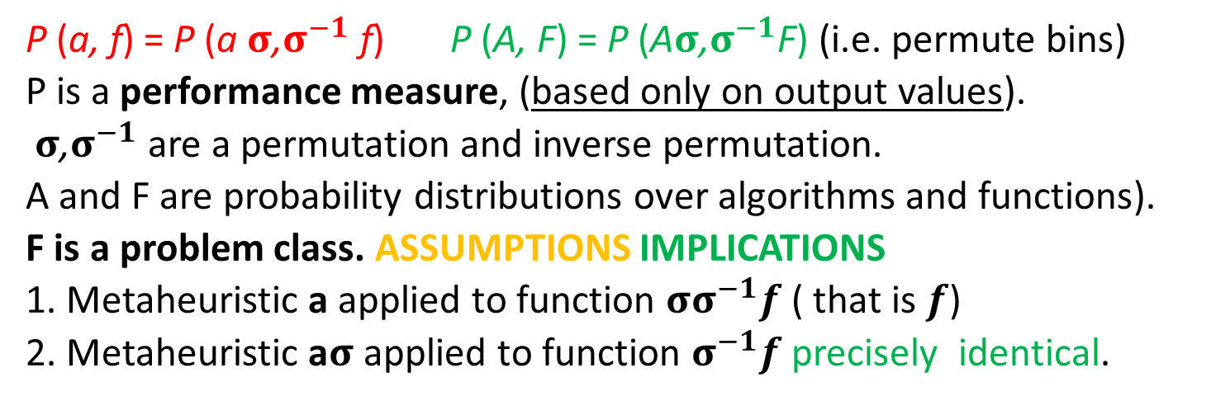
Theoretical Motivation 2
Search
space
permutation
σ
Objective
Function f
Metaheuristic a
$${\text{σ}}^{−1}$$
x1
x1
x1
x1
x1
1.
2.
3.
1.
2.
3.
1.
2.
3.
1.
2.
3.
1.
2.
3.
P (a, f) = P (a$σ$,$σ^{−1}$ f) P (A, F) = P (A$σ$,$σ^{−1}$F) (i.e. permute bins)
P is a performance measure, (based only on output values).
$σ$,$σ^{−1}$ are a permutation and inverse permutation.
A and F are probability distributions over algorithms and functions).
F is a problem class. ASSUMPTIONS IMPLICATIONS
1. Metaheuristic a applied to function ${σσ}^{−1}f$ ( that is $f$)
2. Metaheuristic a$σ$ applied to function $σ^{−1}f$ precisely identical.
Notes:
Not finite, not computable, not all function, not closed under permutation, focussed sets.
Implications. Do not propose a metaheuristic in isolation .
Assumptions - no revisiting, count number of evaluations (ignore execution time. )

Slide 31
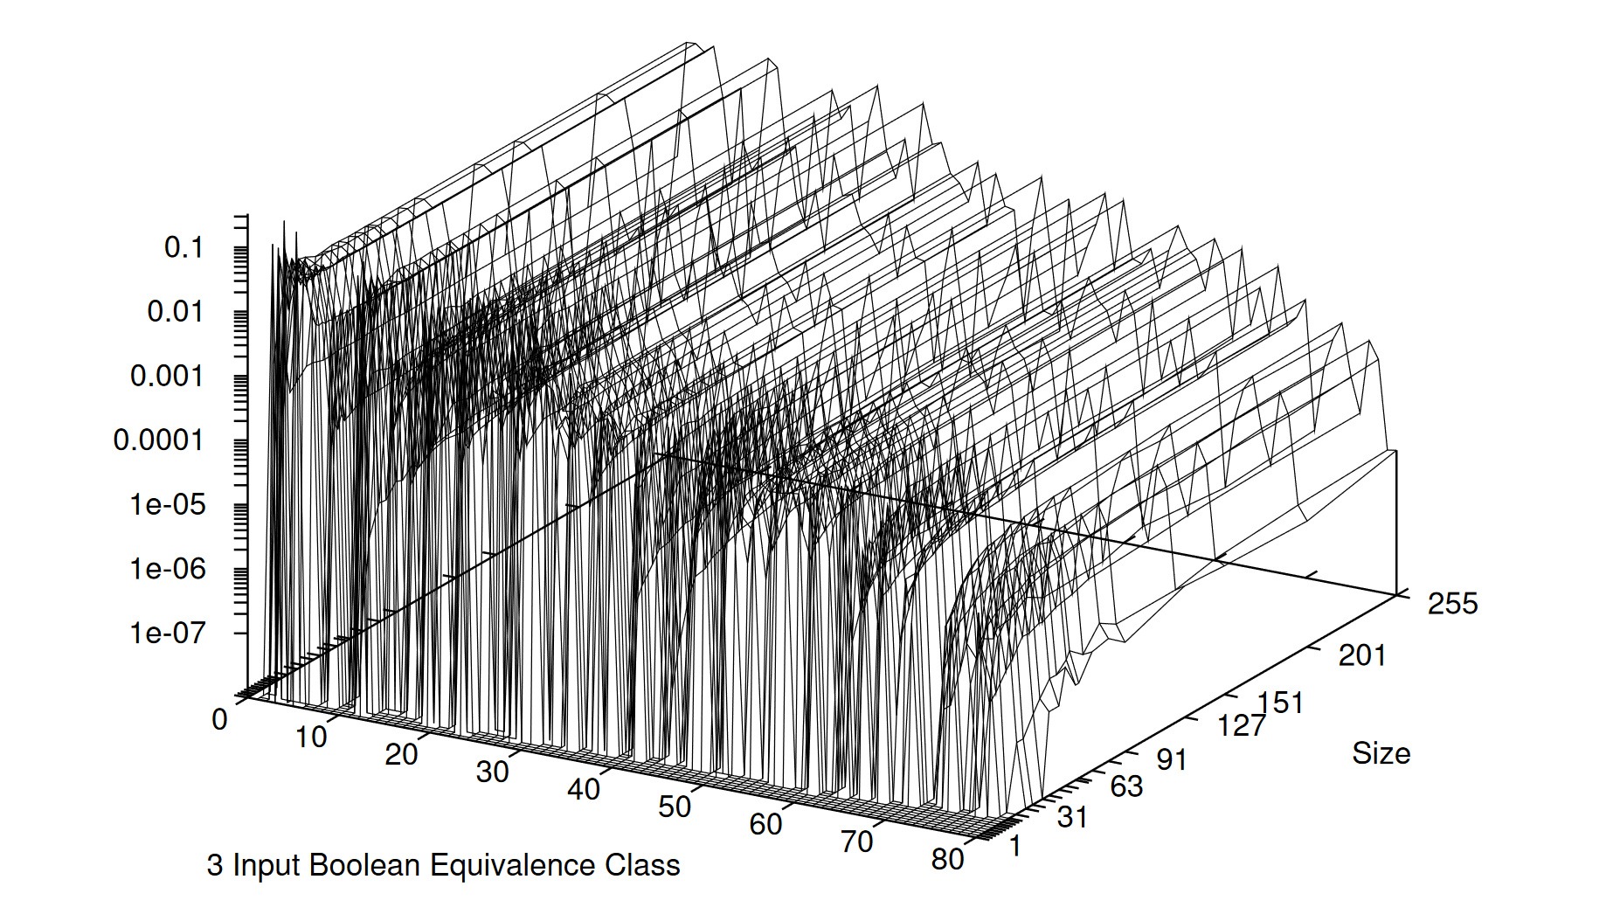

Slide 32
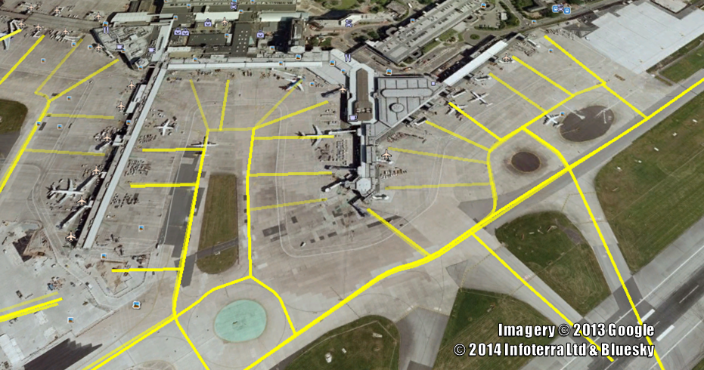

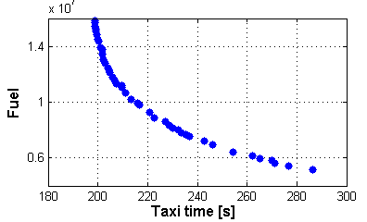
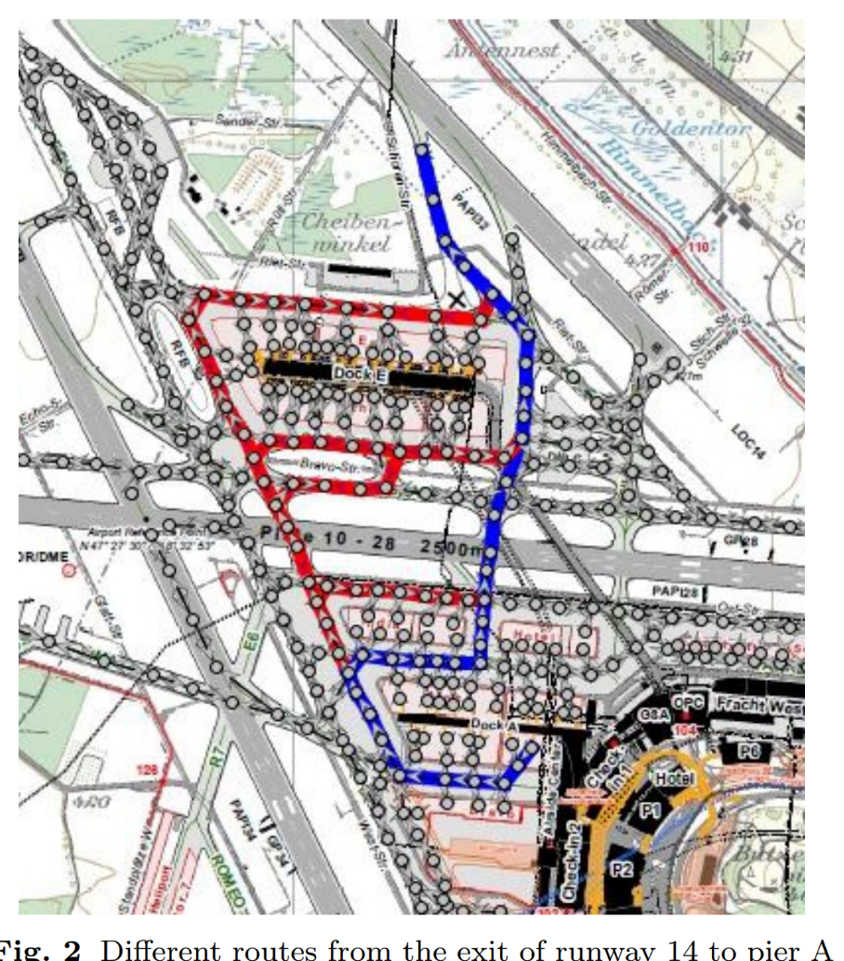


Ground Movements at Airport

Slide 33
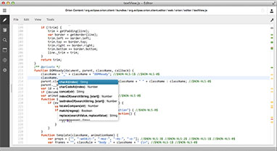
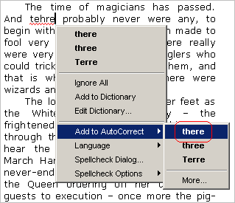
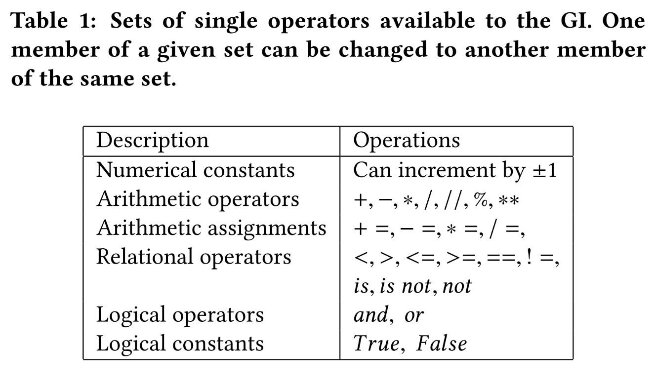
Automated Bug Fixing.
Machine learning
detect bug location
suggest bug fix

Slide 34
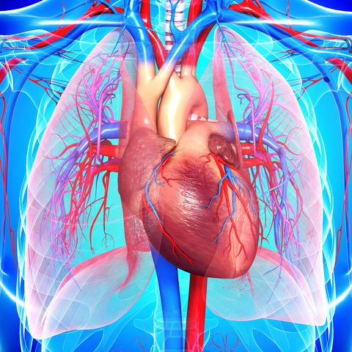
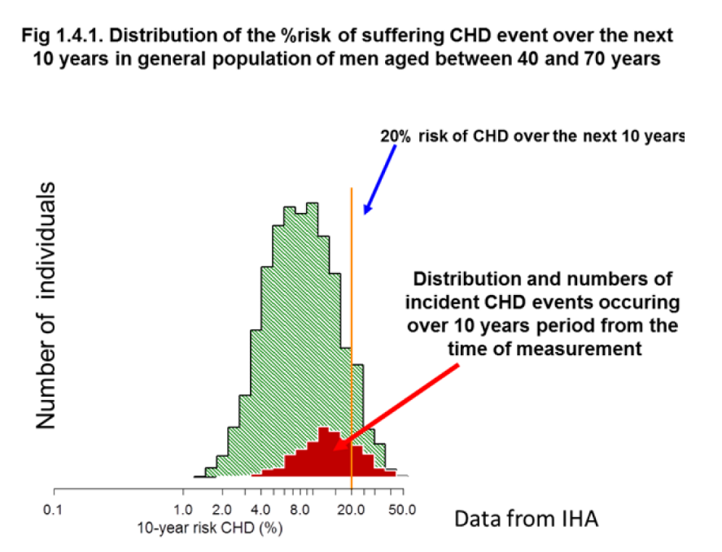
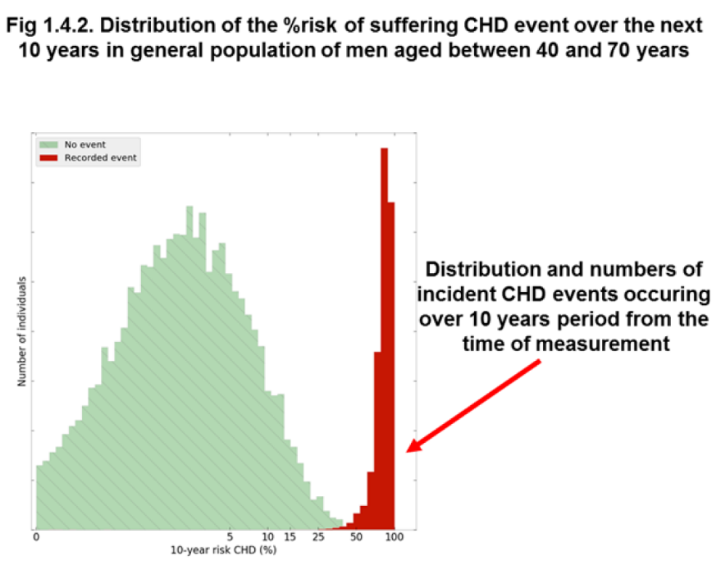
Heart disease predictor.
((kwargs['kvk_10'] * einst['FAMILYMI_Y']) +
((kwargs['kvk_11'] * einst['PREVSMOKER']) +
(((kwargs['kvk_12'] * (einst['CHOL'] - kwargs['kvk_13'])) * einst['SMOKER']) +
((kwargs['kvk_14'] * einst['DM2']) -
((kwargs['kvk_15'] * einst['SPORTSCURRENT']) -
(kwargs['kvk_16'] * ((einst['HDL'] - einst['DM2']) / kwargs['kvk_17'])))))))))))

Slide 35
A Paradigm Shift?
One person
proposes one
algorithm
and tests it
in isolation.
One person proposes a
family of algorithms
and tests them
in the context of
a problem class.
Algorithms investigated/unit time
Human cost (INFLATION) machine cost MOORE’S LAW
conventional approach new approach
Previously one person proposes one algorithm
Now one person proposes a set of algorithms
Analogous to “industrial revolution” from hand made to machine made. Automatic Design.
Notes:
What could you do after this talk you could not do before.

Slide 36
Thank you. Any questions.
Applications
  Airport ground movements.
  Software engineering
  Medicine – heart disease indicator
  j.wooward@qmul.ac.uk
  Head of Operational Research GROUP http://or.qmul.ac.uk/
  I currently teach on programme at BUPT
  Previously at University Nottingham Ningbo China
  http://gpbib.cs.ucl.ac.uk/gp-html/index.html (40th / 10,000. 2nd largest AI BIB)
  https://scholar.google.co.uk/citations?user=iZIjJ80AAAAJ&hl=en
  https://gow.epsrc.ukri.org/NGBOViewPerson.aspx?PersonId=-485755

Slide 38
Summary

