Slide 1
Image © STFC Alan Ford
Notes:
To edit the background image, select ‘Format’ from the PowerPoint menu and ‘Slide Background’ from the drop-down menu. Within the new list of options that appears on the right of the screen, select the ‘File’ button under ‘Insert picture from’ and select your image from your file browser. Remember to delete the image credit if using your own image.

Slide 2
IRIS-IAM
Dec’ 19 Status Update
Tom Dack
Notes:
The abstract pattern can be removed or repositioned if required. Be careful to ‘Send to Back’ so that it does not obscure any important information.

Slide 3
Agenda
1 Project Overview
An overview of the IRIS identity project and the INDIGO IAM application it utilises.
2 Status Update
Update as to the current status and progress of the IRIS IAM digital asset, including challenges and issues encountered.
3 Next Steps
The next steps and goals for the Identity Project in 2020.
Image © STFC Alan Ford
Notes:
To replace photo with one of your own. 1) Send the geometric shape overlay to the back – Right-Click > Send to Back > Send to Back. 2) Replace image – use the guides provided to correctly position it. 3) Send your image to the back so that the geometric overlay re-appears over the image. Remember to delete the image credit if using your own image.

Slide 4
IRIS IAM Overview
Notes:
The abstract pattern can be removed or repositioned if required. Be careful to ‘Send to Back’ so that it does not obscure any important information.

Slide 5
IRIS IAM Overview
INDIGO Identity and Access Management
This is the service utilised by IRIS as its AAI solution
Initially developed as part of INDIGO DataCloud by INFN
Supported through EOSC pilot and EOSC hub projects
Selected for use due to existing capabilities and support
Previous experience with the IAM within the department
Has been selected as the AAI solution for the WLCG authorization project
IAM provides most required capabilities in its current version
Notes:
We need an identity and access management proxy service providing single sign on, credential/token translation, identity management and attribute/claim distribution – IAM does all this and is build using industry standard

Slide 6
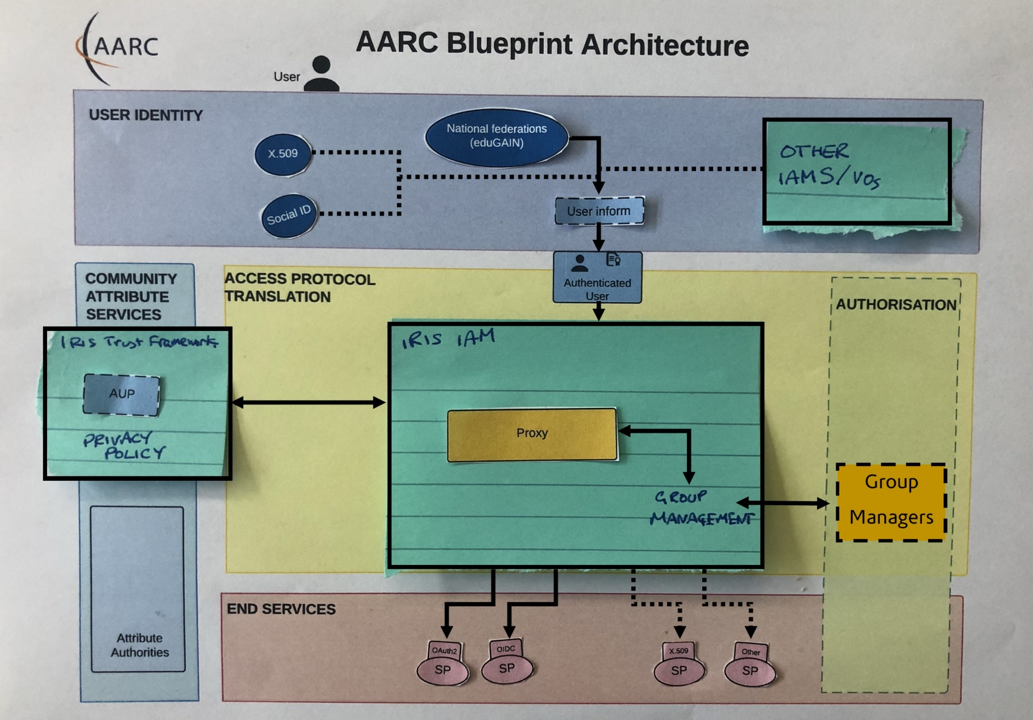
IRIS IAM Overview
IRIS IAM Blueprint
The IAM service takes a user identity and maps the required authorization to it.
This then allows access to IRIS end services behind IAM
Notes:
We need an identity and access management proxy service providing single sign on, credential/token translation, identity management and attribute/claim distribution – IAM does all this and is build using industry standard

Slide 7
The IRIS Identity Project
Implementation
Service is online and available, hosted at: https://iris-iam.stfc.ac.uk
IAM deployed via Docker
Service is hosted on a VM managed by the RAL Tier 1
host fully configured using Tier 1 configuration management (aquilon)
Utilises existing service tools ran within SCD
RequestTracker for ticketing
Icinga for service health monitoring
Telegraf monitoring for metrics & usage
IAM backed database managed by Database Services
Notes:
Replace this guidance text with your own bullet pointed content.
For further guidance please see https://www.bdadyslexia.org.uk/advice/employers/creating-a-dyslexia-friendly-workplace/dyslexia-friendly-style-guide

Slide 8
Status Update
Notes:
The abstract pattern can be removed or repositioned if required. Be careful to ‘Send to Back’ so that it does not obscure any important information.

Slide 9
Current Status
Federation Membership
IAM has been successfully registered as a service provider within the UK Access Management Federation
This enables registration and authentication through any IdP which is an eduGAIN member
Asserting SIRTFI compliance and REFEDS Research and Scholarship entity status
Compliance with GÉANT Data Protection Code of Conduct
IAM has its own SAML implementation, meaning we do not need to run Shibboleth
Glossary:
SIRTFI: Security Incident Response Trust Framework for Federated Identity
REFEDS:
Research and Education FEDerations group
Notes:
Replace this guidance text with your own bullet pointed content.
For further guidance please see https://www.bdadyslexia.org.uk/advice/employers/creating-a-dyslexia-friendly-workplace/dyslexia-friendly-style-guide

Slide 10
Current Status
Policy Work
working closely with the IRIS Trust Framework digital asset
IRIS policy and IRIS IAM capability closely interconnected, and IAM procedures and processes need to follow these policies
Draft privacy and acceptable use policies are in place
AUP is hosted at https://iris-iam.stfc.ac.uk/aup/
Privacy Policy hosted at https://iris-iam.stfc.ac.uk/privacypolicy/
A draft group management procedure has been written and is being revised to align to policy
Notes:
Replace this guidance text with your own bullet pointed content.
For further guidance please see https://www.bdadyslexia.org.uk/advice/employers/creating-a-dyslexia-friendly-workplace/dyslexia-friendly-style-guide

Slide 11
Current Status
Access to Services
IAM can provide authorized access to SCD Cloud, Cambridge IRIS Openstack and IRIS Accounting Portal Beta
Soft launched with SCD OpenStack and IRIS users (CCFE primarily)
Development work underway for access to Dynafed (storage)
Working on implementing test connection to Rucio
Notes:
Replace this guidance text with your own bullet pointed content.
For further guidance please see https://www.bdadyslexia.org.uk/advice/employers/creating-a-dyslexia-friendly-workplace/dyslexia-friendly-style-guide

Slide 12
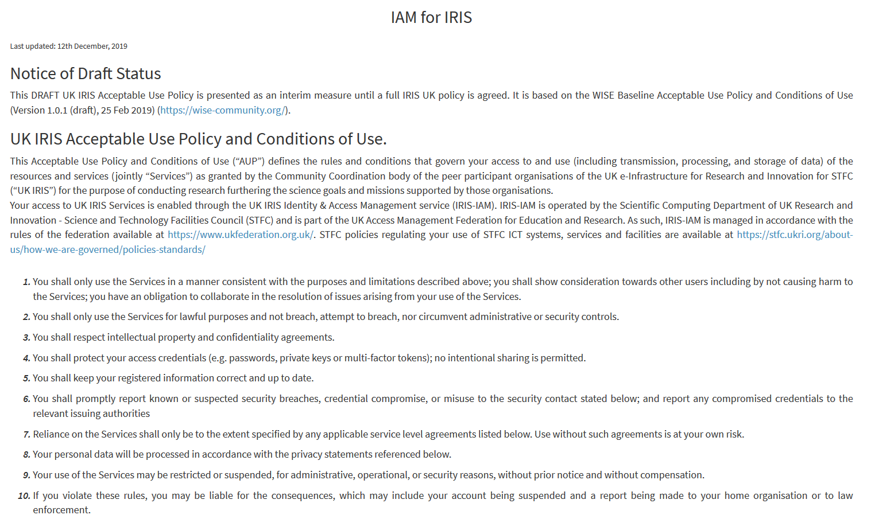
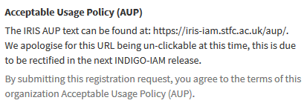
Current Status
Challenges and Issues
Acceptable usage policy formatting
AUP implementation is a single line of text – no formatting
Mitigated hosting AUP at a fixed URL
IAM v1.6.0. will include a direct link to the AUP, rather than the text field currently used
Operational funding questions
Options and possibilities are being discussed
IAM was recently reviewed by SCD services committee
Notes:
Replace this guidance text with your own bullet pointed content.
For further guidance please see https://www.bdadyslexia.org.uk/advice/employers/creating-a-dyslexia-friendly-workplace/dyslexia-friendly-style-guide

Slide 13
Next Steps
Notes:
The abstract pattern can be removed or repositioned if required. Be careful to ‘Send to Back’ so that it does not obscure any important information.

Slide 14
Next Steps
IAM Deployment
When available migrate to IAM 2.0 – built on keycloak
In preparation we are planning to deploy a keycloak test instance in order to prepare for IAM 2.0 release
Policy and Documentation
Produce/finalise and circulate IAM user guides, ensuring these follow policy
Finalise group management process and implement this with IRIS services
Some draft documents have been written, but will need to be aligned with outputs from the Trust Framework DA
Notes:
Replace this guidance text with your own bullet pointed content.
For further guidance please see https://www.bdadyslexia.org.uk/advice/employers/creating-a-dyslexia-friendly-workplace/dyslexia-friendly-style-guide

Slide 15
Next Steps
Identify Solutions for running IAM in Production
Continued investigation for operational funding sources
Undertake tasks to ensure IAM has the service management systems in place to run as a production service
Eg: SLA’s, Change Management processes, etc
On-boarding of IRIS Services
Ongoing work with other IRIS services
Discussions to be had this afternoon to look at which services/DA’s can utilise IAM.
Aim is to have the IAM in a production-ready state by q1 2020
Notes:
Replace this guidance text with your own bullet pointed content.
For further guidance please see https://www.bdadyslexia.org.uk/advice/employers/creating-a-dyslexia-friendly-workplace/dyslexia-friendly-style-guide

Slide 16
Notes:
The abstract pattern can be removed or repositioned if required. Be careful to ‘Send to Back’ so that it does not obscure any important information.

Slide 17
Science and Technology Facilities Council
@STFC_matters
Science and Technology Facilities Council
Notes:
The abstract pattern can be removed or repositioned if required. Be careful to ‘Send to Back’ so that it does not obscure any important information.

