Slide 1
Dashboard for Management of Data Repositories on IRIS High-performance Database Service
George Beckett, Edinburgh,
IRIS Digital Asset Workshop, 17th December 2019

Slide 2
Recall IRIS High-performance Database Service
Tailored storage and compute resources for hosting large-scale data collections (typically database)
2 × 500 TB storage capacity (Ceph clusters)
400 compute cores
40 Gbps network, connected to JANET
Running (IRIS-compliant) Scientific OpenStack
Motivated by survey astronomy
Next-generation surveys with multi-PB catalogues
Move from workstation-class computing to scalable cloud
Aim to identify and include non-astronomy cases too

Slide 3
AAA
Inst. login
IRIS AIM?
Volume Storage – OS / … (small)
OpenStack (small compute)
SSH?
Ingest Service
Production Storage (500TB)
Ceph
Portal
SQL
ODBC/ RDBMS
Test Storage (500TB)
Jupyter
Working Storage
Database Hosting—Traditional
Bare-metal
Edinburgh
Man/ RAL/ Cam …
OpenStack (big compute)
Transient/ Persistent Storage ???
Compute

Slide 4
IRIS Digital Asset Call 2019/2020
Objectives
Streamline creation and management of databases in IRIS
Focus on large, persistent data repositories, curated by science teams
Reduce effort required to administer IRIS service
Image repository of key database technologies
Integrate into IRIS
Ensure dashboard compatible with Scientific OpenStack
Enable access to third-party datasets and other IRIS services
Provide guidance to RSAP on how to measure/allocate database resources
Develop policy for end-user database creation
Extend service to support dynamic, ephemeral (working) databases

Slide 5
Outputs
D1.1: Customised dashboard for O/S Horizon and O/S CLI
Streamline creation/ management of database platforms for science teams
D1.2: Suite of images
Addressing most important relational/ “no-SQL” platforms
D1.3: IRIS integration tools/ configurations
RSAP templates/ guidance
Integration of third-party data collections
Data ingestion
(Look at streamlining setup of UI (TAP server, web service, etc.) if time permits)
D1.4: User Documentation
D2.1: Best Practice Guide for user-generated working databases
D2.2: AUP template

Slide 6
Progress
D1.1: Customised dashboard for O/S Horizon and O/S CLI
OpenStack Trove running on test-bed system
Experimenting with data-storage provision via Cinder
Test catalogue (UKIDSS DR9) ingested and setup
Need to get to grips with Kolla (O/S service config.) w/ help of StackHPC
D1.2: Suite of images
Image for MySQL Version 5.7 – required for test catalogue (UKIDSS DR9)
Should be straightforward to add other DBs
D1.3: IRIS Integration
To start
D1.4: User Documentation
In progress

Slide 7
Screenshots
Taken from instance on LSST:UK Test-bed

Slide 8
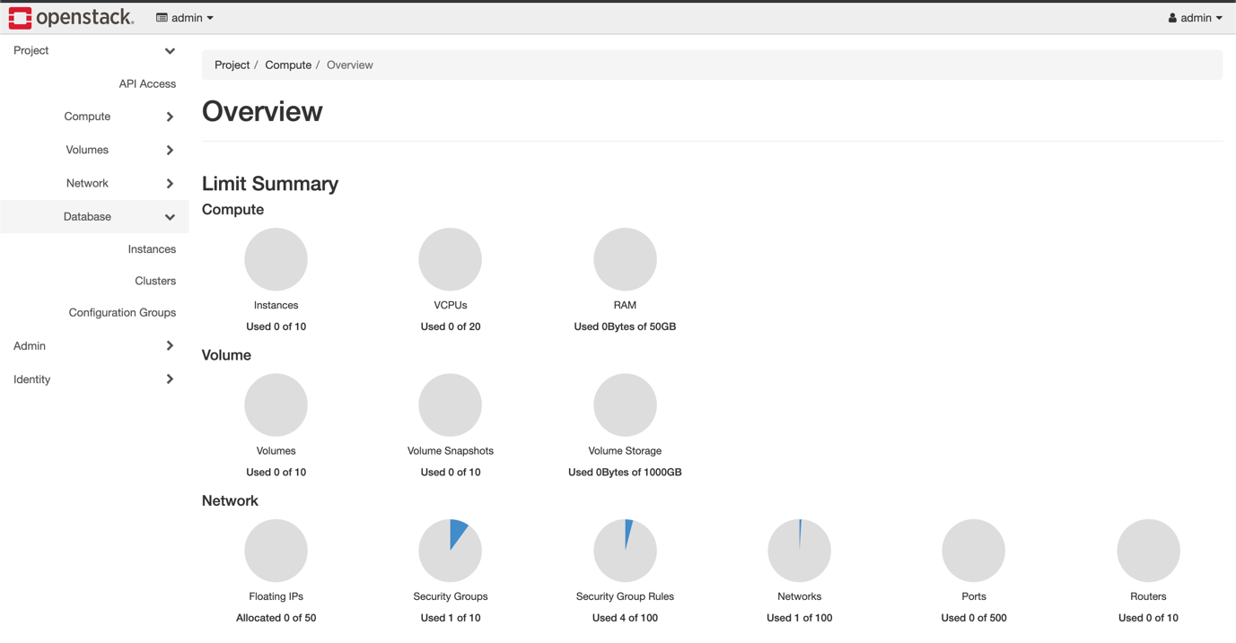
Trove adds new menu option to Horizon dashboard

Slide 9
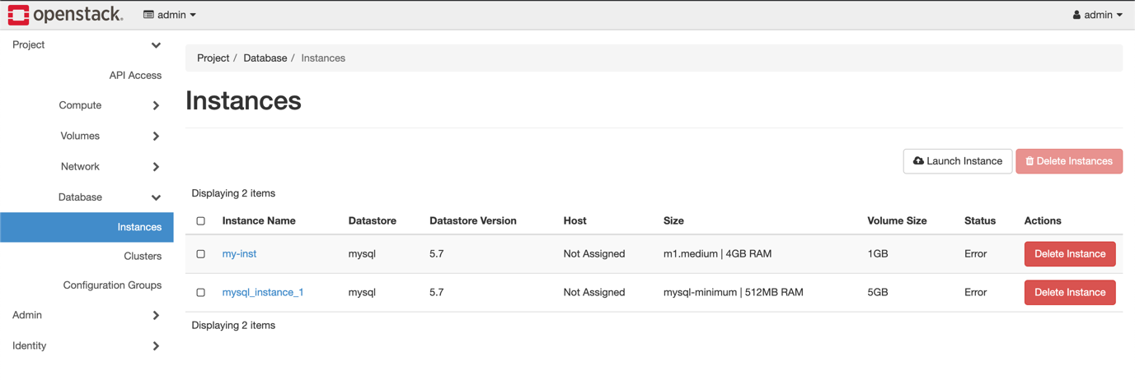
The Instances sub-menu gives details of user’s instances, along with details of their configure, status and data store

Slide 10
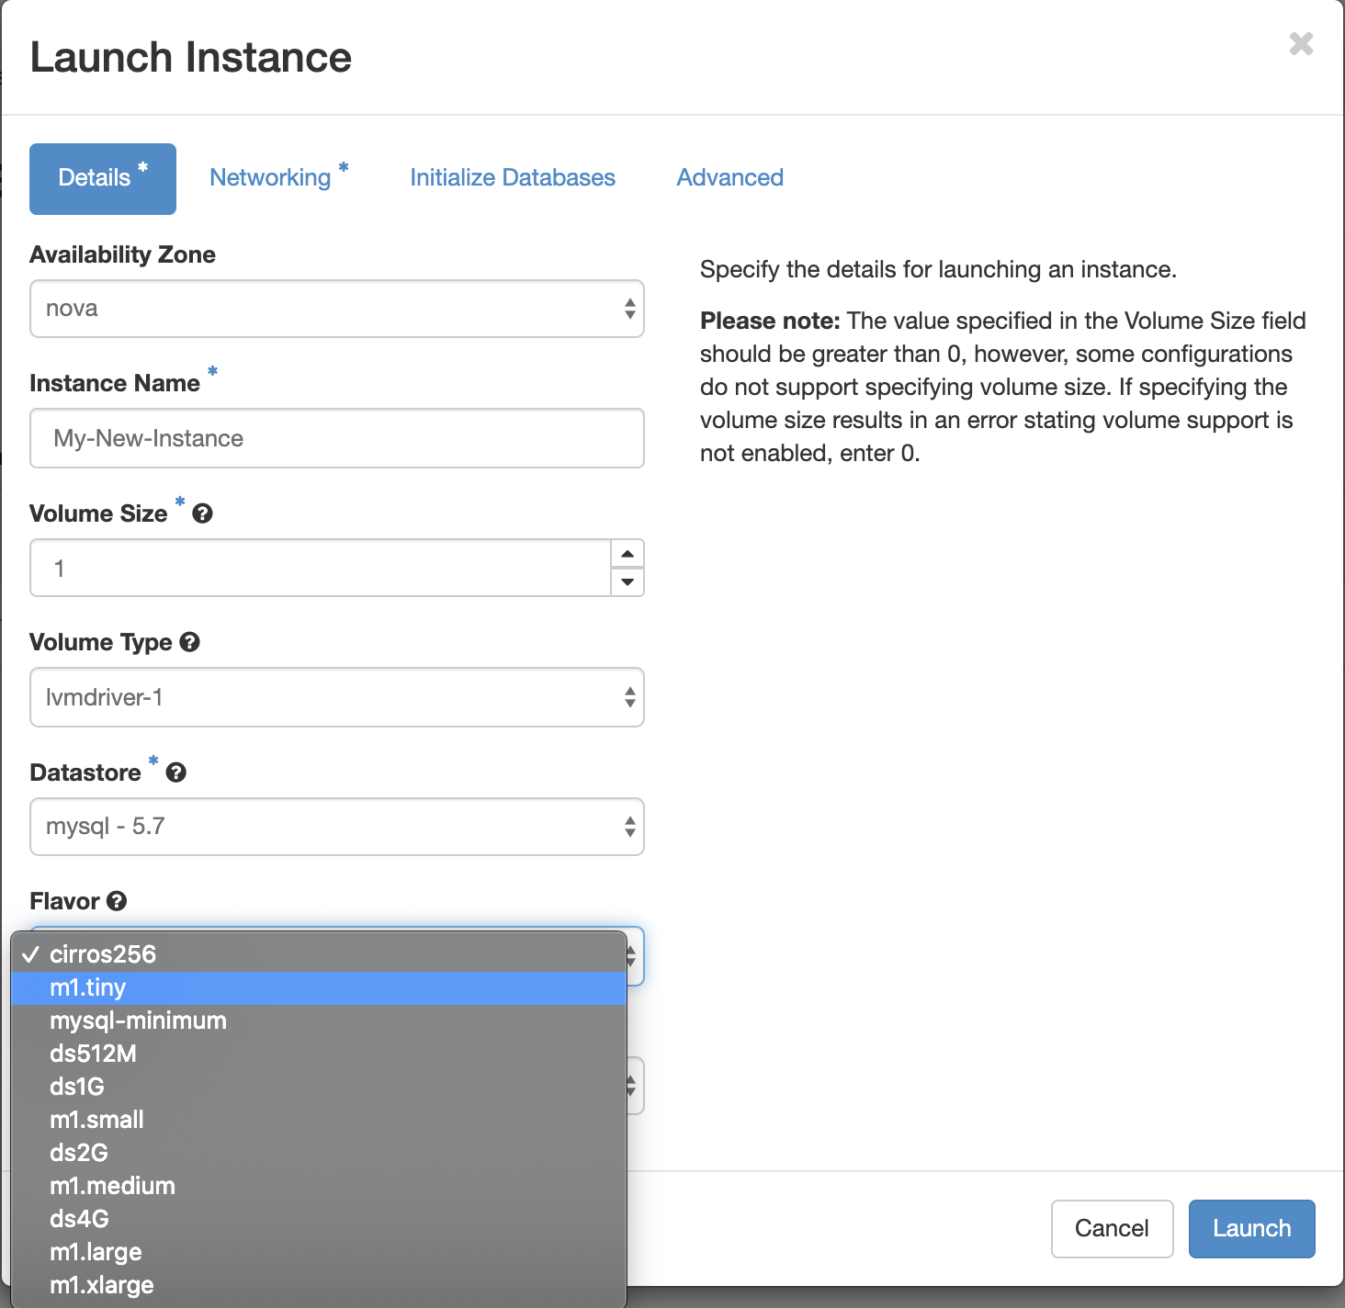
When creating new Instance, one gets a custom setup, which incorporates database-specific elements.

Slide 11
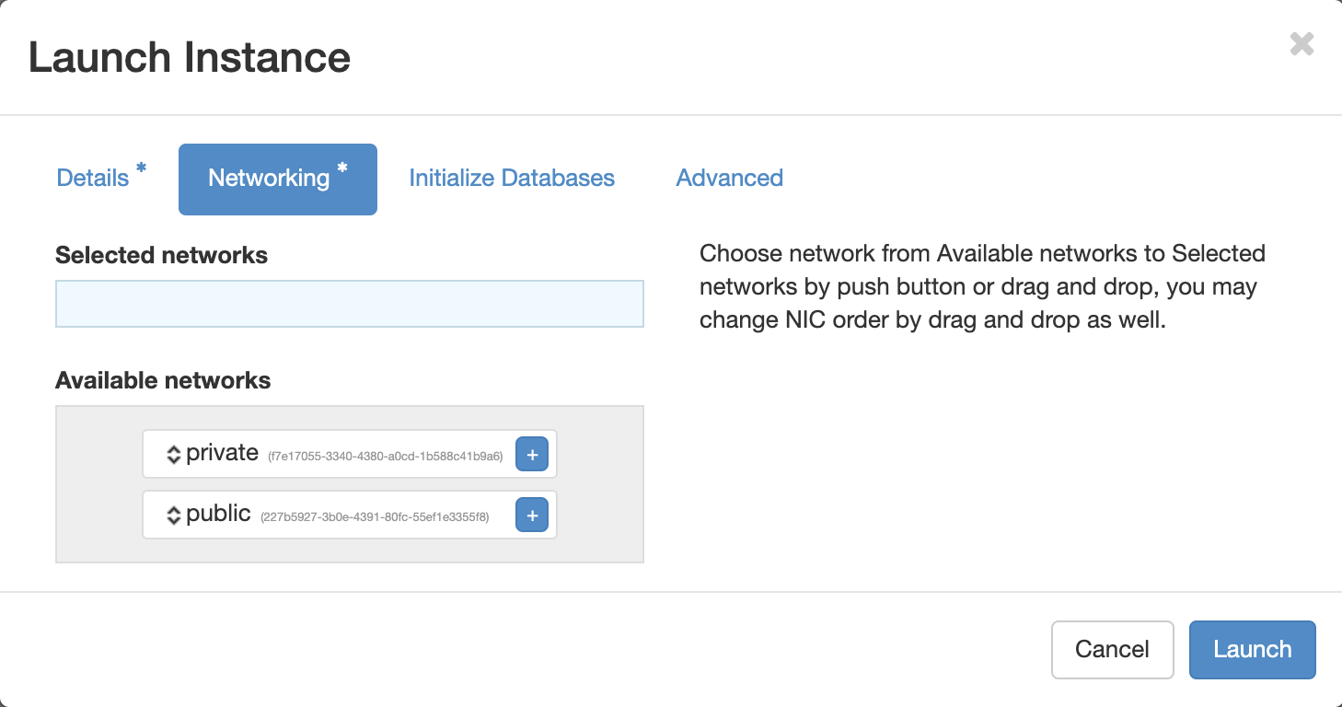
Set up database’s connectivity

Slide 12
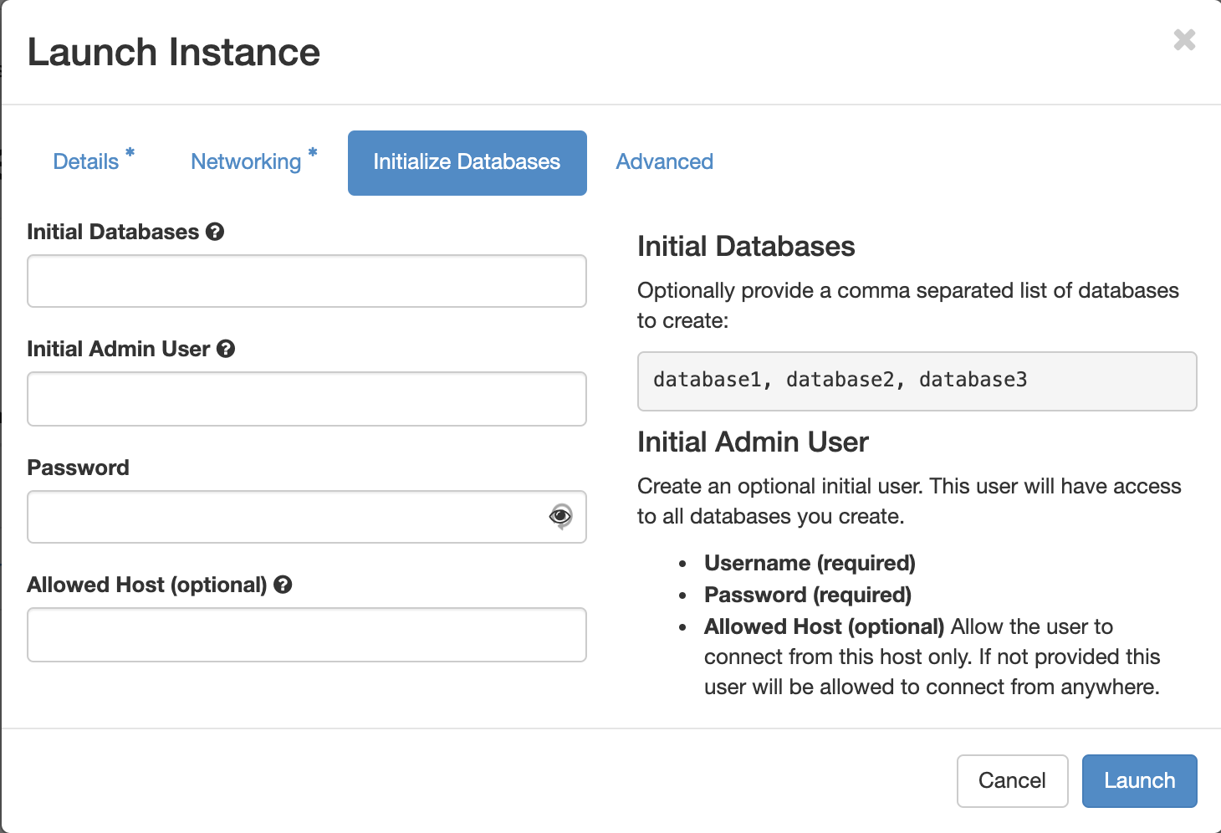
One can perform basic DB configuration as part of creation process

Slide 13
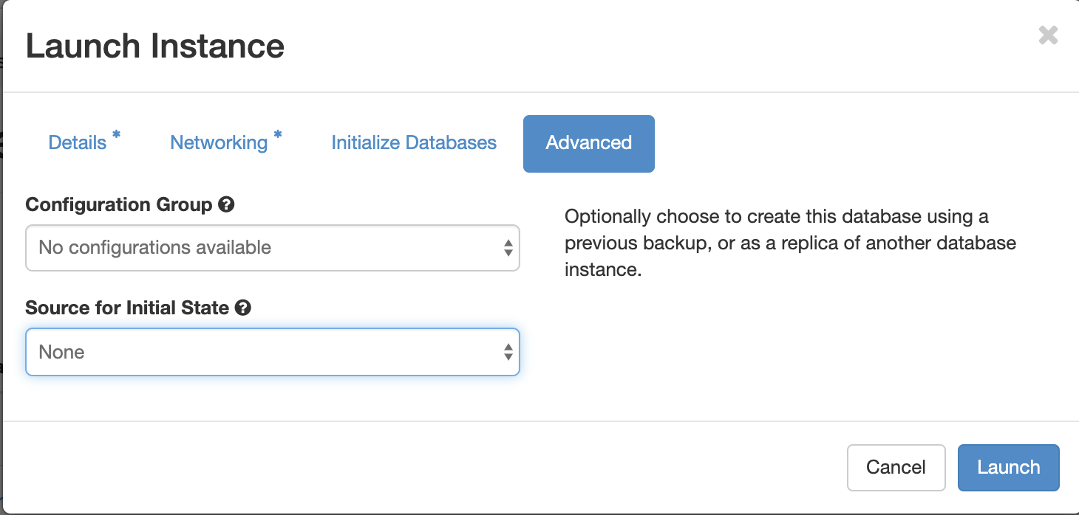
Apply template configurations and replicate from existing database

Slide 14
Risks and issues
Running around 3 weeks behind schedule
Due to change of staffing in November (original developer left)
Potential for WP2 to be de-scoped/ overrun
Database performance
Benchmarking suggests 2× slow-down for Ceph-based databases c.f. bare-metal DB server
Experiments to reduce slow-down in progress
Availability of IP addresses
IPv. 4 addresses are limited
Unclear of path to IPv.6
Experimenting with work-arounds such as NAT and port-forwarding

Slide 15
Thank-you

