Slide 1
APEL for IRIS
Adrian Coveney
IRIS F2F on Digital Assets, Imperial College
17 December 2019

Slide 2
Outline
APEL
What it is
Team Update
IRIS Accounting Dashboard
Solution
Architecture
Status
Recent and Upcoming Changes
Demo
Future Work
Planned Improvements
Digital Asset Bid

Slide 3
APEL

Slide 4
What it is
Resource usage accounting system used in production by EGI and WLCG
Collects data from resource centres around the world that are used by many different scientific user communities
Includes the central Accounting Repository service, and client and server software
EGI/WLCG Portal provided by partner organisation
Used as basis for IRIS Accounting Dashboard

Slide 5
APEL Team Update
STFC now part of UK Research and Innovation
Team
Adrian Coveney
Greg Corbett
Tim Swinbank
6-month placement
Interface and supporting data transformations

Slide 6
IRIS Accounting Dashboard

Slide 7
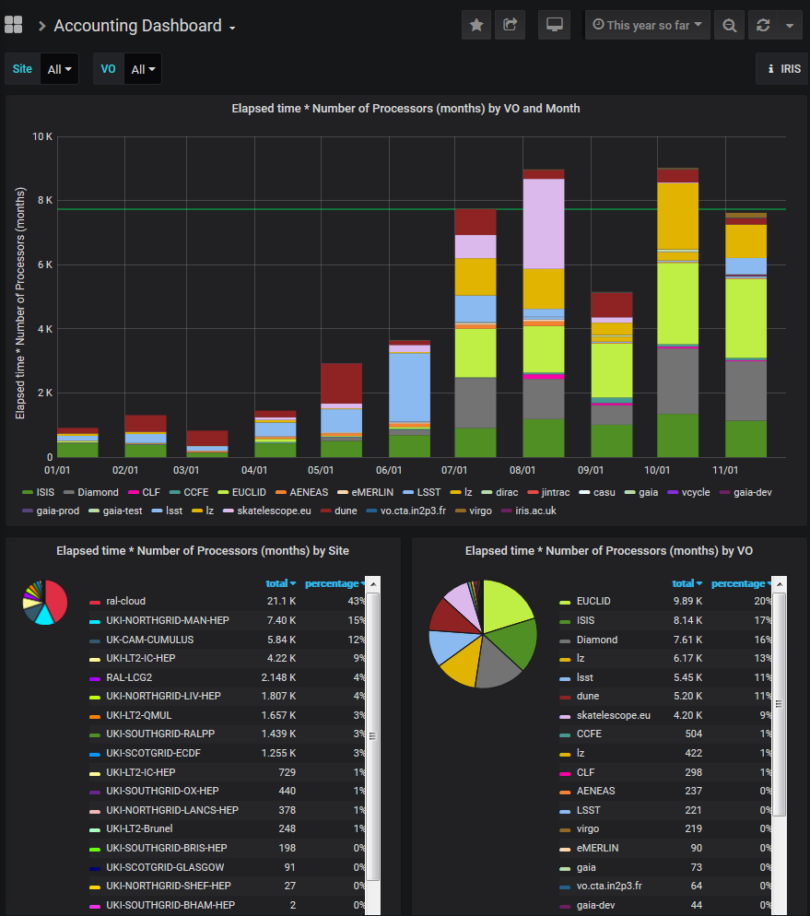
Solution
Dedicated IRIS Accounting Repository using MariaDB with existing Repository schemas and software
New bespoke Grafana dashboard to explore the data

Slide 8
Architecture
Resource Provider
Grid/cloud system
Accounting metric sensor
AMS compatible SSM
Resource Providers extract accounting records in a compatible format
Argo Messaging Service used for exchanging accounting records
Loaded into Accounting Repository and aggregated across many variables e.g. site, community
Displayed via Grafana dashboard
Argo Messaging Service (AMS)
S
S
M
Accounting
Repository
Accounting Dashboard

Slide 9
Status
Not a production service, but generally reliable
Data included
Tier1/GridPP
SCD Cloud
DiRAC and Vcycle via Cambridge
Ongoing integration
Imperial IRIS Cloud
Cardiff UK LIGO cluster

Slide 10
Recent and Upcoming Changes
IRIS IAM support (need certificates before wider rollout)
Consistent colours between panels
Improved filtering
Separate Resource Provider and Activity dashboards
Separate Resource Manager dashboard
Tracking of IRIS capacity (rather than static line)

Slide 11
Demo

Slide 12
Future work

Slide 13
Planned Improvements
Tracking of Activity allocations
Normalisation
Starting with Tier1/GridPP data and SCD Cloud
What would you like to see?

Slide 14
Digital Asset Bid
Extend to storage space accounting
Raw unscaled wall time for grid-style accounting
User-friendly documentation to improve access
Configuration management of service to improve sustatinability

Slide 15
Thank you
apel-admins@stfc.ac.uk

