Slide 1
Dark Matter
Prof David Berman
Centre for Research in String Theory
Queen Mary University of London

Slide 2
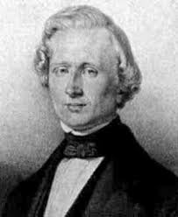
Some History of Ideas
Urbain Le Verrrier
Predicted the existence
and location of Neptune
from studying anomalies
In Uranus’s orbit.
The astronomer Galle found Neptune the night he received Le Verrier’s
Letter.

Slide 3
It worked once….
In 1859 he saw that Mercury also had an anomalous orbit.
It processed.
So again he predicted a new planet, “Vulcan”.
But it wasn’t found.

Slide 4
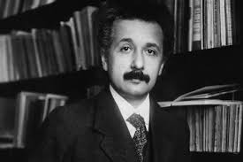
Instead
Einstein discovered the theory of General Relativity and Gravity was altered.
GR- explains the shift in the perihelion of Mercury.

Slide 5
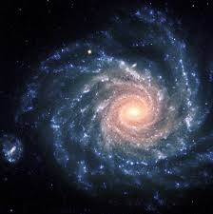
From the solar system to Galaxies
Spiral galaxies rotate

Slide 6
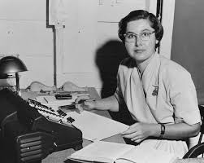
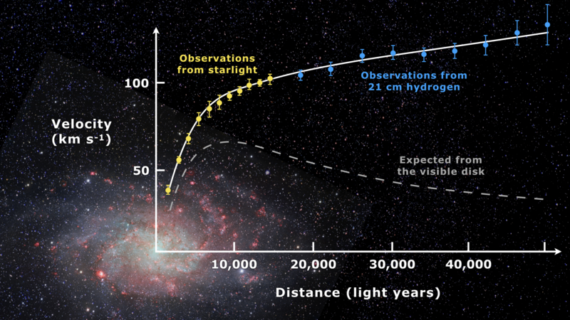
Vera Rubin
1975, Vera Rubin in measured the speed of rotation of spiral galaxies and how it depended on the distance from the galaxy centre.

Slide 7
Galaxy rotation

Slide 8
Solutions
Dark Matter in Halos around the galaxies.
Or Modify gravity, abandon GR!
Or another idea….

Slide 9
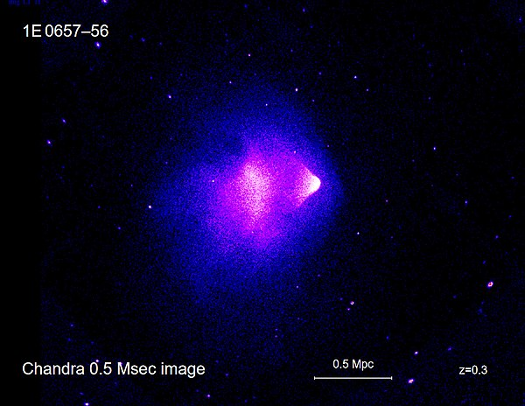
Solution: Dark Matter
Dark matter fits the best from more detailed evidence..
The Bullet cluster:
Galaxy clusters colliding

Slide 10
More
We now have many other ways of learning about the universe:
Cosmic microwave background
Gravitational Lensing
The formation and evolution of galaxies

Slide 11
Microwave background

Slide 12
Gravitational Lensing

Slide 13
Use all of these
The total mass–energy of the universe contains:
5% ordinary matter and energy,
27% dark matter
68% of an unknown form of energy known as dark energy.

Slide 14
Types of dark matter
Obvious things, just cold ordinary stuff that doesn’t glow called “Machos” (Massive compact halo objects); includes things like burnt out stars
Weakly interacting massive particles, “WIMPS”, these are like massive elementary particles that interact very weakly
Primordial blackholes
Novel unusual stuff: monopoles, supersymmetric partners, Kaluza Klein particles from extra dimension

Slide 15
Experimental constraints
Lensing rules out Machos
Limits on primordial blackholes from Hawking radiation, lensing and CMB
Direct searches in LHC have not found any new WIMPS (expectation from cosmology was for new 100GeV particles with interactions via weak force).
Supersymmetry, no direct detection at LHC ☹
Extra dimensions, no direct detection ☹
Monopoles, no direct detection ☹

Slide 16
We need Help
At the moment there are no independent pieces of evidence for Dark Matter outside of cosmology and gravitational physics.
Yes, you should be worried.

Slide 17
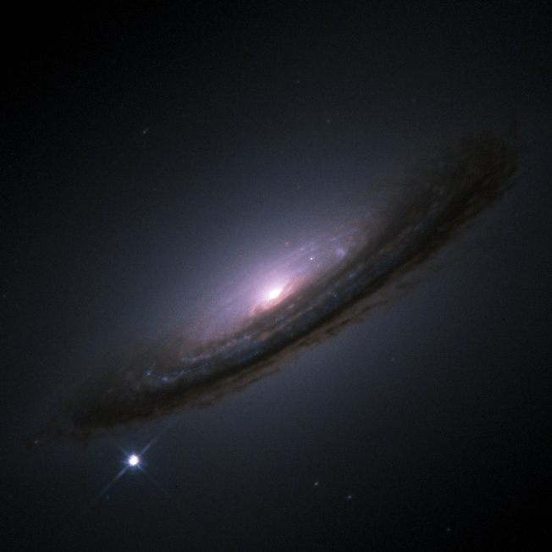
Dark Energy
In order to explain the expansion of the
cosmos we need this, it pushes things apart.
The evidence for this is built around our
understanding of the expansion of the
universe from studying supernovae.
The 2011 Nobel prize was given for the supernova measurements.

Slide 18
Einstein’s old “wrong” idea The Cosmological Constant

Slide 19
Cosmological Constant
What is it?
It is a free parameter that you can add to Einstein’s equations in relativity.
It is in some sense the energy of vacuum
Why not have it zero- seems obvious
Why not have it very large- this is actually what quantum field theory predicts
It is very small, one of nature’s surprises. Around 100 orders of magnitude smaller than predicted. 10⁻²⁹ g/cm³

Slide 20
We need help
At this point theorists have no clue why it is so small or to be honest why it is there at all.
Anthopological argument- we need it to be small
Otherwise no real clue.

Slide 21
Lets be optimistic
We understand 5% of the universe very well indeed.
We have now measured the gravitational effects of the rest of the universe also to a high level.
Physics is far from complete. The simplest thing:
Nothing, the vacuum of empty space is one of its biggest mysteries.

