Slide 1
Half Term Report

Slide 2
2

Slide 3
CPU is Good What about Disk
Will come from digital asset

Slide 4
Working on this – but unsolved
Manchester project

Slide 5
Web site
Philip and CCFE working on this

Slide 6
Project Manager
Excellent
Some progress
Need some solution to batch and VREs

Slide 9
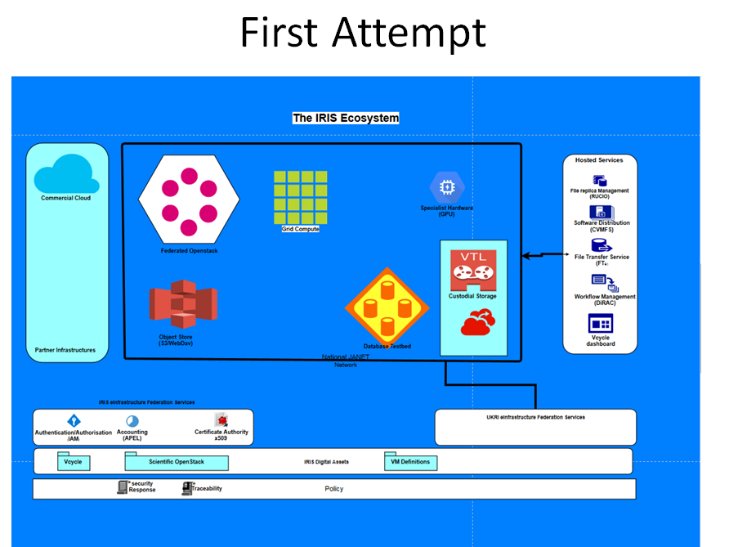
Service Catalogue
JK working on this

Slide 10
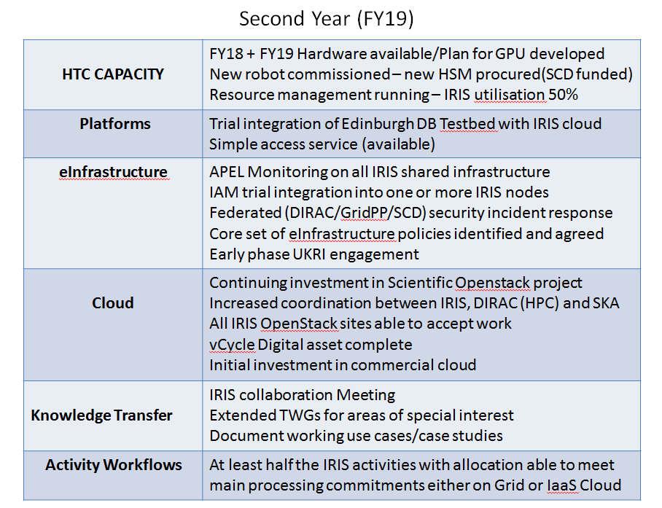
?
Maybe!

Slide 11
