Slide 1
Queen Mary Innovation

Slide 2
Queen Mary Innovation Ltd (QMI) is QMUL’s wholly-owned technology transfer company
We are responsible for the commercialisation of the University’s intellectual property (IP) and management portfolio of spinout companies.
We protect and commercialise QMUL's research-derived IP and help to maximise the economic and societal impact of that research.

Slide 3
Creating value from IP
Drivers and Benefits: Alignment with 2030
A route to research impact (REF2021)
Benefit to institutional reputation
Attract top students and researchers
Generate income
Opportunities for further research funding, both national and international
Stimulate new ideas and thinking
Enhance academic career development
Supports and complements intellectual endeavour

Slide 4

Commercialising research: a UK perspective
we are improving the incentives, processes and skills that support the flow of knowledge and ideas around society and increase opportunities for research commercialisation.
we will increase funding that supports universities and businesses working together to innovate and commercialise research
we need to do more to ensure our excellence in discovery translates into its application in industrial and commercial practices, and so into increased productivity
we must become a more innovative economy and do more to commercialise our world leading science base to drive growth across the UK
our vision for a knowledge-led economy is underpinned by world-leading research, world-class facilities and international collaborations that push scientific frontiers

Slide 5


QMI Structure
QMI Board
QMI
Director
Tech and Eng team
BioPharma team
Core Team

Slide 6
The QMI Process – working with academics
Evaluation
Decision making
Project Development
Delivery
Innovation disclosure
Engage with QMI
Completion of disclosure form
(~ 100 p.a.)
Evaluation
Market need
Competition
IP ownership
Patentability
Feedback
Go/No-go
Outcomes
Commercial Plan (Licensing / Spin-out)
Proof of Concept
IP Protection
Licence
Data pack
Approach Licensees
Spin out
Further diligence
Incubation funding
Seed Finance
Commercialisation

Slide 7
PoC / Translational Funding
HEIF PoC
QMUL run HEIF PoC fund - £400k
Split into 3 panels:
  Tech & Eng;
  Biopharma and
  Life Sciences Initiative
Work closely with industry/VC to agree what milestones will trigger a licence or investment
£10k small award and £50k large award
EPSRC & STFC IAA
Support creation of impact from EPSRC or STFC research
Three streams:
  Early stage commercialisation.
  Business / End User engagement.
  Secondments.
£5k small award always open
£40k large award
External sources
QMI supports applications to external grant bodies, e.g:
UKRI
Defence and Security Accelerator
Wellcome Trust
RAE ERA Enterprise Fellowships
ICURe
MRC
Venture or angel funds
  IP Group Plc
Call open now
– closes 18 Nov 2019
Call open now
– closes 16 Dec 2019

Slide 8















Commercialising research at QMUL
Over 500 invention disclosures evaluated
Over 130 commercial licenses returning over £3 million of income shared with inventors
Established at least one new spin out each year since 2008
QMUL spin outs have attracted over £150 million of investment, creating a portfolio worth in excess of £200 million
Approximately £10 million of QMUL assets with good prospects for growth
Exit from Apatech Ltd. returned £10 million

Slide 9

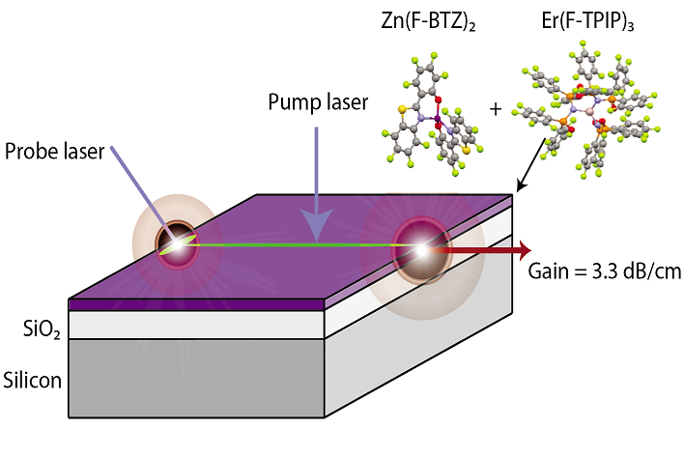
Targeting $3 bn optical amplifier and transceiver markets, which are growing rapidly (25 % CAGR) on back of trend towards silicon photonics
Incorporated in 2017 with grub funding from IP Group and supported by Innovate UK
Just secured seed funding round in October 2019 from IP Group
Organic sensitised rare earth optical amplifiers
Notes:
Actual Experience (AE) is an algorithm-based software tool that works in real time to predict the service quality that is experienced by individual users of applications on a computer network. It also launches instant, automatic diagnostic traces to isolate the cause of problems as they occur. The AE service quantifies and diagnoses perceived application experience.

Slide 10
How to contact me
Dr Colin Davies
Senior Commercialisation Manager
(Physical Sciences)
Phone: +44 (0) 20 7882 7543
Mobile +44 (0) 77 8639 1054
email: c.j.davies@qmul.ac.uk
Contact QMI with potential opportunities before public disclosure

Slide 11
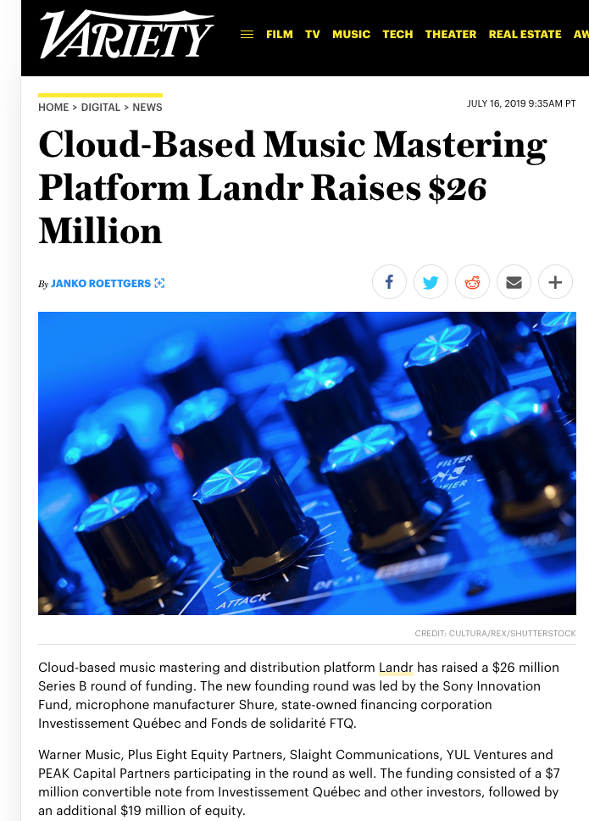
Landr
Prof Josh Reiss EECS
Incorporated in 2013
MixGenius
Canadian VC

Slide 12
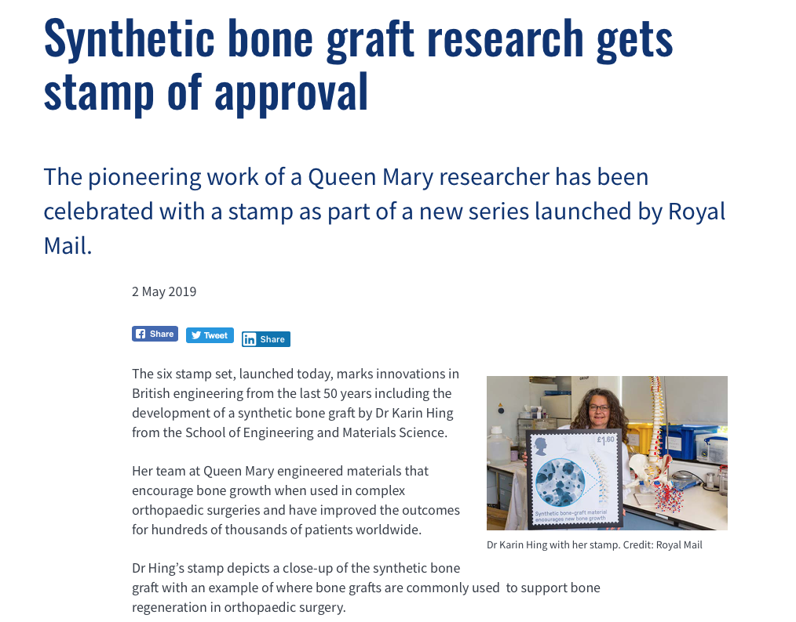
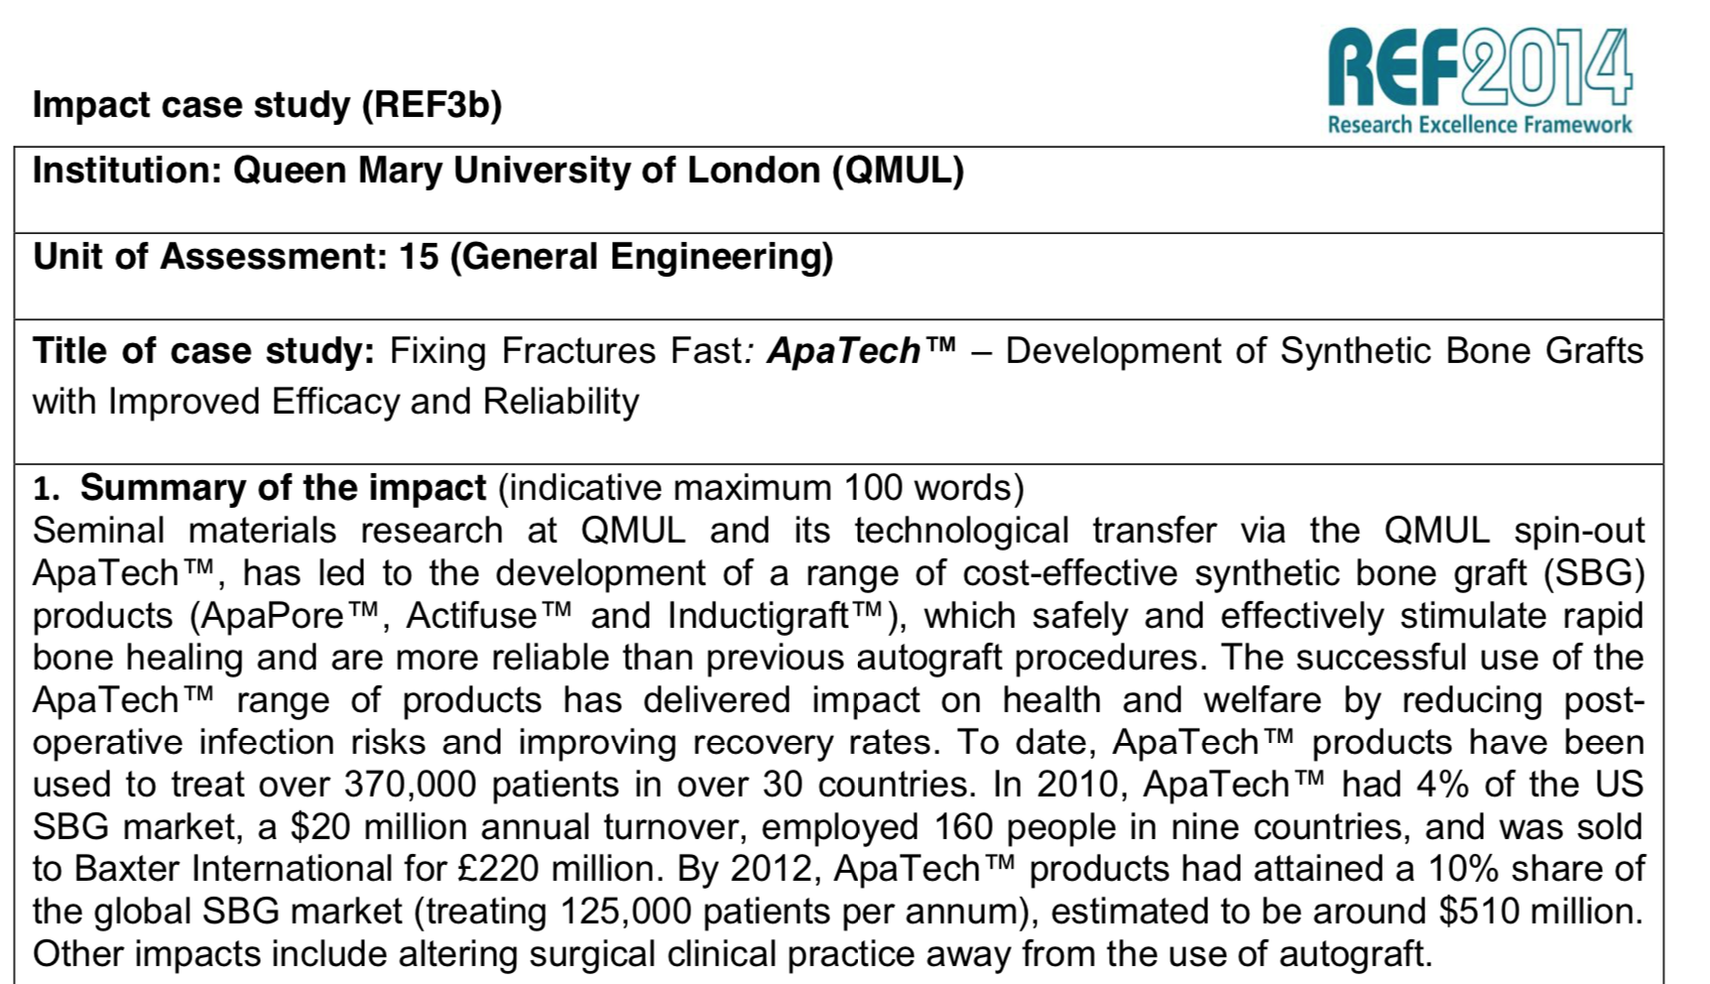
Apatech

Slide 13
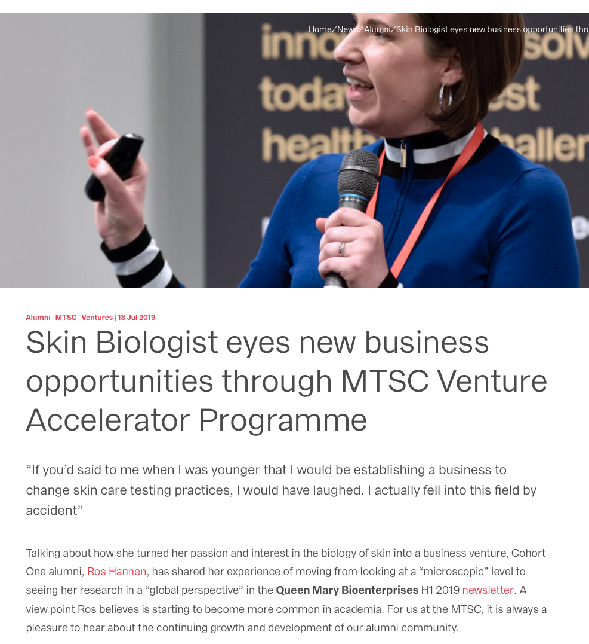
MedTech SuperConnector
MTSC:
Combining Capabilities Fund
£5M collaboration with 6 London HEIs
4 cohorts over 3 years

Slide 14

Apatech
Orthobiologics company specialising in Set up in 2001 to commercialise the research of Professor William Bonfield
Generated sales of approximately $60M in 2009, with lead product, ACTIFUSE, a new class of bone graft material
Acquired by Baxter International Inc. 2010 for a total consideration of up to $330M including an upfront cash payment of $240M and additional payments of up to $90M based on sales milestones
QMUL investment returned ~£10 million from its equity interest
Synthetic bone repair materials for orthopaedic and dental applications.
Notes:
(Apatech was formed before QMI existed and demonstrates the economic and social impact achieved from QMUL’s research)

Slide 15

Actual Experience
2009 - 2013 – Initial grub funding from IP and then raised £6 million investment from IP Group / Henderson Global Partners
AIM listed in Feb 2014 with the shares closing up approximately 400% on the first day.
£16m raised in 2015, with a further £17.4 million in April 2017
Market capitalisation of ~ £120 million
Software to measure the performance of applications across networks.
Notes:
Actual Experience (AE) is an algorithm-based software tool that works in real time to predict the service quality that is experienced by individual users of applications on a computer network. It also launches instant, automatic diagnostic traces to isolate the cause of problems as they occur. The AE service quantifies and diagnoses perceived application experience.

Slide 16
LANDR
2011 – company established as MixGenius in Canada with TandemLaunch Technologies with £250k investment
Been through a number of rounds of investment since and raised >£8m.
Renamed to LANDR as product focused shifted towards mastering
Currently employing 30+ staff and has over 1 million users and has mastered over 4 million tracks
Quarterly revenue of ~$1.3M (Canadian)
Sound like a pro. Instant results at a fraction of the cost of studio mastering.
Notes:
Actual Experience (AE) is an algorithm-based software tool that works in real time to predict the service quality that is experienced by individual users of applications on a computer network. It also launches instant, automatic diagnostic traces to isolate the cause of problems as they occur. The AE service quantifies and diagnoses perceived application experience.

Slide 17
MedTech SuperConnector
MTSC:
Combining Capabilities Fund
£5M collaboration with 6 London HEIs
4 cohorts over 3 years

Slide 18
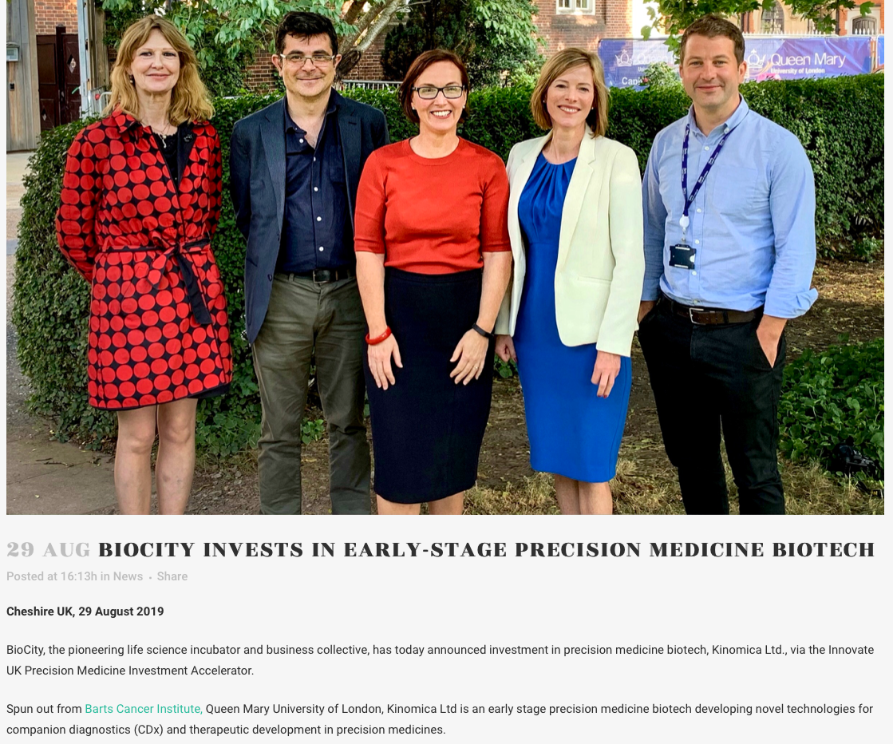
Kinomica Ltd
Pedro Cutillas (BCI)
Incorporated 2016
Innovate UK funding plus matching investment c.£1M

Slide 19
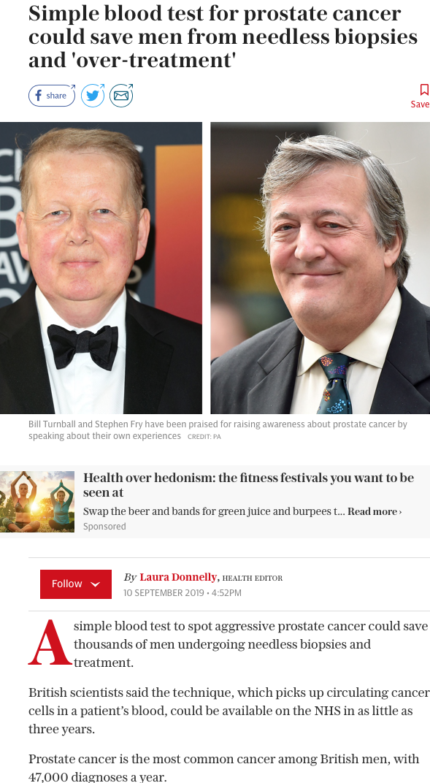
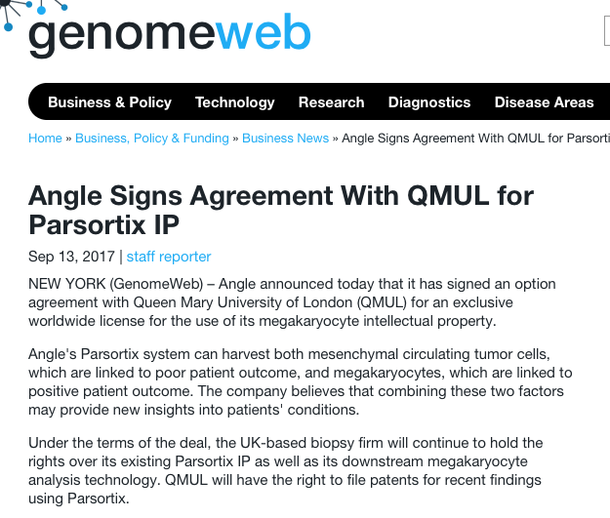
Professor Yong-Jie Lu, BCI

Slide 20





Queen Mary Innovation’s Portfolio
Discovery
Development
Commercialisation
250 projects
60 active
35 Licences
100 Inventions
2 Spin-Outs

Slide 21
QM IP Policy
IP Policy updated in March 2015:
QM owns the Intellectual Property
Staff/Students have an obligation to disclose new inventions
If successful the inventors are the major beneficiaries
If not successful the IP is assigned back to the inventors
QMUL provides support to facilitate the commercialisation of the inventions
Queen Mary Innovation is the main support mechanism

Slide 22
Why do Technology Transfer?
QMUL Strategy
  Strategic Aim 2.4: Sustain an environment in which academic engagement in innovation is recognised, encouraged and rewarded, in order to maximise the societal and economic benefits of QMUL’s research.
Research Excellence Framework 2021
  Impact a measure of Excellence (£120k pa 4* Case Study)
  Technology Transfer one aspect of Impact

Slide 23
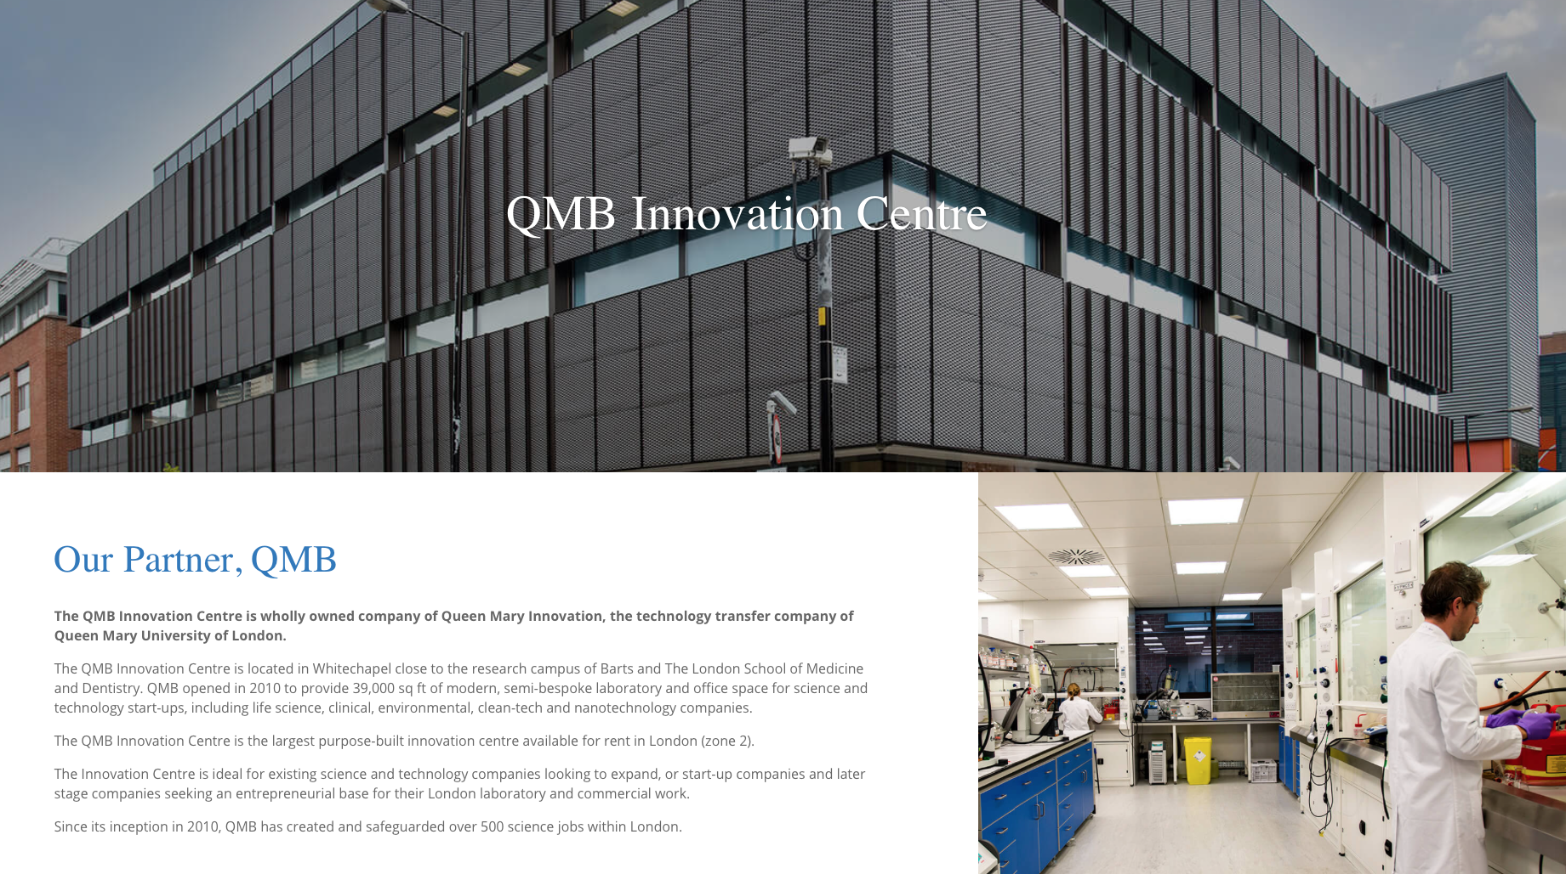
QMUL Patent Budget expenditure devolved to QMI. Decisions to file/abandon made by QMI based on commercial/financial considerations
Licensed technology: QMUL retains influence over global patent strategy and control over patent prosecution, recover patent costs from licensee
Operations:
  In-house patent manager
  MyIP database management system
  External patent attorneys (depending on price and specialism)

Slide 24
PoC / Translational Funding
Most University Research requires further development to license or spin-out
Hence the requirement for Proof of Concept Funding or Translational Funding
Available Funds
  Internal
    HEIF PoC - £400k
    EPSRC Innovation fund & Accelerator programmes (now PoC)
  External funding
    Innovate UK, Defence and Security Accelerator, RAE ERA Enterprise Fellowships, ICURe, MRC, Venture funds (IP Group Plc and others)
Key: Work closely with industry/venture capitalists to agree the target output – what milestones will trigger a licence or investment

Slide 25
EPSRC Impact Acceleration Account
Flexible Innovation Starter Fund
  Up to £5k
  From research outputs to translational funding
Innovation Acceleration Fund
  £25k to £50k
  Business partnership to accelerate research to products/services
Sandpits - e.g. spin-out workshop; AI event
Rebbeca Babb - r.babb@qmul.ac.uk

Slide 26
The QMI Process
Invention disclosure
Evaluation
Decision making
Project manage
Deals
Engage with QMI
Completion of technology disclosure form
Evaluation
Market need
Competition
IP ownership
Patentability
Feedback
Go/No-go
Outcomes
Commercial Plan (Licensing / Spin-out)
PoC funding
IP Protection
Licence
Data pack
Negotiate licence
Spin out
Further diligence
Incubation funding
Seed Finance
Commercialisation

Slide 27
The QMI Process
Invention disclosure
Evaluation
Decision making
Project manage
Deals
Engage with QMI
Completion of technology disclosure form
Evaluation
Market need
Competition
IP ownership
Patentability
Feedback
Go/No-go
Outcomes
Commercial Plan (Licensing / Spin-out)
PoC funding
IP Protection
Licence
Data pack
Negotiate licence
Spin out
Further diligence
Incubation funding
Seed Finance
Commercialisation

Slide 28
Invention Disclosure
To formally record the invention on the QMI database – date, inventors etc
To collect initial information about the technology and opportunity both for patent attorneys and for the Evaluation stage
To formally record the inventors share of any revenues.
WHAT NOT TO DO (IMPORTANT)
Don’t disclose details of your results
(seminars, conference abstracts and
posters etc.) before contacting QMI

Slide 29
The QMI Process
Invention disclosure
Evaluation
Decision making
Project manage
Deals
Engage with QMI
Completion of technology disclosure form
Evaluation
Market need
Competition
IP ownership
Patentability
Feedback
Go/No-go
Outcomes
Commercial Plan (Licensing / Spin-out)
PoC funding
IP Protection
Licence
Data pack
Negotiate licence
Spin out
Further diligence
Incubation funding
Seed Finance
Commercialisation

Slide 30
Evaluation Criteria (1/2)
Market
Technology Solution vs Competition
Intellectual Property position
Route to Market
Financials (Value)

Slide 31
Evaluation Criteria (2/2)
Market | Technology | IP | Route to market | Financials
Size and growth rate. Disruption. Market needs: desirable vs essential – third party opinion Approach to innovation: comparables or willingness to licence (make or buy) | Identify the benefits of your product Match these to the needs of the market Compare these to the competition (USP) | Who owns the IP? Can IP be protected? Patent, trade secret, software copyright, etc Disclosure? Are there any other forms of protection? | How will you get the product to market? What is the distribution channel? Where are you in the value chain? | What is the gross margin? What are the potential sales? What are the marketing and other costs? Is the investment worth the reward?

Slide 32
The QMI Process
Invention disclosure
Evaluation
Decision making
Project manage
Deals
Engage with QMI
Completion of technology disclosure form
Evaluation
Market need
Competition
IP ownership
Patentability
Feedback
Go/No-go
Outcomes
Commercial Plan (Licensing / Spin-out)
PoC funding
IP Protection
Licence
Data pack
Negotiate licence
Spin out
Further diligence
Incubation funding
Seed Finance
Commercialisation

Slide 33
The QMI Process
Invention disclosure
Evaluation
Decision making
Project manage
Deals
Engage with QMI
Completion of technology disclosure form
Evaluation
Market need
Competition
IP ownership
Patentability
Feedback
Go/No-go
Outcomes
Commercial Plan (Licensing / Spin-out)
PoC funding
IP Protection
Licence
Data pack
Negotiate licence
Spin out
Further diligence
Incubation funding
Seed Finance
Commercialisation

Slide 34
IP Commercialisation Options
Outright sale
Assignment and revenue share
Licensing
  Out-licensing the use of IP rights (IPR), partnering with an existing company with a view to leveraging its expertise and/or market position in return for a revenue stream
‘Spin-Out’ or ‘Start-Up’ formation
  Creation of a new venture (usually a company) to add value to the commercial development of products/technologies

Slide 35
Licensing
Based on Intellectual Property (IP) (patent, software copyright, know-how, design right), which is usually the result of a substantial body of development, and has been significantly de-risked
Licensed either exclusively or non-exclusively by field. Usually includes milestones, min royalty payments to minimise the risk of the Licensee doing nothing
The licensee often has to do significant further development - software probably the exception. Therefore, some support required by inventors
Big Companies notoriously risk adverse – hence first step can be Proof of Concept funding

Slide 36
University spin-out company
IP licensed/assigned from University to spin-out. Generally substantial IP providing a platform technology, or has multiple applications in different markets
Venture Capital investment in exchange for equity to achieve specific milestones which aim to trigger subsequent investment
External management to drive commercial side. Inventor commitment high – a number of days a week (Chief Scientist)
Will go through a series of funding rounds against milestone achievements where the value of the company increases
End game: exit either through a trade sale or IPO for a significant value (~$10m to University and inventors)

Slide 37
Spin-out vs Licence
An obvious licence:
  Market is mature with a small number of dominant players, i.e. these companies are needed to get to the market
  Technology is mature with limited (one) applications. Enabling technology
  Examples: software; established market engineering projects: requiring skills and market position of licensee to be a success – i.e. no go it alone option
An obvious spin-out:
  Growing Market, no obvious dominant licensee. Don’t require skills of another company and market position to be a success
  Scalable revenues, exponential sales forecasts.
  Platform technology: lots of potential applications and/or customers

Slide 38
PoC / Translational Funding
Bridging the funding gap
Most university research is not of commercial interest so Proof of Concept Funding or Translational Funding required
  Usually requires Commercial Validation – letters of support; in-kind or actual funding
  A relatively small amount of money to demonstrate commercially relevant milestones
Available funds include
  NIHR Invention for Innovation (i4i), Wellcome Trust
  Defence and Security Accelerator (DSA)
  Small Business Research Initiative (SBRI)
  Innovate UK
  Internal or specialist PoC funding
Key: Work closely with industry/venture capitalists to agree the target output –
  what milestones will trigger a licence or investment?

Slide 39
The QMI Process
Invention disclosure
Evaluation
Decision making
Project manage
Deals
Engage with QMI
Completion of technology disclosure form
Evaluation
Market need
Competition
IP ownership
Patentability
Feedback
Go/No-go
Outcomes
Commercial Plan (Licensing / Spin-out)
PoC funding
IP Protection
Licence
Data pack
Negotiate licence
Spin out
Further diligence
Incubation funding
Seed Finance
Commercialisation

Slide 40
…and afterwards?
Invention disclosure
Evaluation
Decision making
Project manage
Deals
Engage with QMI
Completion of technology disclosure form
Evaluation
Market need
Competition
IP ownership
Patentability
Feedback
Go/No-go
Outcomes
Commercial Plan (Licensing / Spin-out)
PoC funding
IP Protection
Licence
Data pack
Negotiate licence
Spin out
Further diligence
Incubation funding
Seed Finance
Commercialisation

