Slide 1
APEL for IRIS
FY20 Digital Asset
Adrian Coveney
IRIS TWG on Digital Assets
21 April 2020

Slide 2
Outline
IRIS Accounting Dashboard
New Digital Asset work
Storage space accounting
Support for normalisation
Documentation
Publishing without a Grid certificate
Other planned improvements

Slide 3
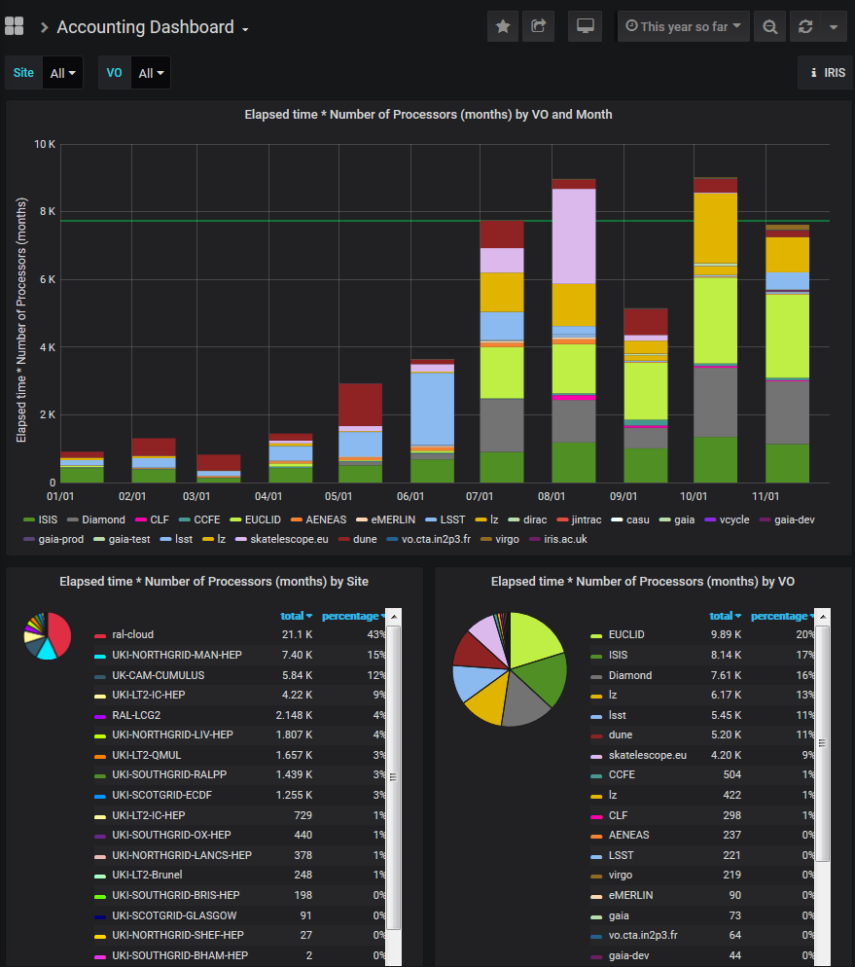
IRIS Accounting Dashboard
Dedicated IRIS Accounting Repository using MariaDB with existing APEL Repository schemas and software
Bespoke Grafana dashboard to explore the data

Slide 4
New Digital Asset work
Storage space accounting
A new version of the IRIS Accounting Repository and Dashboard that supports the inclusion of storage space accounting records and displays them in a useful way.
Support for normalisation
An agreed documented method of normalisation and a new version of the Accounting Dashboard that supports it, allowing comparisons to be made between systems and sites.

Slide 5
New Digital Asset work (cont.)
Documentation
User-friendly documentation aimed at site admins detailing how to extract and publish accounting information.
Publishing without a Grid certificate
A new version of SSM that supports publishing of accounting records without the need for a Grid certificate, relying on tokens and other mechanisms for authentication and authorisation.

Slide 6
Other planned improvements
Configuration management of service to simplify operations
Investigate using IAM groups
Ongoing improvements to the Dashboard
Any other requests?

Slide 7
Thank you
apel-admins@stfc.ac.uk

