Slide 1
GOCDB
Greg Corbett
gocdb-admins@mailman.egi.eu

Slide 2
Agenda
1 GOCDB
2 Digital Assets
3 Useful Links
Image © STFC Alan Ford

Slide 3
GOCDB
GOCDB is a service registry and topology database:
the official repository for storing and presenting EGI and WLCG topology and resource information.
the definitive source of truth for managing Grid, Cloud and Storage topology objects including; sites, services, service-endpoints, service-groups, downtimes, users, roles and business rules.
It emphasises allowing resource providers and user communities to maintain their own information in a centralised location, accessible to both infrastructure staff via a web portal and other automated e-Infrastructure tools via a REST API.
GOCDB is the core operational tool that underpins other core operational tools and policies.
It is intentionally designed to have no operational dependencies on other tools for information.

Slide 4
GOCDB
Hierarchy of resources: Site Grouping -> Site -> Service -> Service Endpoints
Site Groupings
Typically National Grid Infrastructures (NGIs), also CERN, EGI, and projects (Elixir)
Contact info, Users with a role over that NGI, Site list
Site information
Contact info, Users with a role over that Site, list of Services, list of Downtimes affecting that Site
Service information
System information, Production Level and Monitored status, Service Endpoints

Slide 5
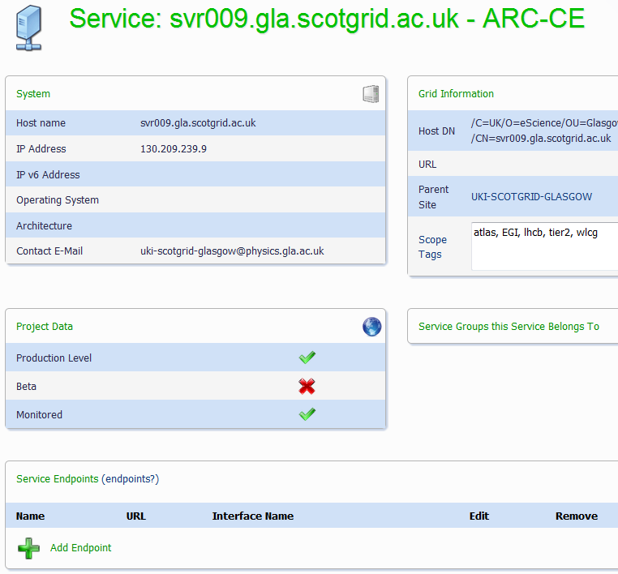
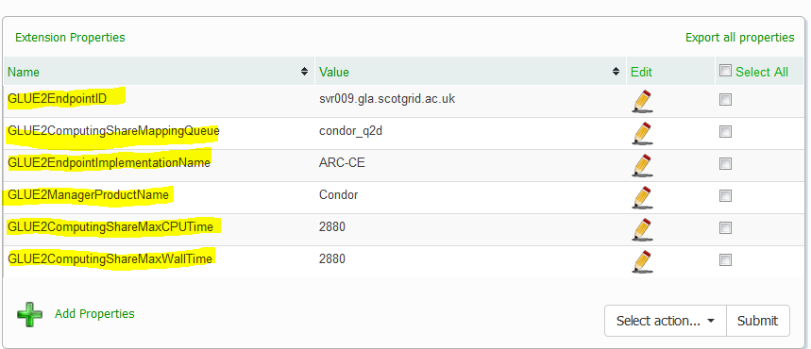
GOCDB – extension properties
GOCDB sites and services can have extension properties.
Extension Properties allows community definable key-value pairs.
For example, sites in IRIS could define an “Installed Capacity” extension property for consumption by APEL.

Slide 6
Digital Asset(s)
Enhanced version(s) of the GOCDB software that integrates with the IRIS-IAM
Create and use GOCDB accounts, via the IAM
APIs accessible via the IAM to allow programmatic access to the service data.
Configuring an instance of the enhanced GOCDB version(s) as an IRIS specific view
GOCDB Web Portal and API under its own URL
Displays data for entities relevant to IRIS by default.
Timeline: October 2020 – March 2021
Benefits:
Operational tools or processes can be implemented in a scalable way.
Advertising installed capacity to the accounting service
Security and incident response, sites will be able to update their security contact information as needed and this will automatically propagate to users or operational tools.

Slide 7
Useful Links
EGI/WLCG production instance
https://goc.egi.eu/portal/
Codebase
https://github.com/GOCDB/gocdb
User documentation
https://wiki.egi.eu/wiki/GOCDB/Input_System_User_Documentation
API Documentation
https://wiki.egi.eu/wiki/GOCDB/PI/Technical_Documentation
https://wiki.egi.eu/wiki/GOCDB/Write_API/Technical_Documentation

Slide 8
gocdb-admins@mailman.egi.eu

Slide 9
Science and Technology Facilities Council
@STFC_Matters
Science and Technology Facilities Council

