Slide 1
DynaFed Digital Asset
Alastair Dewhurst
Notes:
The abstract pattern can be removed or repositioned if required. Be careful to ‘Send to Back’ so that it does not obscure any important information.

Slide 2
Introduction
IRIS has funded 6645 TB of usable space at RAL on our Echo storage service.
Echo can provide both Grid and Cloud interfaces/API.
With the exception of Dune, whose use case is very similar to that LHC Experiments, users have struggled to access Echo.
DynaFed provides an optional layer on top of the Cloud APIs.
It aims aims to greatly improve the ease of use of the service:
Integrate with IRIS IAM service (so no need for X.509 auth)
Provide browser based access to files with a file system like structure.
Facilitate transfers between Grid and Cloud based storage.

Slide 3
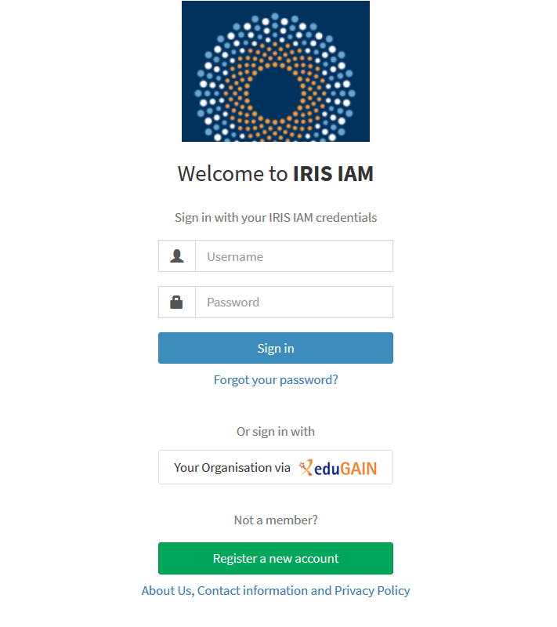
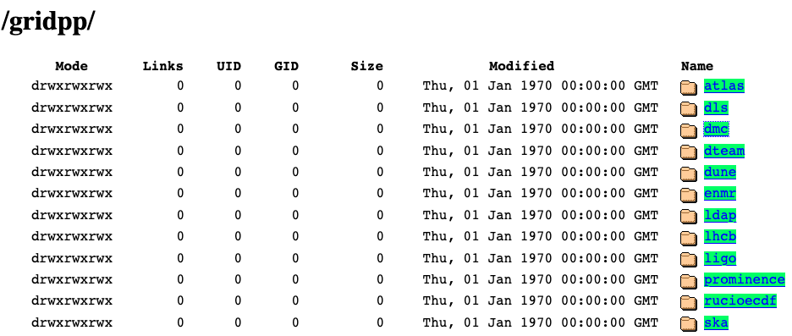
DynaFed Goals
Integration with IRIS IAM
Integration with Rucio and 4th Party Copies
User (FTS / Rucio)
DynaFed
ssh
GridFTP, XRootD,
S3
Site A Storage
Echo S3
Gateway
S3
Ceph backend

Slide 4
Work Breakdown structure
Task | Description | When / PM
1.1 Integrate Rucio with DynaFed | Develop scripts that will automatically update DynaFed if configuration changes are made to the Multi-VO Rucio instance at RAL. | February - March 2021 (3 PM)
1.2 Integrate DynaFed with IAM | Enable DynaFed to accept users who have authenticated via the IRIS IAM service. | October - November 2020 (2 PM)
1.3: Enable 4th Party Transfers | Create, deploy, test and validate the necessary scripts to allow 4th party transfers to be performed. | December 2020 - January 2021 (3 PM)
The 8PM will be allocated as a 6 month graduate project and 2 months from a more senior developer.

Slide 5
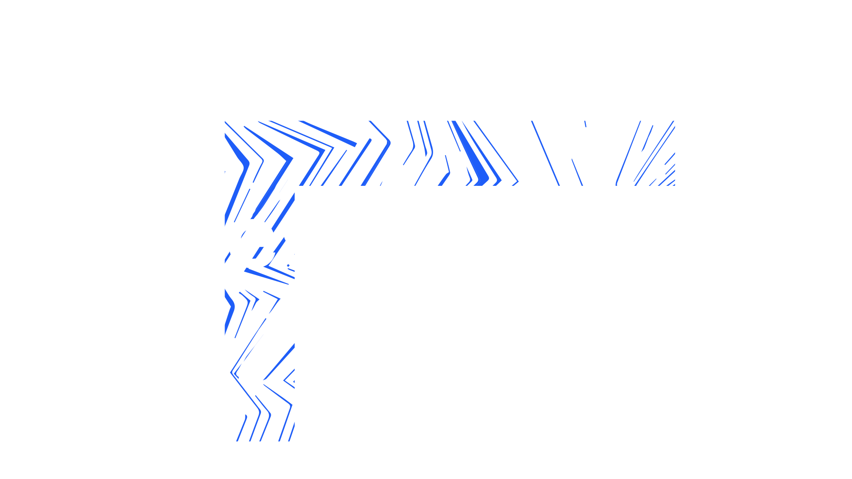
Notes:
The abstract pattern can be removed or repositioned if required. Be careful to ‘Send to Back’ so that it does not obscure any important information.

