Slide 1
IRIS IAM
April 2020 Update
Tom Dack
Notes:
The abstract pattern can be removed or repositioned if required. Be careful to ‘Send to Back’ so that it does not obscure any important information.

Slide 2
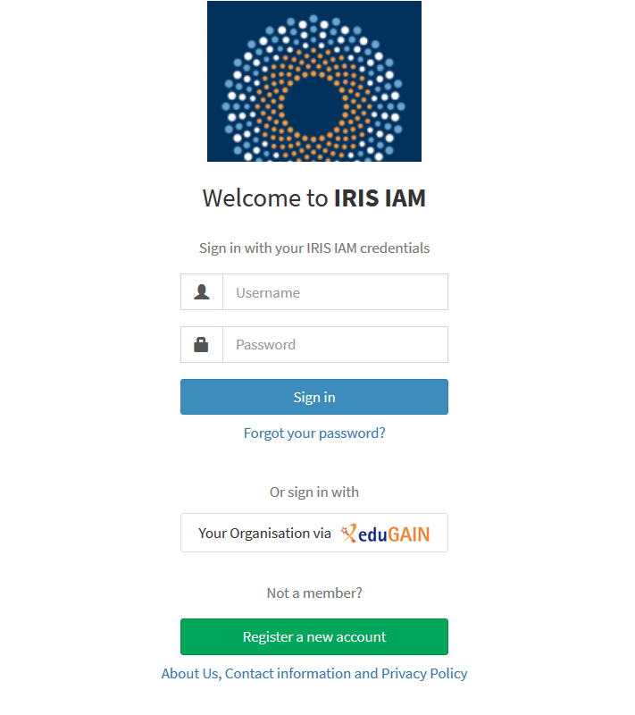
IRIS IAM
The IRIS IAM (Identity and Access Manager) is an authorization and authentication infrastructure (AAI) which provides a range of security and access control functionality to the services which make up the IRIS infrastructure.
Notes:
To replace photo with one of your own. 1) Send the geometric shape overlay to the back – Right-Click > Send to Back > Send to Back. 2) Replace image – use the guides provided to correctly position it. 3) Send your image to the back so that the geometric overlay re-appears over the image. Remember to delete the image credit if using your own image.

Slide 3
FY2019 Milestones
Production-ready service configured and deployed
Primary authentication method for a number of IRIS services
MISP Security Portal, Accounting Dashboard and STFC Cloud External users
Centralised Acceptable Usage Policy and Privacy Policy
Early implementation of community managed group membership
Aligned with community guidelines/blueprints (AARC, FIM4R)

Slide 4
FY2020 Aims
The 2020 Digital Asset focuses around improving the service the IAM can offer IRIS.
Aim to connect to more IRIS services so that a more comprehensive catalogue of services are connected
Jens will be looking into SSH, Command Line implementations
Exploit new features of INDIGO IAM 2.0
Improved group management is most notable here
Migration to Keycloak as a backend
Implement support for “Homeless Users”
eduGAIN IdPs are utilised for the majority of users, however not every IRIS community has an IdP
Development of a new IAM dashboard
Mitigate identified user experience issues and facilitate upgrade to IAM 2.0

Slide 5
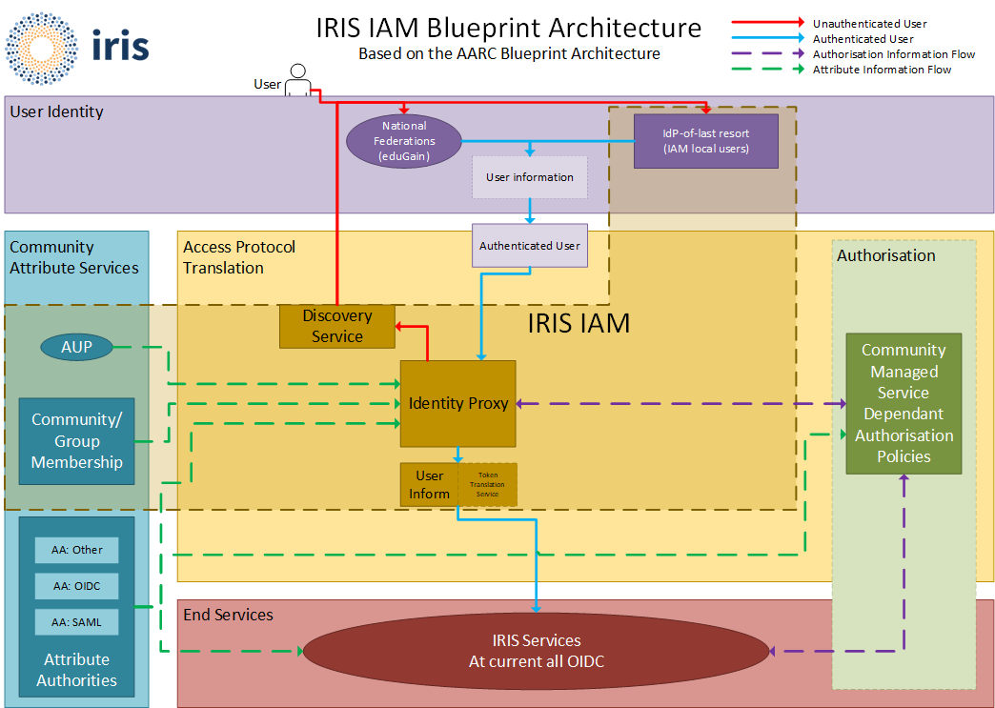
IRIS IAM Planned Architecture

Slide 6
Notes:
The abstract pattern can be removed or repositioned if required. Be careful to ‘Send to Back’ so that it does not obscure any important information.

