Slide 1
Creation of new capability for the Rucio Data management digital component
James Perry
Notes:
Intro to EPCC
Brief history of machine development at EPCC
Low power systems currently under development
An Exascale future?

Slide 2
Objectstore Support
Major improvements have been delivered
Full support for S3, Swift and Google Cloud Storage now in Rucio core
Used for all upload, download and deletion operations on objectstores
Third party transfers can either use objectstore protocol directly in FTS, or use Dynafed as a frontend
Legacy code removed
Scalability testing successfully performed
Minimal objectstore (based on min.io) added to Rucio development Docker image for easy development and testing

Slide 3
Metadata and Configurability
Original plan was to improve metadata support in Rucio
After recent discussions, this was felt to be something best tackled by the core Rucio team at CERN
We may contribute to this effort once it is in progress
Improvements to Rucio configurability have been delivered
VO-specific code factored out of core Rucio code into separate “policy packages”
Available in Rucio release 1.22.0
Example policy packages produced for VOs

Slide 4
Monitoring
Complete monitoring toolkit for collection of Rucio metrics developed
Supports metrics such as data transfer volume, deletion events, user and site accounting data
Deployed using Docker containers for ease and reproducibility of deployment
Monitoring dashboards set up for SKA and DUNE experiments

Slide 5
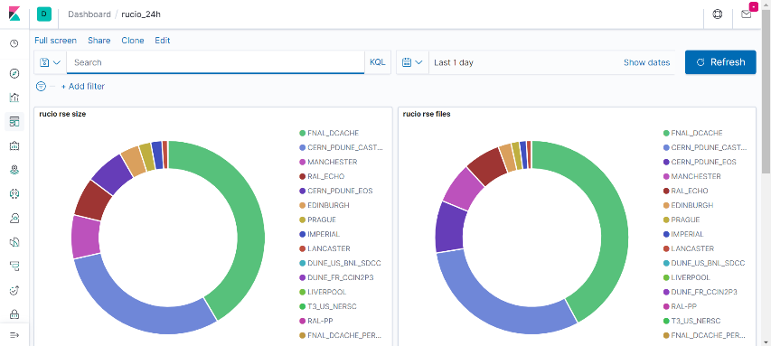
Monitoring dashboard example

Slide 6
Monitoring documentation
Reference documentation has been produced based on experience of setting up monitoring dashboards for DUNE, SKA and multi-VO installation at RAL
Will be pushed into core Rucio once complete

