Slide 1
FitSM
Standards for lightweight IT service management
Adrian Coveney
IRIS TWG on Training
05 May 2020
These slides are derived from "FitSM Advanced Training Service Planning and Delivery" by ITEMO, used under CC BY.

Slide 2
Contents
Overview of FitSM
What is FitSM?
FitSM, ISO/IEC 20000 and ITIL
Related standards and frameworks
FitSM parts
FitSM logic
FitSM qualification program
Why FitSM?
FitSM training for IRIS

Slide 3
What is FitSM?
Standards family for lightweight IT service management
Suitable for IT service providers of any type and scale
Main design principle: Keep it simple!
All FitSM parts are freely released under Creative Commons licenses
FitSM is operated and managed by ITEMO (non-profit)
Certification is provided through ICO-Cert or APMG
www.fitsm.eu

Slide 4
FitSM, ISO/IEC 20000 and ITIL
ITIL (good practices)
About 2,000 pages (5 core books)
No requirements
ISO/IEC 20000
136 pages (3 core documents)
26 pages of requirements (part 1)
FitSM
38 pages (4 core documents)
9 pages of requirements (part 1)

Slide 5
Related standards and frameworks
ISO 9000
ISO/IEC 27000
ISO/IEC 20000
Legend
ITIL
FitSM
IT service management standard / framework
Quality management
standard
COBIT
Information security management standard
Software engineering maturity model
ISO 15504
CMMI
adoption of concepts

Slide 6
FitSM parts
Core Standard
FitSM-0
Overview & vocabulary
Normative
FitSM-1
Requirements
FitSM-2
Objectives and activities
FitSM-3
Role model
Informational
Implementation aids
FitSM-4
Selected templates and samples
FitSM-5
Selected implementation guides
FitSM-6
Maturity and capability assessment scheme

Slide 7
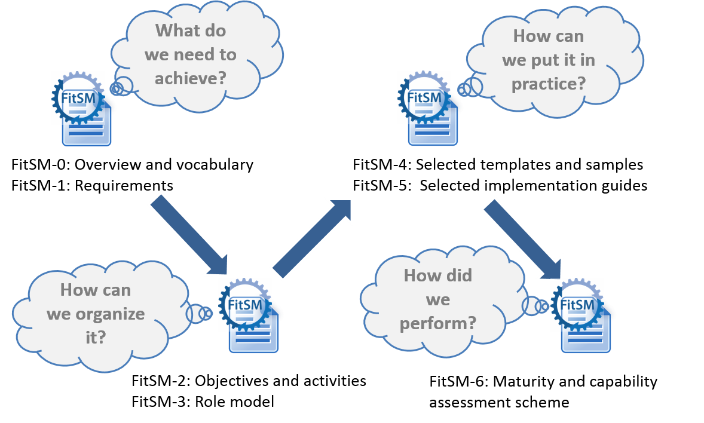
FitSM logic

Slide 8
FitSM qualification program
Expert Level
2 days
3 days
ITIL Expert, ISO/IEC 20000 consultant and auditor
Expert training in IT service management
Expert Bridge
Advanced Level
2 days
2 days
Advanced training in
service planning and delivery
Advanced training in
service operation and control
Foundation Level
Foundation training in IT service management
1 day
Notes:
Mention exams

Slide 9
Why FitSM?
Formalising your IT service management means you can spot the gaps more easily
Shared vocab - means you can talk the same language
Increasingly used within EU funded projects – some are making Foundation Level a requirement for project partners
It’s not ISO 20000/ITIL!
The training is quite fun
STFC has >40 at Foundation and ~20 at Advanced Level
Notes:
Mention benefits seen within SCD/STFC

Slide 10
FitSM training for IRIS
EGI.eu will be restarting FitSM training after June 18th
Currently considering how to implement online training
We’ve volunteered as guinea pigs
We’re considering training our own trainers (Foundation Level)
Also looking into IRIS founding FitSM training for people across IRIS

Slide 11
Thank you

