Slide 1
What can the
IRIS IAM do for you
IRIS Technical Working Group – 14th July 2020
Tom Dack

Slide 2
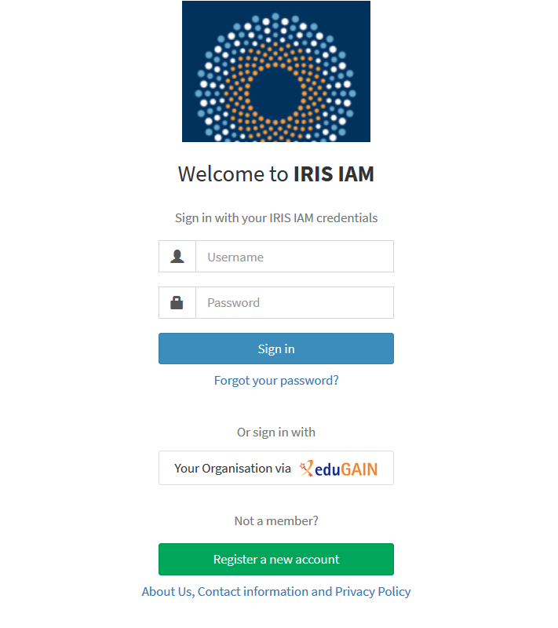
IRIS IAM
The IRIS IAM (Identity and Access Manager) is an authorization and authentication infrastructure (AAI) which provides a range of security and access control functionality to the services which make up the IRIS infrastructure.
After a year of development, the IAM is now a working and usable authentication solution with operational funding to support it.
Notes:
Access to: Multiple clouds, APEL, MISP, FAIRsFAIR

Slide 3
FY2020 Progress
The 2020 Digital Asset focuses around improving the service the IAM can offer IRIS.
Work has been undertaken to improve the IAM service
Host monitoring and logging have been improved
Feedback from IRIS users and services is being fed back into the EOSC-funded Dashboard development
This has also fed into the provision of a registration support page
Work underway to support new communities
First steps to move LSST behind IAM
FAIRdata forum (part of FAIRsFAIR) has implemented IAM for authentication
Command Line work has been started by Jens & Will
Preparation for IAM 2.0, including an Aquilon feature for Keycloak deployment
Notes:
IAM 2.0 likely delayed

Slide 4
Connecting your Service to IAM
It is – in most cases – very easy to connect any web based services to the IRIS IAM.
The IAM utilises the standard OAuth/OIDC flows, present on most modern software and easy to implement with Apache
Any IAM user can register a client
INDIGO IAM documentation here: https://indigo-iam.github.io/docs/v/current/user-guide/client-registration.html
Please contact us if you have any questions!
iris-iam-support@gridpp.rl.ac.uk
Command line connectivity is being developed by Jens and Will
The aim is to have this available later this year
Notes:
IAM 2.0 likely delayed

Slide 5
Command Line Integration – General issues
From Jens
Usability – CLI is for "expert users"?
Migration – traditionally uses X.509/GSI
Expect to need >1 protocol, to cover different services/use cases
Account (de)provisioning
Managing authorisation
Standards and Interoperation
Most profiles are technology agnostic and should work with both SAML and OIDC
Technologies – ssh plugins (including Assent)
Notes:
IAM 2.0 likely delayed

Slide 6
Command Line Access - authentication
ssh client
ssh server
browser
IAM

Slide 7
Command Line Access - authentication
browser
IAM
ssh client
ssh server
ssh

Slide 8
Command Line Access - authentication
browser
IAM
WS client
WS server
https

Slide 9
Command Line Access
browser
IAM
ssh client
ssh server

Slide 10
Command Line Access - authentication
browser
IAM
ssh client
ssh server
Direct access bypasses IAM

Slide 11
Command Line Access
ssh client
UI
ssh server
data
job

Slide 12
Service Access
IAM
End user
service
ssh
IRIS IaaS

Slide 13
FY2020 Next Steps
Improve support around the IAM service to project service capabilities
Documentation as to what the service can offer and how to use it
IRIS IAM as AuthN/Z for the IRIS website and Indico?
Work with LSST and other services to integrate IAM
Further testing of SSH capabilities, with the aim to connect to services later this year
Migration to INDIGO IAM 2.0 when released
Notes:
potential to use the integration as a TWG case-study

Slide 14
Thank you
Facebook: Science and Technology Facilities Council
Twitter:@STFC_matters
YouTube: Science and Technology Facilities Council

Slide 15
Notes:
The abstract pattern can be removed or repositioned if required. Be careful to ‘Send to Back’ so that it does not obscure any important information.

