Slide 1
CCP4 Cloud and web services on IRIS
Ville Uski
Notes:
This is a 20 min talk to be given in IRIS Technical Working Group meeting 11/8/2020.

Slide 2
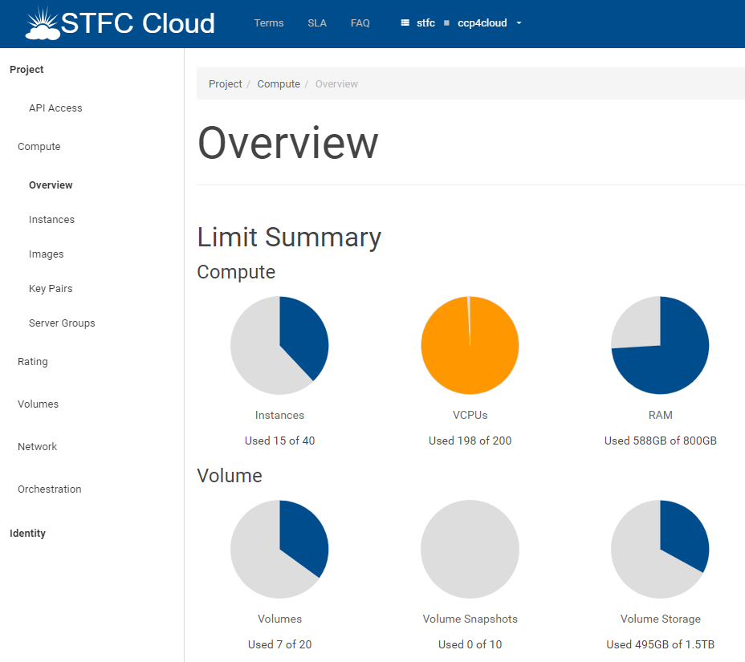

Slide 3
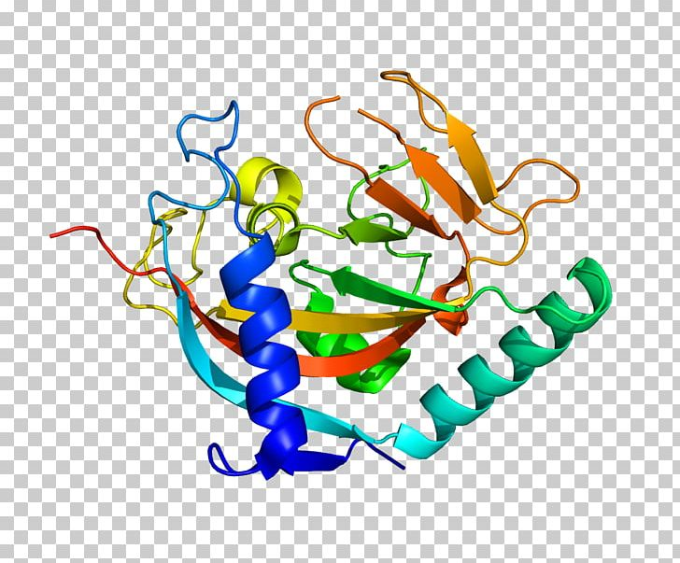
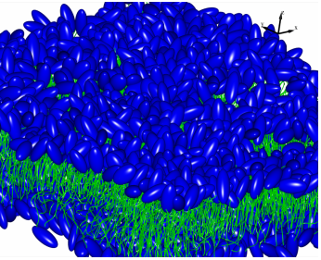
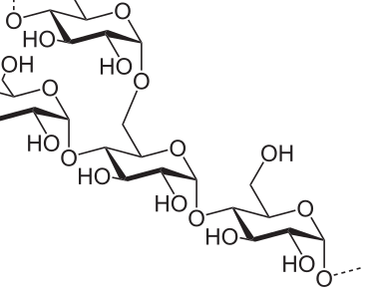
Software for Macromolecular X-Ray Crystallography since 1979
CCP4 provides an integrated suite of 200 programs.
It is used for solving structures of macromolecules: proteins, carbohydrates, lipids, RNAs, DNAs.
CCP4 is supported by the Biotechnology and Biological Sciences Research Council (BBSRC) and the industrial income.

Slide 4
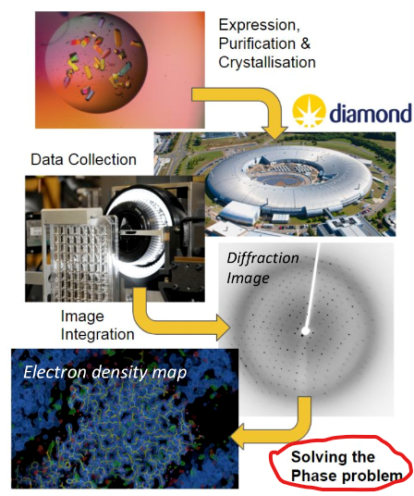
Macromolecular X-ray Crystallography
the leading method for obtaining chemical and biological understanding of the fundamental building blocks of life

Slide 5
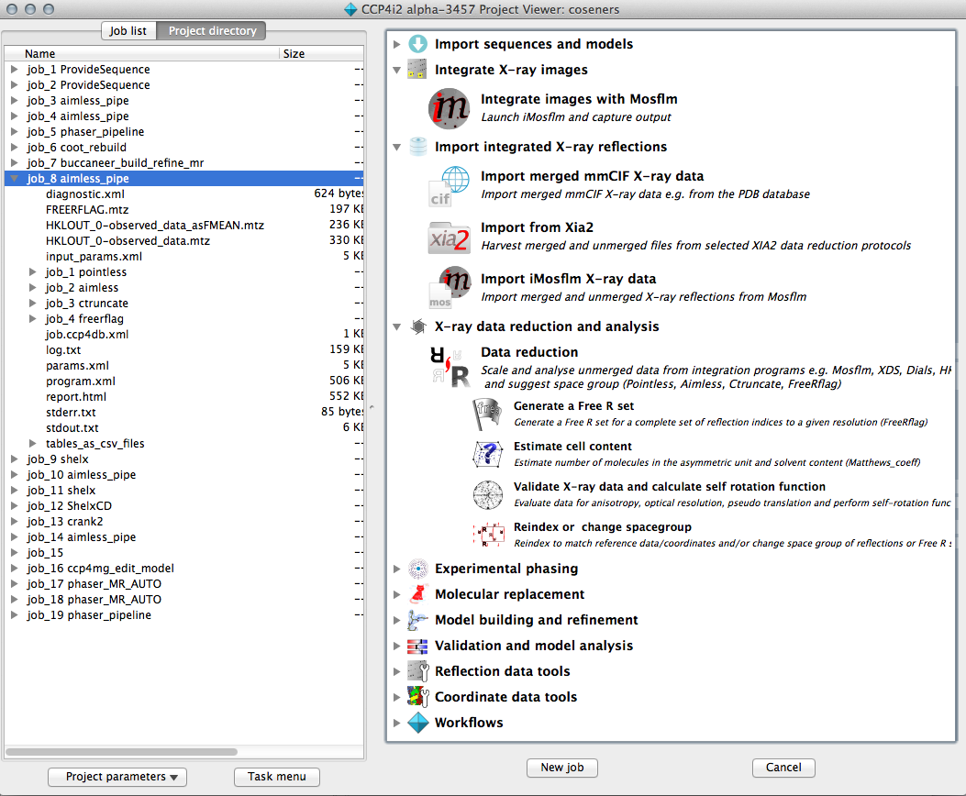
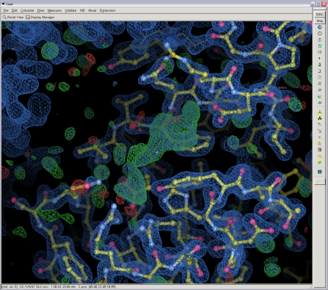
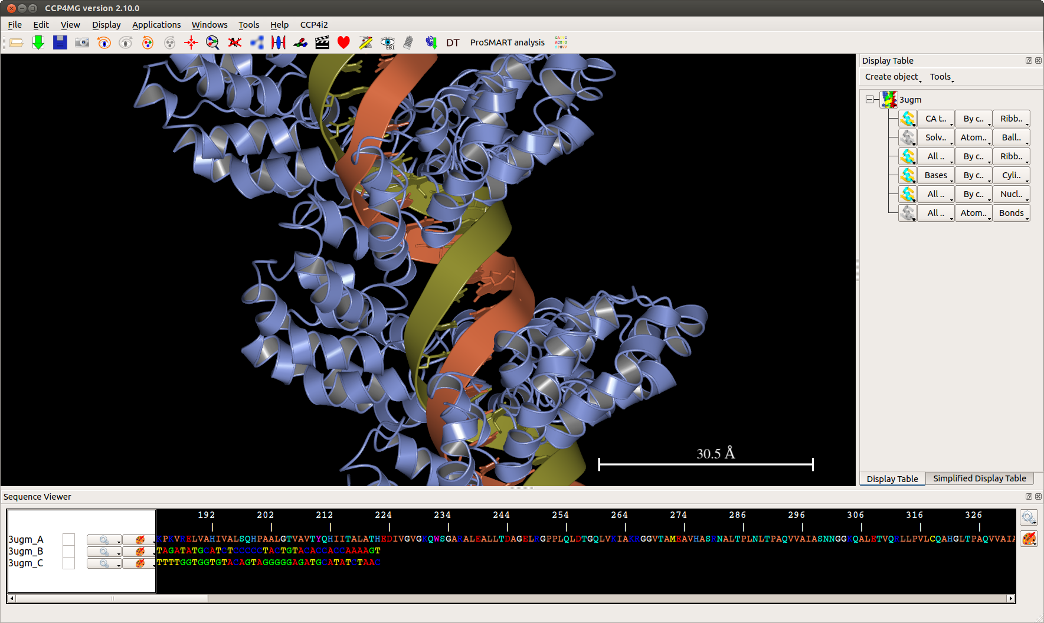
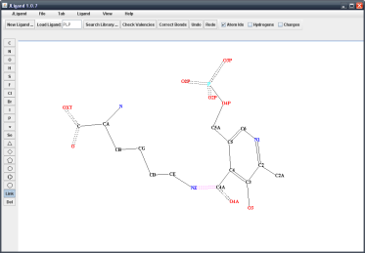
Crystallisation
Data Collection
n
CCP4 Software Suite
Data Processing and Reduction
Molecular Replacement
Experimental Phasing
Density Modification
Model Building
Refinement
Structure Analysis
Deposition

Slide 6
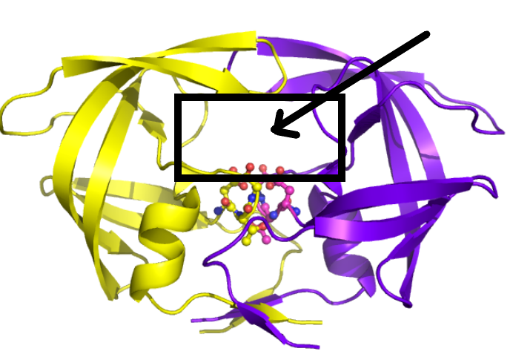
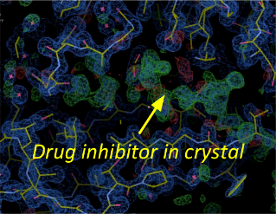
Solving the Phase Problem has led to some of the greatest achievements in medical science.
E.g. the HIV protease protein inhibitors
Active site

Slide 7
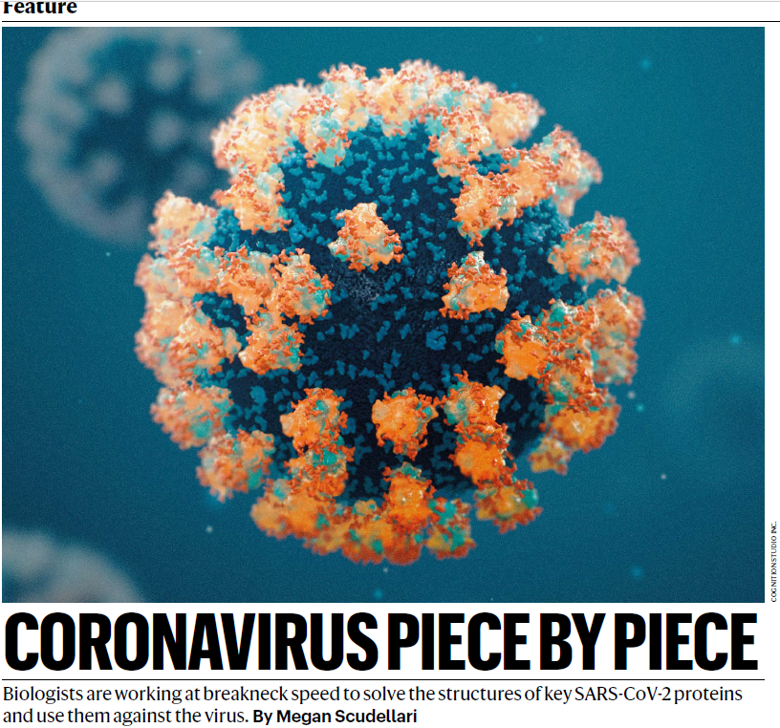
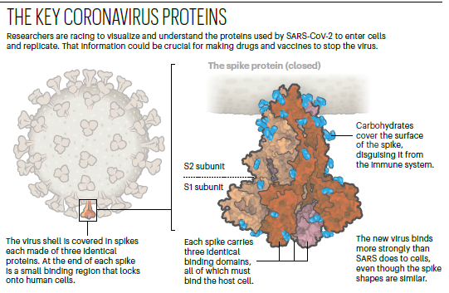
“
“

Slide 8
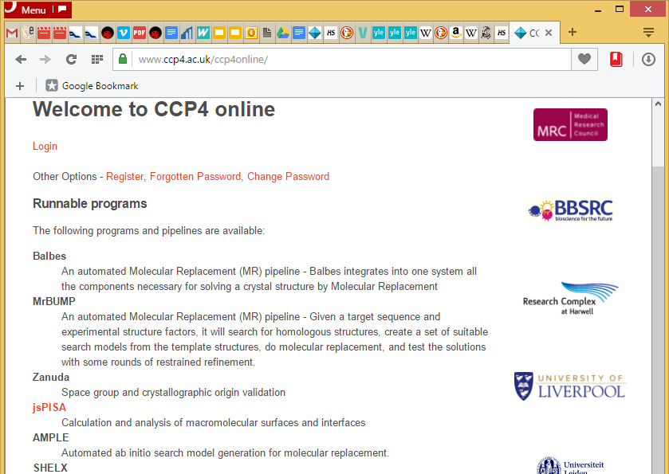
CCP4 Online
Web tools for solving the Phase Problem with different methods:
Molecular replacement
Experimental phasing
since 2012
In 2019:
~ 9000 job submissions from users around the world

Slide 10
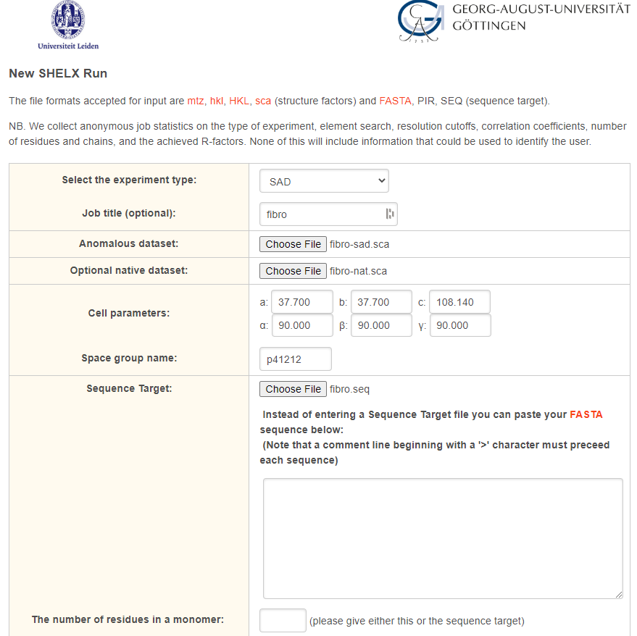
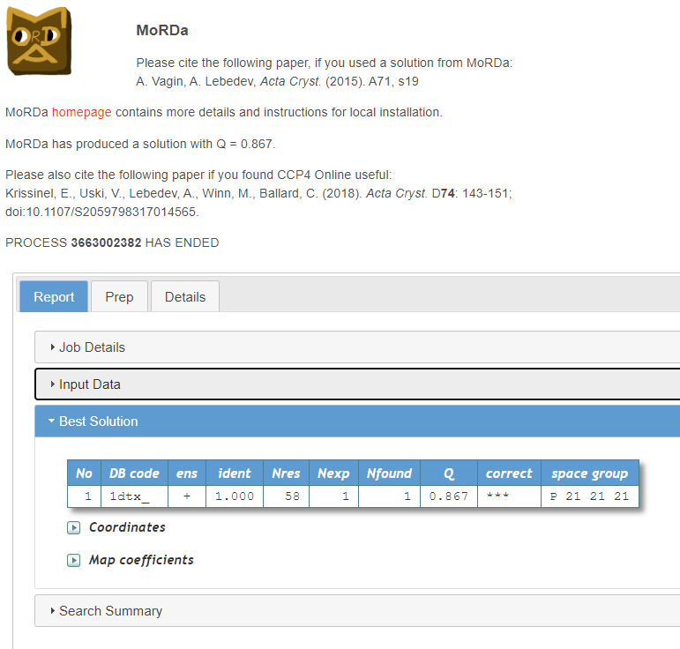
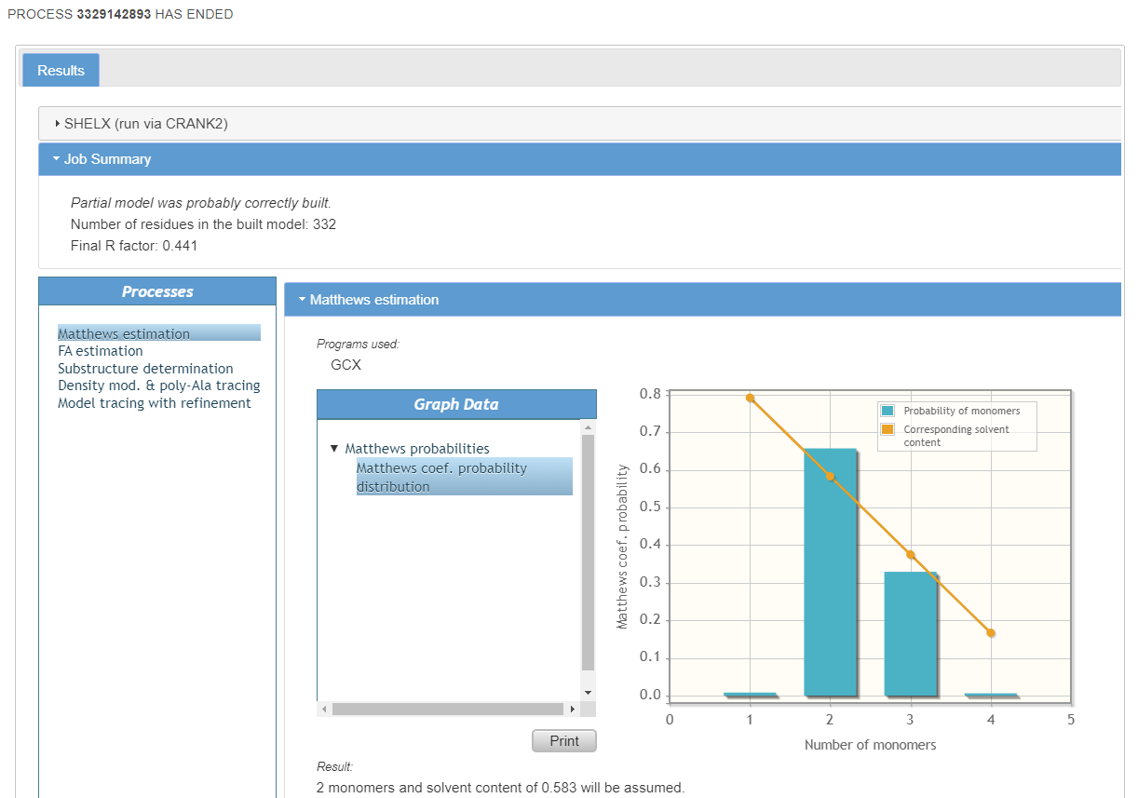
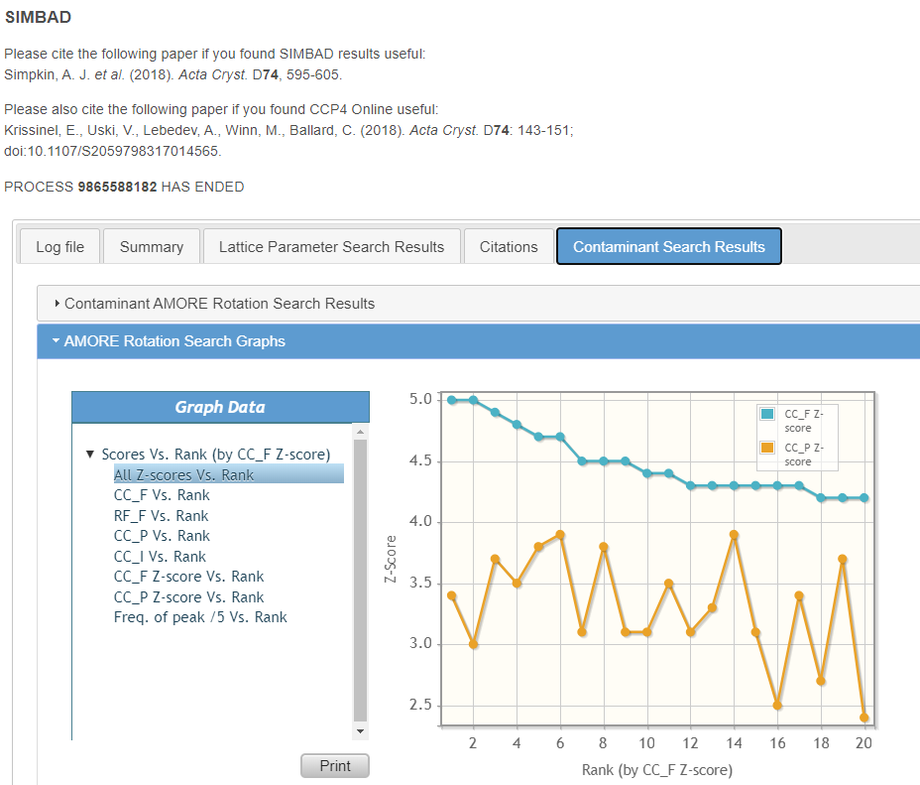
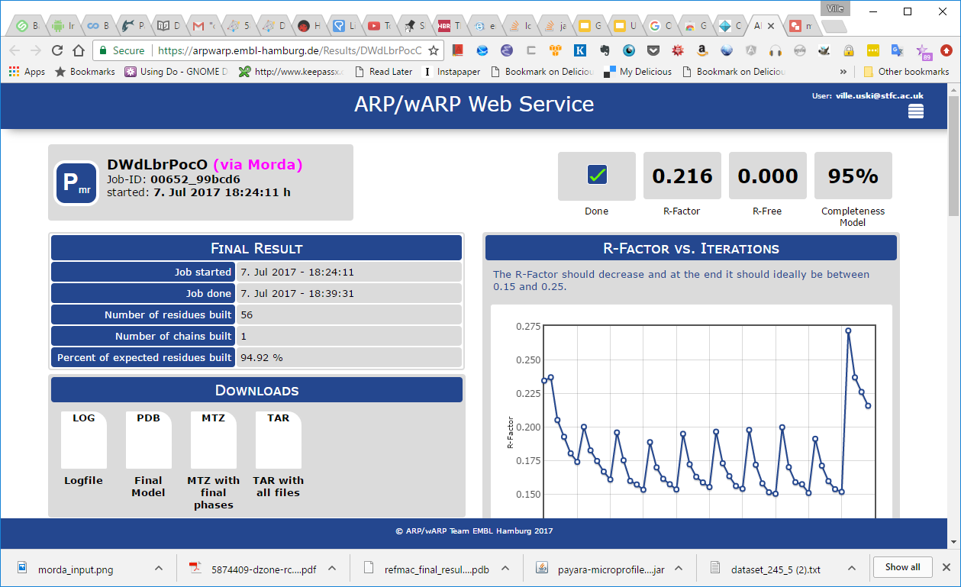
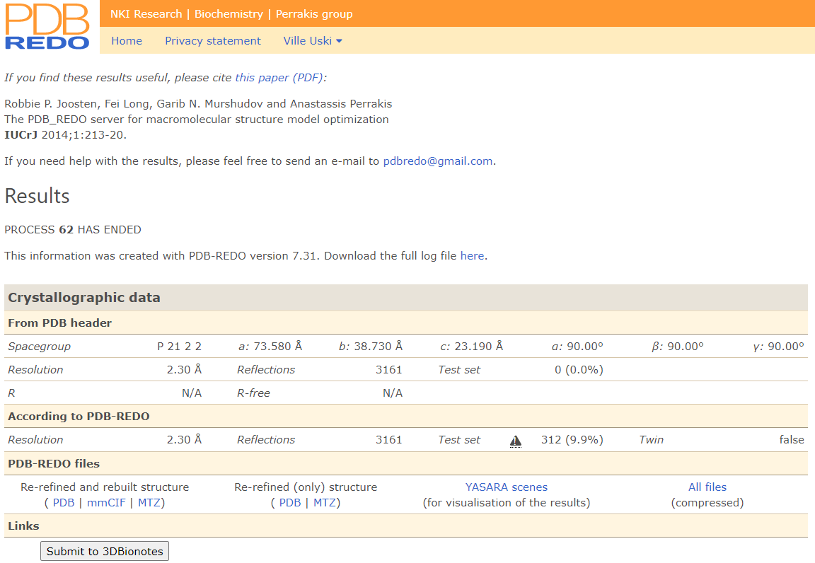

Slide 11
CCP4 Online configuration
Frontend: Java servlet application
Backend: CCP4 cluster: ~ 300 cores
~ 10 years old
Runs an outdated operating system
Plan: replace/extend the CCP4 cluster with a virtual cluster in the STFC Cloud

Slide 12
CCP4 Online on the STFC Cloud
Current setup: mirrors the main server, runs the same jobs
frontend (c1.medium) + 12 compute nodes (c1.3xl)
GridEngine queuing system
Configuration with:
ElastiCluster + Ansible

Slide 13
ElastiCluster
from the University of Zurich
licensed under GNU General Public License version 3
INI-style configuration file to define cluster templates
Automated setup of HPC clusters using SLURM or GridEngine
resizable
Fine tuning with an Ansible playbook
Installation of the CCP4 suite on the compute nodes
Mounting of databases (e.g. Protein Data Bank) from morrigan
Installation of scripts to run CCP4 Online jobs

Slide 14
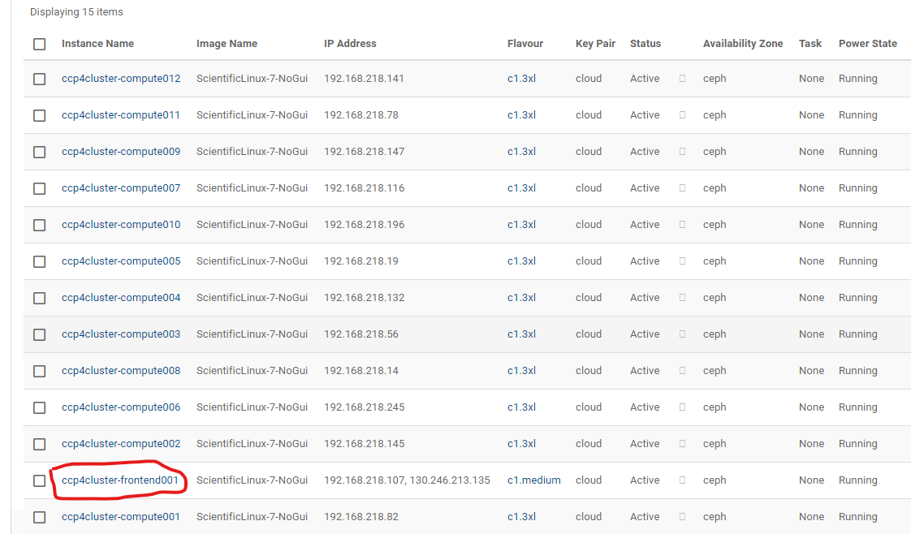

Slide 15
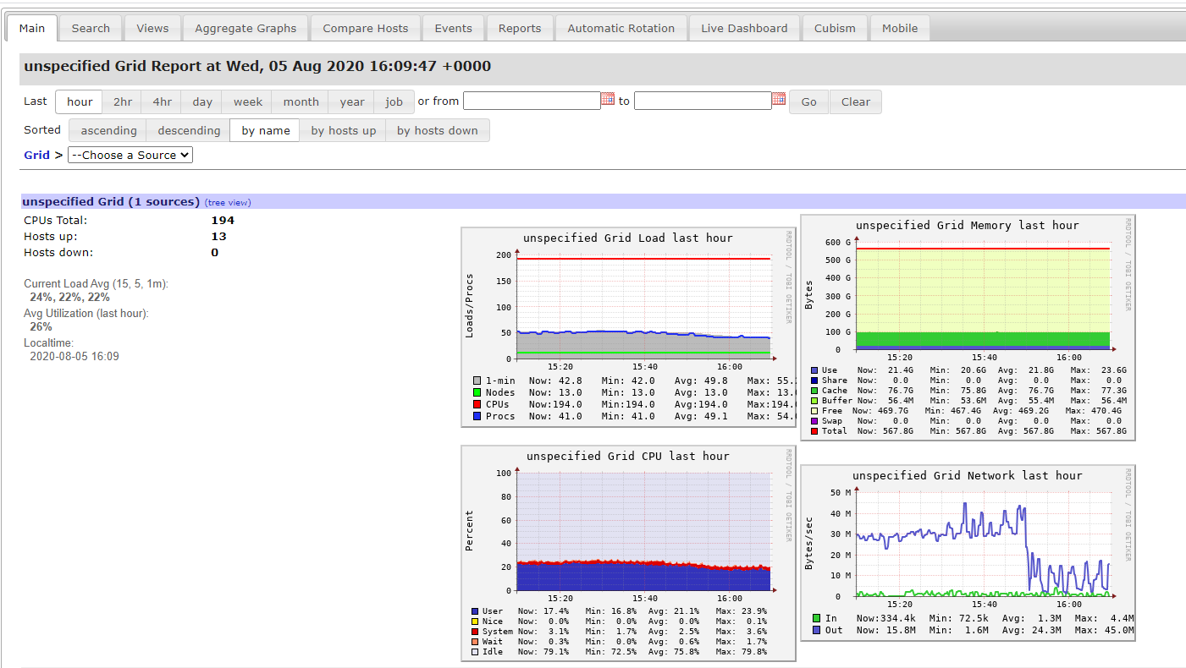

Slide 16
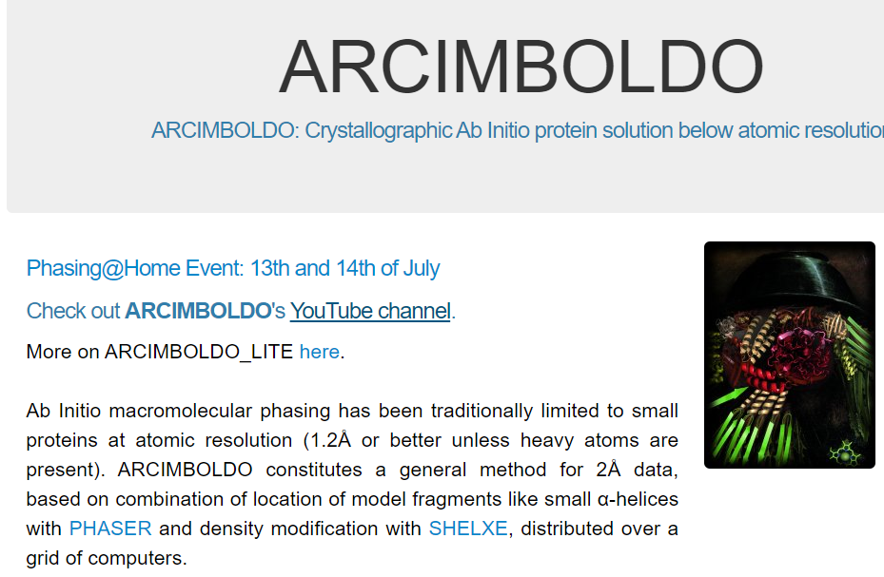
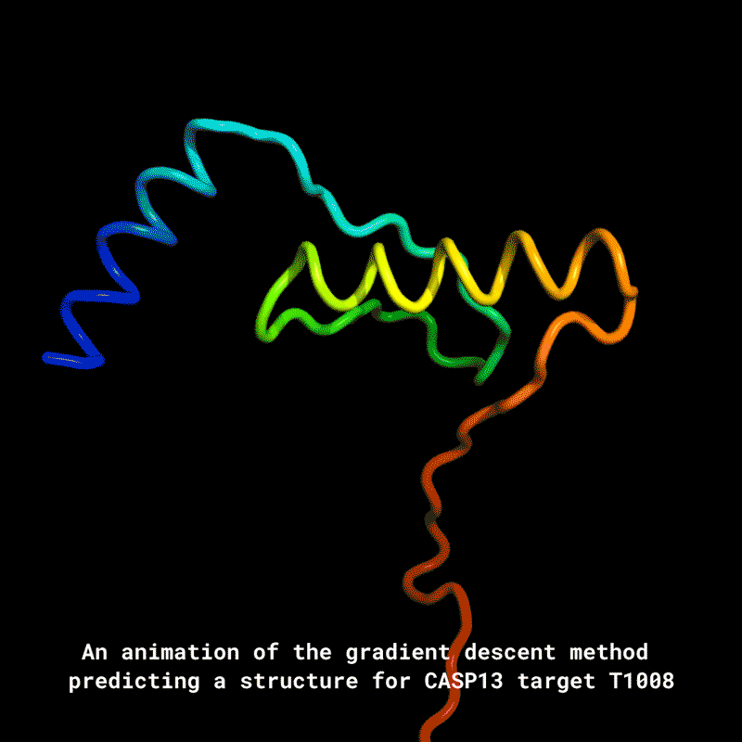
CCP4 Online on STFC Cloud: Future perspectives
Extend and eventually replace the CCP4 cluster
Run more pipelines
Use AlphaFold predictions as search models in AMPLE
Conplot from University of Liverpool
As a Docker container
New COVID-19 pipeline from CCPEM

Slide 18
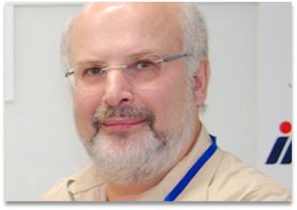
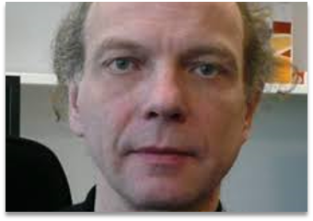
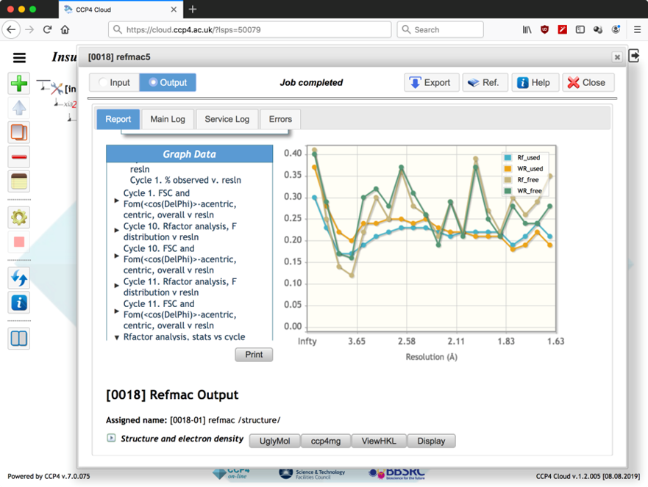
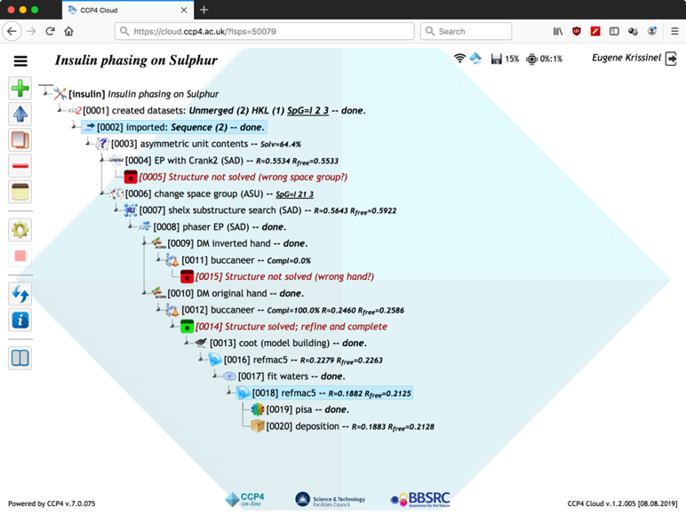
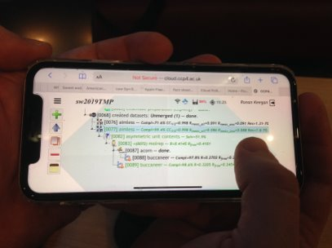
CCP4 Cloud: Structure solution on the Cloud

Slide 19
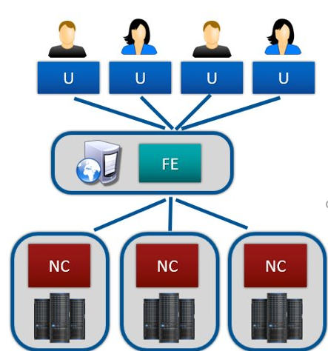
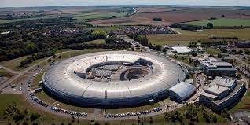
CCP4 Cloud configuration
Currently: CCP4 servers
Plan: STFC Cloud VMs

