Slide 1
Diamond and IRIS
Dr Andrew Richards: Head of Scientific Computing and Data Management
November 2020
andrew.j.richards@diamond.ac.uk

Slide 2
IRIS as part of Diamond Computing Strategy
From the SSCC strategy, Scientific Computing is tasked to ‘Objective 1: Provide Scientific Computing Infrastructure to facilitate best science at Diamond’
Scientific Computing roadmap under development.
To deliver this roadmap a set of High Level Objectives are defined:
  Engage with Diamond computational heavy users to define requirements and steer priorities,
  Deliver Sufficient data centre capacity for research related computing over next 10 years utilising a mixture of on-premise (own build), shared (UKRI), and off-premise cloud,
  Deliver hybrid compute platforms that address data acquisition, data analysis, simulation and modelling requirements as appropriate,
  Deliver staff development plan for ensuring suitably skilled staff are available in Diamond computing teams to support ongoing activities and future R+D

Slide 3
IRIS to date & Future considerations
IRIS usage by Diamond instrumental in supporting XChem and FRAGALYSIS (Frank von Delft) at present
Work in progress to build more use cases / PoC’s
  Use cases are varied across accelerator, science, general computing needs for use of cloud.
  A single approach can not be applied to cloud adoption – but this has resource implications.
  On-premise cloud deployed to act as local testbed, stepping stone to external cloud services
  Also, working to adopt ‘cloud’ mentality in-side Diamond for future service provision
IRIS is more than just ‘Cloud’
  Access to more traditional HPC/Other Services? (#def Cloud != Diamond own kit)
Strategy & Capital planning –What do we need and where?
  Not always clear what we need. Cloud potentially brings flexibility to service provision.
  Diamond needs more compute and associated storage for data processing ‘outside’ of experimental time. (pre and post experiment modelling and processing, simulation)
  Diamond will always need onsite data acquisition platforms. But we need to get better at moving workloads elsewhere
  If we can get the data somewhere else then why would we keep building more in-house compute facilities?
  We need more compute and with it more data centre capacity. BUT, there is a cost and small 1MW data centres are not ‘green’/sustainable/efficient. Push to be part of a larger campus data centre activity. Strongly support this approach but it will take time
Next 1 to 2 years:
  Increase and update in-house capacity for experimental data capture and processing
  Move more workloads to the ‘cloud’

Slide 4


Diamond Cloud Solution
On-prem Kubernetes (K8s) cluster has been deployed
22 nodes, 1000 cores, 2xV100 GPUs
Many applications:
  Jupyterhub
  CI/CD tools
  HTCondor, DASK clusters as a service
  Scientific Web Apps:
    xChem Fragment analysis tools
    MaxIV HDF5 viewer
  Beamline Controls:
    POC running EPICS CAServer in containers on K8s
Kubernetes as a Common Platform Layer:
Kubernetes
Kubernetes
Kubernetes
DLS Science Group “A” HTCondor Cluster Workers Nodes
Notes:
Development underway of a “Cloud Console” for DLS users to start/stop Cloud based services/applications, e.g. HTCondor clusters, Slurm Clusters, DASK Clusters, Object Storage.
Scientists/researchers won’t interact with Cloud APIs/tools directly. They launch services/applications via the Cloud Console and log in/target the resources they start.
Cloud Console will provide DLS billing integration for Pub Cloud resources.
HTCondor running HTC workloads is a good fit for IRIS. Head node(s) runs in DLS (containerised) with workers connecting from anywhere e.g. IRIS, Pub Cloud Spot Markets.
HPC clusters as a service will initially be targeted at Pub Cloud due to purpose designed HPC infrastructure: RDMA, DDN HPC storage etc.
POCs underway for HPC Clusters in the cloud (Oracle, AWS and GCP engaged).

Slide 5


Vision: Simplifying Access to Cloud
Same Kubernetes “stack” running on-prem has been deployed on IRIS VMs.
Kubernetes now common application deployment platform across on-prem and Clouds.
Applications like HTCondor “as a service” are deployed in containers and worker nodes can span Clouds. Containers facilitate fast start/stop of applications. Kubernetes allows load based scaling.
HTCondor nicely tackles High Throughput Computing that comprises 50% of DLS cluster CPU time
Kubernetes
Kubernetes
Kubernetes
DLS Science Group “A” HTCondor Cluster
DLS Science Group “B” HTCondor Cluster

Slide 6
Ongoing Developments
Development underway of a “Cloud Console” for DLS users to start/stop Cloud based services/applications, e.g. HTCondor clusters, Slurm Clusters, DASK Clusters, Object Storage.
Scientists/researchers won’t interact with Cloud APIs/tools directly. They launch services/applications via the Cloud Console and log in/target the resources they start.
Cloud Console will provide DLS billing integration for Pub Cloud resources.
HTCondor running HTC workloads is a good fit for IRIS. Head node(s) runs in DLS (containerised) with workers connecting from anywhere e.g. IRIS, Pub Cloud Spot Markets.
  all applications are in Singularity containers
  a variety of workloads: OpenMP multithreading, MPI parallelism, GPU processing
HPC clusters as a service will initially be targeted at Pub Cloud due to purpose designed HPC infrastructure: RDMA, DDN HPC storage etc.
POCs underway for HPC Clusters in the cloud (Oracle, AWS and GCP engaged).

Slide 7
MX (Macromolecular Crystallography) Pipeline POC
Using established Mollecular Crystallography (MX) pipeline
  processing with CCP4, dials, etc.
  multithreaded, optimally on up to 8 threads
  highly parallelisable workload (on a per job basis), very HTC
  minimal input (~1MB), small output (~10MB)
Done:
  individual jobs submitted and run via HTCondor
To do:
  integrating job submission and output collection via HTCondor into the existing DLS processing pipeline (controlled by Zocalo)

Slide 8


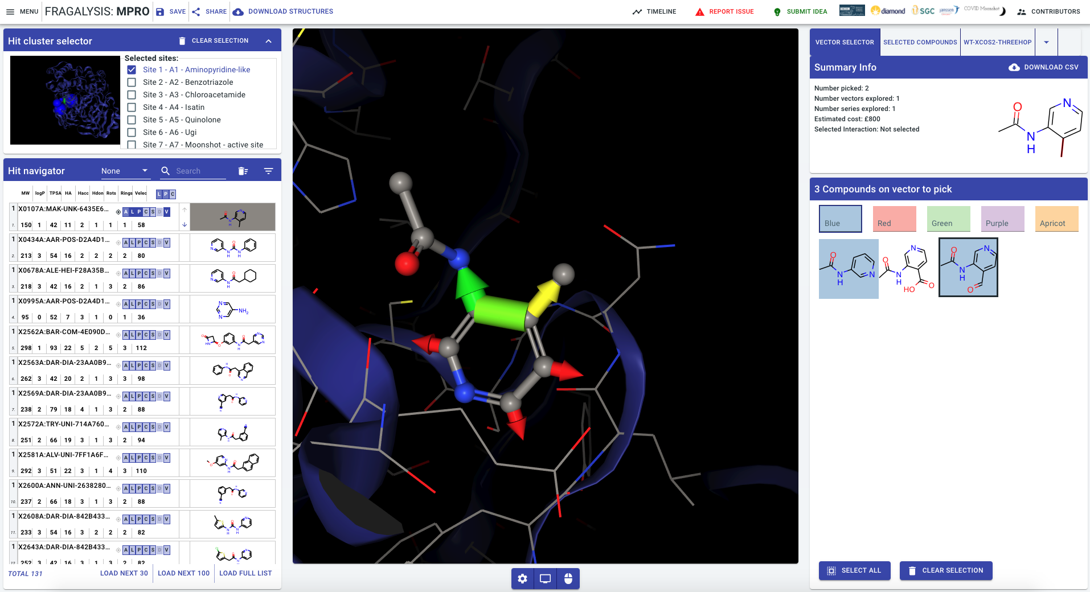
Start
Target protein
Follow-up compounds
Crystallisation
XChem pipelines
XCDB
Fragment library
Soaking
Data collection
Data processing
Structural data
End

Slide 9
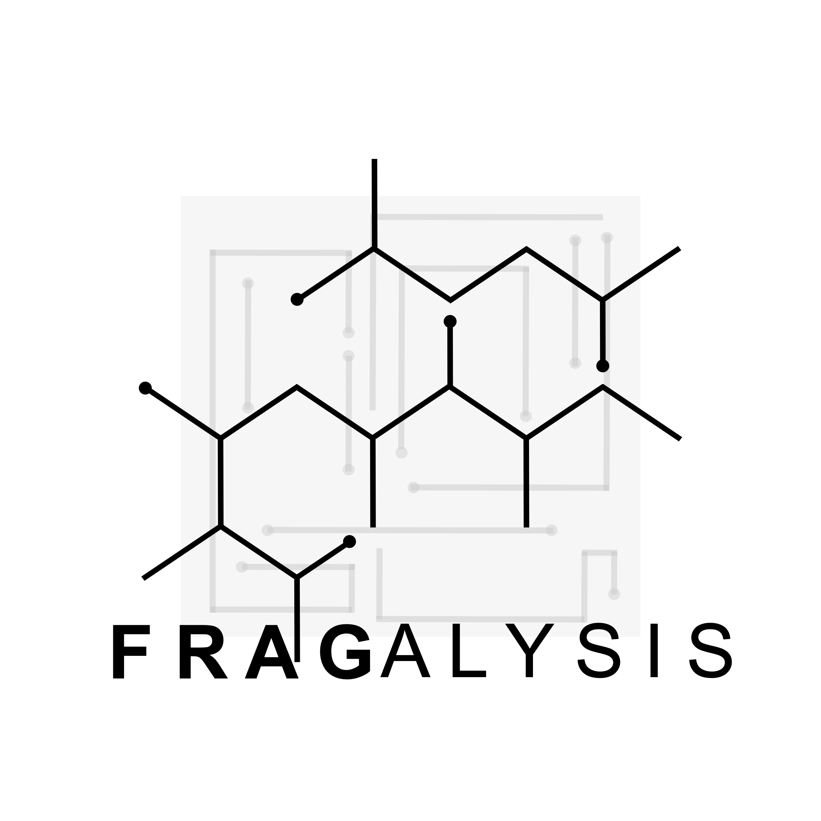
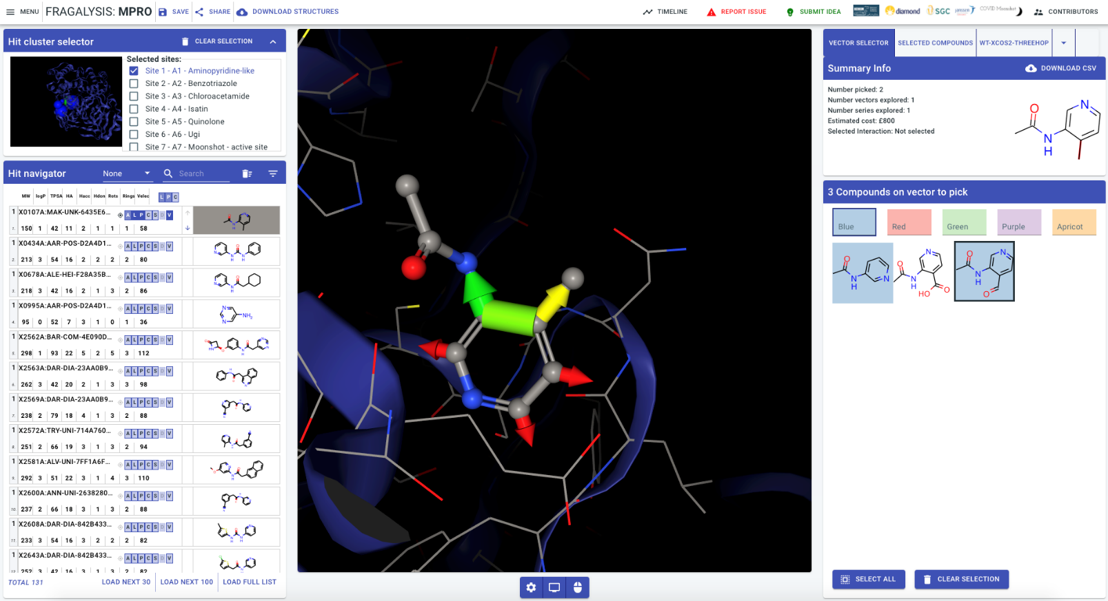
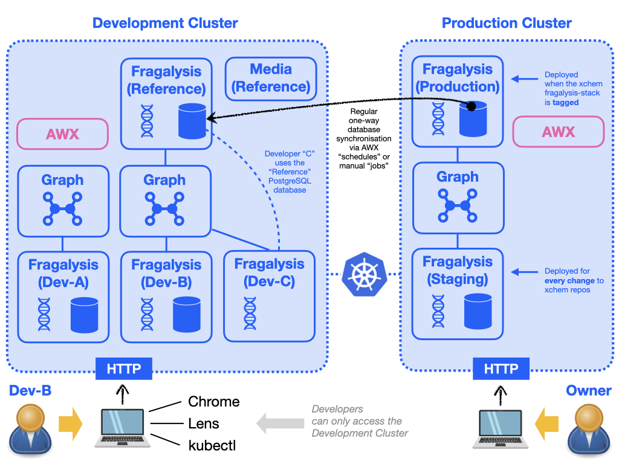
Fragalysis
Fragalysis is an open-source and aggressively structure-based application designed to accelerate fragment-based lead discovery (FBLD)
Web-application deployed on STFC cluster
Deployed on Kubernetes cluster managed by rancher
Ansible playbooks & AWX define builds
Multiple environments: Developer (x4), Staging, Production
FragalysisDB – postgres database – also deployed with full backup schedule
Graph-network – neo4j database – for designing new molecules also deployed
Calculations (computationally intensive & expensive) to generate graph-network also done on VMs ad hoc
Notes:
The Fragalysis web-application is now deployed on the STFC cloud infrastructure. This includes a kubernetes cluster orchestrated by rancher. Ansible playbooks are used to define the build of pods, which are managed and launched from AWX, which provides a web-based user interface, REST API, and task engine built on top of ansible. The infrastructure enabled through the cloud allows multiple Fragalysis environments to exist in isolation from each other: a production stack, a staging stack, and multiple developer stacks. In addition to the application pods, a graph-database enabled through neo4j is also deployed. This is a large graph-database, and encodes molecules and parts of molecules as nodes on a graph, with the edges describing molecular transformations. This is powerful, as we can encode commercially available molecules into the graph, and enumerate from Fragalysis or elsewhere how to change molecules so that they look more like lead or drug molecules. The generation of new graph-network molecules, which is a computationally expensive task, is also enabled through the STFC cloud, with new VMs spun up for the computations each time they are needed
Fragalysis has been heavily utilised in the COVID Moonshot project, being the primary platform for dissemination of 3D structural information from the Beamline, and helping contributors from across the globe to design new molecules.

Slide 10

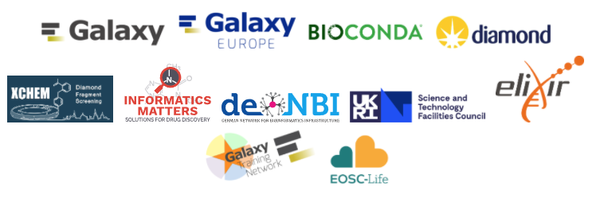
Almost real-time release of initial fragment screen via. Fragalysis to worldwide community
Some contributors designed molecules in Fragalysis
All subsequent screening data released through Fragalysis
Sharing of snaphshots in remote-working world
Direct links between structural data and moonshot website – tracking of designs & experiments
Massive enumeration of graph-network for new molecules
Docking of 10’s thousands of new molecules
Scoring (with GPU) of millions of protein-ligand combinations
Notes:
In addition, remaining VMs in the XChem allocation have been pooled into a hpc cluster for remote job execution from usegalaxy.eu through pulsar (https://github.com/galaxyproject/pulsar). UK users making use of medicinal chemistry tools through the Chemical Toolbox have their jobs executed on the pulsar nodes deployed on the STFC cloud. XChem have been heavy users of this, designing new workflows for evaluation of newly designed molecules. An example of this can be seen for the COVID Moonshot work, where elaborations from initial hits at the beamline (disseminated through Fragalysis) were designed (through the graph-network) and a workflow was designed in galaxy to estimate binding, and score molecules (workflows executed on pulsar cluster): https://covid19.galaxyproject.org/cheminformatics/

Slide 11
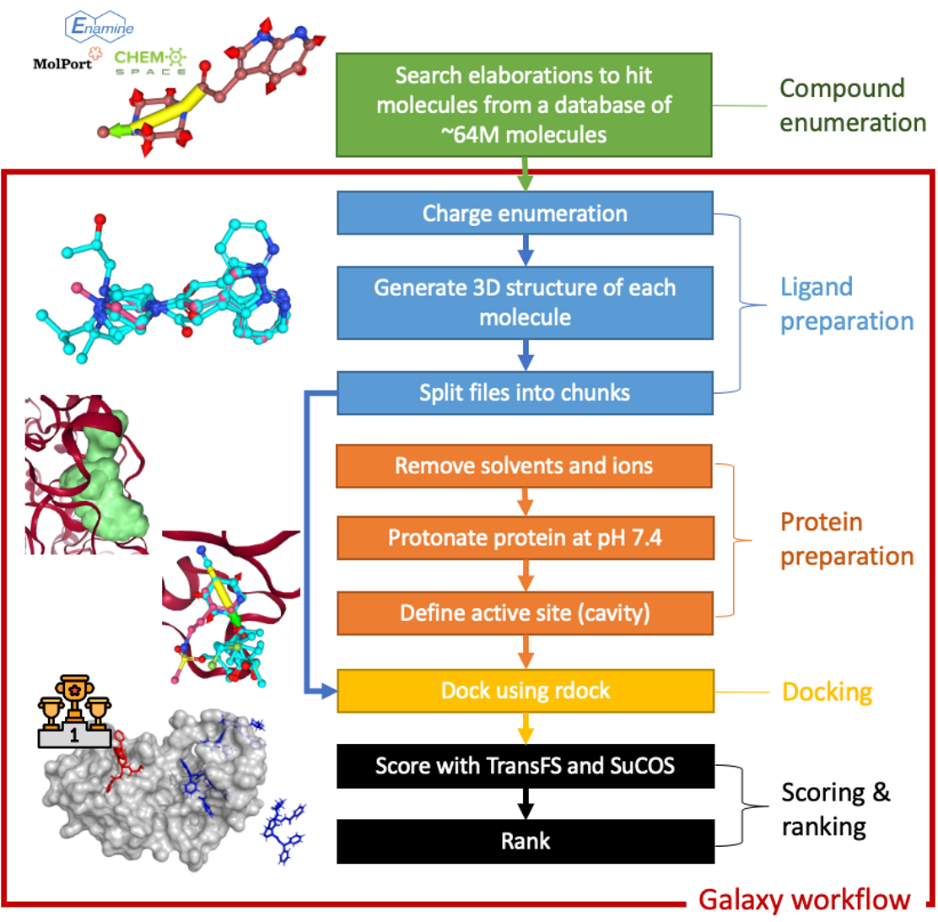
usegalaxy.eu pulsar nodes
Galaxy is an open source, web-based platform for data intensive biomedical research, allowing complex computational workflows and tools for a naïve user
VMs in XChem allocation pooled into HPC cluster
Remote job execution from usegalaxy.eu
UK users making use of medicinal chemistry tools through the Chemical Toolbox have their jobs executed on the pulsar nodes deployed on the STFC cloud
COVID Moonshot - elaborations from initial hits at the beamline (through the graph-network) and a workflow in galaxy to estimate binding, and score molecules: https://covid19.galaxyproject.org/cheminformatics
Notes:
In addition, remaining VMs in the XChem allocation have been pooled into a hpc cluster for remote job execution from usegalaxy.eu through pulsar (https://github.com/galaxyproject/pulsar). UK users making use of medicinal chemistry tools through the Chemical Toolbox have their jobs executed on the pulsar nodes deployed on the STFC cloud. XChem have been heavy users of this, designing new workflows for evaluation of newly designed molecules. An example of this can be seen for the COVID Moonshot work, where elaborations from initial hits at the beamline (disseminated through Fragalysis) were designed (through the graph-network) and a workflow was designed in galaxy to estimate binding, and score molecules (workflows executed on pulsar cluster): https://covid19.galaxyproject.org/cheminformatics/

Slide 12
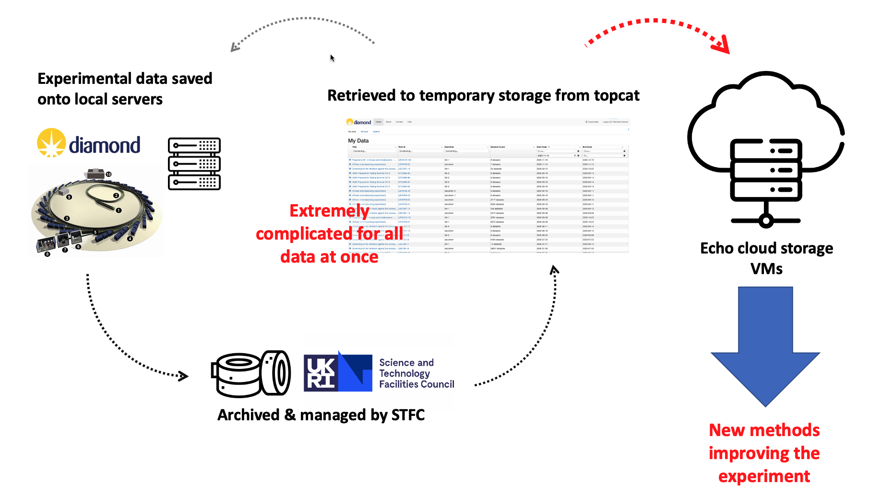
Data & methods
Data from Diamond archived & managed by STFC – put onto tape
Multiple students in group rely on all XChem data (old & new) to develop methods – AI/ML
Worked with STFC to pull all data from archive
Moved data to echo bucket storage for access
Interact with echo using ad hoc VMs utilising GPUs and CPUs:
  Learning what molecules crystallise – library design
  Training methods for ligand identification – data processing
  AI/ML for follow-up chemistry – enumeration & scoring
Notes:
In addition, remaining VMs in the XChem allocation have been pooled into a hpc cluster for remote job execution from usegalaxy.eu through pulsar (https://github.com/galaxyproject/pulsar). UK users making use of medicinal chemistry tools through the Chemical Toolbox have their jobs executed on the pulsar nodes deployed on the STFC cloud. XChem have been heavy users of this, designing new workflows for evaluation of newly designed molecules. An example of this can be seen for the COVID Moonshot work, where elaborations from initial hits at the beamline (disseminated through Fragalysis) were designed (through the graph-network) and a workflow was designed in galaxy to estimate binding, and score molecules (workflows executed on pulsar cluster): https://covid19.galaxyproject.org/cheminformatics/

Slide 13

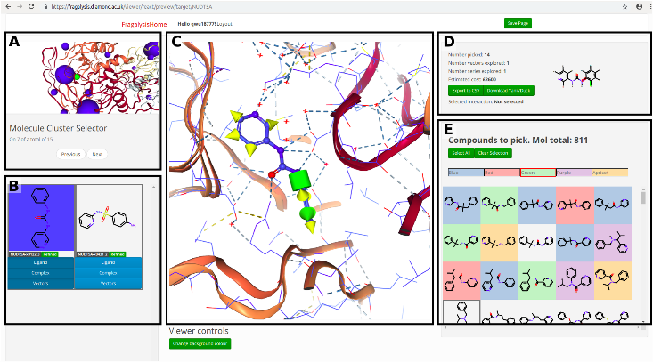



Results of robust workflows available on-demand
Routine users
other scientists
Powerful user-interface (Fragalysis)
High level workflows
Expert users
computational chemists
Code and algorithm development
Interactive development
Robust workflows
Conventions for workflow
development
Service developers
infrastructure architects
Web-based development service
Component
repository
Service providers
hardware/software suppliers
Scalable hardware and services
Execution service

Slide 14
IRIS to date & Future considerations
IRIS usage by Diamond instrumental in supporting XChem and FRAGALYSIS (Frank von Delft) at present
Work in progress to build more use cases / PoC’s
  Use cases are varied across accelerator, science, general computing needs for use of cloud.
  A single approach can not be applied to cloud adoption – but this has resource implications.
  On-premise cloud deployed to act as local testbed, stepping stone to external cloud services
  Also, working to adopt ‘cloud’ mentality in-side Diamond for future service provision
IRIS is more than just ‘Cloud’
  Access to more traditional HPC/Other Services? (#def Cloud != Diamond own kit)
Strategy & Capital planning –What do we need and where?
  Not always clear what we need. Cloud potentially brings flexibility to service provision.
  Diamond needs more compute and associated storage for data processing ‘outside’ of experimental time. (pre and post experiment modelling and processing, simulation)
  Diamond will always need onsite data acquisition platforms. But we need to get better at moving workloads elsewhere
  If we can get the data somewhere else then why would we keep building more in-house compute facilities?
  We need more compute and with it more data centre capacity. BUT, there is a cost and small 1MW data centres are not ‘green’/sustainable/efficient. Push to be part of a larger campus data centre activity. Strongly support this approach but it will take time
Next 1 to 2 years:
  Increase and update in-house capacity for experimental data capture and processing
  Move more workloads to the ‘cloud’

