Slide 1
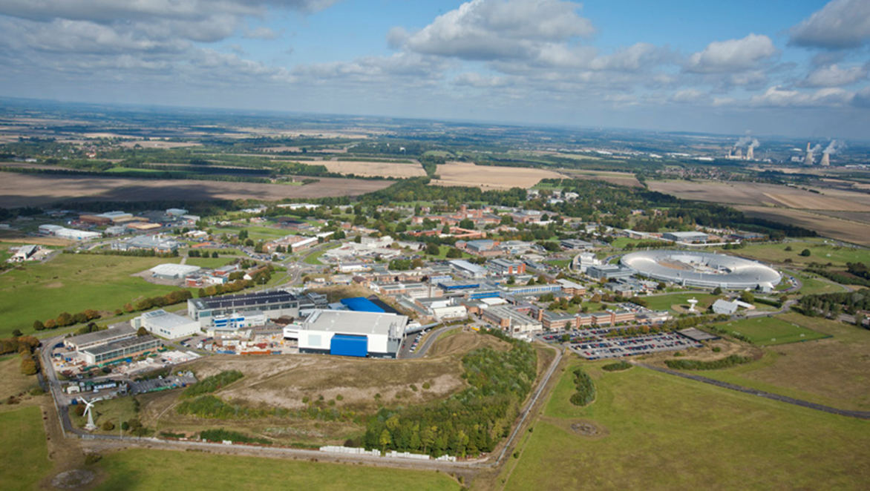
IDAaaS To The Rescue – Facility Operations During Covid
Russell Ewings – ISIS Excitations Group Leader

Slide 2
IDAaaS To The Rescue – Facility Operations During Covid
ISIS – what it is, what it is used for, and who uses it
The IDAaaS system – what it is, how we were using it for a subset of groups
The challenge – remote data analysis for all facility users
How we fared

Slide 3
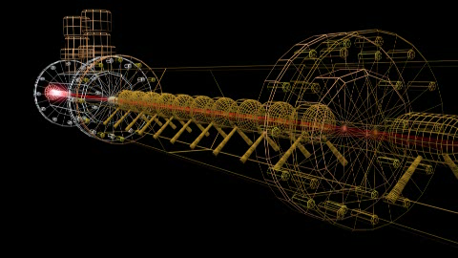
IDAaaS To The Rescue – Facility Operations During Covid
ISIS – what is it, and what is it used for?

Slide 4
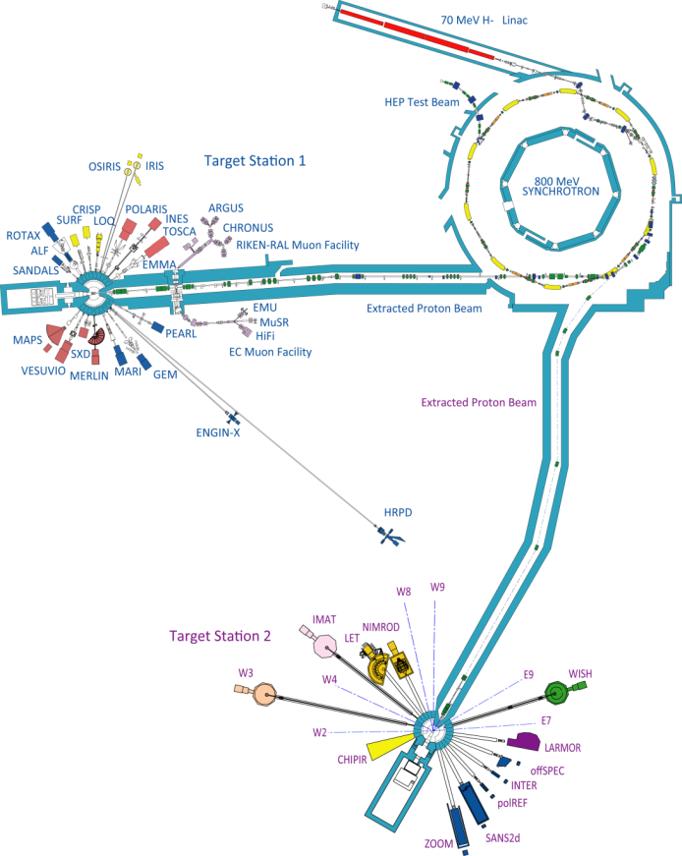
IDAaaS To The Rescue – Facility Operations During Covid
ISIS – what is it, and what is it used for?
Facts and figures:
3000 visits / 800 experiments per year
Operates 24/7, for 180 days per year (split into five beam cycles)
30 neutron instruments, 7 muon spectrometers
450 publications per year; 11,000 publications to date
75% of users are UK-based, the rest are from all over the world

Slide 5
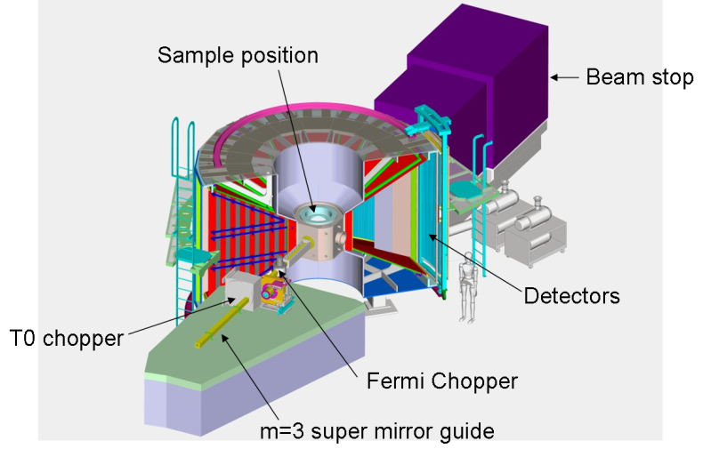
IDAaaS To The Rescue – Facility Operations During Covid
The Excitations group at ISIS - overview

Slide 6
IDAaaS To The Rescue – Facility Operations During Covid
The Excitations group at ISIS – data analysis issues
Typical experiment: 4 – 8 days, raw data files same size, ~100 per day (x3 for parallel measurement mode), file size increases post processing! End up with ~200GB per day, ~2TB at experiment end.
Not big data, but inconvenient data
Too big for user in their office
Interactive workflow (i.e. not job-based)
Specialist software – needs to be carefully curated
Quick, for on-the-fly decision making
Enter ISIS Data Analysis as a Service: IDAaaS…

Slide 7
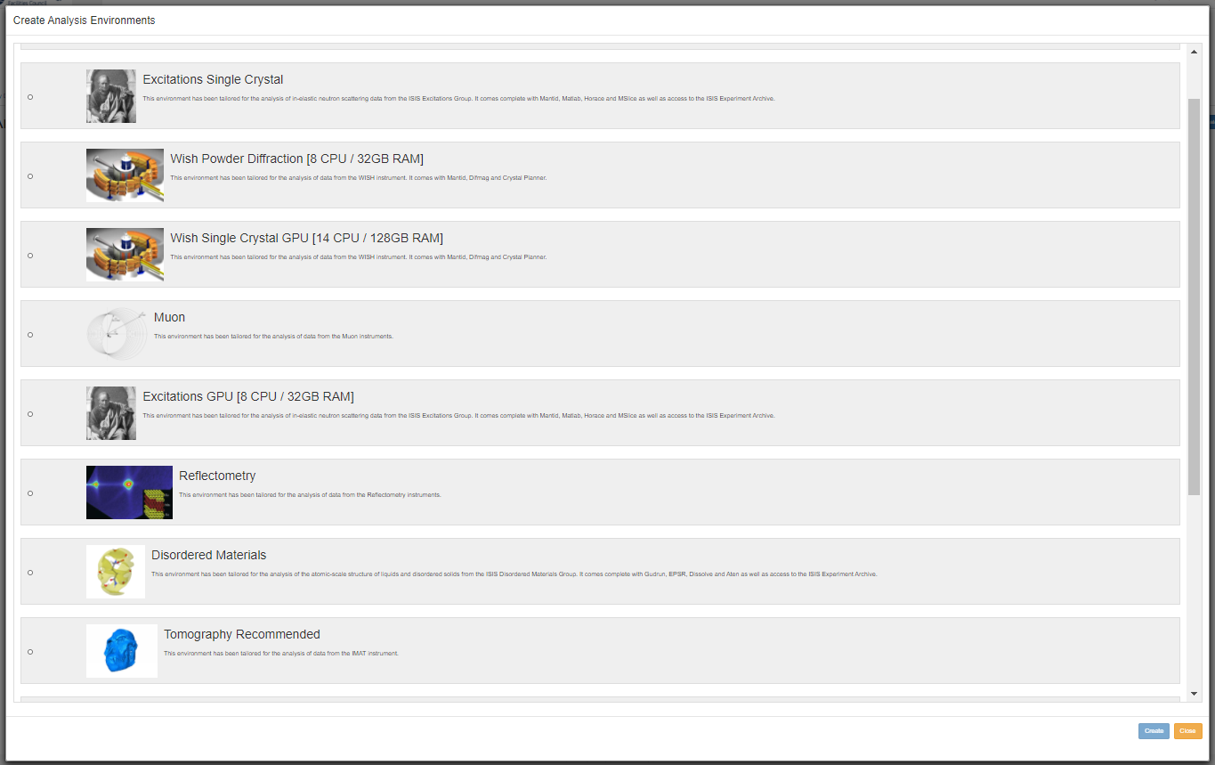
IDAaaS To The Rescue – Facility Operations During Covid
IDAaaS - what it is (from the user’s perspective)

Slide 8
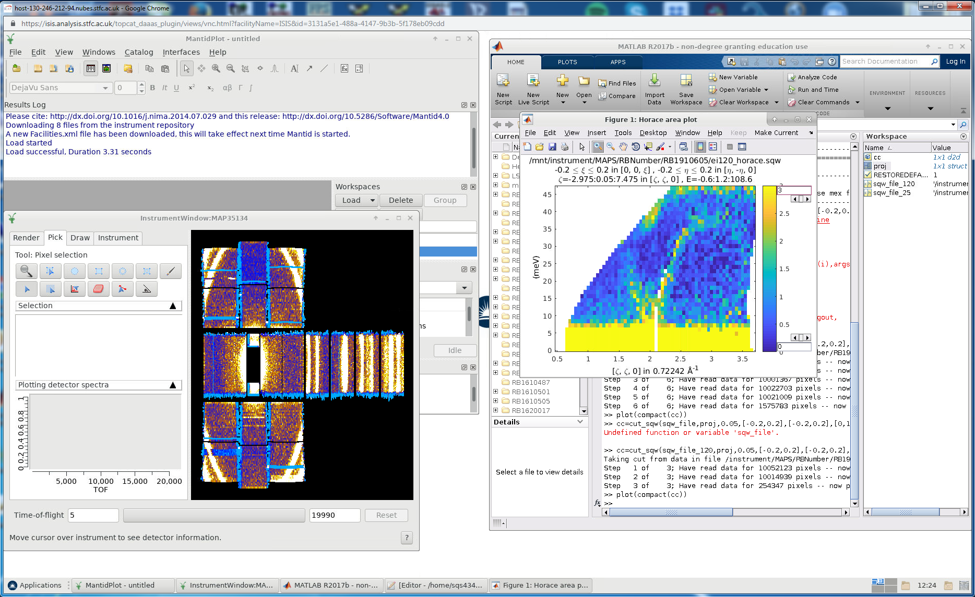
IDAaaS To The Rescue – Facility Operations During Covid
IDAaaS - what it is (from the user’s perspective)
N.B. Users’ virtual machines are somewhat insulated from one another, so avoids problems with one user grabbing too many resources

Slide 9
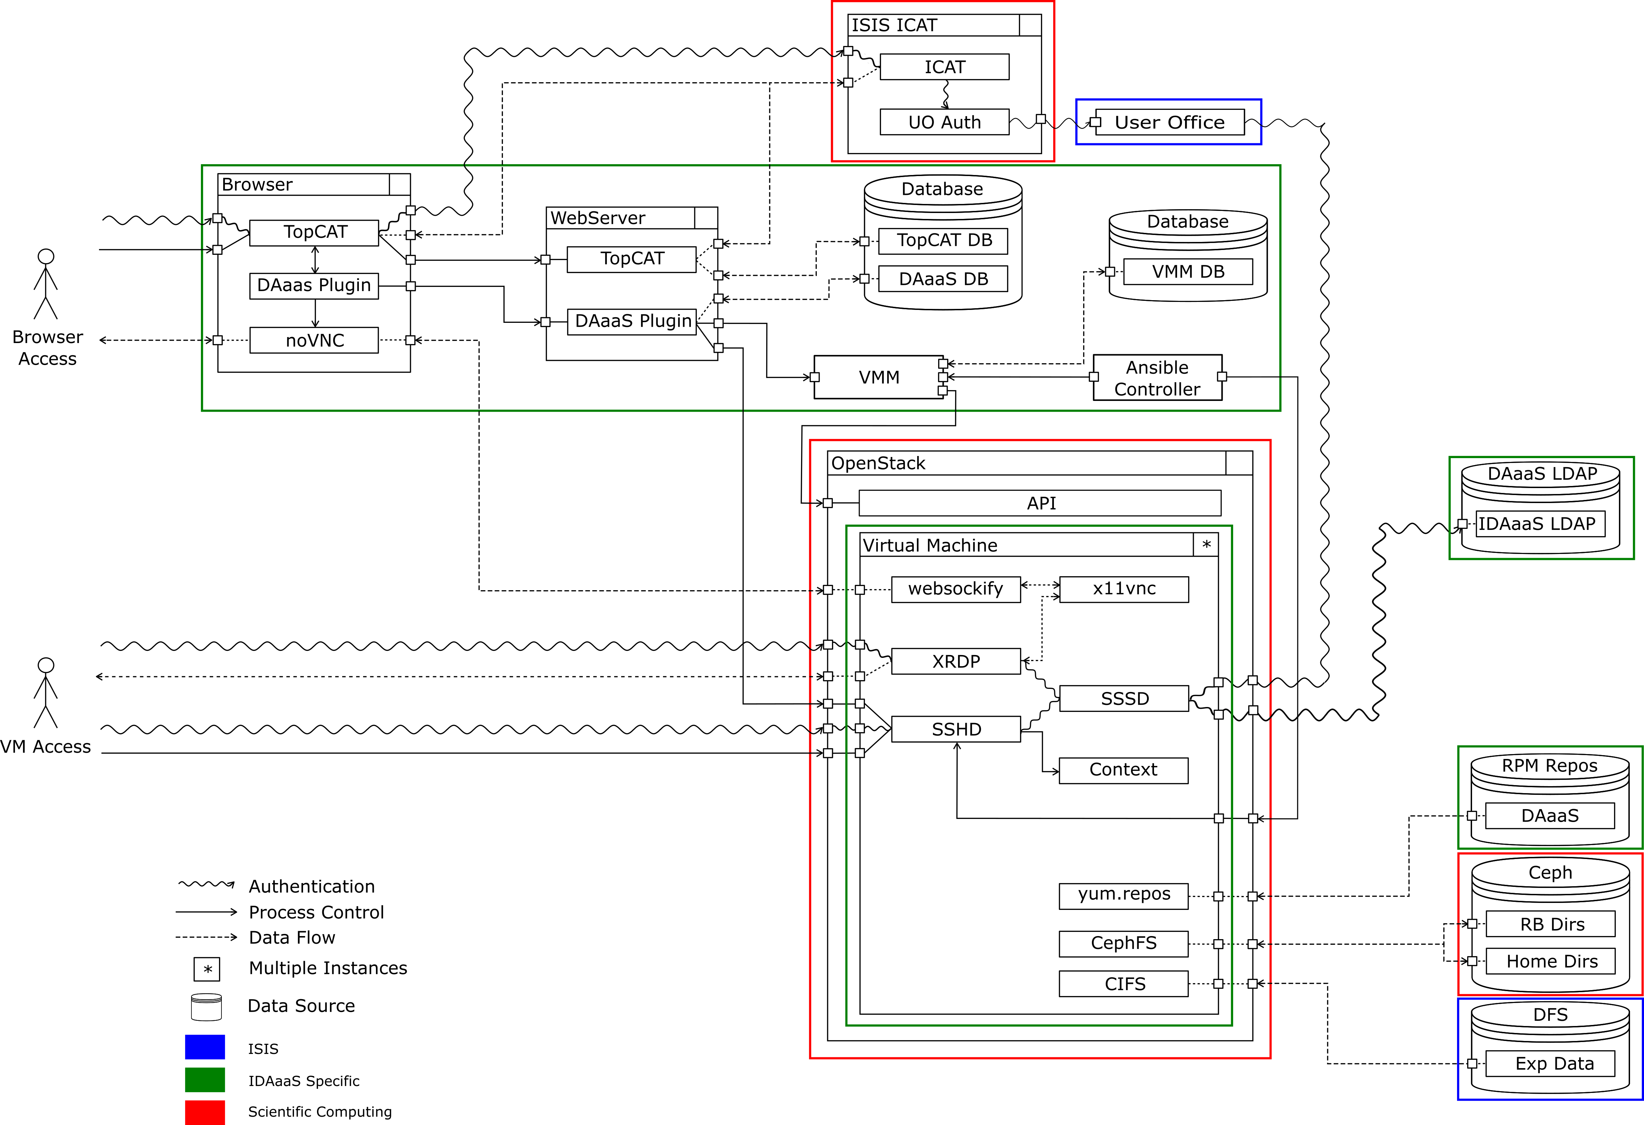

IDAaaS To The Rescue – Facility Operations During Covid
IDAaaS - what it is (behind the scenes)
ISIS Data Analysis as a Service
STFC cloud
  258 virtual machines accessible
  24.8TB RAM
  5300 CPUs in local cloud (more in wider IRIS cloud)
  60 GPUs in local cloud, lots more in IRIS
  More of everything being installed pretty much continuously
All of the virtual machines access a Ceph file store (approx. 2.5 PB). This brings advantages in terms of speed of access to data (object vs file storage)

Slide 10
That was then…

Slide 11
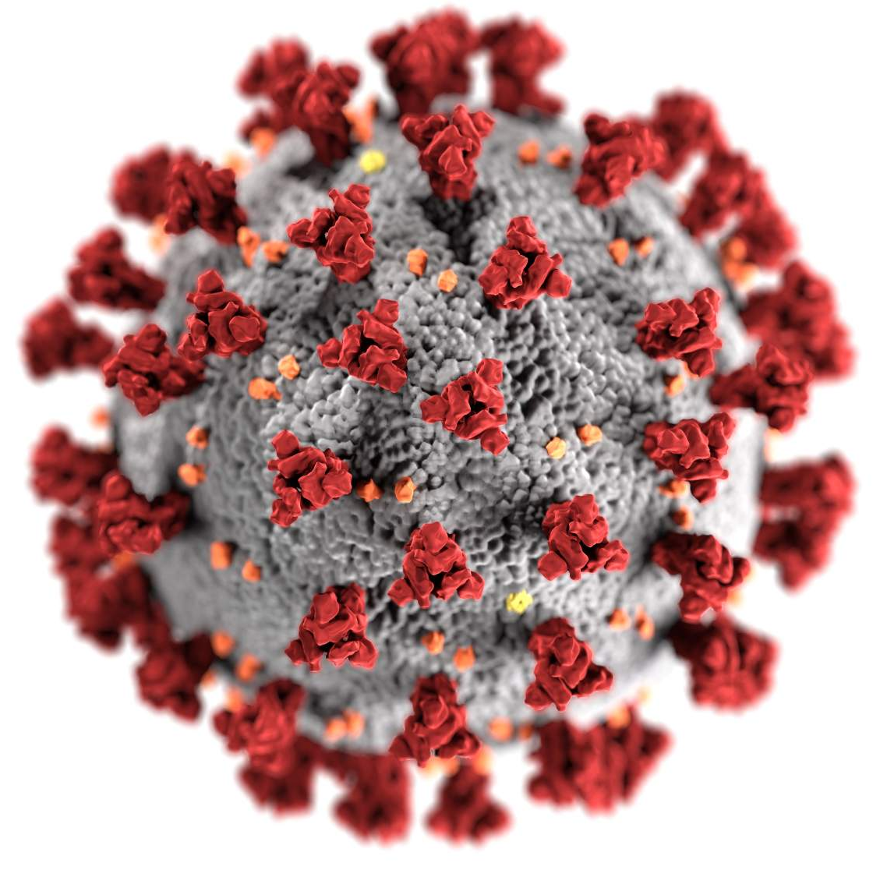

Slide 12
IDAaaS To The Rescue – Facility Operations During Covid
The Challenge – Scattering Neutrons From The Comfort Of Your Own Home
ISIS beam cycle 19/4, 11th Feb to 27th March – terminated on 18th March
Cycle 20/1, 28th April to 5th June – cancelled
Cycle 20/2, 8th September to 23rd October – went ahead, but with no external user groups physically present.
Instrument scientists running experiments, in consultation with user groups.
For this to succeed all users needed to be able to deal with their data as if they were at the facility, in order to make decisions about how experiments should proceed
Data analysis provision critical to successful operation of the facility

Slide 13
IDAaaS To The Rescue – Facility Operations During Covid
The Challenge – Scattering Neutrons From The Comfort Of Your Own Home
The challenge for IDAaaS:
Rapid scale up 5 neutron instruments (2 conceptually distinct environments) to 35 instruments (11 distinct environments)
Hard deadline
Business-critical service

Slide 14
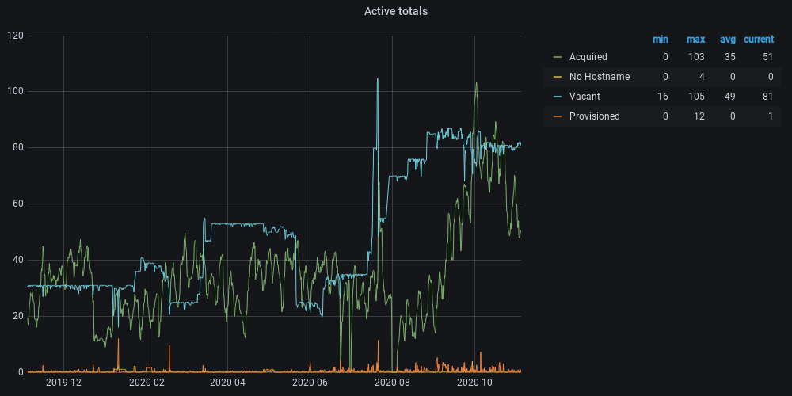
IDAaaS To The Rescue – Facility Operations During Covid
IDAaaS – a timeline
N.B. 637 separate VMs acquired over the course of the recent beam cycle

Slide 15
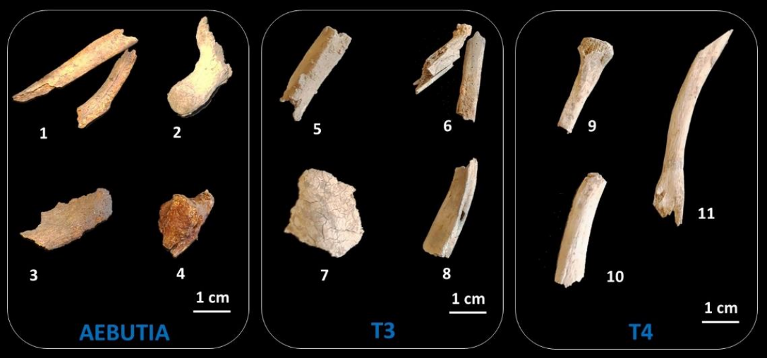
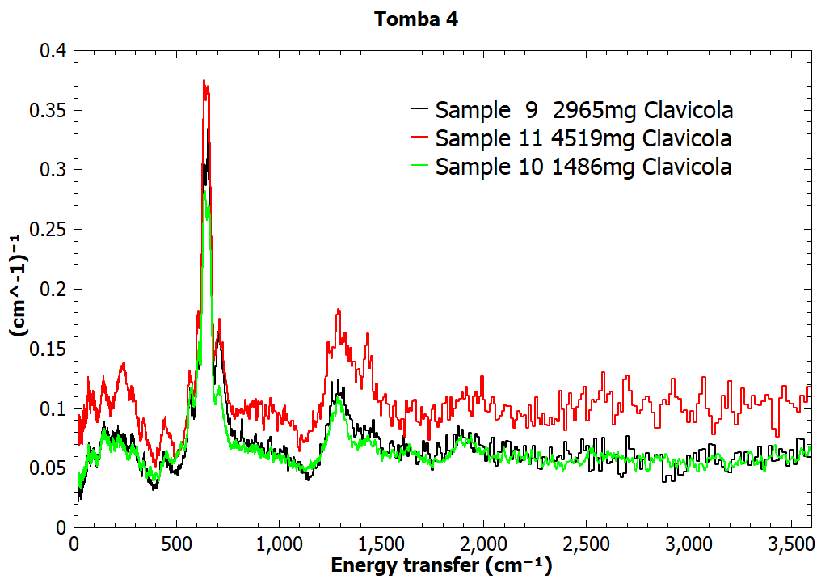
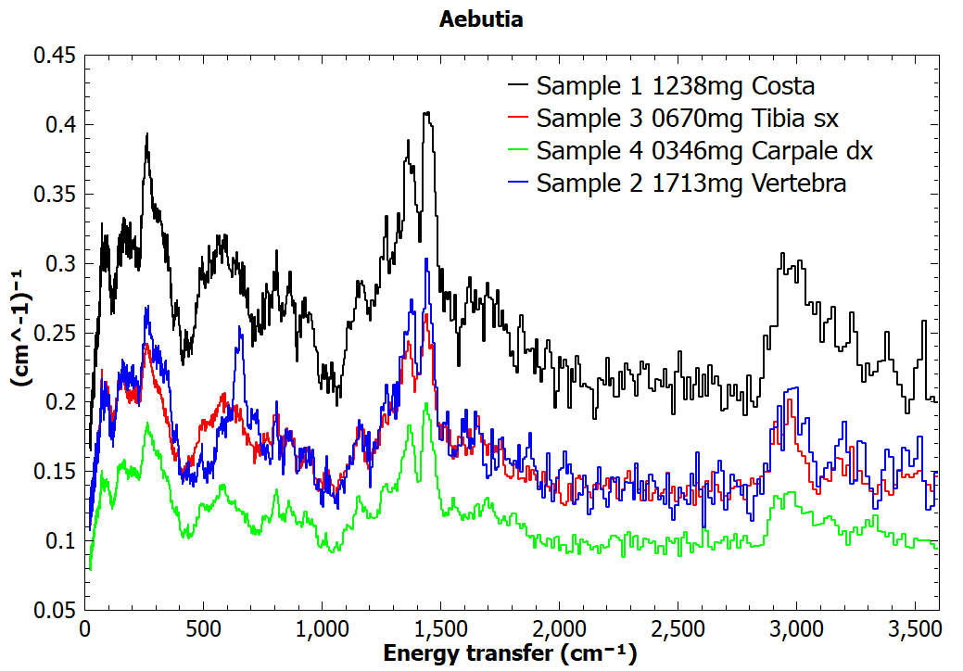
IDAaaS To The Rescue – Facility Operations During Covid
Science examples from the last beam cycle - Roman skeletal remains from 1st century AD
Burned
Not burned
TOSCA spectrometer. Skeletal remains from Roman noblewoman Aebutia Quarta, discovered outside Rome. Non-destructive neutron methods for assessing whether the bones were burned, and if so at what temperature.
G. Festa et al.

Slide 16
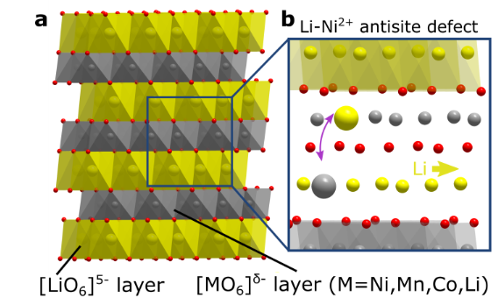
IDAaaS To The Rescue – Facility Operations During Covid
Science examples from the last beam cycle - Li-ion battery material lattice dynamics
Very Low [Li]
moderate [Li]
High [Li]
MARI spectrometer. Studies of materials currently used in mobile phone and laptop batteries. Investigation of lattice dynamics (phonons) with different element stoichiometries to study stability and thermal transport.
V Wood, R Shunmugasundaram, R Senthil Arumugam, P Benedek (ETH Zurich)

Slide 17
IDAaaS To The Rescue – Facility Operations During Covid
Science examples from the last beam cycle – Messenger RNA for Covid-19 vaccine delivery
ZOOM small angle neutron scattering instrument. Messenger RNA is a novel approach for delivery of therapeutic proteins, relevant for Covid vaccines. A key challenge is identification of a “delivery vehicle” (e.g. cationic lipid or polymer). Structure and molecular organisation of one promising candidate using SANS.
BioNtech RNA Pharmaceuticals GmbH

Slide 18
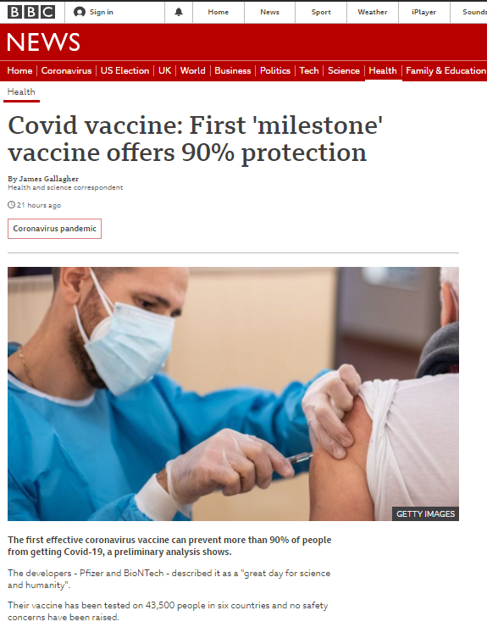
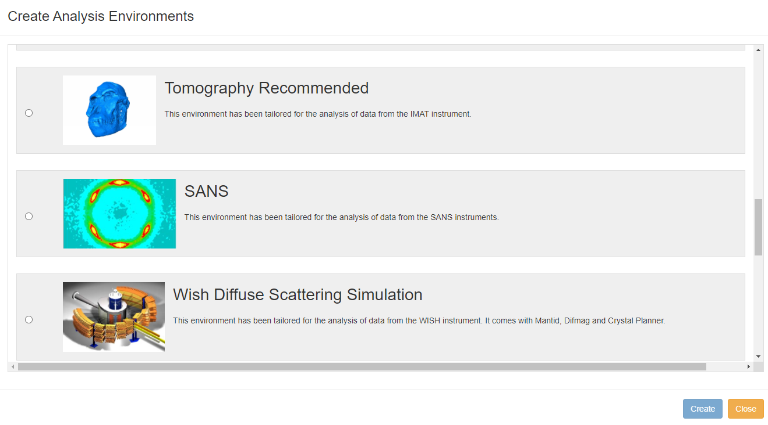
IDAaaS To The Rescue – Facility Operations During Covid
Science examples from the last beam cycle – Messenger RNA for Covid-19 vaccine delivery

Slide 19
IDAaaS To The Rescue – Facility Operations During Covid
Conclusions
ISIS Data Analysis as a Service (IDAaaS) was already a valuable tool for data analysis for a subset of experimental groups at the ISIS neutron and muon facility
Allows inconveniently large datasets to be visualised and analysed with ease by facility users
Coronavirus, and the consequent need to operate the facility safely with external user groups not physically present, meant a rapid roll-out of data analysis environments for many more groups with varied requirements
Without the IDAaaS capability, it is doubtful whether we would have been able to run the facility anything like as effectively as we have done.

Slide 20
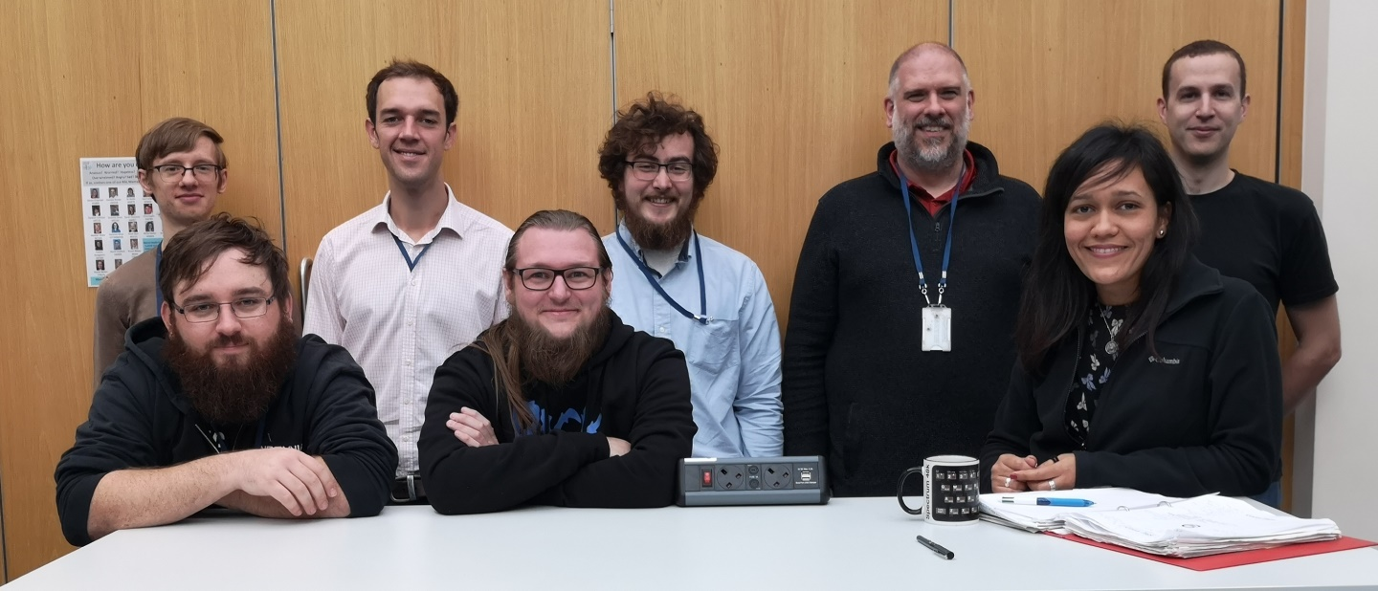
IDAaaS To The Rescue – Facility Operations During Covid
Acknowledgments
Julimar Romero
Frazer Barnsley
Jeremy Spencer
Josh Cunningham
Lamar Moore
Franz Lang
Alex Dibbo
Gordon Brown
(and countless others in STFC’s Scientific Computing Department)

