Slide 1



Data Movement and Storage Developments
Alastair Dewhurst
Notes:
The abstract pattern can be removed or repositioned if required. Be careful to ‘Send to Back’ so that it does not obscure any important information.

Slide 2
Introduction
IRIS has invested in various storage endpoints:
  Grid Storage (multiple sites)
  File System Cambridge
  S3 Storage at RAL
  Tape Storage at RAL
Unlike CPU usage, storage usage is very much below capacity, even though we have many requests.
Why is this?
  GridPP storage works but has a very steep learning curve.
  Data is persistent so evolution is slower.
    Sites don’t want to lose it.
    Experiments need to put in effort to migrate to the next thing.

Slide 3
What do we need?
Why can’t we just have a globally accessible file system?
  The semantics of a POSIX file system are not compatible with highly scalable systems.
  Its expensive and you don’t really need it.
  In a research collaboration there is an added complication of needing to rely on multiple heterogenous resources.
At small scale file systems are fine:
  Few users - manual creation of accounts
  Meta data - encoded in directory structure, local wiki page.
  Throughput - single machine bottlenecks are fine.
  Data resilience - duplicate it.
The Grid Evolved for a reason…

Slide 4
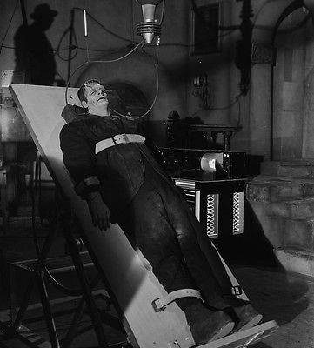
IRIS Data Digital Assets
IRIS have invested in several storage digital assets:
  Improving Grid services.
  Integrating modern features
  Making things easier.
Lots of related developments that are dependent on each other.
  Long delivery times but we are starting to see results…
  … although I wouldn’t call the system alive yet.
Rucio
IAM
DIRAC
DynaFed
FTS

Slide 5



Storage Services
Rucio
IAM
FTS
DynaFed
SRM / XrootD
Webdav
XrootD
Tape
S3
Castor
CTA

Slide 6
Rucio
Rucio is a distributed data management system.
  Used by ATLAS and CMS as well as others - Long term support.
  Policy driven - you say what you want, Rucio figures out how.
At its core is a database that lists all your data.
  As well as any metadata you want to record.
  It also contains information on how to use the various storage endpoints.
Many smart daemons automate the work.
RAL finished development of a multi-VO Rucio instance in July.
  Test instance has been running since August supporting SKA and dteam.
  Aim to enter production first half of 2021.
  Significant funding from other sources EGI, Swift-HEP to continue development of this.

Slide 7
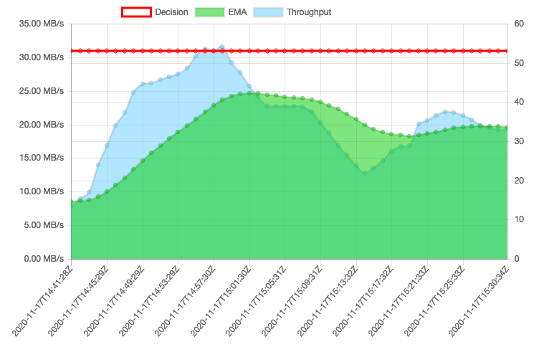

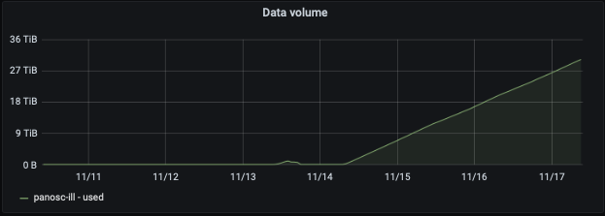
Data Movement
Moving lots of data rapidly between sites requires effort.
  We want to avoid proxying data through machines.
  Authorization between sites is non-trivial.
FTS designed to orchestrate transfers between many sites.
  Utilized by DIRAC and Rucio
Many tools available to upload to S3.
FTS
PaNOSC using

Slide 8
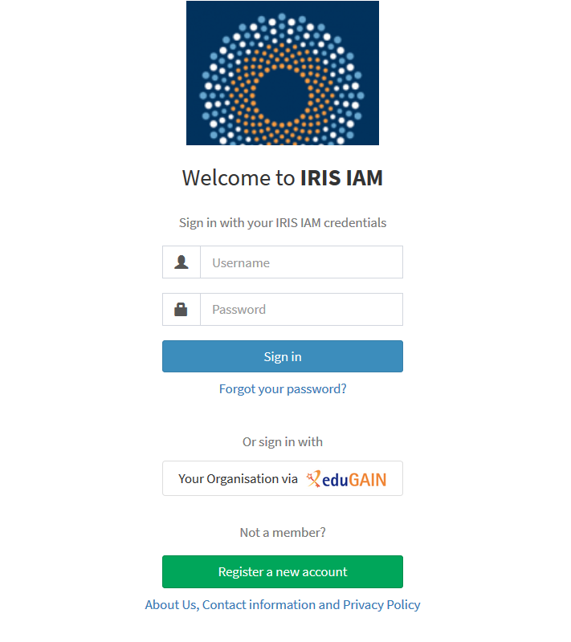
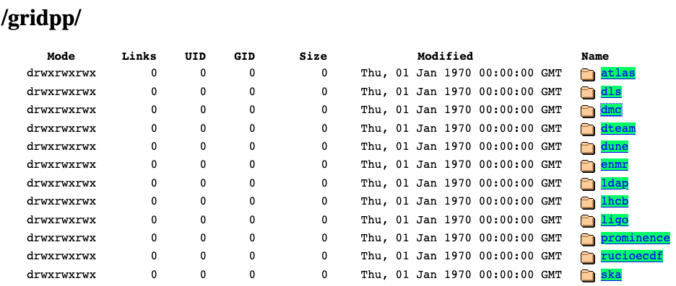

DynaFed Development
Active DynaFed digital asset started in September 2020.
  IAM integration
  Rucio integration
Dynafed provides browser access to S3 storage.
The IAM integration is working in test:
  https://dynafed-test.stfc.ac.uk/gridpp
  Email feedback to: Sam.glendenning@stfc.ac.uk

Slide 9
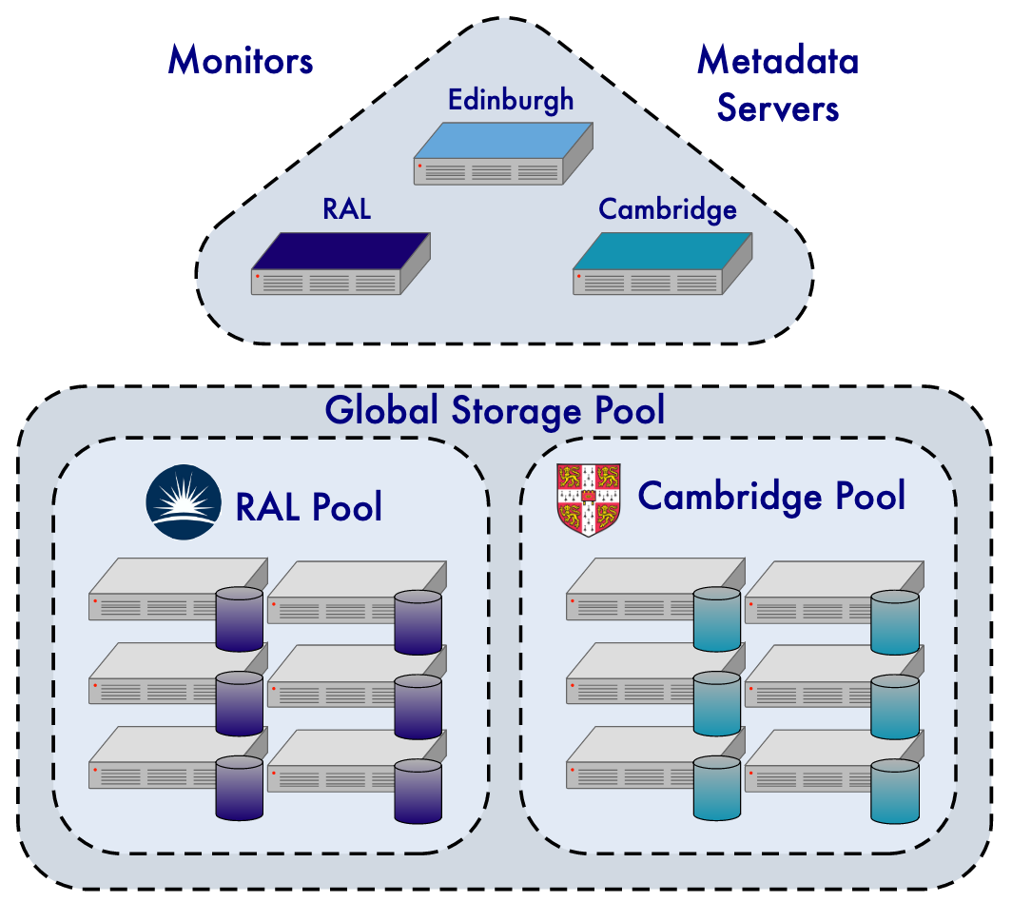
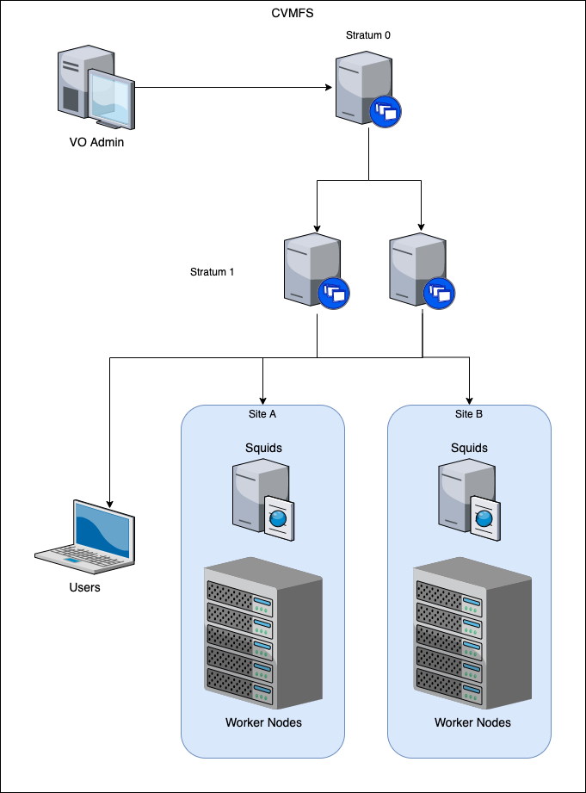
Global File Systems
Multi-Site CephFS[1]
CVMFS
Multi-Site CephFS
Duplicates data across sites.
Not obvious how you scale to many sites.
CVMFS:
Single upload point everywhere else is Read only.
Scales to a 10s of TB of data.
[1] https://indico.ph.qmul.ac.uk/indico/getFile.py/access?contribId=2&sessionId=2&resId=0&materialId=slides&confId=571

Slide 10
Summary
There does not yet exist a straightforward solution for storage.
Some VOs are doing it themselves.
There are ongoing projects to make the Grid easier to use.
There is lots of interest in S3.

Slide 11

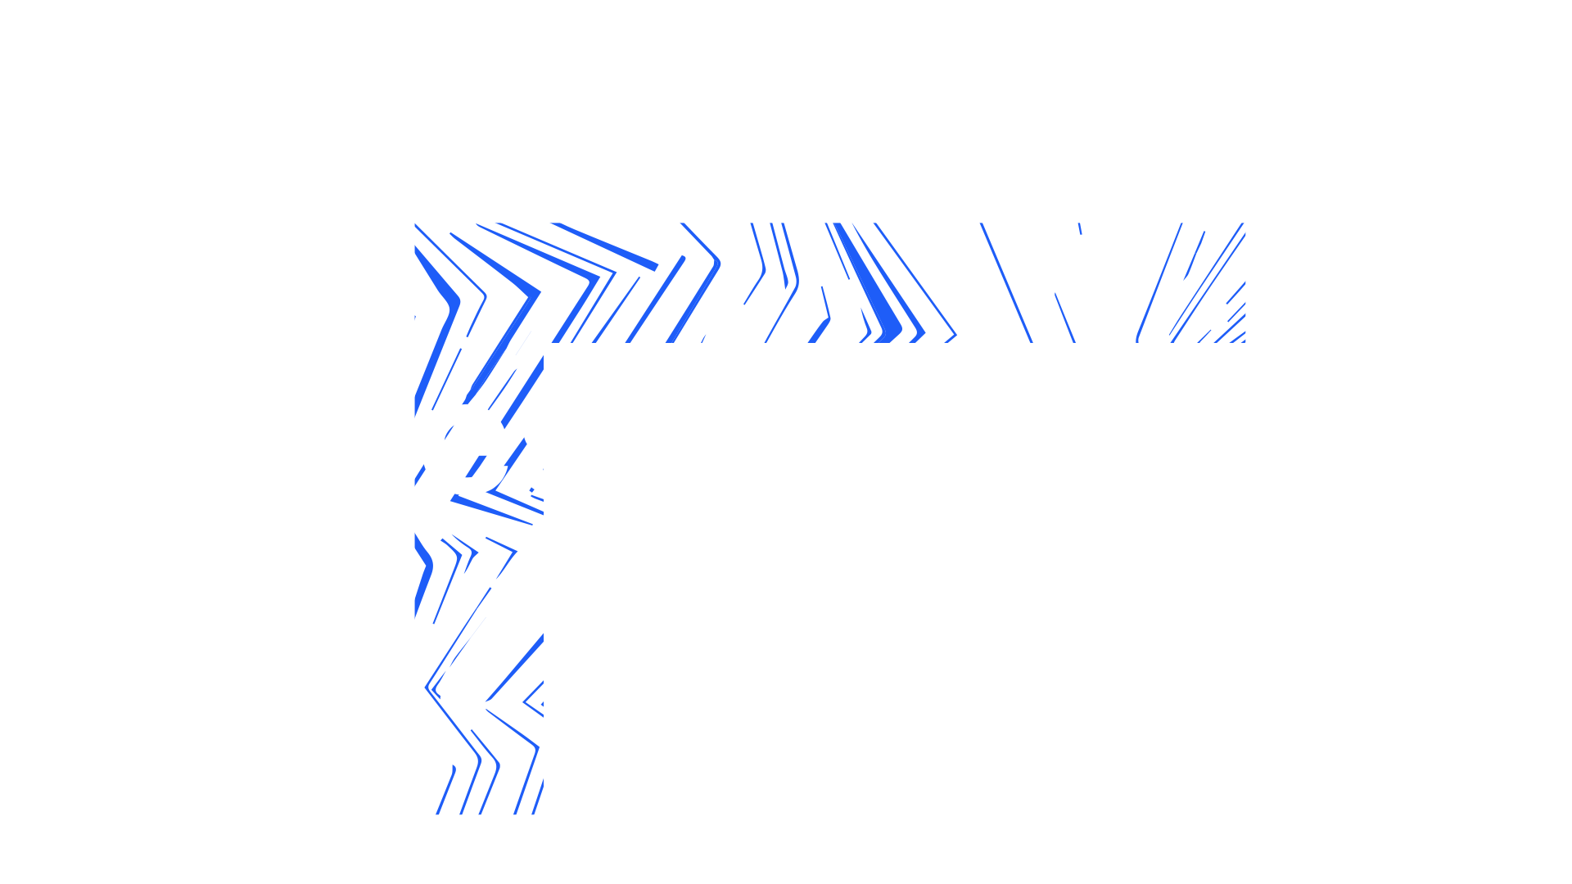

Notes:
The abstract pattern can be removed or repositioned if required. Be careful to ‘Send to Back’ so that it does not obscure any important information.

