Slide 1
Introduction to APEL
Adrian Coveney

Slide 2
Outline
Introduction to APEL
What is APEL?
APEL in IRIS
Architecture
Central system detail
Gaining Access to the IRIS Accounting Portal using IAM
IAM basics
Logging in and registration
Demo

Slide 3
What is APEL?
Resource usage accounting system used in production by EGI and WLCG
Collects data from resource centres around the world that are used by many different scientific user communities
“APEL” includes the central Accounting Repository service, and client and server software
EGI/WLCG Portal provided by partner organisation
Used as the basis for the IRIS Accounting Dashboard

Slide 4
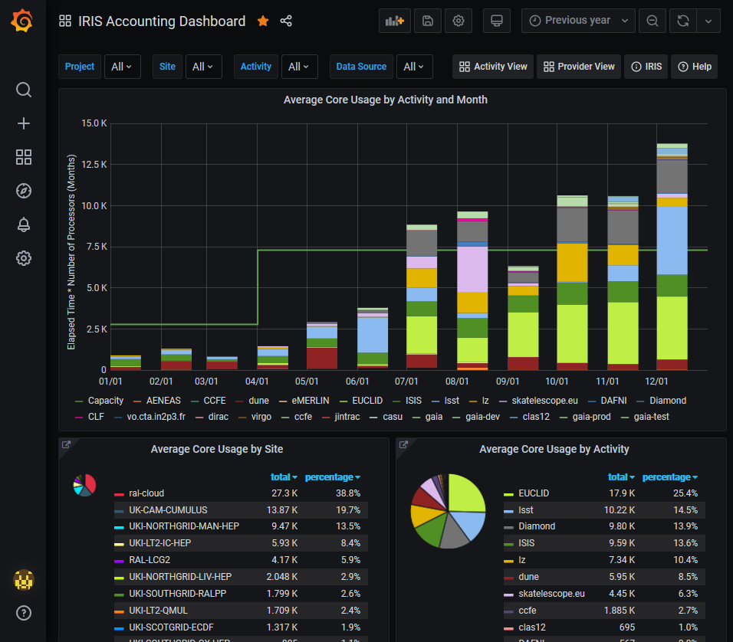
APEL in IRIS
Dedicated IRIS Accounting Repository using MariaDB with existing APEL repository schemas and software
New bespoke Grafana dashboard to explore the data
Integrated with IRIS IAM

Slide 5
Architecture
Resource Provider
Grid/cloud system
Accounting metric sensor
AMS compatible SSM
Resource Providers extract accounting records in a compatible format
SSM used for exchanging accounting records via the Argo Messaging Service
Loaded into Accounting Repository and aggregated across many variables e.g. site, activity
Displayed via a Grafana dashboard
Argo Messaging Service (AMS)
S
S
M
Accounting
Repository
Accounting Dashboard

Slide 6
Central system detail
Grid system usage
Cloud system usage
Semi-static data
Capacities
Accounting Repository
Allocations
Accounting Dashboard
Activities
Projects
Dashboard configurations

Slide 7
Gaining Access to the IRIS Accounting Portal using IAM
Adrian Coveney

Slide 8
IAM basics
IRIS IAM provides authentication and authorization to a number of IRIS resources.
The primary way of doing this is by creating an account associated with a user’s home institution identity.
By associating accounts with institutional identities, it ensures that all members have an active affiliation with an IRIS partner at sign-in time.

Slide 9
Logging in and registration
Initiate a login and select the eduGAIN button
Filter for your institute* and select “Sign in with IdP”
Sign in through home institution*
Approve release of information to IRIS IAM*
Complete registration page
Read and confirm your agreement to the IRIS IAM AUP
Wait for admin approval
* These steps are possible to skip on next login

Slide 10
Demo

Slide 11
Thank you
https://accounting.iris.ac.uk
https://iris-iam.stfc.ac.uk/help/
apel-admins@stfc.ac.uk

