Slide 1
GOCDB in IRIS
Greg Corbett
https://gocdb.iris.ac.uk
gocdb-admins@mailman.egi.eu

Slide 2
Agenda
1 GOCDB
2 Using GOCDB
Logging in
IRIS Level Roles
Adding New Sites
Adding New Services
Tagging Existing Resources
3 Summary
Image © STFC Alan Ford

Slide 3
GOCDB
GOCDB is a service registry and topology database:
source of truth for managing Compute, Cloud and Storage entities
including; sites, services, downtimes, users and roles.
It emphasises allowing resource providers to maintain their own information in a centralised location, accessible to both infrastructure staff via a web portal and other automated e-Infrastructure tools via a REST API.
GOCDB is the operational tool that underpins other operational tools and policies. In other contexts it underpins downtime notifications, service monitoring and communication channels.

Slide 4
GOCDB PI
Programmatic access to the data within GOCDB is well documented:
https://wiki.egi.eu/wiki/GOCDB/PI/Technical_Documentation
https://wiki.egi.eu/wiki/GOCDB/Write_API/Technical_Documentation
Access to the GOCDB PI is granted via the IAM (we used oidc-agent).

Slide 5
Using GOCDB

Slide 6
Using GOCDB
gocdb.iris.ac.uk and goc.egi.eu are views on the same shared database
This was done because of the overlap of sites offering services to EGI, WLCG and IRIS.
Maintains the single source of truth.
Existing users – user with a GOCDB account in the shared database
Existing sites and/or services – entities already in the shared database

Slide 7
Logging in
Existing users should log into https://gocdb.iris.ac.uk as they would https://goc.egi.eu
New users
Request membership of the GOCDB group in the IAM
Once approved, select the “IRIS IAM” option on https://gocdb.iris.ac.uk to access GOCDB
Register for an account
If you have a X.509 certificate loaded into your browser, you will be prompted to identify yourself with this. If you do this, you wont be able to identify yourself via the IAM.

Slide 8
IRIS Level Roles
Operations Manager: ???
Operations Deputy Manager: ???
Security Officer: David Crooks
These roles can be requested suitable people at https://gocdb.iris.ac.uk/portal/index.php?Page_Type=NGI&id=2765
Notes:
Managers of IRIS Operations – should be able to say which sites aren’t in GOCDB already and who is responsible for them.

Slide 9
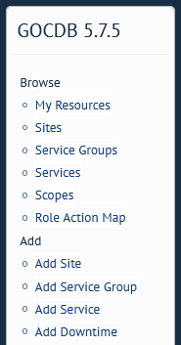
Add new Sites to GOCDB
Done by someone with an IRIS level role.
Required Information to input the site in the first instance:
Domain
Short Name
Description
Email
Telephone

Slide 10
Sites Roles in GOCDB
Once a site has been added, the following roles can be requested:
Operations Manager
Operations Deputy Manager
Security Officer
Someone with an IRIS level role will need to approve the first role. When visiting the main page, if there are roles you can approve you will see:
Once roles are accepted, site security contact details need to be added.

Slide 11
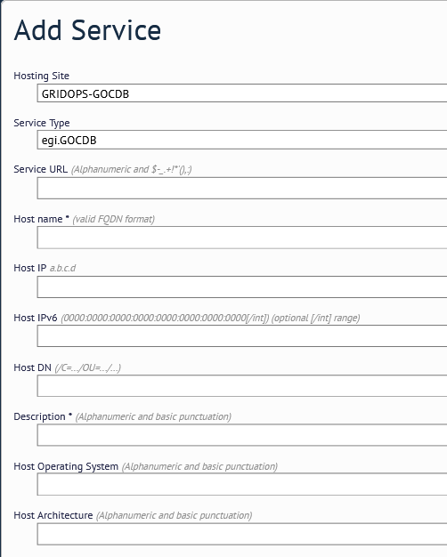
Adding Services to a Site in GOCDB
Once the Site has been created, a user with a role can add a Service.
3.
1.
2.
2. A list of the different service types already in GOCDB is available here. New service types can be added.

Slide 12
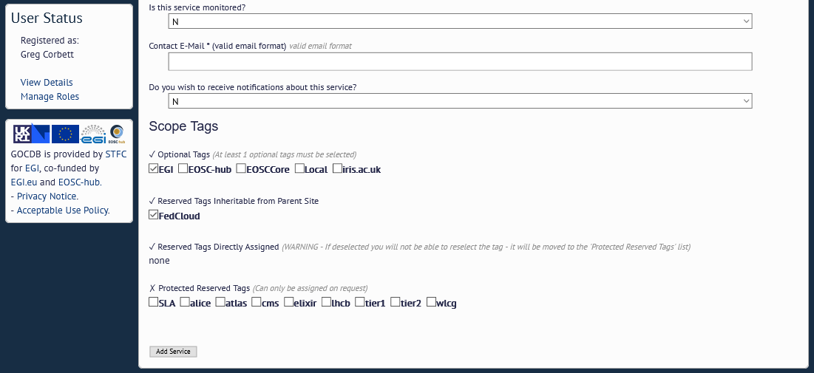
Adding Services to a Site to GOCDB
4.
5.

Slide 13
Tagging existing resources as IRIS
i.e. Existing sites and services in GOCDB.
Should to apply the “iris.ac.uk” scope tag to the individual services provided to IRIS, as well applying the scope tag to the site providing these service.
Those with a suitable role over the site in question can do this via editing the site and services.

Slide 14
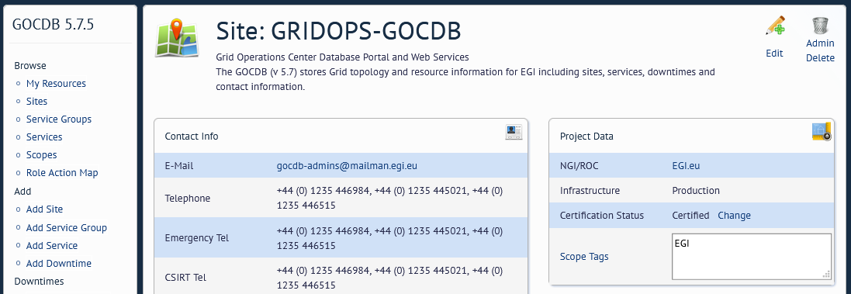
Tagging existing resources as IRIS
1.

Slide 15
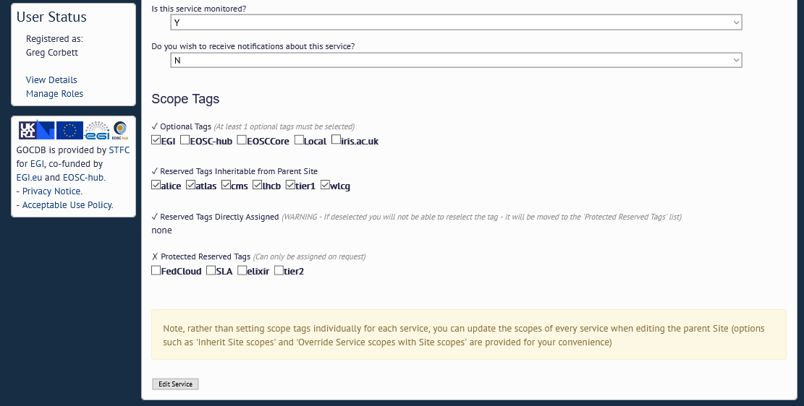
Tagging existing resources as IRIS
2.
3.

Slide 16
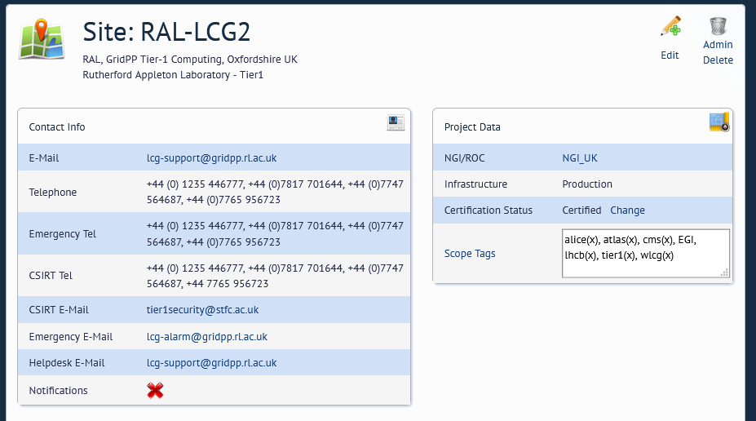
GOCDB – extension properties
GOCDB sites and services can have extension properties.
Extension Properties allows community definable key-value pairs.

Slide 17
Summary
IRIS level staff need to request appropriate roles
IRIS level staff can then add new IRIS sites
Site staff need to then request appropriate roles over these sites
Once approved:
Site staff need to update security contact details
Add services, new service types can be requested via GGUS.
Existing Sites/Services within GOCDB that are being provided to IRIS should tag the Site and Services with “iris.ac.uk”.

Slide 18
Summary
How do I get in touch with the GOCDB team?
Ticket: Configuration and Topology (GOCDB) support unit on ggus.eu
Email: gocdb-admins@mailman.egi.eu
“In person”: IRIS TWG

Slide 20
Science and Technology Facilities Council
@STFC_Matters
Science and Technology Facilities Council

